Slide 1

Depression Detection from Tweets with PHQ-9 Mapping
An Explainable AI Approach to Mental Health Analysis on Social Media
Notes:
This presentation explores an AI-based method to detect potential signs of depression through users' social media behavior, particularly on Twitter.

Slide 2
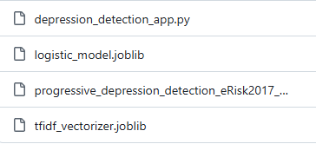
Code Access
https://github.com/syyadmsai/AIH-HRP
Streamlit App Code
Model Code

Slide 3
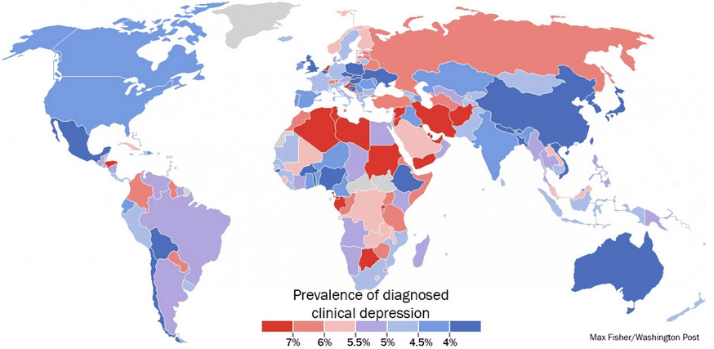
Motivation
Depression is a growing global concern.
Many individuals express distress on social media.
Early detection can aid timely intervention.
StrongMinds. 2023. Depression in Developing Countries. Retrieved May 4, 2025 from https://strongminds.org/depression-in-developing-countries/
Notes:
Depression is a growing global concern. The objective is to use machine learning and NLP to classify users based on their tweet history and draw parallels with PHQ-9 symptoms.

Slide 4
Research Objective
Detect depressive behavior from Social MEDIA POSTS.
Align tweet content with PHQ-9 symptoms.
Use SHAP for explainable predictions.
Notes:
The eRisk 2017 dataset contains Reddit posts labeled by clinical experts as depressed or not. This labeled dataset was used to train a logistic regression model using TF-IDF features.

Slide 5
Dataset
Training Data: eRisk 2017 Reddit Depression Dataset.
Evaluation: Handpicked and real Twitter user timelines.
Labels: Depressed / Not Depressed.
Losada, D. E., Crestani, F., & Parapar, J. 2017. eRISK 2017: CLEF Lab on Early Risk Prediction on the Internet: Experimental Foundations. In Proceedings of the Conference and Labs of the Evaluation Forum (CLEF 2017). CEUR-WS.org, Dublin, Ireland, September 11–14, 2017. CEUR Workshop Proceedings, Vol. 1866. http://ceur-ws.org/Vol-1866/
Notes:
The methodology involves preprocessing tweets, vectorizing them using TF-IDF, and predicting depression using a logistic regression model. SHAP is used to explain the model’s output. Tweets are also semantically mapped to PHQ-9 using sentence embeddings.

Slide 6
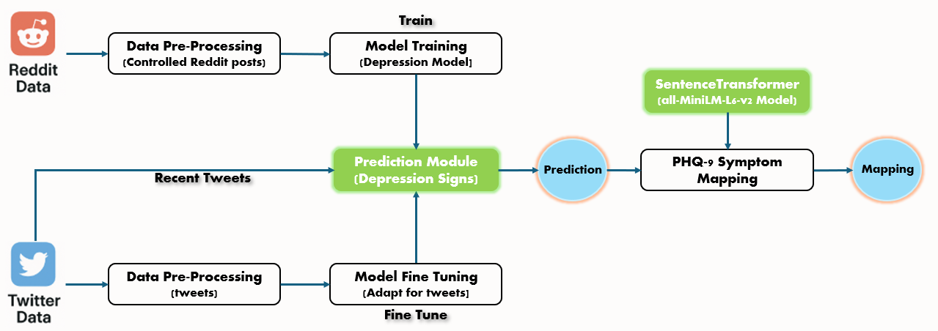
Methodology Overview
Text preprocessing and TF-IDF vectorization.
Logistic Regression model for classification.
SentenceTransformer for semantic similarity.
PHQ-9 symptom mapping via cosine similarity.

Slide 7
DEMO AND Sample Results
Case 1: Potential depressive signs detected.
Case 2: Neutral tweets, no depression signals.
PHQ-9 alignment varies by user profile.

Slide 8
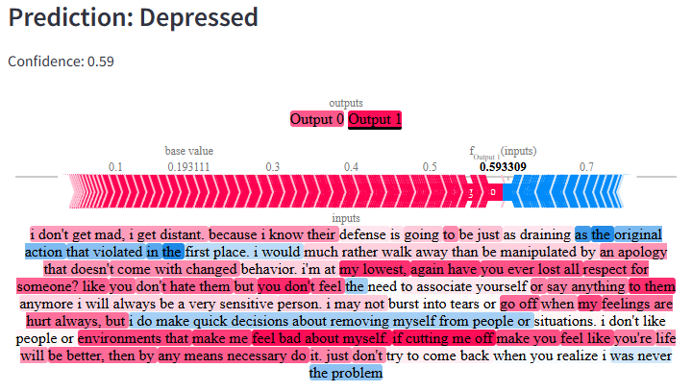
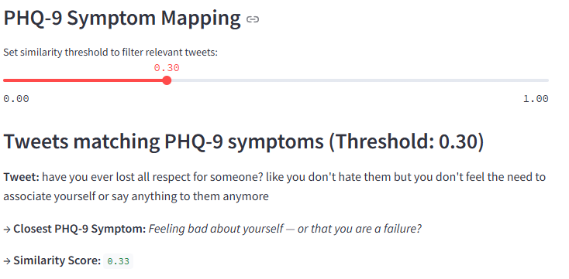
Sample Results
Case 1: Depressive signs detected.
For the Twitter handle thisusertwtss, the
tool fetched 5 recent tweets and model
analyzed those tweets.
The model predicted a depressed status with
a confidence score of 0.59. Several tweets
showed notable emotional content such as:
"i'm at my lowest, again"
"i don't get mad, i get distant..."
"i will always be a very sensitive person..."

Slide 9
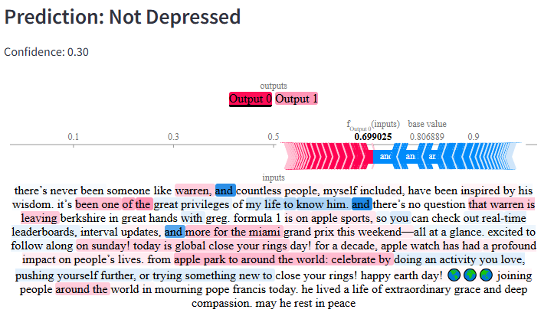
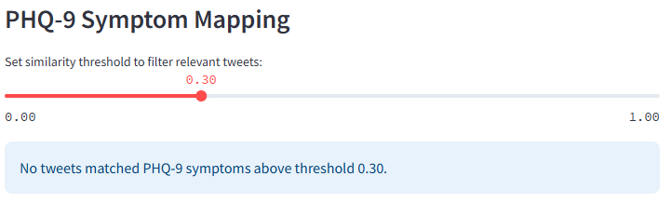
Sample Results
Case 2: Depressive signs not detected.
For the Twitter handle tim_cook, the same
pipeline was applied to 5 recent tweets. The
model predicted a not depressed status with
a confidence score of 0.30. Tweets in this case
were generally positive or informational in
nature:
"Today is Global Close Your Rings Day!"
"Joining people around the world in mourning
Pope Francis today."

Slide 10
Conclusion
Social media can reveal mental health signals.
PHQ-9 mapping bridges clinical and digital.
SHAP adds explainability to black-box models.

Slide 11
Future Directions
Support for multimodal inputs like images and interactions.
Real-time integration with social media platforms.
Broader clinical validation.
Ethical safeguards and user consent mechanisms.
Notes:
In the future, more sophisticated deep learning models and temporal tracking can enhance detection. We also aim to expand the dataset and integrate multimodal inputs like images and interactions.

Slide 12
Thanks
Syyad ali
Dallas TX
Syyad.ali@utexas.edu

