Slide 1


AI in Healthcare // LLM Tutorial
Syyad Ali
10 APRIL 2025

Slide 2
Assignment Goal
The goal of this assignment is to get familiar with generative AI technologies (e.g., ChatGPT) and know how to apply them to understand healthcare issues.
Project Title
Symptom-Diagnosis Mapping Using NLP and Large Language Models.
Objective
To evaluate how well an NLP model—especially a large language model (LLM) like ChatGPT model—can:
Extract symptoms from unstructured text (e.g., clinical notes).
Map these symptoms to possible diagnoses.

Slide 3
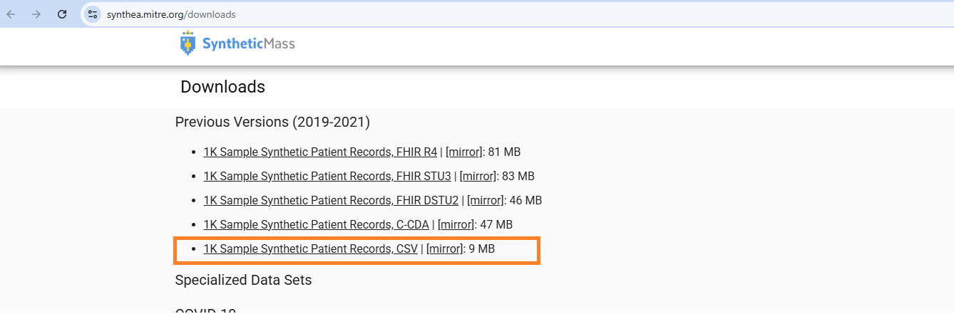
Resources
Dataset: Synthea (https://synthea.mitre.org/downloads)
Data has been generated by SyntheaTM, an open-source patient population simulation made available by The MITRE Corporation.
Data Format: CSV files (e.g., allergies.csv, encounters.csv, conditions.csv, symptoms.csv, medications.csv)
Type: Synthetic health records of thousands of patients, including symptoms, conditions (diseases), allergies, medications, and more.
Why Use Synthea:
No privacy/ethics concerns (synthetic).
Realistic structure for EMR systems.
Useful for training and evaluating healthcare NLP systems.
Model Used: OpenAI GPT-4

Slide 4
Code and Output
Code and output files can be found at following Github link
https://github.com/syyadmsai/AIH-LLM

Slide 5

PART 1: Trying various prompting techniques
In next few experiments, following prompting techniques were attempted by accessing OpenAI GPT-4 model from local machine via OpenAI APIs:
Chain of Thought
Tree of Thought
Few Shot Prompting
Pre-requisites:
Key creation in OpenAI account
Add Credit Balance if needed

Slide 6
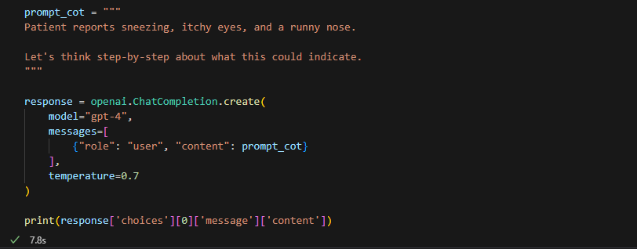
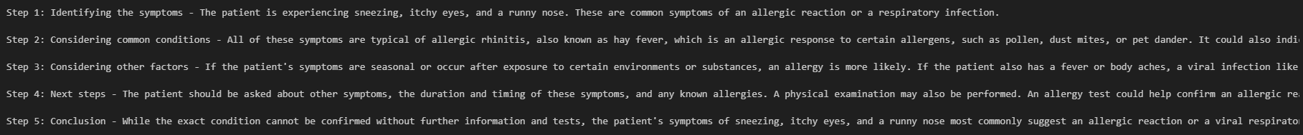
Experiment 1: Chain-of-Thought (CoT) prompting
Get the model to break down reasoning step-by-step before answering.
Output should walk through symptoms and match them to allergy types or conditions.
Example:
GPT-4 Response

Slide 7
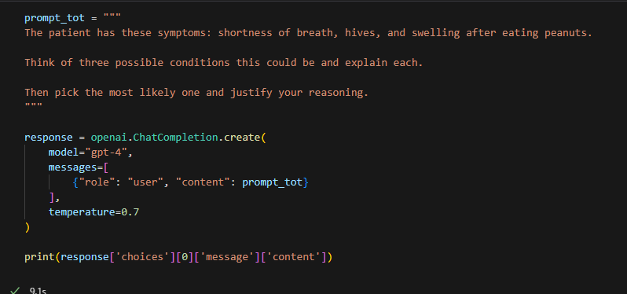
Experiment 2: Tree-of-Thought (ToT) prompting
Explore multiple reasoning paths.
Example:
GPT-4 Response

Slide 8
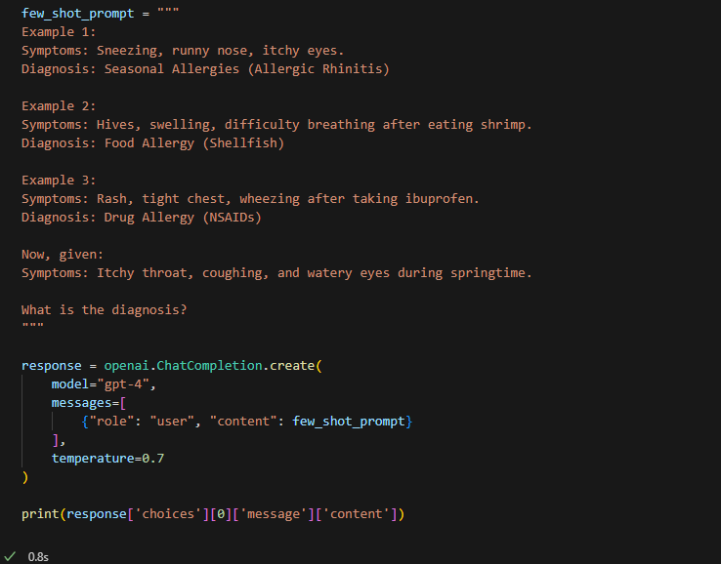

Experiment 3: Few Shot prompting
Prediction based on multiple data points.
Example:
GPT-4 Response

Slide 9
PART 2: Allergy Prediction Using One-Shot Prompts using Synthea Dataset
In the next experiment, the Synthea dataset is used to generate one-shot prompt, which is then provided to the LLM model. The model is subsequently tasked with predicting the possible allergy category based on the given symptoms.
Models' responses are analyzed to calculate the accuracy.
Model : GPT-4

Slide 10
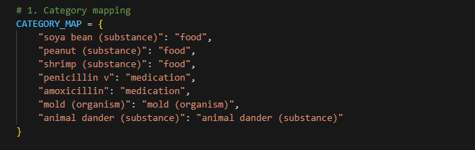
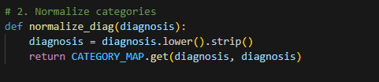
Step 1: Category Mapping
Different allergy diagnosis are mapped to common allergy categories to remove overlapping diagnosis.
Step 2: Normalize Categories

Slide 11
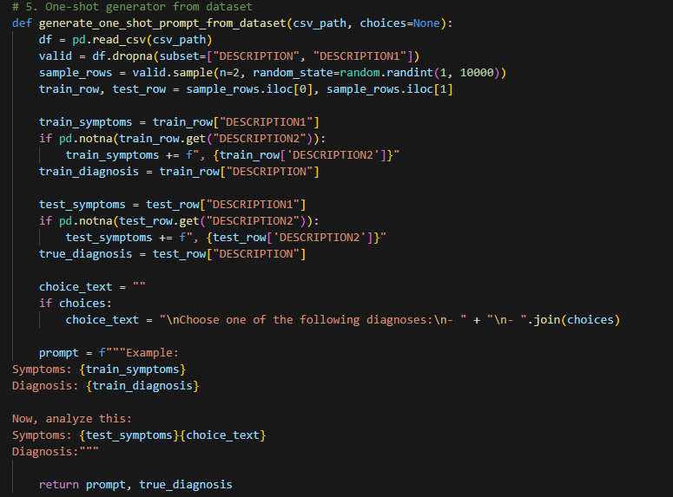
Step 3: One-Shot Prompt generation
Randomly two row are selected from the allergy dataset. One is used for providing example to GPT-4 and other is used for test.

Slide 12
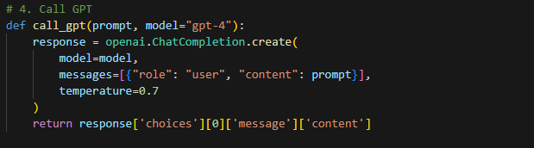
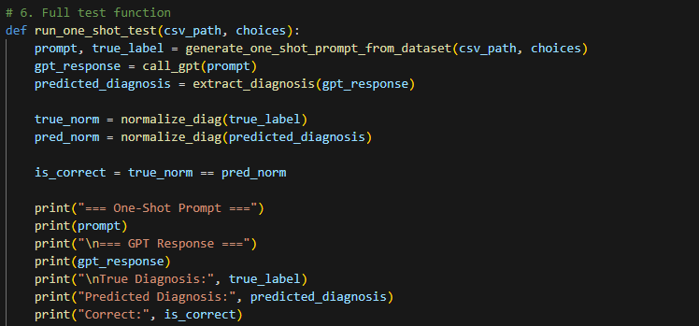
Step 4: Calling GTP-4 LLM
Following functions are used to call GTP-4 Model and analyze the response.

Slide 13
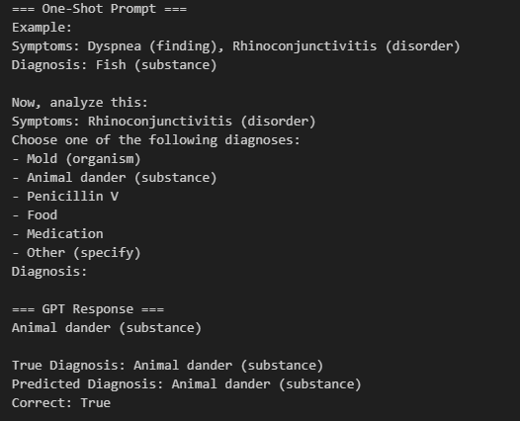
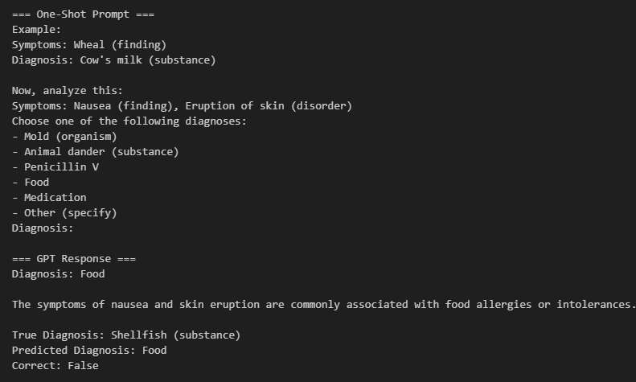
Step 5: Results
It was observed that the diagnosis tended to improve when multiple symptoms were provided as input. However, due to the overlap of allergy symptoms across different underlying causes, GPT-4 often produced incorrect predictions. This highlights the difficulty in accurately identifying allergy types based solely on symptom similarity.

Slide 14
PART 3: Allergy Prediction Using Few-Shot Prompts using Synthea Dataset
In the next experiment, the Synthea dataset is used to generate a few-shot prompts, which are then provided to the LLM model. The model is subsequently tasked with predicting the possible allergy category based on the given symptoms.
Models' responses are analyzed to calculate the accuracy.
Model : GPT-4o

Slide 15
Step 1: Data loading and Pre-processing
Load Data and apply filter to get only rows where multiple allergy symptoms are available.
Step 2: Define Choices
In the prompt, LLM Model is also instructed the possible Prediction choices. This is done to make sure prediction accuracy can be calculated.

Slide 16
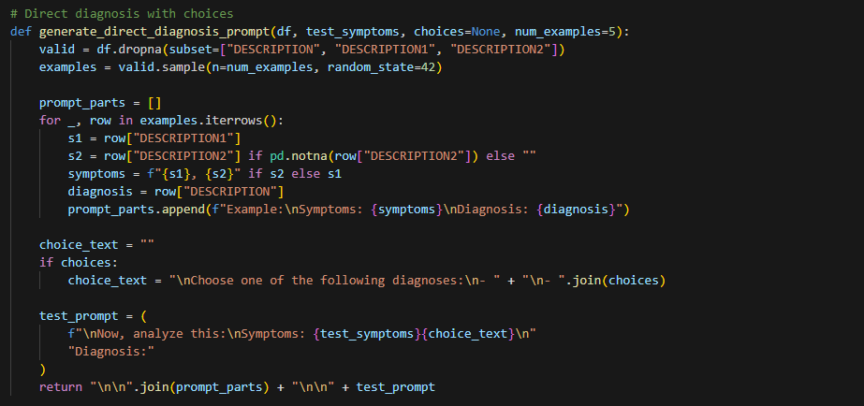
Step 3: Generate Prompts
Following function is used to generate the complex prompt which included multiple few shot examples (in this case 5) followed by test prompt .

Slide 17
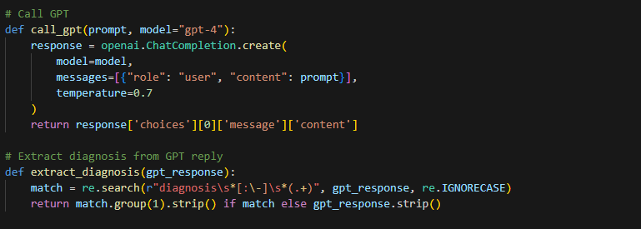
Step 4: Call LLM Model and Parse Response
Following functions are used to call LLM Model and extract diagnosis for the test prompts from the LLM’s response.

Slide 18
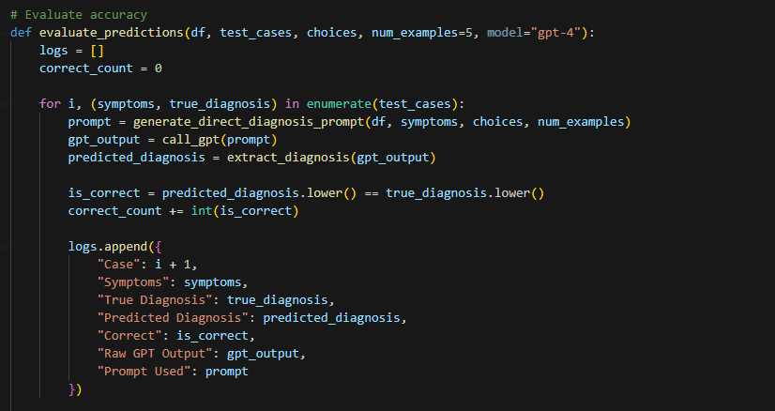
Step 5: Calculate Prediction Accuracy
Following function is used to calculate LLMs prediction accuracy.

Slide 19
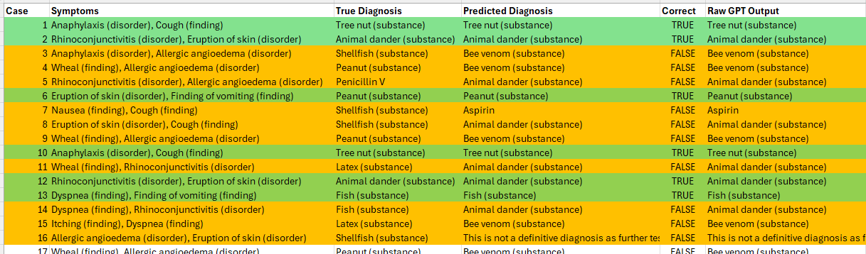
Step 5: Results
Since similar symptoms can be triggered by various types of allergy onsets and prediction is based on only two major symptoms, the LLM's predictions were accurate only for 34% of the time. This highlights the challenge in distinguishing between different allergies based on overlapping symptom patterns.
Here is a snapshot of the csv file generated by the tool listing results:

Slide 20
Future Ahead
As demonstrated by these experiments, LLMs (Large Language Models) prove to be highly effective tools in the medical field. When utilized appropriately, they have the potential to significantly improve care dynamics by assisting with tasks such as diagnosing, predicting, and personalizing treatment plans. Their ability to process vast amounts of data quickly and accurately can support healthcare professionals in making more informed decisions, ultimately enhancing patient care and outcomes. However, optimal application and continuous refinement are crucial to fully harness their capabilities in this complex domain.

Slide 21
Thanks
Syyad Ali

