Slide 1
Credit Card Financial Dashboard
•••• •••• •••• 2023
Revenue, transaction and customer analytics by year, quarter and month, built with Power BI and DAX
CREDIT CARD ANALYTICS
Power BI
DAX
PostgreSQL
Notes:
Intro: a two-page Power BI dashboard on credit card transactions and customers, with the DAX behind it. Built from 10,108 customer records across 2023.

Slide 2
Project objective
Give stakeholders an interactive view of credit card revenue, interest, transactions and customer segments, filterable by year, quarter, month and week, so trends can be spotted and acted on quickly.
55.3M
7.8M
Total revenue
Interest earned
Questions the dashboard answers
Which cards, channels and spend types drive revenue?
Which customer segments (age, income, state) are most valuable?
How is revenue trending across quarters, months and years?
656K
10,108
Transactions
Customers
Notes:
Frame the business problem first. KPI figures come from the dashboard cards: revenue 55.3M, interest 7.8M, 656K transactions, 10,108 customers.

Slide 3





From raw data to dashboard
CSV to PostgreSQL
Tables created in the ccdb database, then CSV data loaded with COPY (10,108 rows each)
Power BI import
Connected to PostgreSQL in Import mode; Date_Table generated with DAX
Data model
One-to-one on client_num between customers and cards; calendar joined one-to-many
DAX layer
Calculated columns for segments and revenue; measures for WoW, MoM and YoY growth
Interactive dashboards
Two report pages with week, quarter and gender slicers, plus insights and recommendations
Notes:
Walk left to right through the pipeline. Storage mode is Import, so refresh pulls from the database on demand.

Slide 4
Loading data into PostgreSQL
STEP 1 | CREATE DATABASE AND TABLES
STEP 2 | LOAD CSV FILES WITH COPY
-- create database and tables
CREATE DATABASE ccdb;
CREATE TABLE cc_detail (
Client_Num INT,
Card_Category VARCHAR(20),
Week_Start_Date DATE,
Credit_Limit DECIMAL(10,2),
Total_Trans_Amt INT,
Interest_Earned DECIMAL(10,3),
-- 18 columns in total
);
CREATE TABLE cust_detail (
Client_Num INT,
Customer_Age INT,
Income INT,
-- 15 columns in total
);
-- load the main data
COPY cc_detail
FROM 'D:\credit_card.csv'
DELIMITER ','
CSV HEADER;
-- fix date format error
SET datestyle TO 'ISO, DMY';
-- append week-53 data
COPY cc_detail
FROM 'D:\cc_add.csv'
DELIMITER ','
CSV HEADER;
Step 3: Power BI connects to ccdb and imports the tables
Notes:
CSV files were loaded into PostgreSQL with COPY ... CSV HEADER. A datestyle error was fixed with SET datestyle TO ISO, DMY. Extra week-53 rows were appended with the same COPY pattern. Power BI then connects to the ccdb database in Import mode.

Slide 5
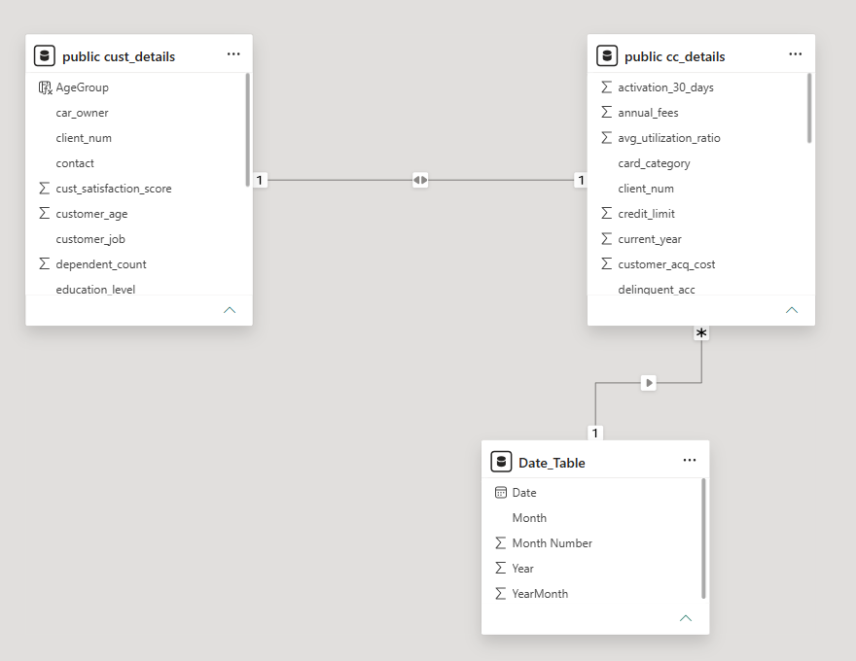
Data model
cc_details | Fact
Fees, interest, transactions. One-to-one with customers on client_num
cust_details | Dimension
Age, income, state, education, 10,108 customers
Date_Table | Calendar
358 days from Jan 2023, one-to-many to card data
Notes:
Two data tables joined 1:1 on client_num so customer attributes slice card metrics, plus a DAX-generated date table that enables time intelligence.

Slide 6
DAX: calculated columns and tables
CALCULATED COLUMN | cust_details
CALCULATED COLUMNS | cc_details
AgeGroup = SWITCH(TRUE(),
[customer_age] < 30, "20-30",
[customer_age] >= 30 && [customer_age] < 40, "30-40",
[customer_age] >= 40 && [customer_age] < 50, "40-50",
[customer_age] >= 50 && [customer_age] < 60, "50-60",
[customer_age] >= 60, "60+",
"unknown")
Revenue =
[annual_fees]
+ [total_trans_amt]
+ [interest_earned]
week_num2 =
WEEKNUM([week_start_date])
CALCULATED COLUMN | cust_details
CALCULATED TABLE | Date_Table
Income_Group = SWITCH(TRUE(),
[income] < 35000, "Low",
[income] >= 35000 && [income] < 70000, "Med",
[income] >= 70000, "High",
"Unknown")
ADDCOLUMNS(
CALENDAR(
MIN([week_start_date]),
MAX([week_start_date])),
"Year", YEAR([Date]),
"Month Number", MONTH([Date]),
"Month", FORMAT([Date],"MMM"),
"YearMonth",
YEAR([Date])*100+MONTH([Date]))
Notes:
SWITCH(TRUE(), ...) buckets customers into age and income bands used in the customer report. Revenue = fees + transaction amount + interest. The date table is built from the min and max week_start_date. Table prefixes are shortened on the slide for readability.

Slide 7
DAX: measures and time intelligence
MEASURES | latest-week snapshot
MEASURES | week-over-week growth
TotalRevenue = SUM(cc_details[Revenue])
Current_Week_Revenue =
CALCULATE(SUM(cc_details[Revenue]),
FILTER(ALL(cc_details),
cc_details[week_num2] =
MAX(cc_details[week_num2])))
Previous_week_revenue =
CALCULATE(SUM(cc_details[Revenue]),
FILTER(ALL(cc_details),
cc_details[week_num2] =
MAX(cc_details[week_num2]) - 1))
Previous_week's_revenue =
CALCULATE([TotalRevenue],
DATEADD(Date_Table[Date], -7, DAY))
WoW_growth% =
DIVIDE([TotalRevenue]
- [Previous_week's_revenue],
[Previous_week's_revenue], 0)
Same pattern, new offset
MoM_Growth%: DATEADD(..., -1, MONTH)
YoY_Growth%: DATEADD(..., -1, YEAR)
Notes:
ALL() removes slicer filters so the latest week can be compared with the one before it. The DATEADD versions use the Date_Table, so they respond to filters. MoM and YoY reuse the same DIVIDE pattern with -1 MONTH and -1 YEAR. DIVIDE avoids divide-by-zero errors.

Slide 8
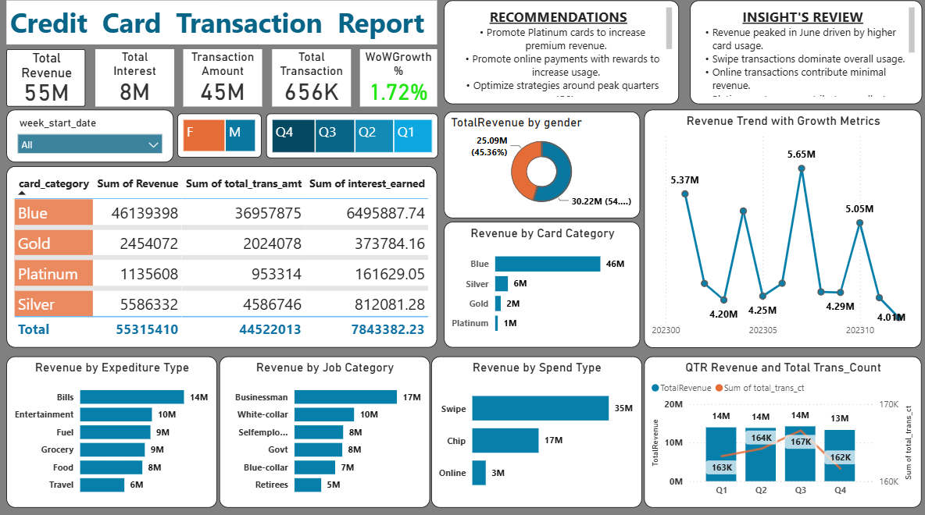
Dashboard 1: transaction report
1.72%
Week-over-week revenue growth
~63%
of revenue from card swipes
83%
of revenue from Blue cards
KPIs, card and channel breakdowns, quarterly and growth trends
Notes:
Page 1 is operational: KPIs, card category table, channel and spend breakdowns, quarterly revenue vs transaction count, and the growth trend.

Slide 9
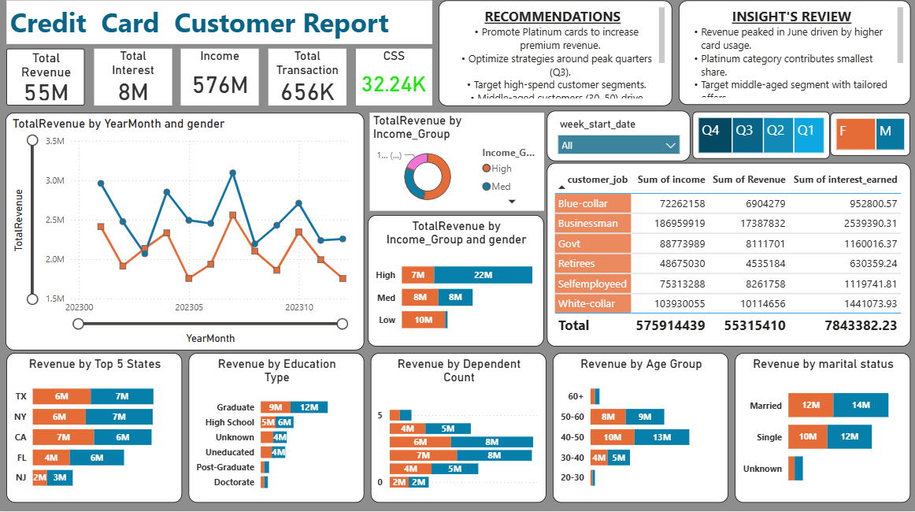
Dashboard 2: customer report
~13M
revenue each from TX, NY, CA
~29M
from high-income (~52%)
40-50
age band earns most (~23M)
Revenue by income, state, education, age and marital status
Notes:
Page 2 is segmentation: who the customers are and which groups generate revenue. AgeGroup and Income_Group from the calculated columns power these visuals.

Slide 10
Key insights
Blue and Silver cards drive 93.5% of revenue; Platinum adds only 2%.
1
Swipe transactions lead at 35M; online adds just 3M.
2
Male customers bring 30.2M (54.6%) against 25.1M from female customers.
3
Quarterly revenue is steady near 14M, with Q4 easing to 13M.
4
Notes:
Percentages computed from the card category table: Blue 46.14M + Silver 5.59M = 51.73M of 55.32M total. Gender split from the donut: 30.22M male, 25.09M female.

Slide 11
Recommendations and takeaways
Recommendations
Skills demonstrated
Promote Platinum cards to lift premium revenue
Reward online payments to grow an under-used channel
Target high-spend, middle-aged (40-50) segments
Plan campaigns around peak quarters
SQL data sourcing
Data modelling and relationships
DAX: SWITCH, CALCULATE, DATEADD
Dashboard design and storytelling
Notes:
Close with what the data suggests the business should do, then the skills this project shows.

