Slide 1
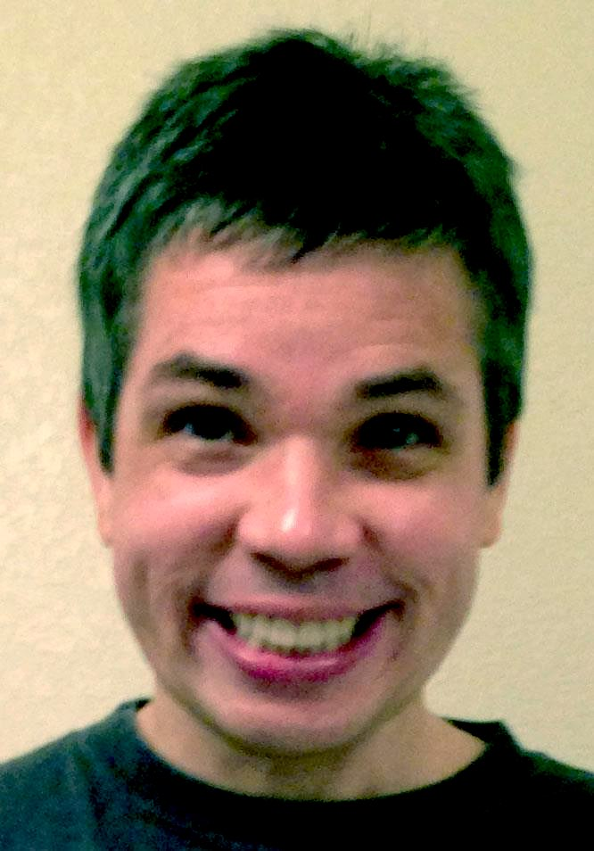
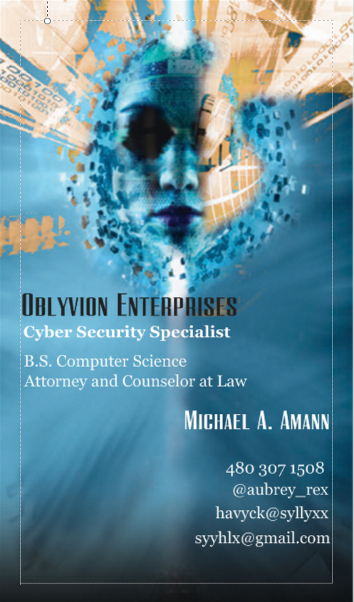
Michael A. Amann
B.A. Rhetoric
University of Oregon
B.S. Computer Science
Attorney and Counselor at Law
Arizona State University

Slide 2
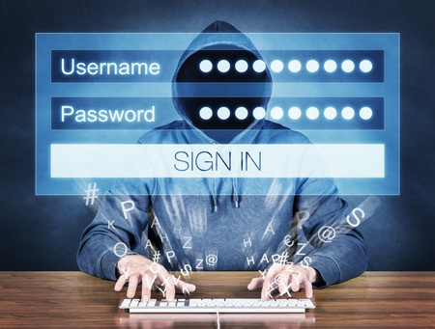
The Computer Fraud and Abuse Act (CFAA) 18 USC §1030

Slide 3

Got why? Why care about the CFAA?
10 points to
Gryffindor!
“Our only hope, our only peace is to understand it.
To understand the ‘why.’ Why is what separates us from them,
you from me. Why is the only real source of power Without it you
are powerless…”

Slide 4
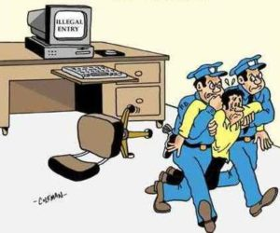
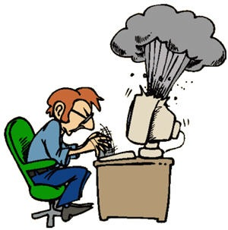
Number one why!
If you’re busted for hacking by the feds this is the statute they will charge you with.
“For sixty points to your wizarding house, why do we have the CFAA?”
Hint: Mr. Robot

Slide 5
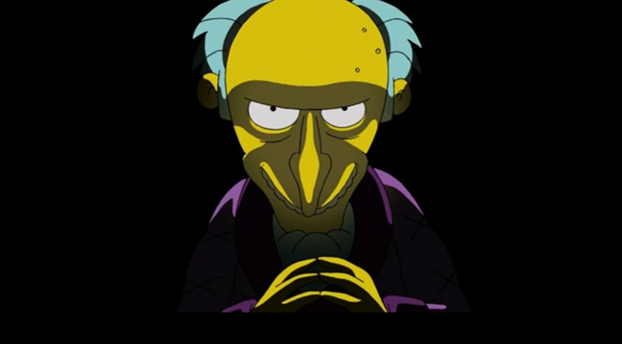
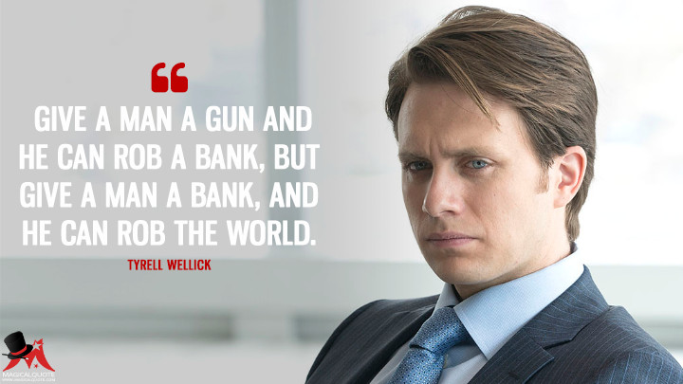
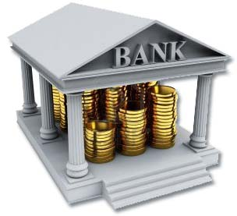
Why number two!
The banks protected themselves…

Slide 6
The priorities of your government
When the conduct constituting the offense affects the computer’s use by or for a financial institution or the United States government
A protected computer which is used in or affecting interstate or foreign commerce or communication, including a computer located outside the United States that is used in a manner that affects interstate or foreign commerce or communication of the United States.

Slide 7
What is covered? Everything!!!
Whoever – having knowingly accessed a protected computer without authorization or exceeding authorized access…
Accessed, authorization, authorized access
Authorized has never been defined!
Passed in 1986
The CFAA was passed years before the advent of the modern internet and is desperately out of touch with how we use computers today. – Electronic Frontier Foundation

Slide 8
The Seven Deadly sins!
The CFAA prohibits seven kinds of conduct.
Obtaining National Security Information
Compromising Confidentiality
Trespassing in a government computer
Accessing to defraud and obtain value
Damaging a computer or information
Trafficking in passwords
Threatening to damage a computer
$5000 threshold for felony charges

Slide 9
When does the statute apply?
“The problem is the CFAA is so broadly written and it fails to define what is seeks to prohibit.” – Tor Ekeland
U.S. v. Rushdan 870 F.2d 1509,1514 (9th cir. 1989)
Illicit possession of out of state credit card numbers is offense affecting interstate or foreign commerce for purposes of the statute.
1994 Amendment added “knowingly causing the transmission of a program, information, code or command which intentionally causes damage without authorization.”

Slide 10
When doesn’t the statute apply?
U.S. v. Drew 259 F.R.D. 449 (C.D. Cal 2009)
The court in Drew noted that the CFAA does not specifically state that it criminalizes breaches on contract in the context of website terms of service. In this case MySpace.
MBTA v. Anderson – Free Speech Massachusetts Bay Transportation authority wanted to prevent MIT students from publicly disclosing a vulnerability they had found.
U.S. v. Nosal 676 F. 3d 854 (9th Cir. 2012)
Violations of corporate policy are not equivalent to federal computer crime law.
What do hackers generally do that violates this statute?
*Weren’t Defendant Nosal and his cohort guilty of trafficking in passwords?
10 points to your wizarding house.

Slide 11
What about rainbow tables?
Tables filled with hash values that are pre matched to possible plain text passwords.
Dissenting Judge Reinhardt wrote that this case (Nosal) is about password sharing and that CFAA does not make millions of people who engage in this ubiquitous, useful and generally harmless conduct into unwitting federal criminals.
Typically there is no charge without a victim.

Slide 12
What is trafficking?
Definition of traffic – trafficked; trafficking
Intransitive verb
1: To concentrate’s one’s efforts or interest. Broadly; engage or deal
Intransitive verb
2:To carry on trade or have dealings. – The American Heritage Dictionary 8th edition

Slide 13
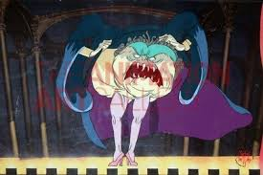
How legal analysis works…
Prior Cases:
Nosal
Drew
Rushdan
Your case:
Facts Facts
Facts Facts
Facts Facts
Facts Facts
CFAA
RESULT

Slide 14
Quantum Thinking
TECHNOLOGY
LAW
In Quantum Computing a bit can be both positive and negative
at the same time.
Similarly the fact the CFAA is so broad is both positive and negative
at the same time.

Slide 15
Courts are like assembly instructions
000000 111
00 1111111
The verdict is the result of a majority of ones.

Slide 16
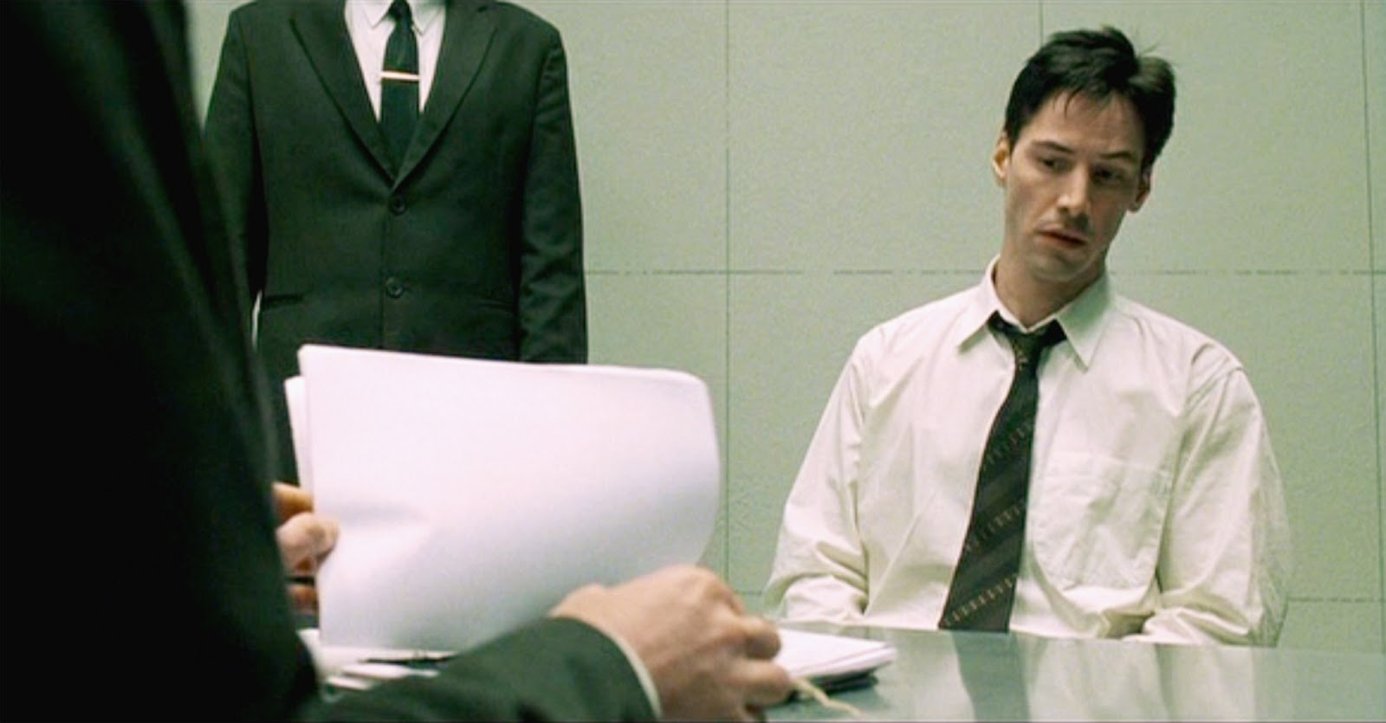
Prosecutors don’t want a trial!

Slide 17
Sixth Amendment Right to trial
The Sixth Amendment states: In all criminal prosecutions, the accused shall enjoy the right to a speedy and public trial, by an impartial jury of the State and district wherein the crime shall have been committed.
The uncertainty of a trial is your best bet…

Slide 18
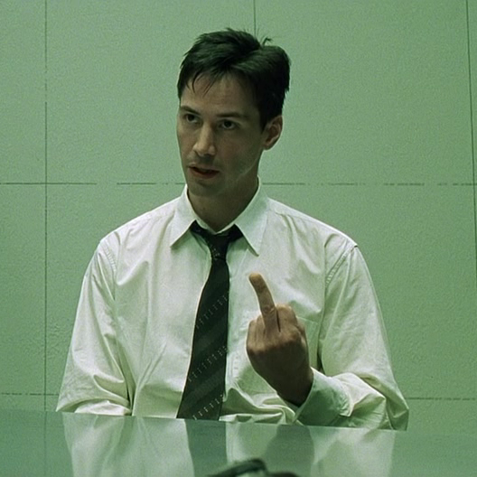
Always be Neo!
Aaron Swartz case
”Prosecutors for decades have threatened alleged criminals with disproportionately large sentences in hopes of securing a plea bargain, thus avoiding the expense and effort of a full blown trial.” - Slate

Slide 19
Right to trial by jury
Aaron Swartz was charged with multiple counts of wire fraud and CFAA violations.
Unlawfully obtaining information from and damaging a protected computer.
Prosecutors filed a superseding indictment adding nine more felony counts exposing Swartz to 50 yrs. Imprisonment and 1 mill. In fines.
They offered a plea deal of six months imprisonment and threatened to seek seven years if he exercised his right to a trial.

Slide 20
What do we mean by “without authorization?”
It depends who you ask…
“Without authorization is an unambiguous non-technical term given its plain and ordinary meaning means accessing a protected computer without permission.
Rules that determine who is allowed to do what. Adam may be allowed to create and delete databases while Ursula is only allowed to read them.

Slide 21
In Windows™
User rights
User rights AUTHORIZE users to perform specific actions such as logging onto a system or backing up files and directories.
User rights are different from permissions they apply to user accounts whereas permissions are attached to objects
User rights are best administered on a group account basis. This ensures that a user logging on as a member of a group automatically inherits the rights associated with that group. – Microsoft Tech Blog

Slide 22
In Unix/Linux
Permissions is a complex subject in Unix/Linux
User, File and Directory permissions.
Read, Write and Execute. “r” “w” “x”
The meanings of these permissions differ based on context. Read permission on a directory means it is searchable it does not mean you can read the contents of the files.

Slide 23
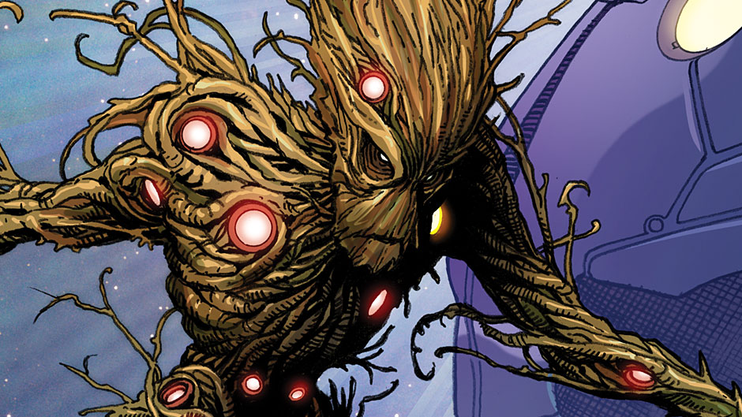
Got Root?
I am Root!
According to the CFFA if you’re not a super user in
Windows or Linux you’re “unauthorized?”

Slide 24
Buffer Overflow
Buffer overflow alters the execution path of an application by overwriting parts of its memory. Malicious extra data [often] contains code designed to trigger specific actions in effect sending new instructions to the attacked application resulting in unauthorized access to the system. – Veracode
What the court should have said. - Accessing without permission and permissions!
char buff [10] = {0};
strcpy( buff, “This string will overflow the buffer.”);

Slide 25
Unauthorized is technical!
The Stack
The Heap
Return Address
Push, Pop
Memory Virtualization
Threads
Processes
All the fun stuff you learn in Computer Science.

Slide 26
Useful “Take Aways”
Prosecutors will stack charges to scare you into taking a plea agreement.
You have a right to a trial and nobody wants that.
Usually if there’s no victim there’s no charge.
The CFAA’s breadth makes it easier to charge but also easier to defend.
We need more engineers to go to law school to craft and contribute to legislation.
You can still be a plumber!

Slide 27
Hypothetical Zero
You buy a new router.
You notice your neighbor has the same router, make, model and is available to connect.
You access their router using the password that came with the box. Is this “authorized” under the CFFA? Why or why not? What other question(s) does it raise?

Slide 28
Is a router a computer?
How do routers work?
The router powers on and loads its OS from flash.
It loads the configuration file saved to NVRAM
Adds network address and subnet for each interface to its routing table.
Netgear Nighthawk has a dual core processor

Slide 29
CFAA defines computer as…
An electronic, magnetic, optical, electrochemical or other high speed data device performing logical, arithmetic or storage functions and includes any data storage facility or communications facility related to or operating in conjunction with such device.
“A cellular phone used only to place calls and send text messages is a computer as defined by the Computer Fraud and Abuse Act (CFAA) 18 USC §1030.” US v. Kramer February 8 2011 United States Court of Appeals for the 8th Circuit

Slide 30
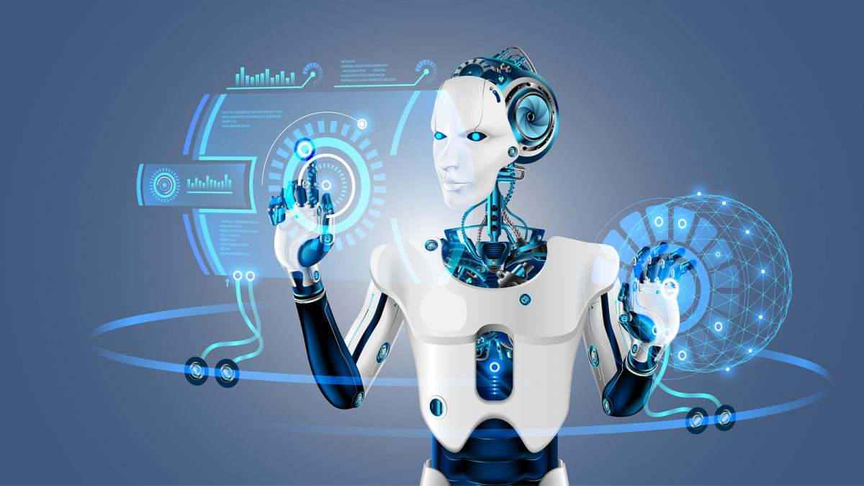
Does everything have a computer?
“But such term does not include an automated typewriter or typesetter a portable hand held calculator or other similar device…” -CFAA

Slide 31

What is a computer?
A microprocessor?
Includes an ALU Arithmetic
Logic Unit, the CU Control Unit,
registers, instruction decoders, bus
control unit, etc…
“Everything has a computer in it nowadays.”
– Steve Wozniak Co Founder of Apple Computer

Slide 32
What is a “computer?”
Since the 70’s our cars have had ECUs “engine control units” in them.
Gathering data from dozens of sensors, the ECU performs millions of calculations per second i.e. looking up values in tables and calculating the results of long equations.
Is and ECU a computer?
Is a car a computer under the CFAA?
Tesla? Driverless car?

Slide 33
Hypothetical One
You set up a wi fi hot spot in Starbucks called “Super Awesome Dope Cool free wi fi.”
An unsuspecting lap top user logs on to your hot spot.
You gain access to their computer and sniff their packets.
Is this “unauthorized” access under the CFAA? Why or why not?
Which other violation is possible?

Slide 34
Useful “Take Aways”
Unfortunately public Wi Fi access is so new the
Courts have not established any definitive answer to these liability questions. It is likely some form of the Tort premises liability would provide the basis for determining liability.
Negligence:
The failure of the possessor to exercise reasonable care to (a) discover that such acts are being done or are likely done, or
(b) give a warning adequate to enable the visitors to avoid harm or otherwise protect against it. - MBM Attorneys at Law
Contributory Negligence: Clients assume the risk when they log onto public wi fi. Arizona has contributory Negligence.
Is this even “access” under the CFAA? What is access?

Slide 35
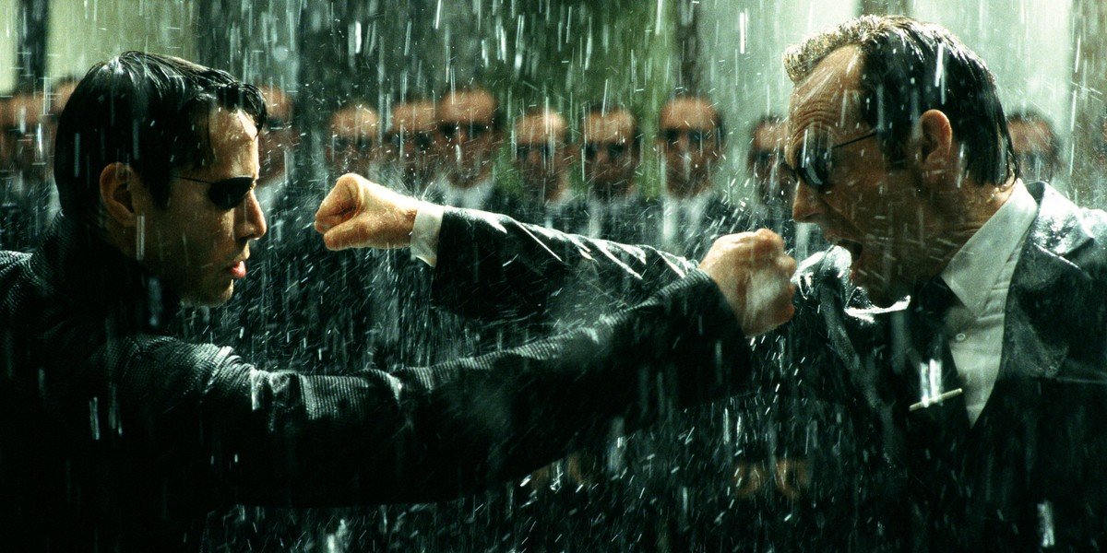
Thank you
101

