Slide 1
W04 CAPSTONE · EDGE AI & MODEL COMPRESSION
Compressing Vision Models for inGen's Physical AI Platforms
Quantization · structured pruning · knowledge distillation · GA micro-NAS — one baseline, one protocol, five deployment budgets
4
4
5
1
weeks · one measurement protocol (seed 42, bs = 1)
compression techniques benchmarked
platform budgets: < 3–20 MB, < 50–500 ms
playbook: per-platform recommendations
Siyu Xiang — Edge AI & Model Compression Intern · Supervisor: Iqbal Patel · repo: syyovo/siyu-ingen-edge-ai (v1.0) · July 2026
Notes:
30-min talk, ~3 min per slide. One sentence framing: four weeks, one fine-tuned baseline, four compression families measured under one protocol, ending in a per-platform playbook. Everything quoted is in the capstone report and reproducible from the repo at tag v1.0.

Slide 2
DEPLOYMENT CONTEXT
Five platforms, one constraint set: 3–20 MB and 50–500 ms — on embedded CPUs with no GPU
Platform | Size | Latency | Strategy after W1 → after W3
Aido Rover — outdoor patrol, 10 Hz | < 5 MB | < 100 ms | Quantization → prune 12% + recovery ft
Sentinel Prime — battery, always-on | < 3 MB | < 200 ms | INT8 PTQ → distillation route
Fari — elder companionship | < 20 MB | < 500 ms | Distillation → FP32 as-is
Aido Humanoid — 10 Hz+ control loop | — | < 50 ms | Pruning ≤ 10% + ft (unchanged)
Senpai — course-retrieval embeddings | < 20 MB | — | Embedding quantization → re-test on target
Why INT8 should win on an ARM edge CPU
16 vs 4
INT8 lanes per 128-bit NEON register — 4× the MAC work per instruction
4×
fewer bytes moved — the likelier bottleneck at bs = 1 (each weight fetched once)
− energy
The strategy column moving is itself a result: four of five Week-1 plans moved — three overturned by measurement, one (Senpai) for lack of any.
integer ALUs are simpler circuits — battery relevance for Sentinel
inGen Dynamics · W04 Capstone · Siyu Xiang
2 / 10
Notes:
Budgets derive from sensor rate, power source, interaction context. 10 Hz = a frame every 100 ms; the model must finish inside it. Then the INT8 hardware logic: SIMD lanes, memory traffic, integer ALU — set up here so the Slide 4 collapse lands as a surprise with an intact speed mechanism. Each mechanism alone caps near 4× — the measured 11.3× and its gap return on slide 9.

Slide 3
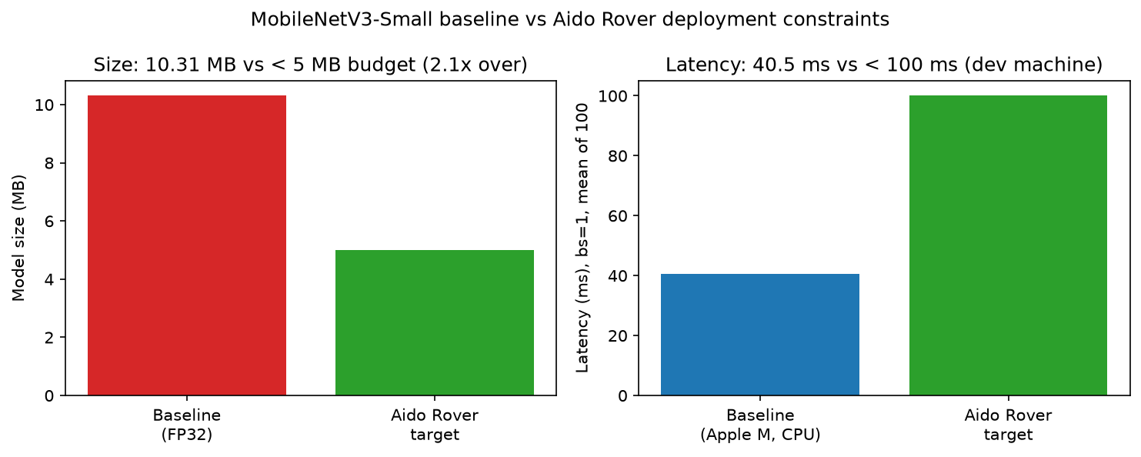
BASELINE & DEPLOYMENT GAP
The honest baseline: 93.38% / 6.24 MB — the real Rover gap is 1.24 MB, not the 2.1× first reported
10.31 MB
6.24 MB
93.38%
FIGURE 1
as loaded — ImageNet 1000-class head (2.54 M params)
after 10-class head swap + fine-tune (1.53 M params)
full 10k CIFAR-10 test accuracy
Head swap alone removed ~1 M parameters. W01 profiled the wrong head for the task — corrected openly in W02 and carried through every later number.
One protocol behind every number
seed 42 · PyTorch 2.12.1 CPU · full 10k test split · size = state_dict on disk · latency = bs 1, 10 warm-up + 100 timed runs · clean-session baseline 37.3–39.2 ms; loaded sessions annotated, never silently mixed
Baseline vs Aido Rover budget — size & latency bars
experiments/W01_deployment_gap.png
inGen Dynamics · W04 Capstone · Siyu Xiang
3 / 10
Notes:
Two-beat story: profile said 2.1x over budget; the honest correction is that the ImageNet head was the wrong head — fine-tuned deployment baseline is 6.24 MB, gap 1.24 MB. Latency passes on the dev machine but that is Apple silicon, not Cortex-A — flagged now, resolved on slide 10.

Slide 4
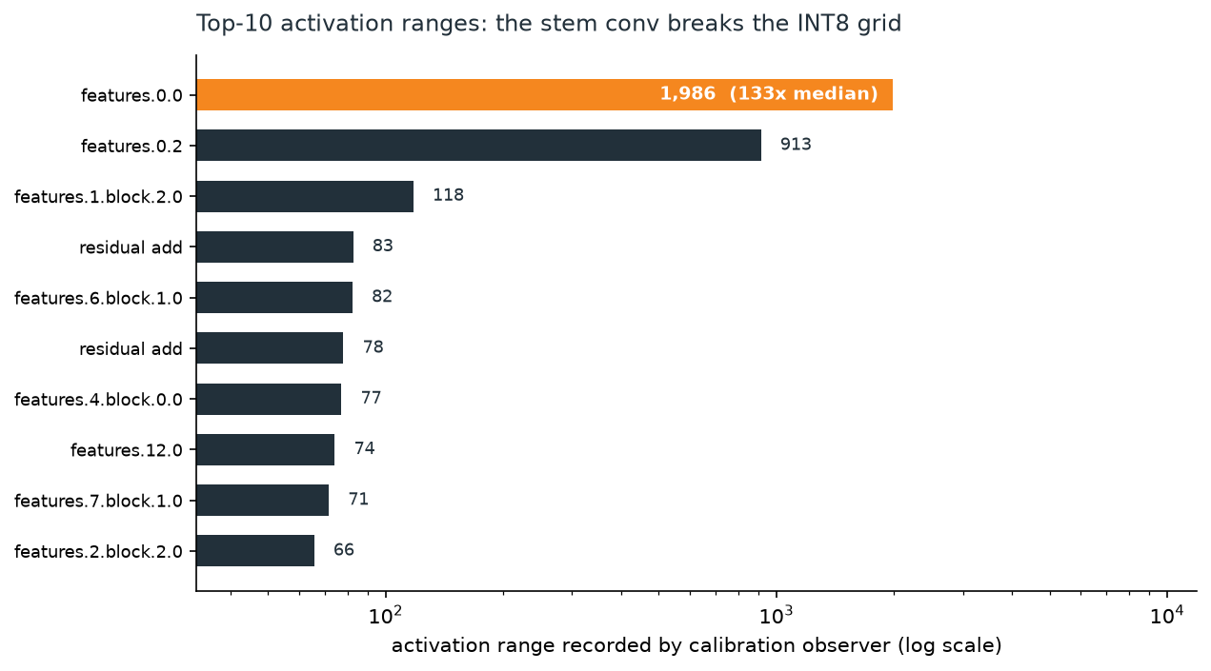
QUANTIZATION — A DIAGNOSED NEGATIVE RESULT
INT8 delivers 3.4× size and 11× speed, then collapses to 15.91% — traced to one 133× activation outlier
PTQ config | Accuracy
per-channel + Histogram | 15.91% (full test)
per-tensor + Histogram | 10.00% (full test)
per-channel + MinMax | 12.2% (1k screen)
default qnnpack mapping | 10.2% (1k screen)
QAT, 3 epochs | 14.67% — does not repair it
FIGURE 3
Diagnostic chain — four beats of seven steps
Per-layer activation ranges — stem outlier annotated (log scale)
Weight-only quantization: 90.64% → activations are guilty
Stem output range ≈ 1986 vs network median 14.95 — a 133× outlier
INT8 grid step ≈ 7.8 erases all normal-magnitude activations
FP32 fallback fails — the outlier tensor still crosses an INT8 boundary
experiments/W02_activation_ranges.png · scripts/w04_fig3_actranges.py
Verdict: architectural, not procedural. Don't ship INT8 on this hard-swish/SE backbone; re-attempt on a ReLU-based one.
inGen Dynamics · W04 Capstone · Siyu Xiang
4 / 10
Notes:
Speed and size deliver in full — the INT8 family owns the fastest corner measured (3.3–3.4 ms; the ~11× exceeds the ~4× either mechanism predicts, remainder unattributed — report §10.5) — so the failure is purely accuracy. Walk the causal chain, land on the 133x stem outlier, then the informative fallback failure: pathology lives in tensors, not ops. The 3-epoch QAT run does not repair it and was still rising at cutoff — budget-limited, so the architectural verdict rests on the diagnostic chain, not on QAT. Likely origin: 4-epoch fine-tune left near-ImageNet stem weights facing upscaled CIFAR-10.

Slide 5
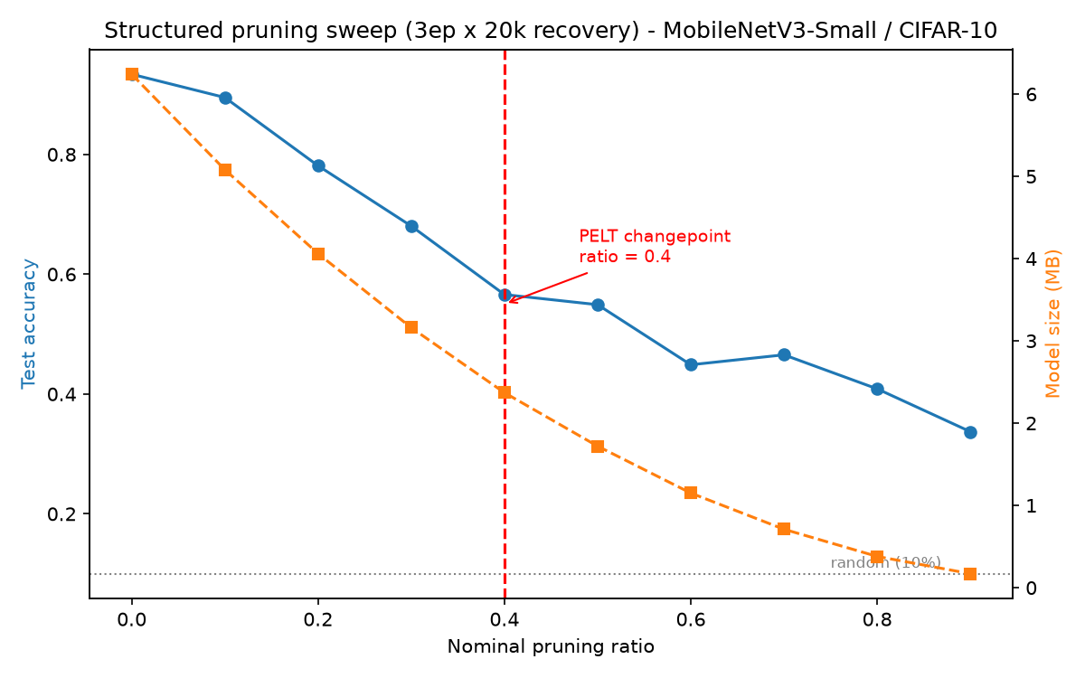
STRUCTURED PRUNING
No free pruning region: 10% already costs 3.9 pp — and the PELT changepoint at 0.4 marks the end of the steep decline
Nominal ratio | ft3 accuracy
10% | 89.50%
12% ◆ | 88.45%
15% ◆ | 85.32%
20% | 78.11%
30% | 68.04%
40% — PELT changepoint | 56.60%
50% | 54.91%
90% | 33.71%
0.4
FIGURE 4
changepoint: stable over penalty ∈ [0.5, 2]; exact DP (Dynp) agrees — same signal
63%
params physically removed at nominal 0.4 — dependency-group coupling
×12
Dual-axis: ft3 accuracy + size vs ratio, changepoint marked
recovery budget (3 ep × 20k) vs the failed 1-ep probe — accuracies still budget-limited
experiments/W02_pruning_dualaxis_ft3.png
◆ = W04 verification run, identical ft3 protocol (experiments/W04_rover_verification.csv). Zero-shot pruning collapses at every ratio — recovery fine-tuning is mandatory.
inGen Dynamics · W04 Capstone · Siyu Xiang
5 / 10
Notes:
Zero-shot collapses everywhere — the standard behavior of structural pruning (co-adapted weights, BN stats), which is why recovery ft is part of the technique; the little-dormant-capacity claim rests on the 3.88 pp post-recovery residual, not on the zero-shot curve. Recovery is real at low ratios but never free: 10% costs 3.9 pp. Read the changepoint correctly: ~9.2 pp/step before 0.4, ~4.6 after — still falling, one later step hits 10 pp. It marks where the steep regime ends, not where damage begins or stops. Never quote 0.4 as a safe limit.

Slide 6
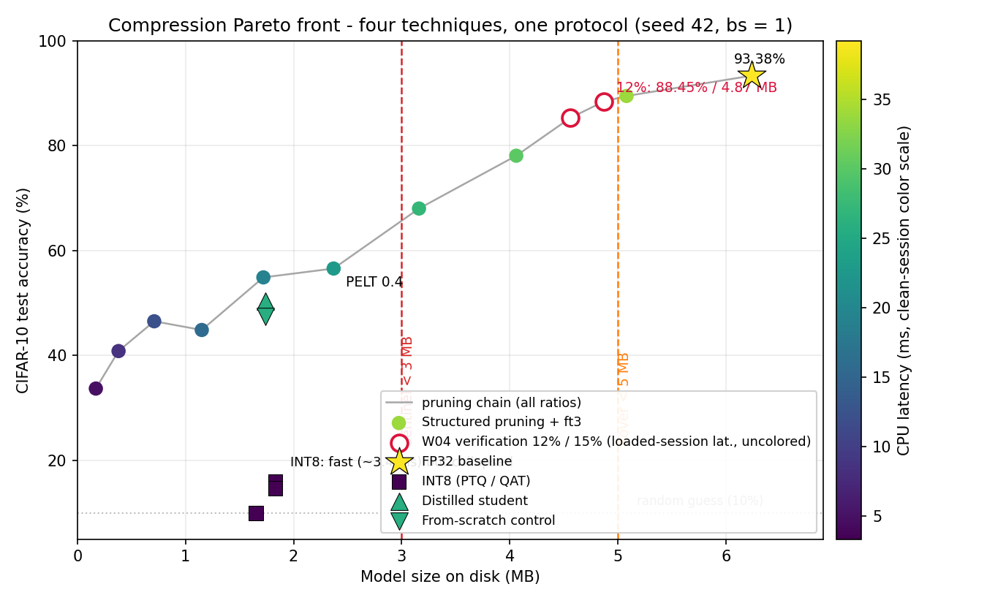
PARETO FRONTIER
The empty corner decides Sentinel: no measured configuration exceeds 85% accuracy under 3 MB
How to read it
FIGURE 5
The frontier is the pruning-recovery chain, FP32 down to 90% (60% is dominated by 70% — off the frontier).
The distilled student sits below the pruned model of its size class.
INT8 owns the fast-but-collapsed corner: 3.3–3.4 ms — the speed mechanism is intact even where accuracy fails.
> 85% accuracy below 3 MB: zero points. That empty corner is the Sentinel infeasibility finding — the recommendation becomes a route, not a config.
Four-technique Pareto: accuracy vs size, latency as color; 5 MB & 3 MB budget lines
experiments/W04_pareto_combined.png · scripts/w04_fig5_pareto.py (W2-only predecessor: W02_pareto_combined.png)
inGen Dynamics · W04 Capstone · Siyu Xiang
6 / 10
Notes:
One figure, one message: where the measured configs live. Trace the frontier, point at the INT8 corner as strategic (fastest corner measured), then the empty upper-left — that emptiness is the Sentinel finding and the pivot to distillation as a route.

Slide 7
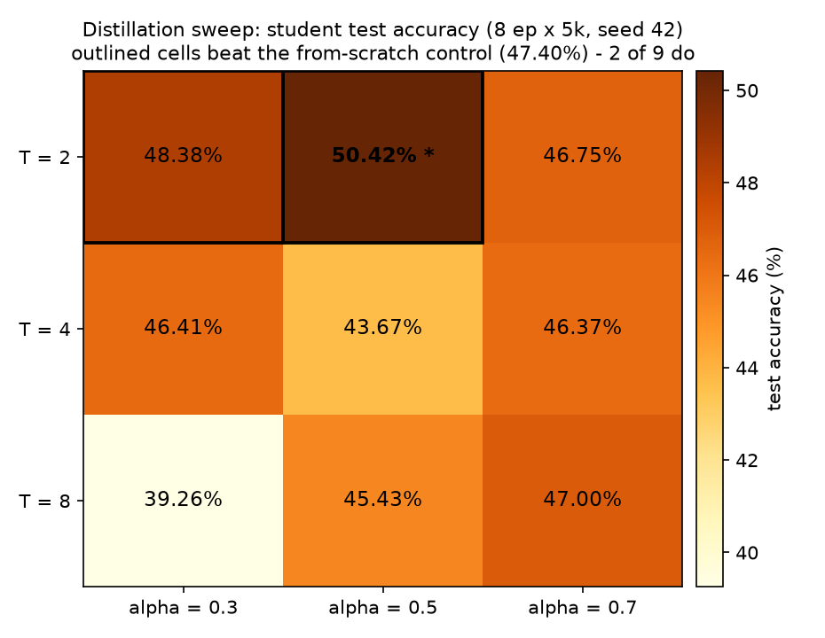
KNOWLEDGE DISTILLATION
The distillation signal is real: +3.02 pp over an identical-budget control — but only 2 of 9 configs beat it
 | α = 0.3 | α = 0.5 | α = 0.7
T = 2 | 48.38% | 50.42% ★ | 46.75%
T = 4 | 46.41% | 43.67% | 46.37%
T = 8 | 39.26% | 45.43% | 47.00%
FIGURE 6
From-scratch control (same arch, data, budget, init): 47.40% · worst cell (T = 8, α = 0.3) lands 8 pp below it — the gain is hyperparameter-sensitive, never a default.
T × α sweep heatmap, control level marked
The inheritance gap. Pruned @ 50% (54.91% / 1.72 MB) beats the best student (50.42% / 1.74 MB) at matched capacity (403k vs 409k params, a 4.49 pp gap): pruning inherits trained features; a student re-grows them from scratch. Distillation is the route below what light pruning can reach — at a production training budget.
experiments/W04_distill_heatmap.png · scripts/w04_fig6_heatmap.py, from experiments/W03_distill_sweep.csv
Student: width ×0.5 = 409 k params (−73%) · 1.74 MB · 25.8 ms — teacher is our own 93.38% baseline, so capacity is the only variable.
inGen Dynamics · W04 Capstone · Siyu Xiang
7 / 10
Notes:
Controlled design: same-family width-0.5 student, own baseline as teacher, from-scratch control isolates the signal: +3.02 pp. Low T wins because the teacher is confident — T=8 over-smooths to 8 pp below control. Then the inheritance gap explains the strategy split between pruning and distillation. Dead end owned: the 3-epoch sweep underfit to 10% and is archived, not deleted.

Slide 8
COMPRESSION PLAYBOOK
Rover ships at 12%: measured 88.45% / 4.87 MB with 0.13 MB headroom — extrapolation verified within 0.5 pp
Platform | Primary recommendation | Config | Profile (size · acc · latency)
Aido Rover | Light pruning + recovery ft — measured, not extrapolated | 12% (W04-verified) | 4.87 MB · 88.45% · 46.6 ms ▲
Sentinel Prime | Distillation route — needs production training budget | width ×0.5 student | 1.74 MB · acc TBD · 25.8 ms
Aido Humanoid | Structured pruning ≤ 10% + ft — latency-first | 10% | 5.08 MB · 89.50% · 33.8 ms
Fari | No compression — deploy FP32 as-is; accuracy decides | — | 6.24 MB · 93.38% · ~38 ms
Senpai | Extrapolated from Fari; re-test INT8 on embedding models | testing plan | vision-CNN evidence only
Every row carries a hardware qualifier: absolute latencies are Apple-M dev-machine numbers; INT8 speedups assume wide integer SIMD.
▲ loaded sessions, both caught by the in-session baseline control (50.61 / 49.61 ms vs 37.3–39.2 clean): 46.6 verification · 43.8 re-measurement (report §10.1); no deployment conclusion depends on the absolute value. Rover: the 15% bracket prices deeper headroom at ~1 pp per nominal %.
inGen Dynamics · W04 Capstone · Siyu Xiang
8 / 10
Notes:
The verification loop is the story: W02 measured 10% at 5.08 MB — 0.08 over — and extrapolated ~88% at 12%; a W04 run measured 88.45% / 4.87 MB under the identical protocol. Gap found, gap measured, loop closed. Sentinel stays honest: route, not config. Fari: the winning move is no compression at all.

Slide 9
LIMITS & WHAT TRANSFERS
What transfers is ratios — 3.4× size, ~11× speed — not milliseconds; a changepoint marks a completed transition, in reservoirs as in networks
Limits that matter
RISC-V changes the ranking
PELT, twice
Dev-machine (Apple M) latencies — hardware-in-the-loop next · ft3 accuracies likely understate longer budgets (loss still falling) · one vision CNN, one dataset: do not generalize the INT8 negative to embeddings · torch.ao FX deprecated → migrate to torchao PT2E
The 11.3× INT8 speedup exceeds the ~4× either mechanism predicts alone (SIMD lanes / bytes moved); the remainder is unattributed — likely fused INT8 kernels. The SIMD share is ISA-contingent: on RISC-V it needs the V extension — without it INT8 buys 4× size but little speed, demoting quantization below pruning. Pruning's size gain is ISA-invariant; moving fewer bytes is the reliable win on any ISA.
Reservoir study (Liao, Ding, Xiang et al., J. Lake Sci. 2025): PELT changepoints on monthly surface area, corroborated by SPEI12. Here: changepoint 0.4, checked internally — penalty sweep + Dynp on the same signal (no external signal; an honest asymmetry). Same reading both times — area declined before Sep 2018; accuracy fell before 0.4. A changepoint marks completed transition, never a safe limit.
inGen Dynamics · W04 Capstone · Siyu Xiang
9 / 10
Notes:
Close on three transfers: what doesn't transfer (absolute ms), what conditionally transfers (INT8 speed — ISA-dependent, the RISC-V observation), what always transfers (ratios; the memory-bound insight). End on the PELT bridge to the reservoir paper — same algorithm, same misreading to avoid. Then Q&A; defense notes cover calibration choice, PELT criterion, T/α sensitivity, GA fitness design, ARM→RISC-V.

Slide 10
RECAP
Three findings, one shipped config — Rover at 12% pruning: 88.45% / 4.87 MB, 0.13 MB inside budget
INT8 — diagnosed, not mysterious
Pruning — no free region
Distillation — a route, not a config
3.4× smaller, ~11× faster, 15.91% accurate — diagnosed to one 133× activation outlier (hard-swish stem); weight-only INT8 is fine at 90.64%. Re-test on a ReLU-based backbone, not this one.
10% costs 3.9 pp even with recovery; PELT 0.4 marks the end of the steep decline, never a safe limit. Every pruning step ships with a recovery budget (3 ep × 20k here).
Best cell +3.02 pp over a matched from-scratch control — but only 2 of 9 cells beat it. The < 3 MB route is train-small at a production budget: validated direction, not a deployable config.
Shipped today: Aido Rover @ 12% pruning + recovery ft — 88.45% / 4.87 MB / < 100 ms. Everything else is a route, honestly labeled.
inGen Dynamics · W04 Capstone · Siyu Xiang
10 / 10
Notes:
Closing recap: one breath per finding, then the single shipped config. If time runs short, this slide alone is the summary. Q&A next; backup slide: GA micro-NAS.

