Slide 1
Introduction to Git/Github
Suyeol Yun, Nov 12, 2021
PML Workshop

Slide 2
What is git?
Suyeol Yun, October 12, 2021
MIT 17.200: American Political Behavior I

Slide 3
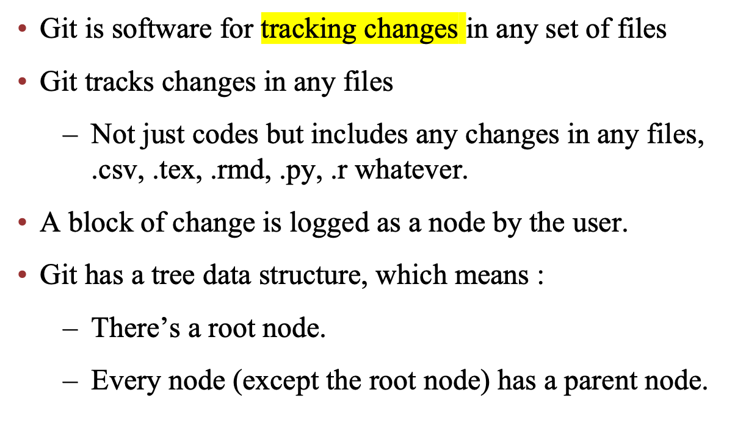
What is git?
Notes:
Show sum changes in .csv, .tex, .rmd, .py, .r
Any local changes are automatically tracked

Slide 4
Unreadable changes: docx, ppt
Change of files which are simple collection of characters are readable
  Such as .tex, .r, .py, .csv, etc.
  Files can be read with “any” text editors
Change of files which can be only edited by certain programs, such as MS Words, PowerPoint, etc.
  Changes are not readable.
  But still make sense to use git to version control those files.

Slide 5
Benefit of using git
Git tracks any changes in any files automatically
Changes can be selectively logged as a meaningful block
  Every change is related to certain goal.
  One can log lines of changes under the same purpose with the description.
  Only a subset of entire changes can be grouped to be logged as a meaningful block.
Notes:
Change ducks to goose in paper.tex

Slide 6
Major Questions
Does public opinion become public policy?
How, if at all, does the force of public opinion enter into governance in America? – Stimson et al. (1995)
How to measure public opinion
Some studies of policy representation test hypotheses about the relationship between citizens’ views and elites’ positions on multiple issues by proceeding one issue at a time. Others summarize citizens’ and elites’ preferences with ideology scores and test hypotheses with these – Broockman (2016)

Slide 7
Does public opinion become public policy?
Modeling the prior knowledge on process of policy making
Two Mechanism of Dynamic Representation
1. Election changes government’s political composition, which is reflected in new policy
2. Policymaker’s calculation of future implication of current public opinion and act accordingly
(Stimson et al. , 1995)

Slide 8
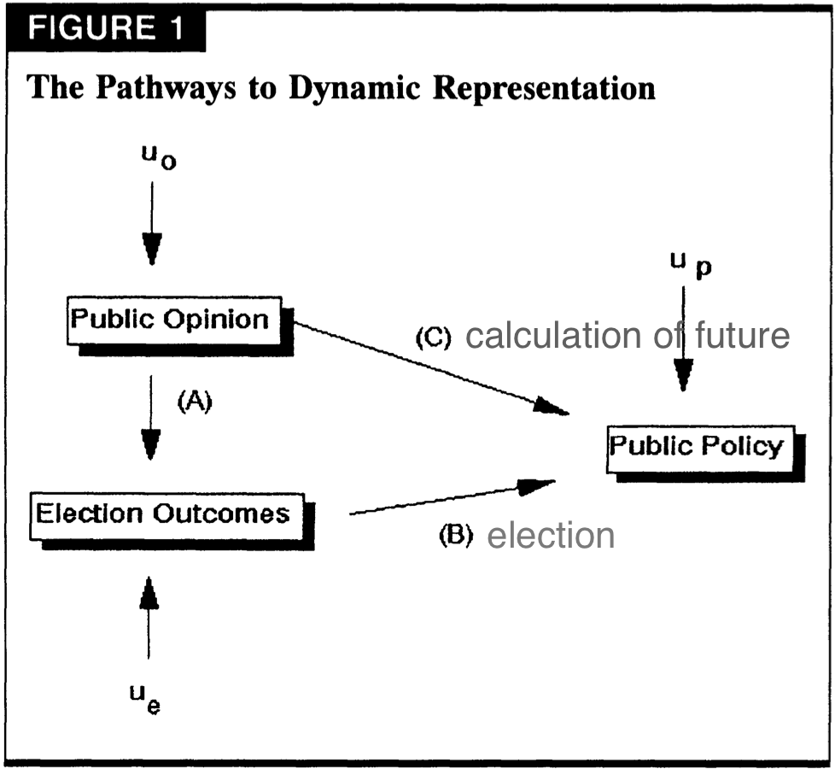
Does public opinion become public policy?
Two Mechanism of Dynamic Representation
1. Election changes government’s political composition, which is reflected in new policy ;(B)
2. Policymaker’s calculation of future implication of current public opinion and act accordingly ;(C)
(Stimson et al. , 1995)

Slide 9
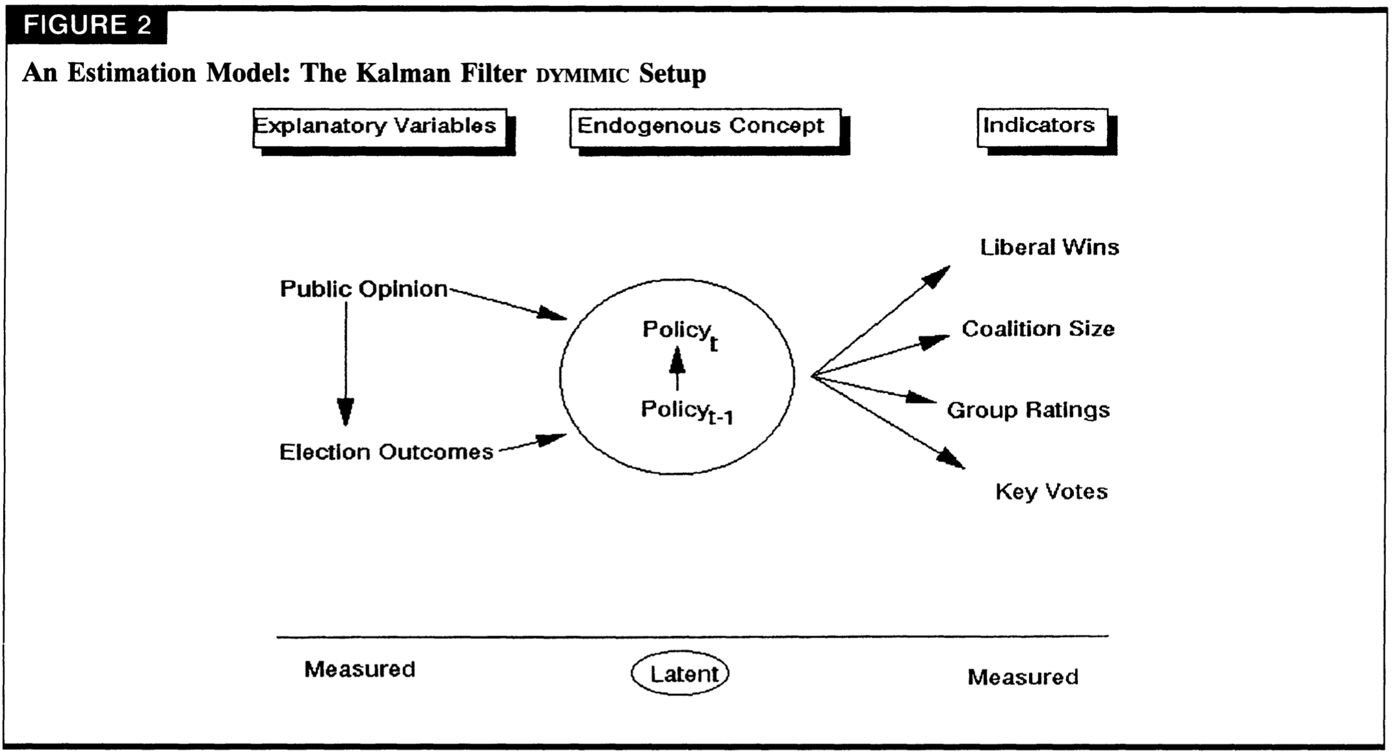
DYMIMIC : Dynamic Multiple-Indicator Multiple-Cause
(Stimson et al. , 1995)

Slide 10
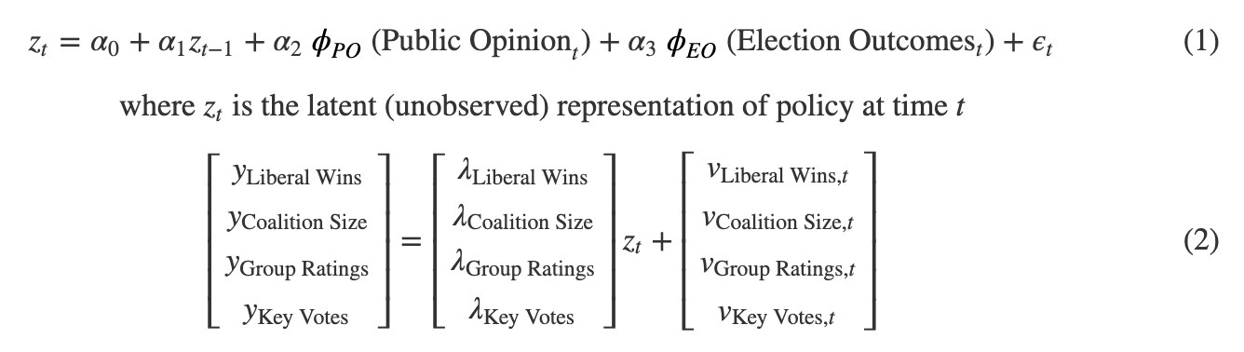
DYMIMIC: Dynamic Multiple-Indicator Multiple-Cause
  *formulation refers to (Quagrainie, 2003)

Slide 11
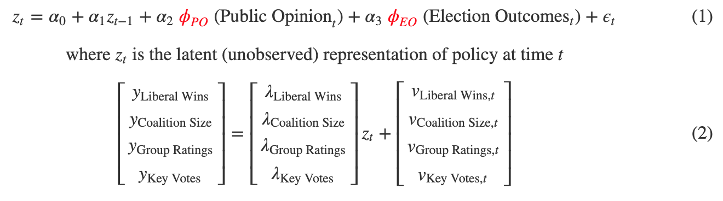
DYMIM: Dynamic Multiple-Indicator Multiple-Cause
  The way of defining ϕ is controversial

Slide 12
Measurement Issue
Stimson et al. (1995) and Herron (2010) uses ideological score to measure public opinion
Broockman (2016) refutes the use of ideological score to measure public opinion
Others summarize citizens’ and elites’ preferences with “ideology scores” and test hypotheses with these. I show that approach is flawed.

Slide 13
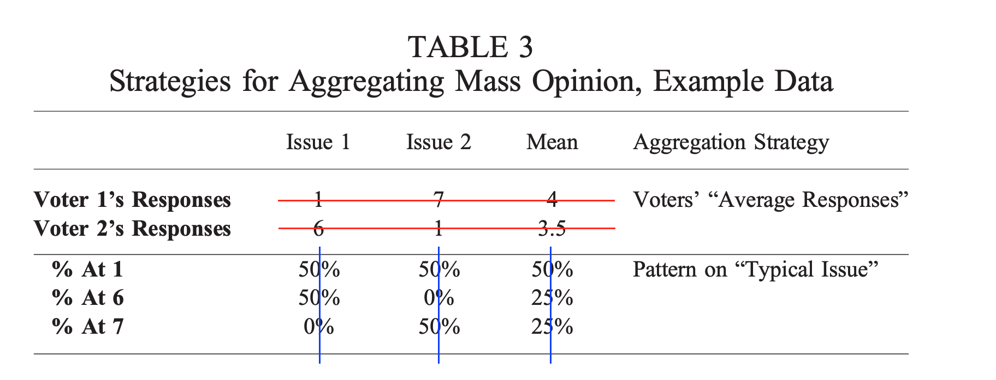


Measurement Issue
Broockman (2016) compares two different aggregation methods, which produce two opposite outputs about who’s more extreme between citizen and legislators.

Slide 14

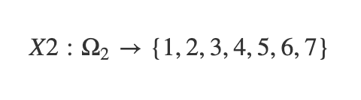
Measurement Issue
Broockman (2016) compares two different aggregation methods, which produce two opposite outputs about who’s more extreme between citizen and legislators.

Slide 15
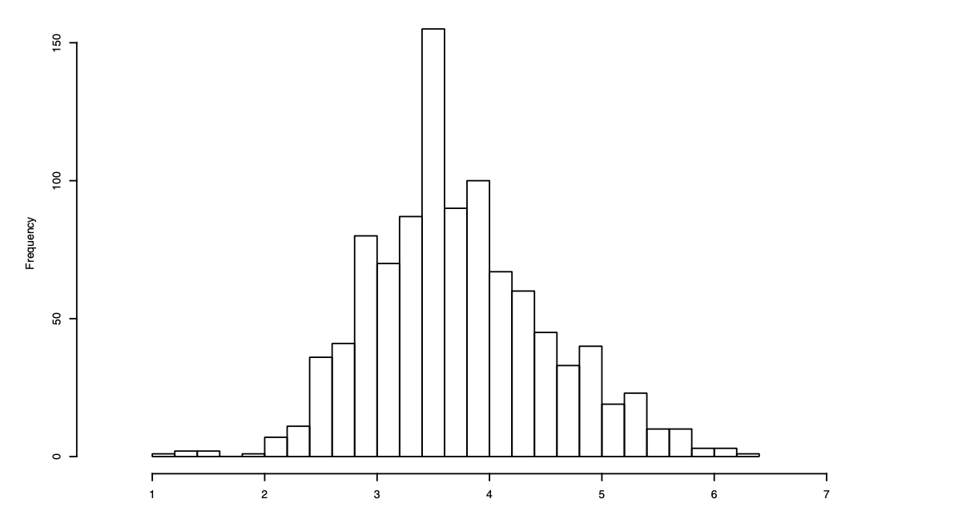
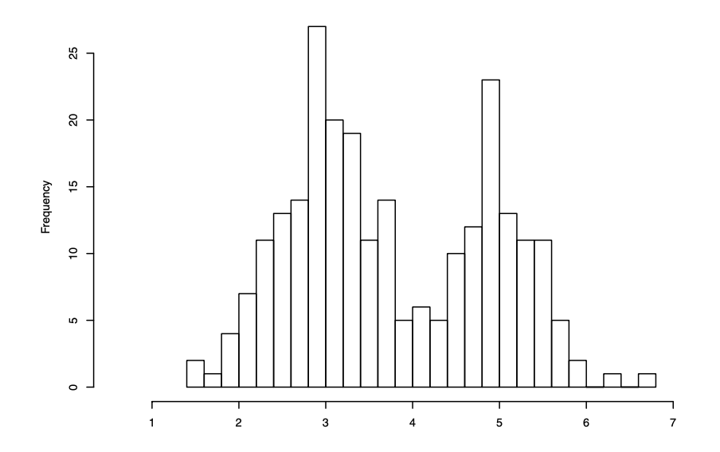
Measurement Issue
Broockman (2016) compares two different aggregation methods, which produce two opposite outputs about who’s more extreme between citizen and legislators.
citizens
legislators

Slide 16
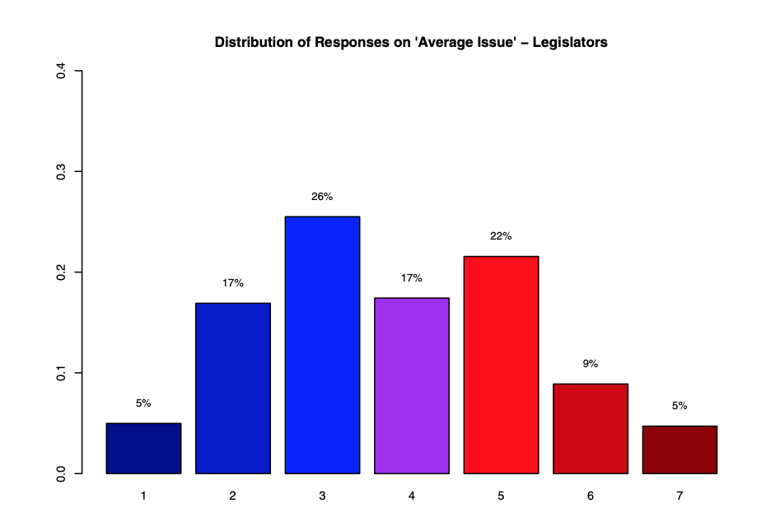
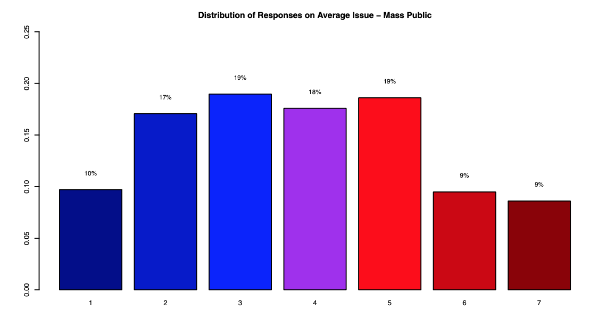
Measurement Issue
Broockman (2016) compares two different aggregation methods, which produce two opposite outputs about who’s more extreme between citizen and legislators.
citizens
legislators

Slide 17
Discussion
Is [Stimson et al.] still valid given that [Broockman]’s argument - using ideological score is flawed - is true?
Considering following two factors: legislators represent the donors’ preference more closely and donors are more extreme than other voters. If so, isn’t [Herron]’s finding – legislators are more extreme than voters - still valid?
[Stimson et al.] excludes causal relationship that public policy affects public opinion based on Granger analysis. But isn’t it self-contradictory to prior assumption that politicians calculate the future effect of policy change?

Slide 18
References
Pitkin, Hanna, 1967. The Concept of Representation, Los Angeles: University of Press.
Quagrainie, Kwamena K., et al. “A Latent Structure Approach to Measuring Reputation.” Southern Economic Journal, vol. 69, no. 4.
James Stimson, Michael Mackuen, and Robert S Erikson. Dynamic Representation.American Political Science Review, 89(3):543–565, 1995
David E. Broockman. Approaches to Studying Representation. Legislative Studies Quarterly, 41(February):181–215, 2016
Joseph Bafumi and Michael C Herron. Leapfrog representation and extremism: A study of American voters and their members in Congress. American Political Science Review, 104(03):519–542, 2010

