Slide 1
Introduction to Git/Github
Suyeol Yun, Nov 12, 2021
PML Workshop

Slide 2
What is git?
Suyeol Yun, October 12, 2021
MIT 17.200: American Political Behavior I

Slide 3
What is git?
Git is software for tracking changes in any set of files
Git tracks changes in “any” files
  Not just codes but any changes in any files, .csv, .tex, .rmd, .py, .r whatever.
A block of change is logged as a node by the user.
Git has a tree data structure:
  a root node.
  Every node (except the root node) has a parent node.
Notes:
Show how changes are tracked in .csv, .tex, .rmd, .py, .r in pml-git
Any local changes are automatically tracked

Slide 4
What is git?
also, Git is DAG
  Tree is acyclic graph.
  Since every node in Git tree has only one parent, thus it eventually becomes directed.
    Simply speaking, Git tree develops (branches) only in one direction – being away from the root node
Notes:
Show sum changes in .csv, .tex, .rmd, .py, .r
Any local changes are automatically tracked

Slide 5
Unreadable changes: docx, ppt
Change of files which are collection of characters/texts are readable (by git)
  Such as .tex, .r, .py, .csv, etc.
  Files that can be read with “any” text editors
Change of files which we can edit those using certain programs, such as MS Words, PowerPoint, etc.
  Changes are not readable by git.
  But still make sense to use git to version control those files.

Slide 6
Benefit of using git
Git tracks any changes in any files automatically
Changes can be selectively logged as a meaningful block
  Every change is related to certain goal.
  A subset of entire changes can be grouped and be logged together as a meaningful block.
One can change files to any status logged in previous nodes.
One can travel back and forth in git commit graph.
Notes:
Change ducks to goose in paper.tex

Slide 7
We use Github w/ git
What is Github?
Why use Github w/ git?

Slide 8
What is Github?
Github is a hosting service that we can upload our git tracked files to remote from local.
What is local/remote?
  Local refers to your own computer.
  Remote refers to a server that is managed by Github.
  It’s 24/7 accessible w/ url.
  We can up/download our git tracked files to/from Github.

Slide 9
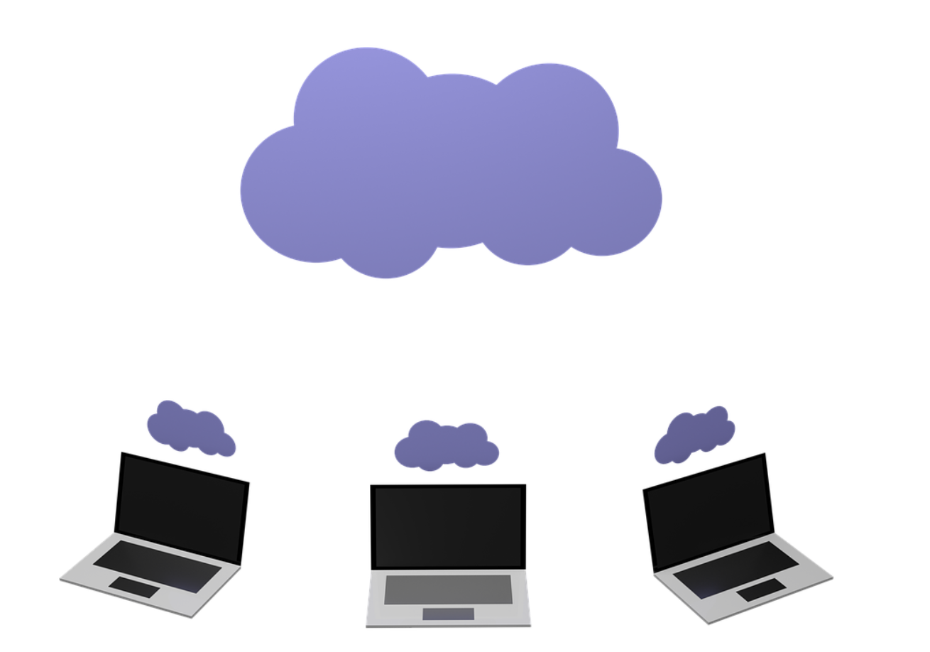
Why use Github (w/ git)?
Same reason as we’re using cloud services, such as google docs.
  24/7 accessible from any computer/machines
  Many people can collaborate in real time.

Slide 10
Check your setup
In terminal(MacOSX) or GitBash(windows) type in
  git version
Logged-in state of github account in chrome (or any default browser you use)
GitKraken is installed and logged-in w/ your github account.
Please let me know if you encounter any problem!
I also prepared virtual windows environment.

Slide 11
Let’s create a new repository
Go to github.com/username
  Click Respositories
  Click New
  Type in Repository name
  Initialize with README
    Initialize means creating a root node
    README is a markdown file that we can add notes about what this repository is about

Slide 12
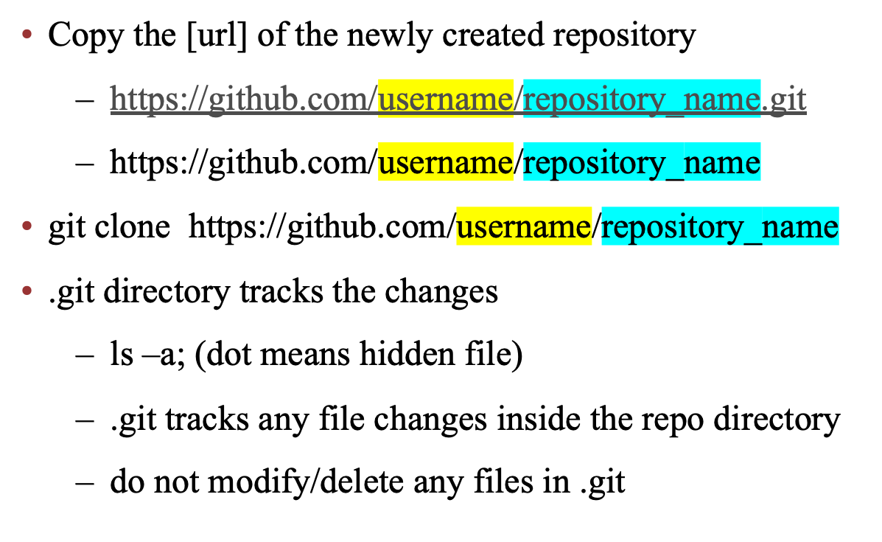
Now clone the repository to local

Slide 13
Useful commands to git clone
pwd: print where you are at now
ls: list files/directory in your current location
cd: change directory
  cd ..
  cd [directory name]
  use tab all the time to leverage auto-completion.
  cd ; location called “home”
  /Users/syyun (mac) ; /c/Users/syyun (windows)

Slide 14

.git works behind the scene
.git

Slide 15
Let’s use GUI
We did git clone in terminal/GitBash
Terminal/GitBash is CLI (Command Line Interface) environment
  CLI processes commands to a program in the form of lines of text.
GUI (Graphical user interface) is much more efficient to use git in terms of productivity.
  We use GitKraken this time, but there’re many other alternatives - Github Desktop, Sourcetree, etc.

Slide 16
Let’s open our cloned repository
We cloned repository from the remote
Repository exists in a form of directory, which contains .git directory in it.
Open GitKraken
Click Directory symbol
Open a Repository
Navigate to the location where you cloned the repository.
Click the directory and then open. (Do not double click!)

Slide 17
Let’s start writing something..
Open R studio
Create a new r file
Write down print(“hello world”)
Save the file with main.r
Go to GitKraken and check whether your changes tracked
  added a new file main.r
  added a new line print(“hello world”)

Slide 18
Let’s log this change..
We log changes in files to refer to those in the future
  It provides context about why/how the code/files has changed
  We can search/cherry-pick the certain changes in the future to perform similar task
Logging the changes in git consists of two-steps:
  Choose what to log as a block; staging
  Make a block; commit

Slide 19
Let’s stage and commit
Let’s stage our newly created main.R
Write down commit message describing the change:
  “create main.R”
  It’s highly recommended to write down your commit message short & clear
  Tip: Starting your commit message with verb usually makes your commit message neat and clean

Slide 20
Let’s go back and forth
Let’s stage our newly created main.R
Click the previous nodes and right click => checkout this commi
You can see HEAD is created.
  HEAD refers to the current commit you are viewing.
  Go back to R-studio whether your change is gone. (It should be gone because you are now in the previous stage)
  Now double click the main branch and come back

Slide 21
Commit makes hash block..
Each commit creates a hashed block
Hashed block contains information about which changes have been made (block = node = commit)
Hashed (value) is an address/identifier of that block
[Optional] git uses SHA-1 hash algorithm and generates fixed length of hash value for each commit block
  Something looks like: 8725e9449475289fb0bdae65282a87dd0d24b095 (40)
Every commit has a parent commit except root.

Slide 22
Review.. What is git?
Git has a tree data structure:
  a root node.
  Every node (except the root node) has a parent node.
also, Git is DAG
  Tree is acyclic graph.
  Since every node in Git tree has only one parent, thus it develops (branches) only in one direction – being away from the root node
Notes:
Show how changes are tracked in .csv, .tex, .rmd, .py, .r in pml-git
Any local changes are automatically tracked

Slide 23
Let’s push the commit
Push means you upload your code changes (represented in commit blocks) to remote repository.
Click push icon on the 2nd row of the GitKraken.
Go to your remote repository url and check whether your change is successfully uploaded.
Now you can git clone such changes at any other computers as well.

Slide 24
Collaboration w/ others using git
Git is a super powerful tool to work w/ others.
You can check which changes your colleague has made
You can create multiple “branches” where each branch is in charge of a distinguished task.
For example, a project can consist of
  Data collection
  Analysis
  Writing paper

Slide 25
Let’s collaborate
Our question: Is there any relationship between petal and sepal length?
Person A: Collect data
Person B: Writing code to analyze data
Person C: Write a paper
I need three volunteers to help me
  Good chance to make yourself learn by doing
How can people collaborate in the same repository?

Slide 26
Let’s collaborate
Our question: Is there any relationship between petal and sepal length?
Person A: Collect data
Person B: Writing code to analyze data
Person C: Write a paper
I need three volunteers to help me
How can people collaborate in the same repository?
  Invite as collaborator

Slide 27
Invite collaborators to your repo
Github repository url
Settings
Manage access
Add people
  - Type username/email of github account

Slide 28
Workflow of collaboration
Each collaborator (+ Everyone)
  git clone https://github.com/syyunn/iris
Person A creates a branch called “data-collection”
Person B creates a branch called “data-analysis”
  who can run R code in his/her local machine
Person C creates a branch called “paper”
  who can compile source .tex file local machine

Slide 29
How to create a new branch
At GitKraken
  Select a commit block that you want to create/start a branch
  Right click and Create branch here
  Enter branch name, e.g. “data-collection”

Slide 30
Person A: Collect Data
At GitKraken
  Select a commit block that you want to create/start a branch
  Right click and Create branch here
  Enter branch name, eg. “data-collection”
  Person A download iris.csv from
    https://gist.github.com/netj/8836201
    Then stage/commit/push

Slide 31
Apply change between branches
Are automatically tracked by GitKraken
  GitKraken query the server with certain interval(< 10sec) and keep updating the changes by others
  Let’s take changes in “data-collection” to “main” branch
  Use (git) merge
  (Git) merge is to join two or more development histories together

Slide 32
Apply change between branches
First, (git) checkout to the branch that you want to update changes from another branch
  branch “data-collection” => branch “main”
To checkout, simply double click the branch name
Sometimes it fails to switch branch because your changes are not logged yet, then simply use (git) stash
  Stash stores changes simply in local without stage/commit and roll back the code without such changes

Slide 33
Apply change between branches
First, (git) checkout to the branch that you want to update changes
  branch “data-collection” => branch “main”
To checkout, simply double click the branch name
Right click the branch you want to merge another branch’s change
then click Merge [branch A] into [branch B]
  Merge “data-collection” into “main”

Slide 34
Person B: Analyze Data
Similarly, let’s create a branch called “data-analysis”
  Write codes on lm(sepal ~ petal)
  Save lm_result.png
  Then commit/push

Slide 35
Person C: Writing a paper w/ .tex
Similarly, let’s create a branch called “paper”
  Merge the “data-analysis” branch which contains lm_result.png.
  Use the \includegraphic to include the plot merged from “data-analysis”
Let’s compile paper.tex file to produce our final output.

Slide 36
cf. Apply changes in same branch
Use git pull
Git pull is used to fetch and download content from a remote repository

Slide 37
Conflict between changes
Let’s suppose you are working on a file and you have some unpushed commit(s).
While you’re working, your collaborator has changed the same file, same region, and commit/pushed.
You are trying to push your code, then it should return a conflict error.
Conflict can occur not just for push, but happens when pull, merge.. whatever when an (unpushed) commit conflicts with another commit.
Notes:
This is because all pushed codes are pushed after such conflict is compromised.

Slide 38
Conflict between changes
This is a reason why we need to create branch when we collaborate
If each person works in different branch, it’s safe from conflict
Notes:
This is because all pushed codes are pushed after such conflict is compromised.

Slide 39
Use branch to modularize
We created three branches for different tasks.
It’s a good convention to create different branches for different tasks.
Regardless of you’re collaborating w/ others or not, it’s good to keep creating branches for different tasks.
Branched git tree help us to understand which separate jobs are running/has run in parallel for each task right now/before
Notes:
This is because all pushed codes are pushed after such conflict is compromised.

Slide 40
Use .gitignore
It’s highly recommended not to git track redundant files that are not necessary to replicate your/other’s work.
For example, you don’t have to git track .aux, .log, .synctex.gz which are created when you compile your .tex file.
Such files can be ignored using .gitignore
Git disregards any changes of files or directory listed in .gitignore.

Slide 41
Work w/ private repository
We’ve used public repository till now.
Let’s use private repository.
  To use private repository, you need personal access token
  This is very recent change of policy; Beginning August 13, 2021
  When you clone your repo in terminal, simply type your personal access token instead of password.

Slide 42
Personal Access Token
https://github.com/settings/tokens
Generate new token
Type Note “your_purpose_of_token”
Click repo checkbox
  This will grant the token to clone your private repository
Generate Token
Copy and Paste somewhere

Slide 43
Let’s create a private repo
Go to github.com/username
  Click Respositories
  Click New
  Type in Repository name/Check private
  Initialize with README
    Initialize means creating a root node
    README is a markdown file that we can add notes about what this repository is about

Slide 44
Let’s clone the private repo
git clone https://github.com/username/private
Type in username
Type in Personal Access Token for password instead of actual password for github logging-in password

Slide 45
Private repository w/ GitKraken
Let’s open up the cloned private repo using GitKraken
GitKraken requires $4.95/month to work with private repositories
But w/ github student developer pack account, you can use GitKraken pro for 2 years.
(I’m not affiliated with GitKraken;)

Slide 46
Private repository
You can also invite collaborators to your private repository as well.
  But it’s limited to 3 people w/o any payment.
  This discrimination between private/public repository is a basic of their business model.
    think of pricing when you go private.

Slide 47
Important Convention: Size Limit
Github is originally designed to manage code lines only.
  We run hash algorithm for every file/file changes to make commit block.
  This can be computationally burdensome if git tracked file size become large
Github has 100MB size limit per file.
Github has 5GB size limit per repo.
Still, it’s good to git track small sized files less than 100MB. (But recommend to only track < 20MB)

Slide 48
How to version control large files
Think of using Git LFS (Git large file system)
  Outside of today’s session scope
  Check https://git-lfs.github.com/
There is a field called “DataOps”
  This is about how to design pipeline from data collection, version control, preprocess and to feed data to model/analysis.
  Check https://dvc.org/

Slide 49
Github Issues
Github is remote place where people can gather and share information
  To collaborate, we often need a bulletin board where we can discuss, report errors/bugs, further directions, any collaboration related information.
  It’s highly recommended to use Github Issues for this purpose

Slide 50
Github Issues
https://github.com/username/repository_name/issues
One can refer commit message to specific issue board
Every issue has issue number
  #1, #2, #3…
  Write down your commit message containing those #N
  e.g. #1: collect more data
  This is useful features/conventions to use/follow

Slide 51
Let’s write down
https://github.com/username/repository_name/issues
One can refer a commit block to specific issue board
Every issue has issue number
  #1, #2, #3…
  Write down your commit message containing those #N
  e.g. #1: collect more data
  This is useful features/conventions to use/follow

Slide 52
Let’s create a issue
  https://github.com/username/new/issues
  Click new issues
  Title: refer commit to specific issue
  Body: test
  Go to R-studio and add a line to main.r;
  - print(“test referring commit block to issues”)
  Go to GitKraken and stage/commit and write down commit message as “#1: refer commit to issues.”

Slide 53
Github Issues
We eventually become to forget what we did previously with our codes/files..
But using this feature, we can trace back to what we’ve done following which direction/goals/discussions.
Many AI teams logs their experiment results in github issues.
There’re many unexpected findings when you collect/preprocess data, performing your analysis, etc. and those are related to your design of codes – so it’s good to relate your code w/ your findings/reasoning.
It supports markdown as well.

Slide 54
Wrap-up
Can you create a new repository in github?
Can you clone a new repository from github?
Can you make commit block grouping your changes?
Can you push your commit block to remote?
Can you create branch?
Can you merge another branches commits to your current branch?
Can you checkout to previous commit?
Can you resolve conflict?

Slide 55
A user of git should be..
Do not let others repeatedly do what you’ve done already.
Make your code/writing/whatever exportable and let others be able to just clone-and-go using git.
This handy manner of git enhances reproducibility of your code/experiment.
Many CS journals require to create anonymous github account/repo to upload their code to github.

Slide 56
Final comments
Take your time to learn-by-doing w/ your own code/tex
Try git to collaborate with your colleagues.
Teach others how to do git clone/commit/push/pull/merge/create branch/resolve conflict.

Slide 57
Thanks!
  End of prepared material.

