Slide 1


DreamOS
AI-Native Semantic File Management for the Desktop
PROJECT MONITORING - I
Zaid Ali Syed (2305139) | Om Vyas (2305170) | Krushna Kadam (2305165)
B.Tech Information Technology - IICT, MGM University

Slide 2



The Problem, and What We're Building
OUR OBJECTIVE
A REAL DESKTOP, TODAY
Search by meaning
final_final_v3.txt
Untitled document.txt
CV2.txt
backup_of_backup.txt
scan0007.txt
new_doc_2026_03_11.txt
Find files by what they're about, not what they're named.
Open by intent
"Open my resume" resolves and launches the right file directly.
Organize with AI
Nobody finds a file by its name anymore - they remember what it's about.
Auto-categorize a messy vault - safely, and fully reversibly.
Selected from three proposed directions (Cognitive Spectre / DreamOS / SentinelLLM) - proposal deck, slides 7-10.

Slide 3
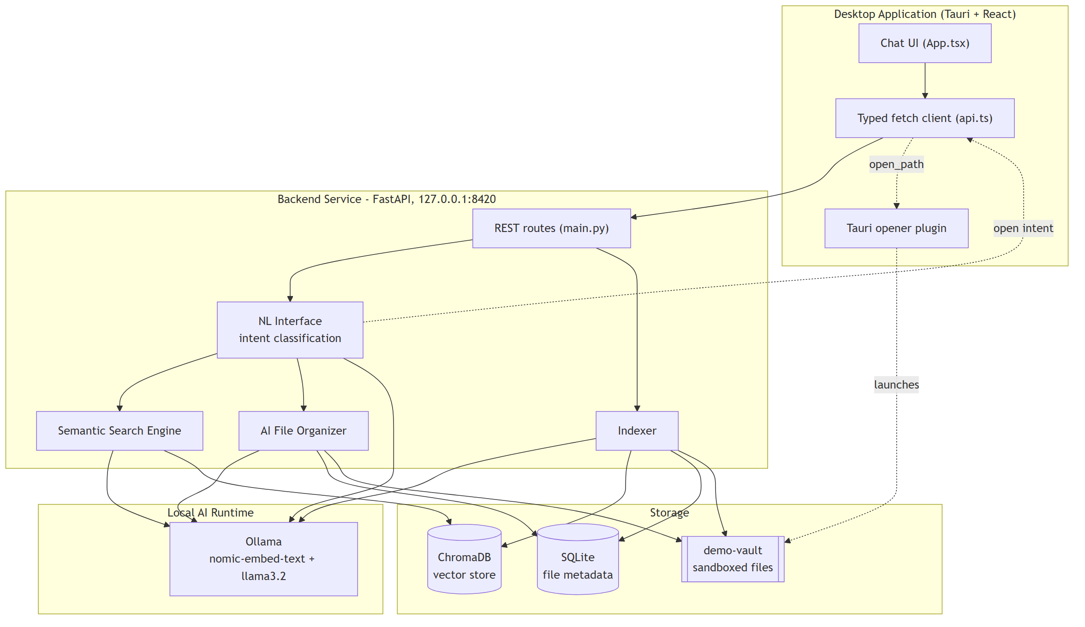




System Architecture
TECH STACK
Desktop shell
Tauri + React
Backend service
FastAPI (Python)
Storage
SQLite metadata + ChromaDB vectors
Local AI runtime
Ollama - nomic-embed-text, llama3.2
No cloud calls, no API keys - everything runs on-device.

Slide 4


Where We Stand at Monitoring - I
50%
~20%
21 / 21 backend tests passing
Fully offline - embeddings & LLM mocked in tests
Packaged as a real Windows installer (MSI + NSIS)
of module scope built, tested, and packaged
is what these guidelines expect at this checkpoint
BUILT & TESTED
PLANNED - MONITORING II / III
Natural Language Interface - routes search / open / organize
Semantic Search Engine - vector similarity, tuned threshold
AI File Organizer - categorize, apply, reversible revert
Knowledge Graph - file relationship graph
Context Memory Engine - session-aware retrieval
Intelligent Workspace Manager

Slide 5
Today's Demo, and What's Next
LIVE TODAY
ROADMAP
Semantic search
II
Monitoring - II (~80%)
"find something about a meeting" - no filename match needed
Knowledge Graph + Context Memory Engine; begin Intelligent Workspace Manager
Open by intent
"open my resume" - resolves and launches the right file
III
Monitoring - III (100%)
Finish Intelligent Workspace Manager; full testing; final report & submission
AI organizer + revert
Categorize the vault, apply, then reverse it cleanly
3 of 6 proposed modules shipped and verified - ahead of schedule, with an honest plan for the rest.

