Slide 1
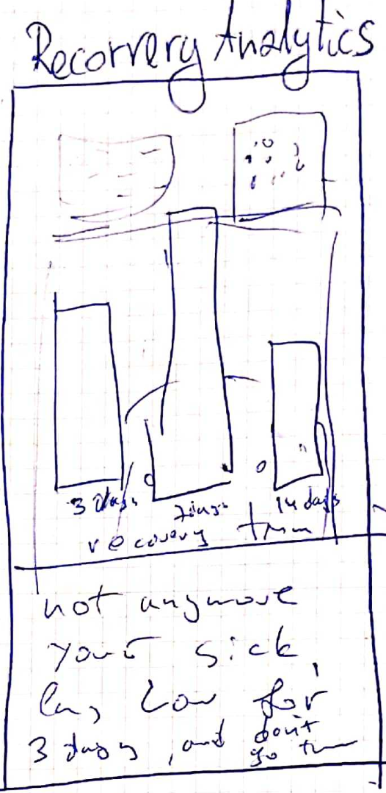




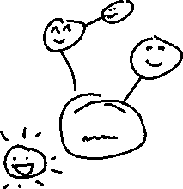

Of people in your area take
a flu shot before an outbreak
Is the efficienty of the vaccine
for an average person
Decrease in productivity due to flu through the year:
Your network seems to be mostly heathy.
Don’t spread the flu, get your shot!
Lukasz, consider
staying home!
Lukasz, consider
staying home!

