Slide 1
DATA SCIENCE Model Evaluation Procedures

Slide 2
Training Error vs Test Error
Training error
Training error is the error over the training sample (when we train and test on the same dataset)
Test error is the error over an independent test sample
We use the test error to estimate the model’s use but training error is not a good estimator for test error

Slide 3
Training error
Q: What’s wrong with training error?
Thought experiment:
Suppose we train our model using the entire dataset.
Q: How low can we push the training error?
We can make the model arbitrarily complex (effectively
“memorizing” the entire training set).
A: Down to zero!

Slide 4

Training error
Q: What’s wrong with training error?
Thought experiment:
Suppose we train our model using the entire dataset.
Q: How low can we push the training error?
We can make the model arbitrarily complex (effectively
“memorizing” the entire training set).
A: Down to zero!
This phenomenon
is called
overfitting.

Slide 5
Training error
Q: What’s wrong with training error?
Thought experiment:
Suppose we train our model using the entire dataset.
Q: How low can we push the training error?
We can make the model arbitrarily complex (effectively
“memorizing” the entire training set).
A: Down to zero!
This phenomenon
is called
overfitting.

Slide 6
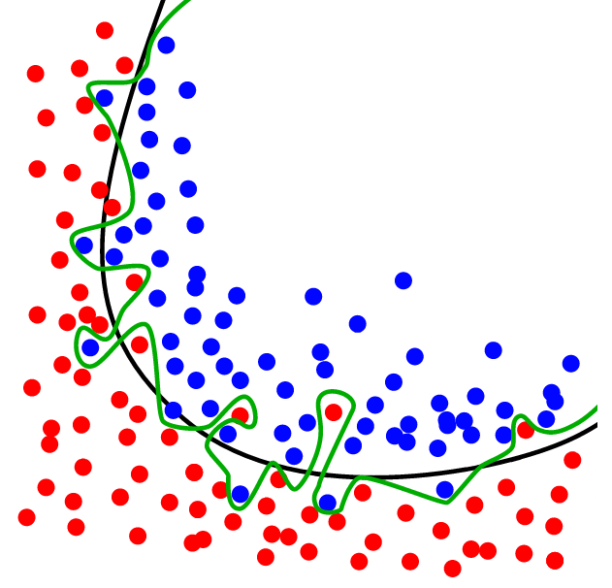
Overfitting
The black line gets a good “sense” of the shape of the data
The green line is overfit, its trying too hard
Source: http://www.dtreg.com

Slide 7
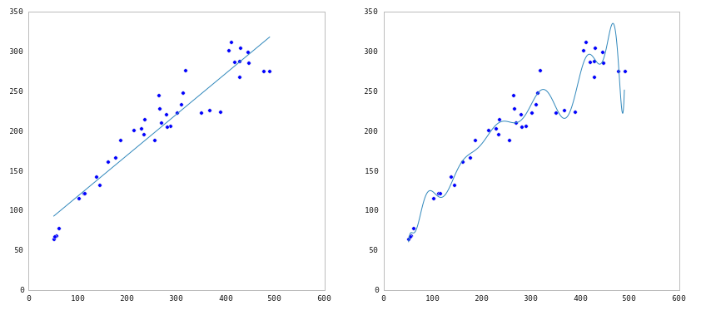
Underfitting and Overfitting
Source: http://nbviewer.ipython.org/github/fonnesbeck/Bios366/blob/master/notebooks/Section6_3-Model-Selection-and-Validation.ipynb

Slide 8
Training error
Q: What’s wrong with training error?
Thought experiment:
Suppose we train our model using the entire dataset.
Q: How low can we push the training error?
We can make the model arbitrarily complex (effectively
“memorizing” the entire training set).
A: Down to zero!

Slide 9
Training error
Q: What’s wrong with training error?
Thought experiment:
Suppose we train our model using the entire dataset.
Q: How low can we push the training error?
We can make the model arbitrarily complex (effectively
“memorizing” the entire training set).
A: Down to zero!
A: Training error is not a good estimate of
accuracy beyond training data.

Slide 10
Why this matters
Training error
The data that we are given for prediction won’t always be the end of the data stream!
We will gather data and build and iterate over models however the whole point of building the model was to predict unseen test cases
Examples: new UFO sightings will come in, new Iris’ will be found, new children will be born

Slide 11

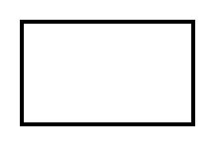
Test Set Approach
Q: How can we make a model that generalizes well?
model
dataset

Slide 12
Test Set Approach
Q: How can we make a model that generalizes well?
1) split dataset
model
dataset

Slide 13

Test Set Approach
Q: How can we make a model that generalizes well?
1) split dataset
2) train model
training set
model
dataset

Slide 14
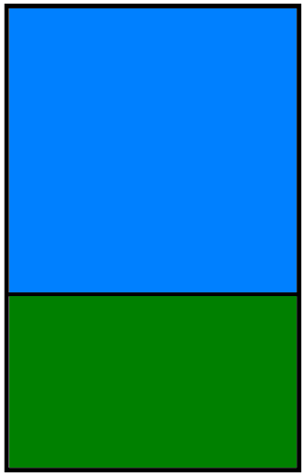
Test Set Approach
Q: How can we make a model that generalizes well?
1) split dataset
2) train model
3) test model
training set
model
test set
dataset

Slide 15
Test Set Approach
Q: How can we make a model that generalizes well?
1) split dataset
2) train model
3) test model
4) parameter
tuning
training set
model
test set
dataset

Slide 16
Test Set Approach
Q: How can we make a model that generalizes well?
1) split dataset
2) train model
3) test model
4) parameter
tuning
5) choose best
model
training set
model
test set
dataset

Slide 17
Test Set Approach
Q: How can we make a model that generalizes well?
1) split dataset
2) train model
3) test model
4) parameter
tuning
5) choose best
model
6) train on all data
training set
model
test set
dataset

Slide 18

Test Set Approach
Q: How can we make a model that generalizes well?
1) split dataset
2) train model
3) test model
4) parameter
tuning
5) choose best
model
6) train on all data
7) make predictions
training set
model
test set
new data
dataset
on new data

Slide 19
Test Set Approach
Q: How can we make a model that generalizes well?
1) split dataset
2) train model
3) test model
4) parameter
tuning
5) choose best
model
6) train on all data
7) make predictions
NOTE
This new data is called out of sample data. We don’t know the labels for these OOS records!
We want to estimate OOS prediction error so we know what to expect from our model.
training set
model
test set
new data
dataset
on new data

Slide 20
Test Set error
Suppose we do the train/test split.
Q: How well does test set error predict OOS?
Thought experiment:
Suppose we had done a different train/test split.
Q: Would the test set error remain the same?
A: Of course not!

Slide 21
Test Set error
Suppose we do the train/test split.
Q: How well does test set error predict OOS?
Thought experiment:
Suppose we had done a different train/test split.
Q: Would the test set error remain the same?
A: Of course not!
A: On its own, not very well.

Slide 22
Test Set error
Suppose we do the train/test split.
Q: How well does test set error predict OOS?
Thought experiment:
Suppose we had done a different train/test split.
Q: Would the test set error remain the same?
A: Of course not!
A: On its own, not very well.
NOTE
The test set error gives a high-variance estimate of OOS accuracy.

Slide 23
Test Set error
Something is still missing!
Q: How can we do better?
Thought experiment:
Different train/test splits will give us different test set errors.
Q: What if we did a bunch of these and took the average?
A: Now you’re talking!
A: Cross-validation.

Slide 24
Cross-validation
Steps for K-fold cross-validation:
1) Randomly split the dataset into K equal partitions.
Use partition 1 as test set & union of other partitions
as training set.
3) Calculate test set error.
Repeat steps 2-3 using a different partition as the test set
at each iteration.
5) Take the average test set error as the estimate of OOS accuracy.

Slide 25
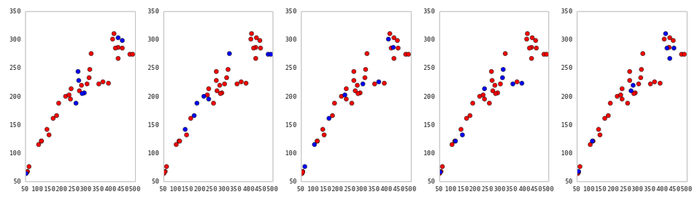
Cross-Validation
5-fold cross-validation: red = training folds, blue = test fold
Source: http://nbviewer.ipython.org/github/fonnesbeck/Bios366/blob/master/notebooks/Section6_3-Model-Selection-and-Validation.ipynb

Slide 26
Cross-validation
Features of K-fold cross-validation:
More accurate estimate of OOS prediction error.
2) More efficient use of data than single train/test split.
- Each record in our dataset is used for both training and testing.
Presents tradeoff between efficiency an computational expense.
- 10-fold CV is 10x more expensive than a single train/test split
4) Can be used for parameter tuning and model selection.

Slide 27
DATA SCIENCE

