Slide 1
DATA SCIENCE Confusion Matrix

Slide 2
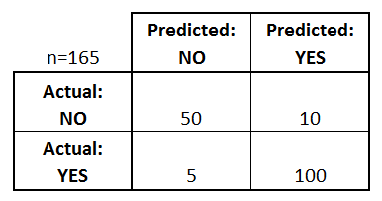
Confusion Matrix
Confusion Matrix: table to describe the performance of a classifier
How many classes are there?
How many patients?
How many times is disease predicted?
How many patients actually have the disease?
Example: Test for presence of disease
NO = negative test = False = 0
YES = positive test = True = 1

Slide 3
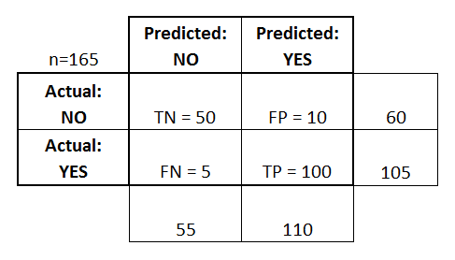
Confusion Matrix
Basic Terminology:
True Positives (TP)
True Negatives (TN)
False Positives (FP)
False Negatives (FN)
Misclassification Rate (Error Rate):
Overall, how often is it wrong?
(FP + FN) / total = 15/165 = 0.09
Accuracy:
Overall, how often is it correct?
(TP + TN) / total = 150/165 = 0.91

Slide 4
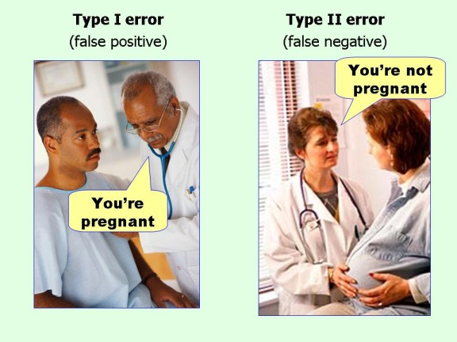
Confusion Matrix

Slide 5
Confusion Matrix
Sensitivity:
When actual value is positive, how often is prediction correct?
TP / actual yes = 100/105 = 0.95
“True Positive Rate” or “Recall”
Precision:
When the predicted value is positive, how often is prediction correct?
TP / predicted yes = 100/110 = 0.91
False Positive Rate:
When actual value is negative, how often is prediction wrong?
FP / actual no = 10/60 = 0.17
Specificity:
When actual value is negative, how often is prediction correct?
TN / actual no = 50/60 = 0.83

