Slide 1
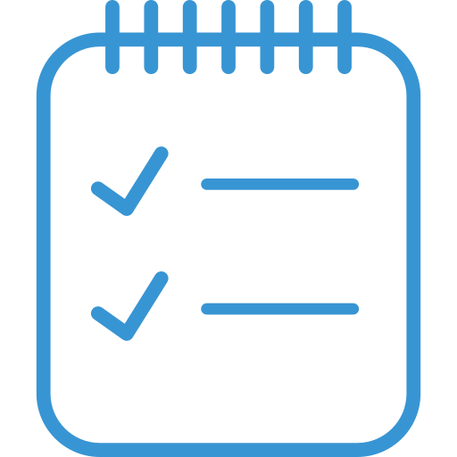
TO-DO LIST

Slide 2
PRESENTATION OUTLINE
Introduction
Objective
Requirement
Technology used
Screen Shots
Features & Design
Conclusion
References

Slide 3
INTRODUCTION
At their most basic, TO-DO LIST contain all of the tasks that you need to complete on a given day. It’s a great app for managing time that enables you to lay out everything that you need to accomplish and plan and prioritize your day from there. You can also make to-dos for major tasks like a work assignment or an overall goal.
Therefore, the overall purpose of creating a to-do is to remember tasks and create a plan of action to accomplish them.
What can you do with it?
For the most part, to-dos are used to follow daily tasks, but you can also use them for larger projects like planning a party. Longer-term to-dos allow you to break major tasks into smaller chunks that are easier to accomplish and allow you to visualize every step you need to take to attain your goal. To-dos are incredibly versatile as they serve the general purpose of laying out tasks that you need to accomplish.

Slide 4
OBJECTIVE
The main purpose of a to-do is to help organize tasks, so it will benefit you by improving your time management abilities and decreasing your stress levels .
A to-do allows you to better manage your time by allowing you to lay out what you need to accomplish and then coordinate your time from there. When you first compose it, you’ll note the most important tasks and make time for them. You can also see if certain tasks can be easily coordinated. For example, if you have a business lunch near a store that you need to go to, you can plan to accomplish both on the same run.
Keeping organized with to-dos can reduce stress in three primary ways:
Reducing forgetfulness - If you write something down on a to-do, you’re less likely to forget about it since you’ll have it in front of you and the act of adding it cements it in your memory.
Breaking tasks down - Major tasks can be overwhelming, but if you break them down into smaller, manageable chunks, they can seem much less daunting. Breaking tasks down also enables you to more effectively and easily plan and set intermittent deadlines to ensure that you complete everything in time.
Feeling productive -The act of writing out a to-do itself can give you a sense of accomplishment, giving you a boost in motivation that will help you complete your to-dos. Additionally, as you tick off items, you will be able to clearly see your progress and feel a sense of accomplishment as you move forward, which helps to relieve your stress.

Slide 5
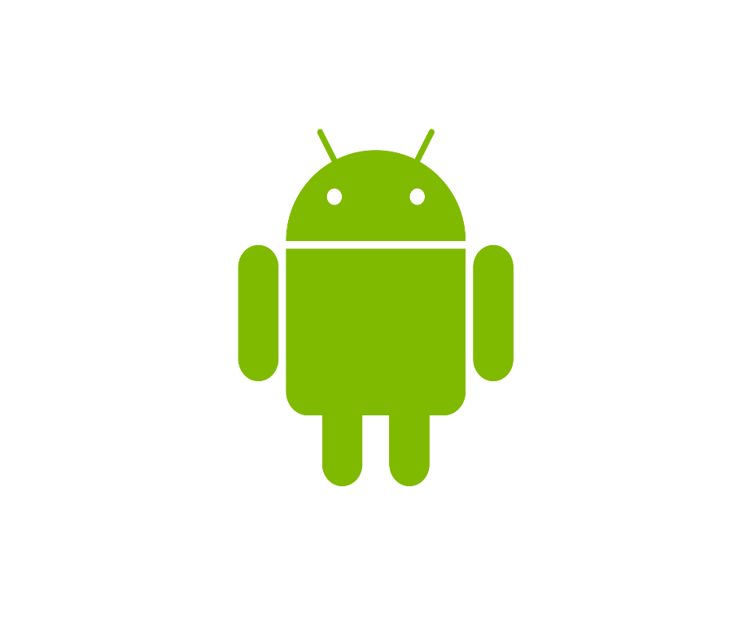
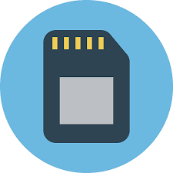
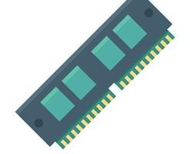
SYSTEM REQUIREMENT
ANDRIOD >= 4.4
RAM >= 1GB
STORAGE >= 3MB

Slide 6

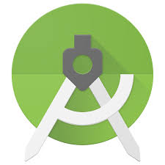
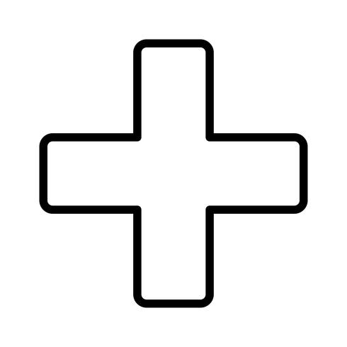
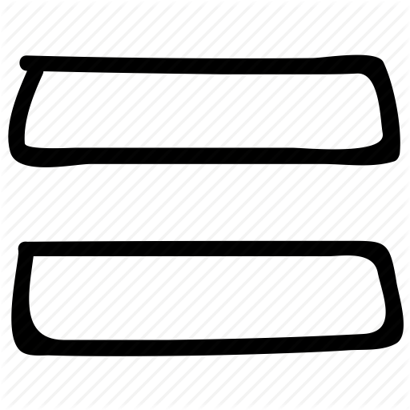
TECHNOLOGY USED
KOTLIN
ANDROID STUDIO
TO-DO LIST

Slide 7
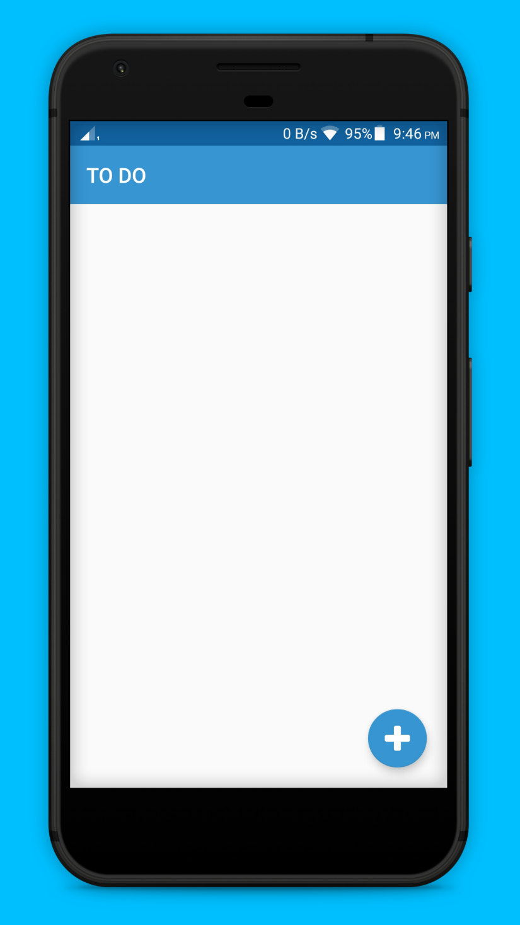
Organize Life
EASILY
Life can feel overwhelming, but it doesn’t have to.
To do List lets you keep track of everything in one place, so you can get it all done and enjoy more peace of mind along the way.

Slide 8
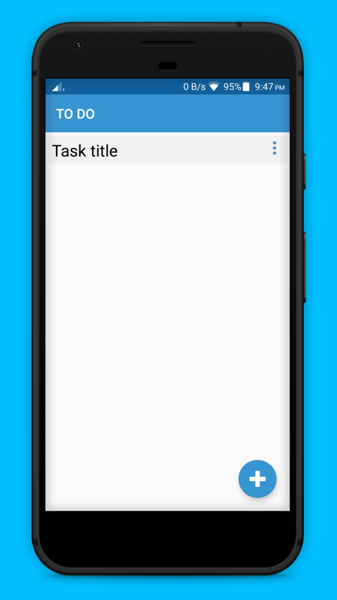
NEVER WORRY ABOUT FORGETTING THINGS AGAIN
Let To do list remember it all for you. You can get tasks out of your head and onto your to-do list anytime, anywhere, on your device

Slide 9
DESIGN

Slide 10
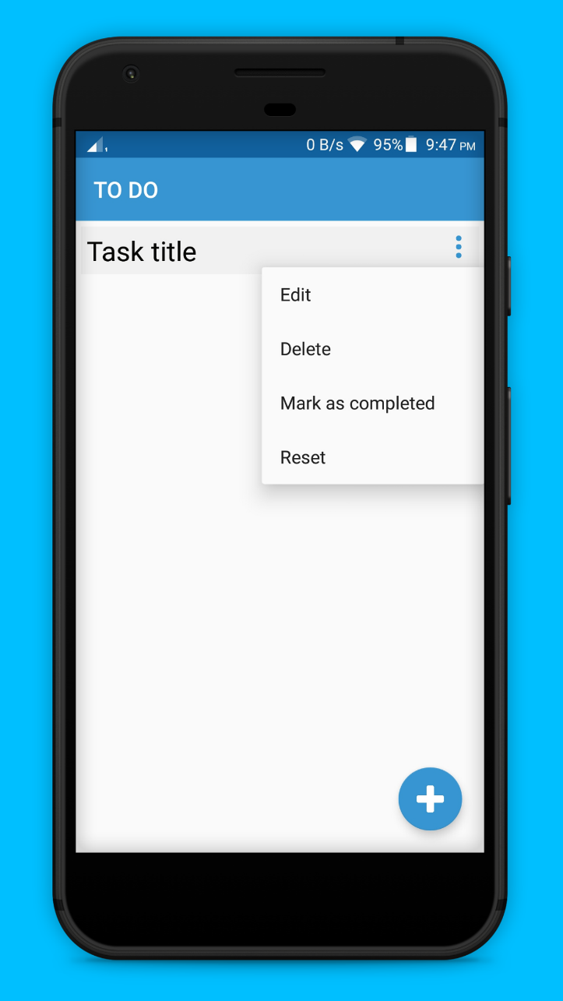
Menu button for additional options
Edit your task title
Delete your task
Mark your task as completed
Reset your progress
Floating button to add new task

Slide 11

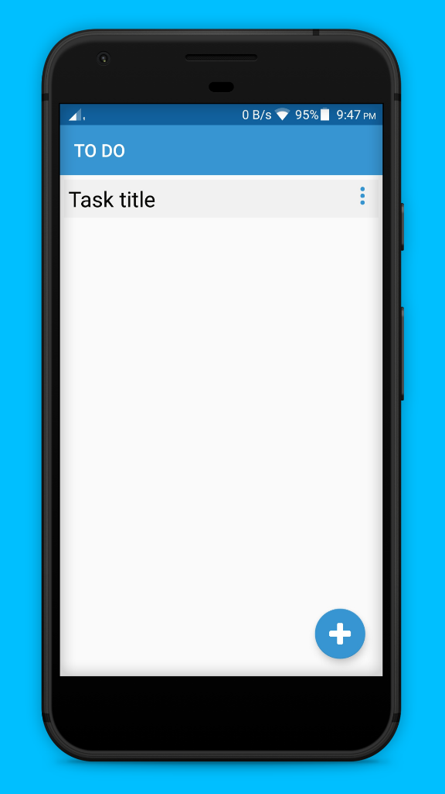

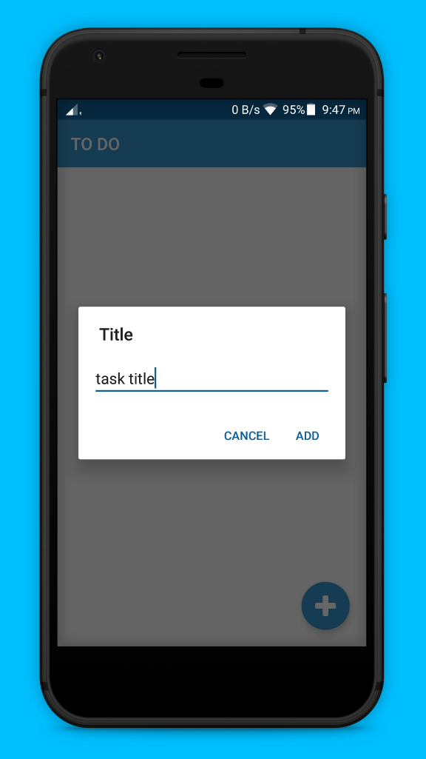


Slide 12
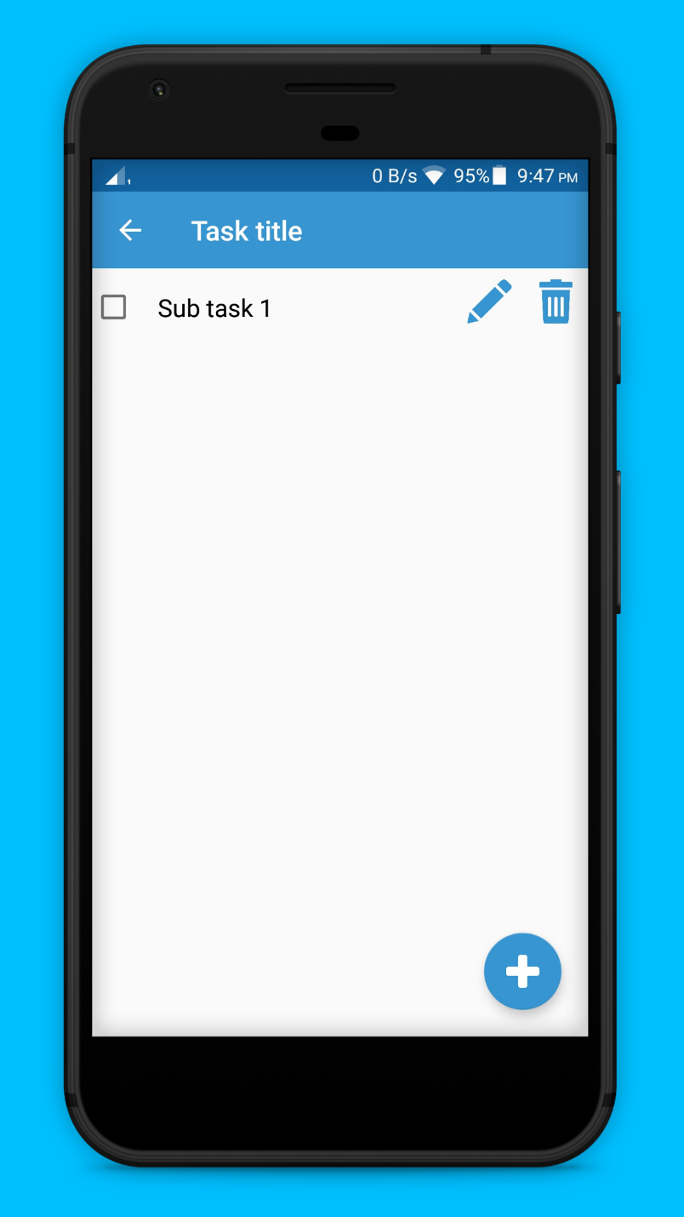
RUN YOUR LIFE LIKE A
PRO
Organize all your to-do’s in lists and projects. Boost your productivity subtasks.
Make tasks more manageable Break tasks down into simple steps to keep you on track.

Slide 13
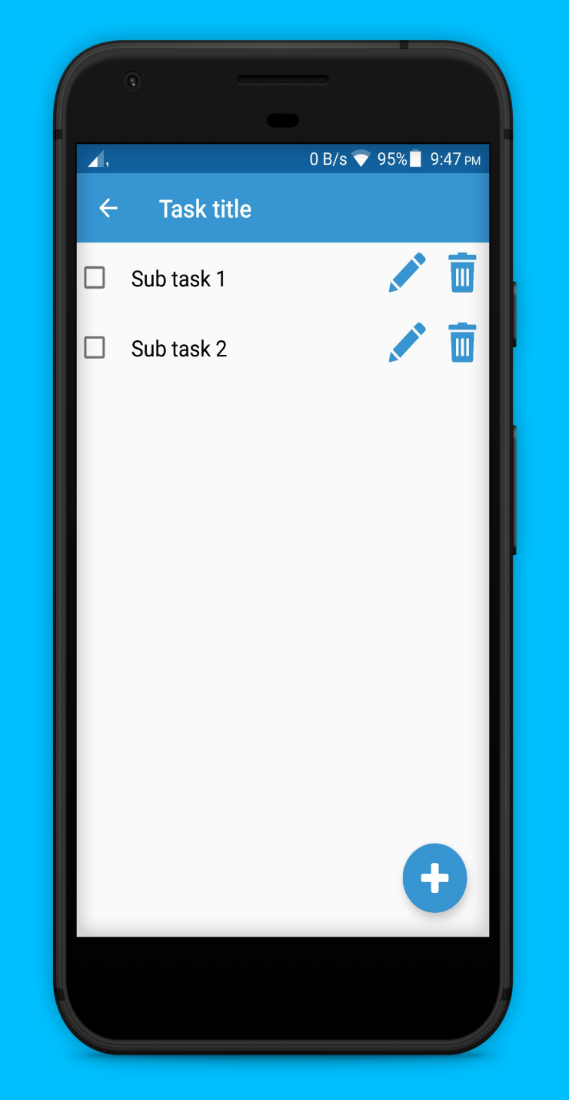
DIVIDE AND
CONQUER
Make Tasks More Manageable

Slide 14
DESIGN

Slide 15
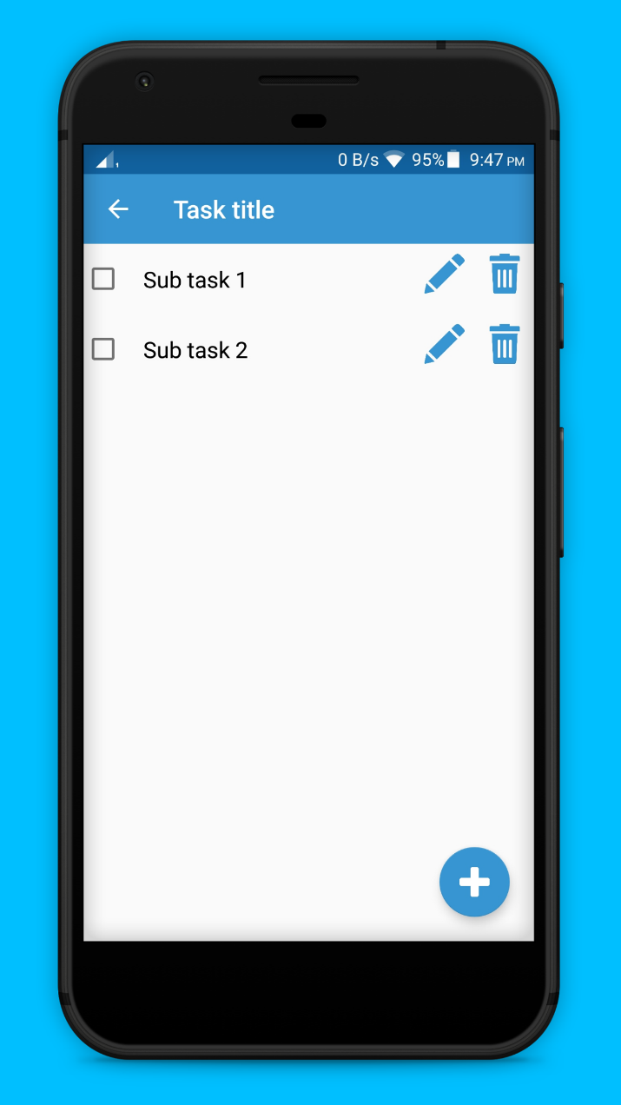
Delete subtask
To complete subtask
Edit title of subtask
Floating button to add new subtask

Slide 16

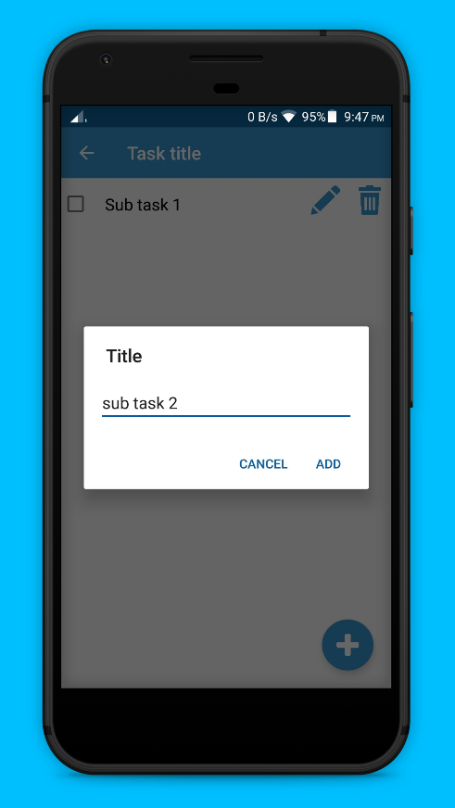

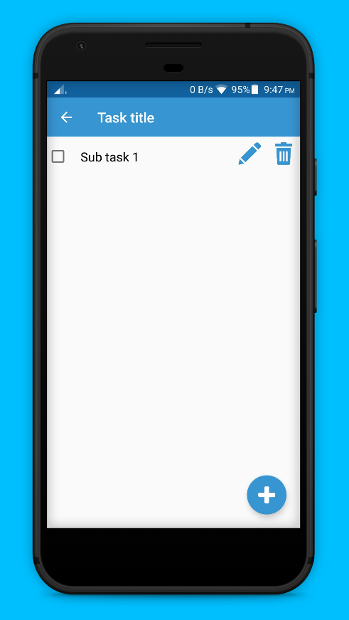


Slide 17

CONCLUSION
Smart daily planning
Anywhere you are
Increase productivity
Accomplish what’s meaningful to you each day with My Day, intelligent and personalized suggestions to update your daily to-do list.
Quickly capture and retrieve your lists and tasks on your devices to help you stay organized at work, home, or on the go.
Whether you want to increase your productivity, decrease your stress levels, or just free up some mental space, To Do makes it easy to plan your day and manage your life.

Slide 18
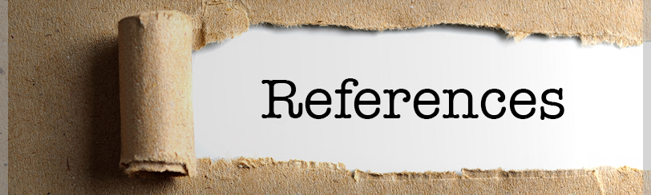
REFERENCES
https://developer.android.com/kotlin
https://www.youtube.com
https://www.udemy.com
https://stackoverflow.com

Slide 19

THANKS!

