Slide 1
NYCU DL Lab1 - Backpropagation
TA 陳敬中 Bill
Mar. 4, 2025

Slide 2
Outline
Lab Description
Scoring Criteria
Time Schedule

Slide 3
Lab Description
Implement a simple neural network with two hidden layers
Perform backpropagation to update model weights
You can only use Numpy and other python standard libraries.
Pytorch, TensorFlow, … frameworks are NOT allowed in this lab
Visualization
Plot comparison figures showing the predictions and ground truth.
Plot your learning curve (loss vs. epoch).
Print the accuracy of your prediction.
You are allowed to use matplotlib

Slide 4
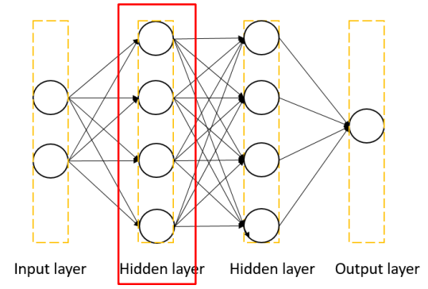
Lab Description
Each layer should contain
At least one transformation (e.g., Linear, CNN, …)
One activation function (e.g., sigmoid, tanh, relu, …)

Slide 5
Lab Description – Flowchart
Prepare data
Create model
Forward pass
Repeat n times or until convergence
Training
Backward pass
Update weights

Slide 6
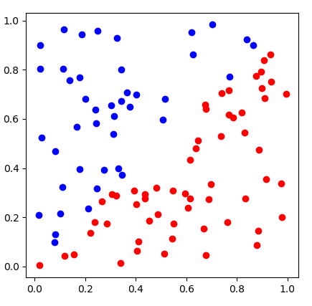
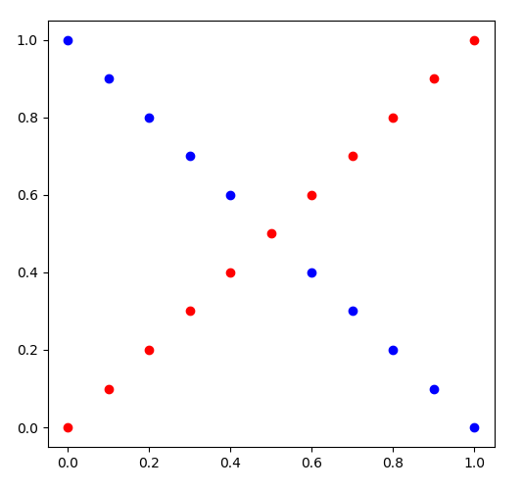
Lab Description - Data
generate_linear()
generate_XOR_easy()

Slide 7

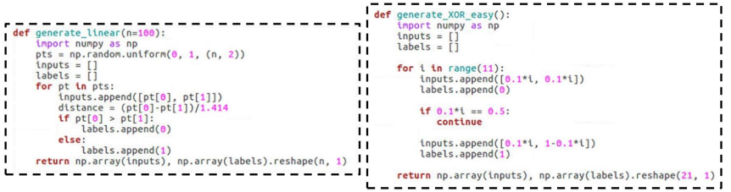
Data Generation
Do NOT overwrite these functions
Training and Testing with the same data

Slide 8
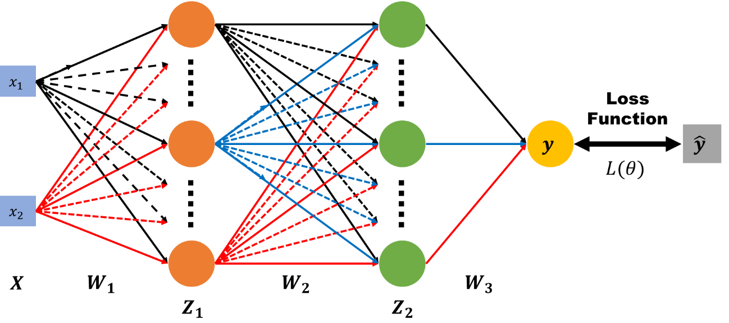
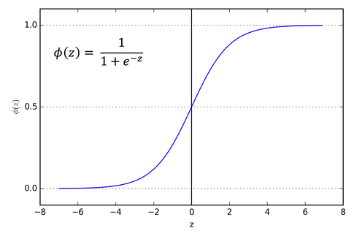
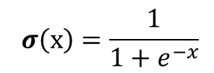
Lab Description – Forward

Slide 9









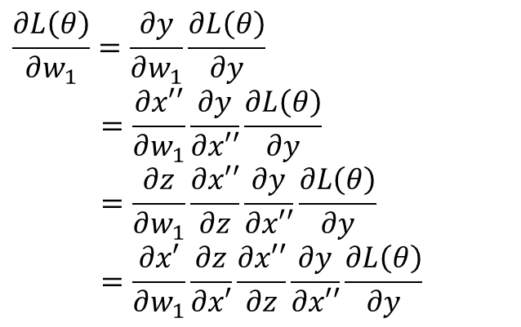

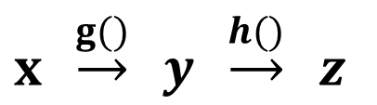
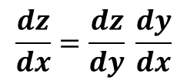
Lab Description – Backward
Chain rule

Slide 10

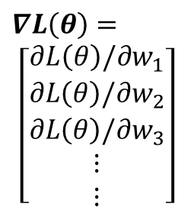
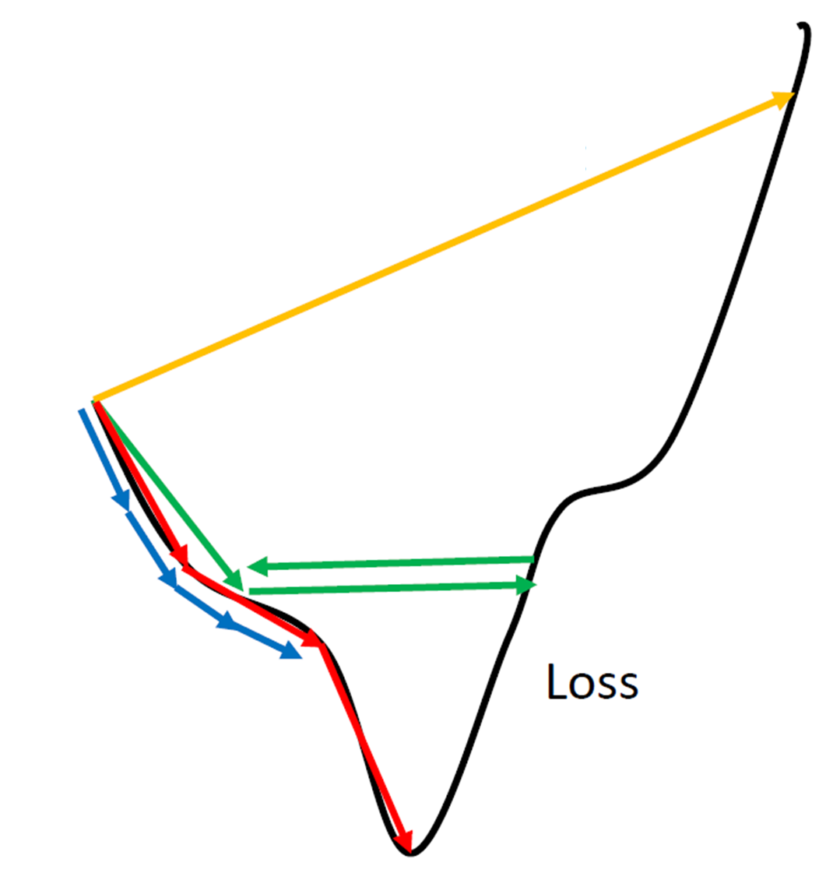








Lab Description – Gradient descent
Network Parameters
http://www.denizyuret.com/2015/03/alec-radfords-animations-for.html

Slide 11
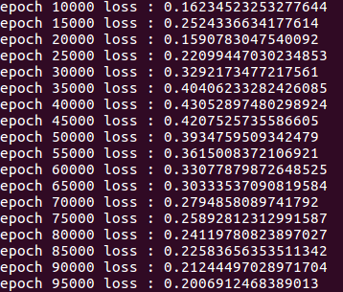
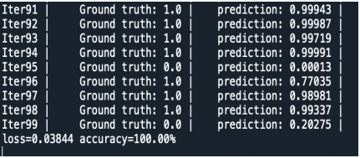
Lab Description - Prediction
During training, print the loss
During testing, show the predictions and the accuracy

Slide 12
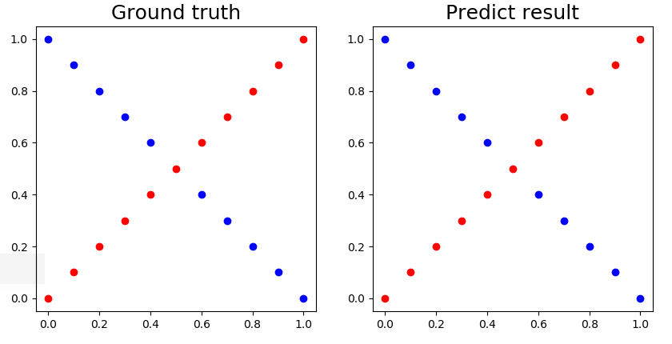
Lab Description - Prediction
Visualize the predictions and ground truth at the end of the training process

Slide 13
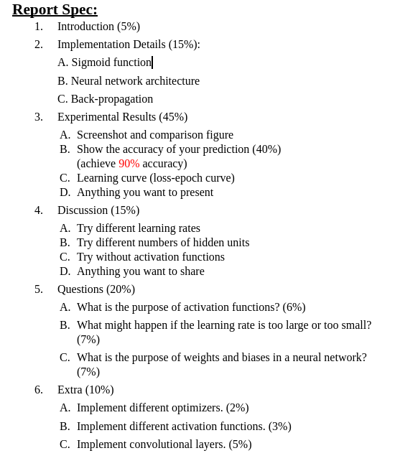
Scoring Criteria
Achieve 90% accuracy in testing to get 40% experimental results score

Slide 14
Important Date
Report Submission Deadline: 3/11 (Tue.) 23:59
Zip all files in one file
Report (report.pdf)
Source code
Name it like「DL_LAB1_yourstudentID_name.zip」
E.g., 「DL_LAB1_313551157_陳敬中.zip」
If there are any format errors in your files, you will receive a 5-point penalty

Slide 15
Reference
http://www.denizyuret.com/2015/03/alec-radfords-animations-for.html
http://speech.ee.ntu.edu.tw/~tlkagk/courses_ML17_2.html

Slide 16
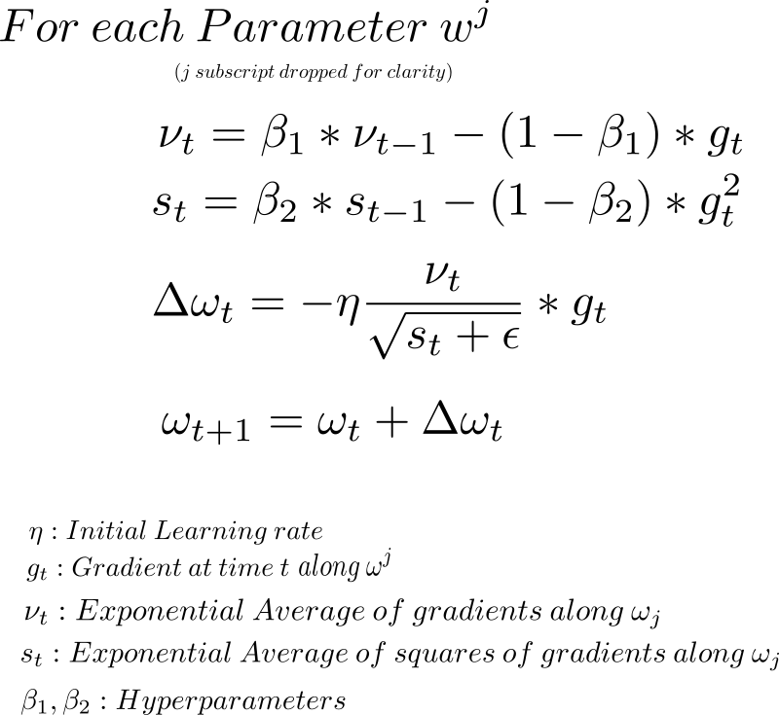
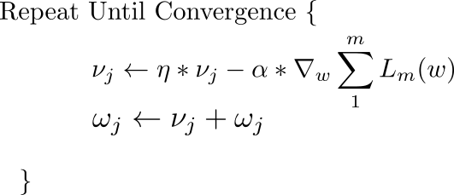
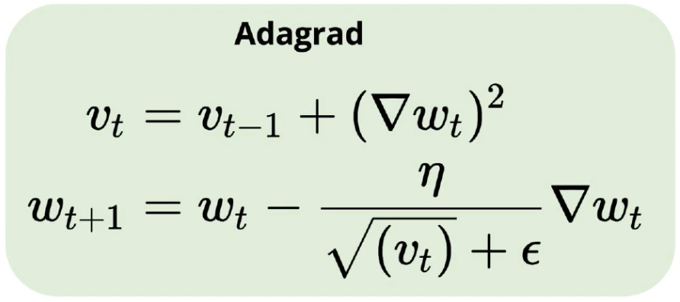
Optimizers
SGD – minibatch
Momentum
Adagrad
Adam

Slide 17
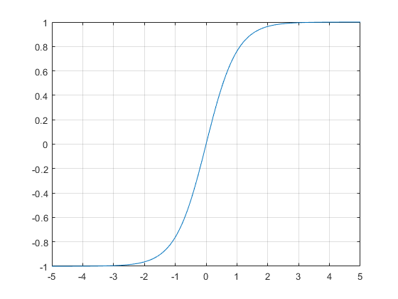
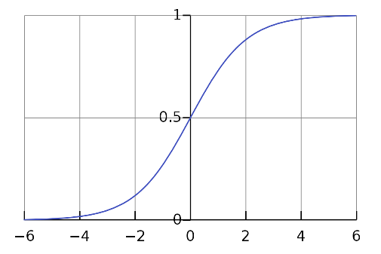
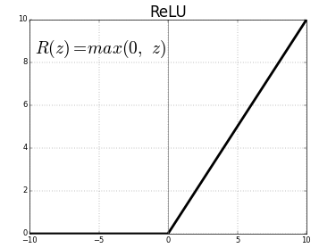
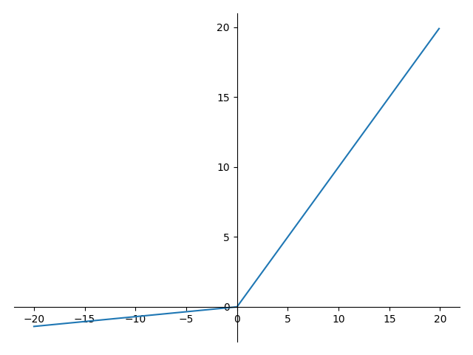
Activation functions
Sigmoid
Tanh
Relu
Leaky Relu

Slide 18
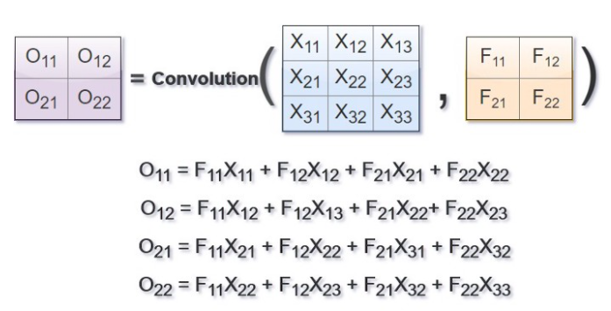
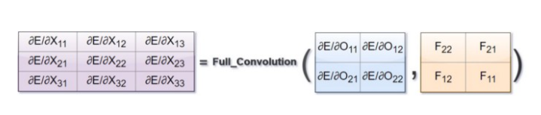
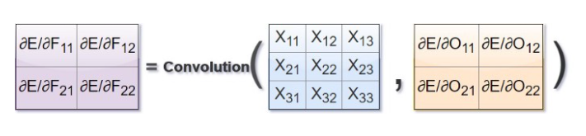
Backpropagation in Convolutional Neural Network
Reference : https://medium.com/@2017csm1006/forward-and-backpropagation-in-convolutional-neural-network-4dfa96d7b37e

