Slide 1
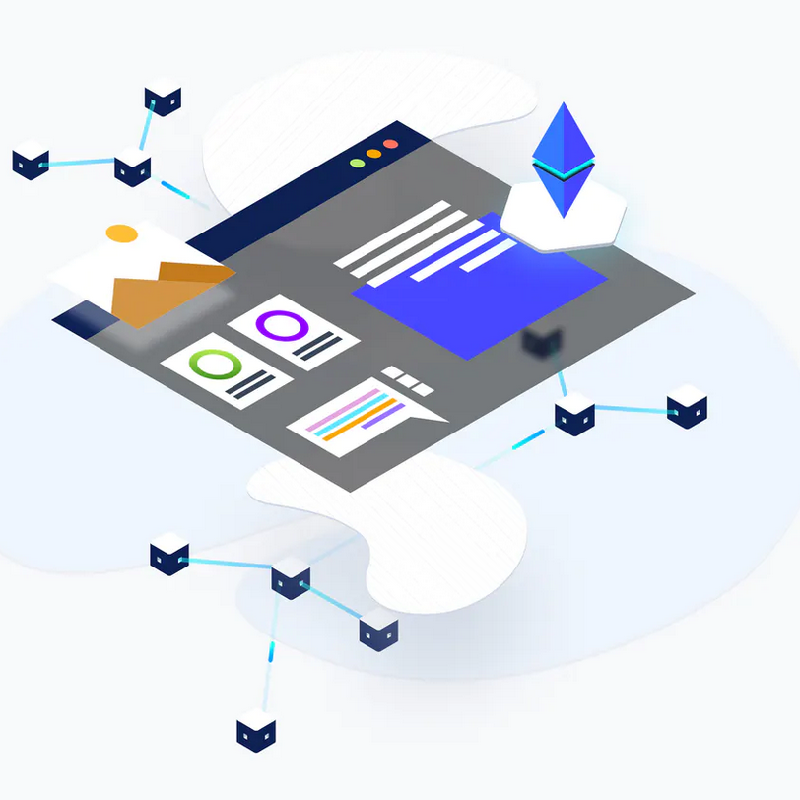
Team 2
KYC Smart Contract
KYC SMART CONTRACT
(Know Your Customer)
Blockchain & Smart Contract
Team Member: Booker Sessoms
Leon Zubkov
Richard Bertrand
Song Zhao
Faculty Advisors: Aaron, Adam, Jeff, Julia, Yichao
Notes:
We worked on a KYC smart contract application, where we aim to reduce the cost and increase the efficiency for financial institutions’ operations process.

Slide 2
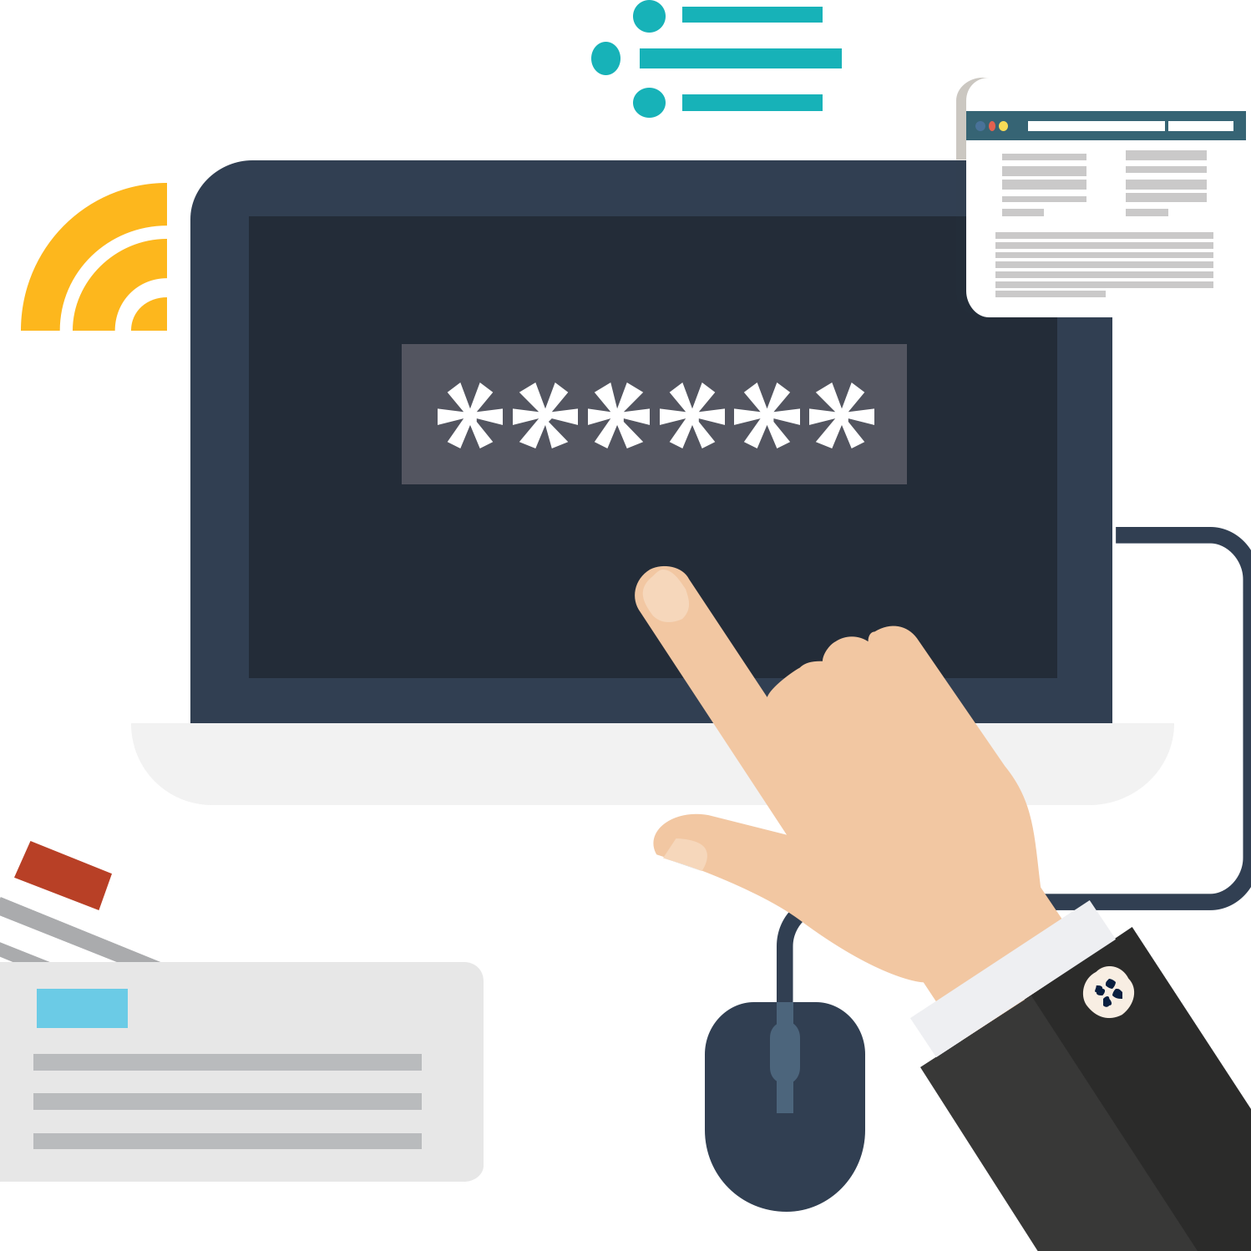
Team 2
KYC Smart Contract
Project Overview
WHAT IS KYC?
A process by which banks obtain information about the identity of the customers
Customers
Account/Business Owner
Authorized Professionals
Beneficial Owners
Applications
Account Opening
Due Diligence
Store Data
Elements
Customer Identification
Customer Due Diligence
Ongoing Monitoring
Risk Management
Notes:
KYC stands for KNOW YOUR CUSTOMER. It strongly rely on identity management, and provide the backbone of organizational and financial institutions’ anti-money laundering efforts. KYC is a regulatory and legal requirement that it has to fullfill by the bank for both new and existing clients.
A bank usually cater to a large clients base to both retail and business segment. KYC helps institution with the process of clients’ identification.
The clients include, account.business owner, authorize professionals, and beneficial owners. The process includes customer identification, due diligence, ongoing monitoring and riks management. It happnes during account opening, due diligence and storeing the clients details.

Slide 3


Team 2
KYC Smart Contract
CURRENT PROBLEMS
Institutions do their own KYC
Both new information and ongoing changes
Repetitiveness
- Repetitive procedures if customers want to approach to different banks
High Cost
Low efficiency
Notes:
Current system requires institutions to do their own KYC,t his translates into higher cost in acquisition for the banks. Also, if the customer wish to engage with a different bank, the process gets repetitive procedures all over again.

Slide 4
Team 2
KYC Smart Contract
ABOUT KYC
SOLUTION
1
2
3
4
ACCESS
SPEED
COST
SECURITY
Decentralized database provides universal accessibility
Reduce the process by eliminating the repetitiveness
Lower the time spent for information acquisition
Lower the cost for user information acquisition
Stronger security to protect from hack and attack
Notes:
So our solution tackles all above problem by providing universal accessibility to institutions with a decentralized databse; it will reduce the speed by eliminating repetitive processes c=for customers and the institutions; it will also lower the time spent for information acquisition. As a result, it reduces cost for bank to acquisit for maintain the cusotomers information. And as the nature of block, the system provide stronger security to protect from hack and attack.

Slide 5
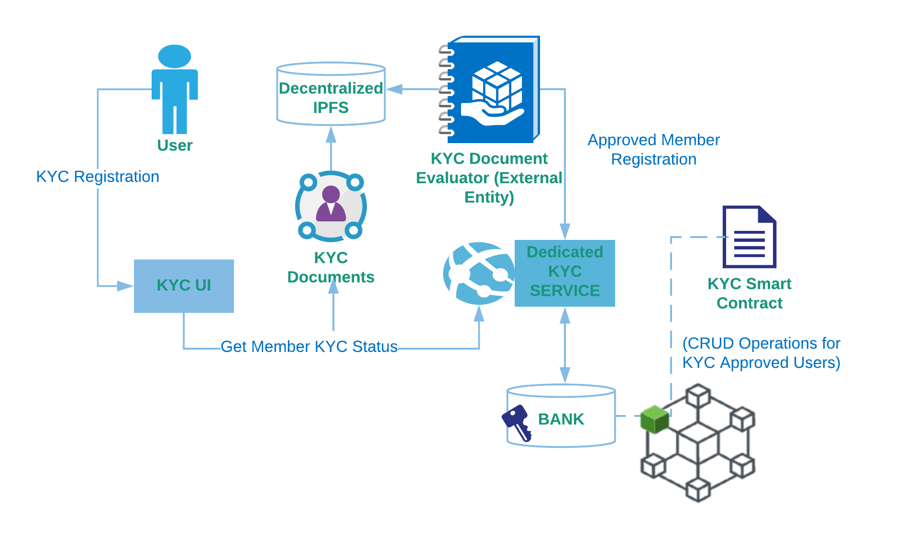
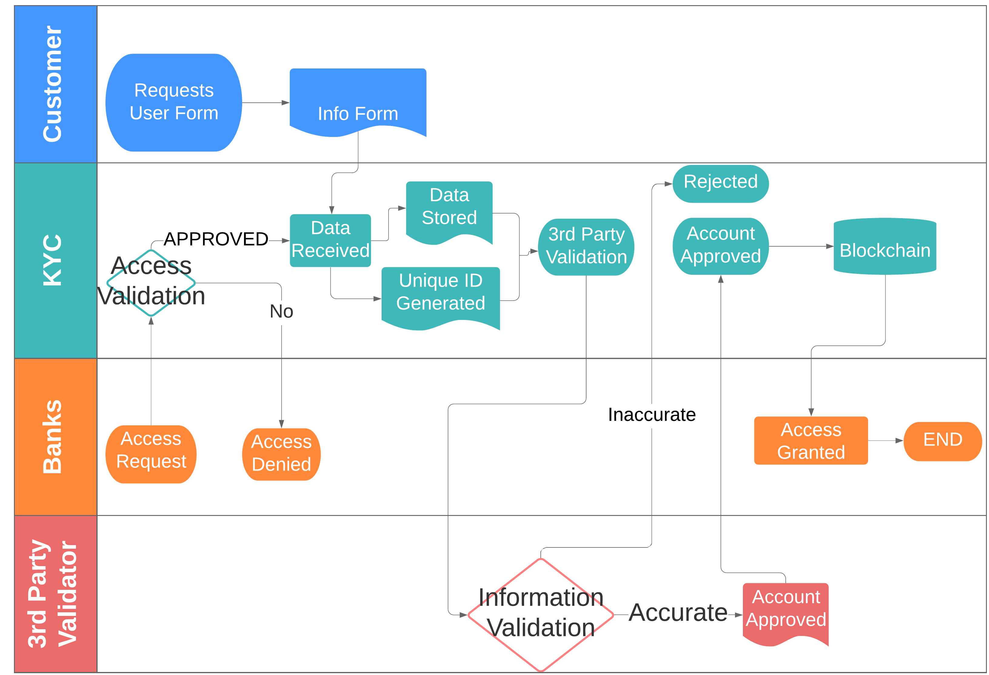
Team 2
KYC Smart Contract
STRUCTURE
PROCESS
Notes:
And now, I’m going to pass to Leon, Booker and Richard to demonstrate the system structure, prototype and a walkthrough, as well as our review on the development and for future improvement.

Slide 6

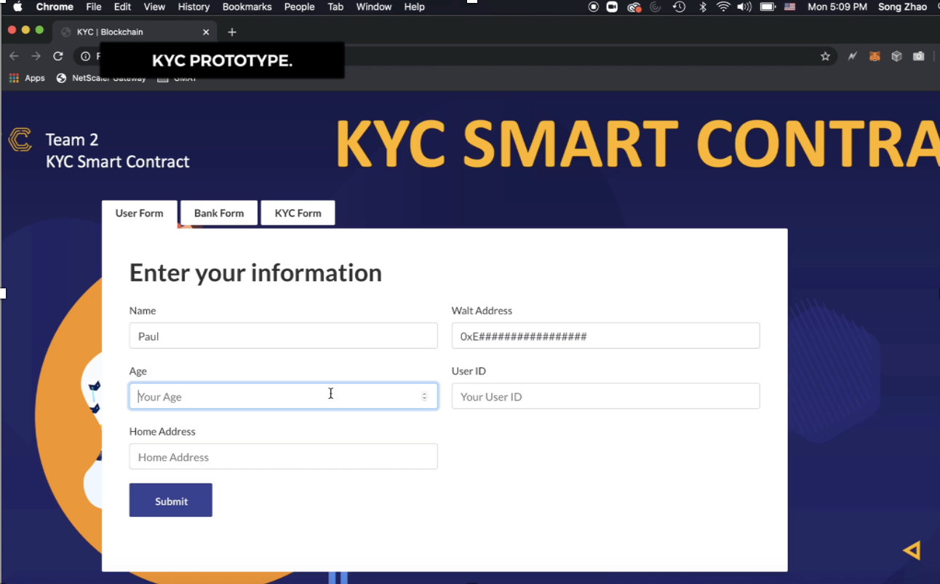
Team 2
KYC Smart Contract
PROTOTYPE
LOW OPERATIONAL COSTS
NON-REPETITIVE, ON DEMAND ACCESS

Slide 7

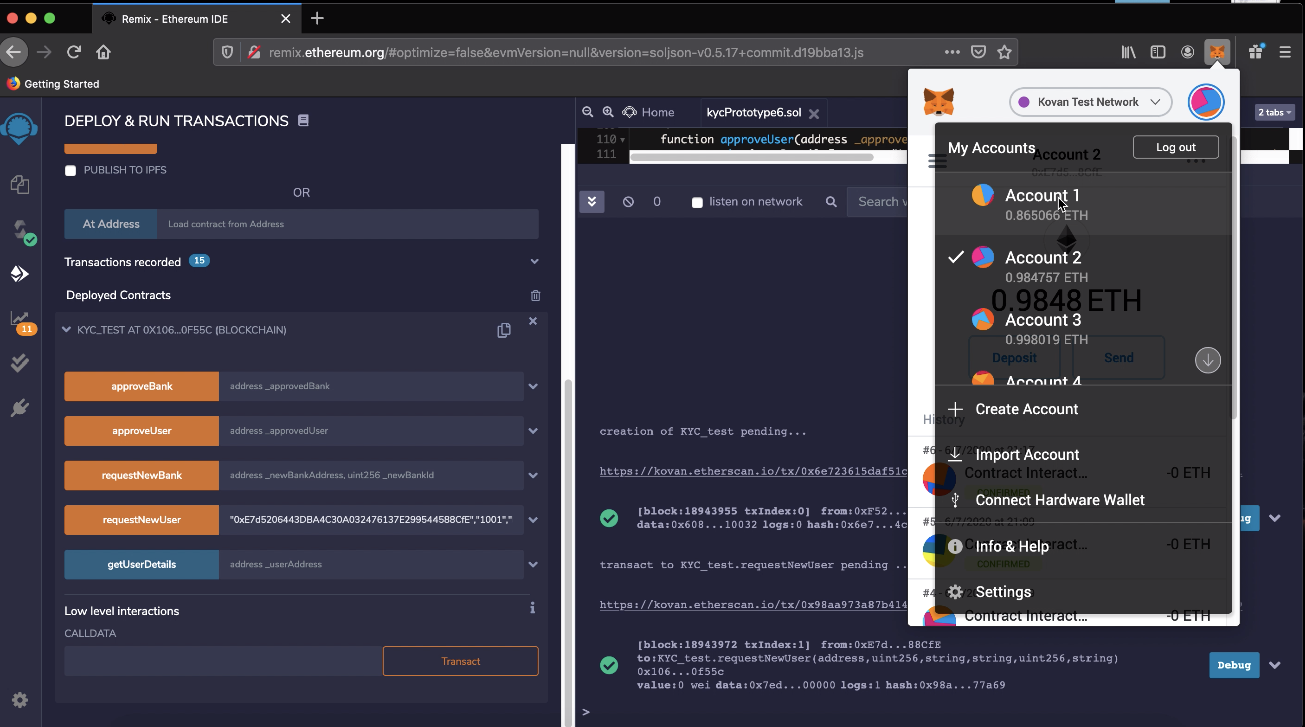
Team 2
KYC Smart Contract
Interface Mockup

Slide 8
Team 2
KYC Smart Contract
Refined Security
Add more layers of security through smart contract coding and Quorum, a private blockchain
PROJECT REVIEW
IMPROVEMENT
Document Integrity
Put structures in place that weed out duplicate submissions while also accounting for customers entire profile
Contract Functionality
Current product is limited in scope and is mostly a proof of concept, but have kept expansions in mind

Slide 9
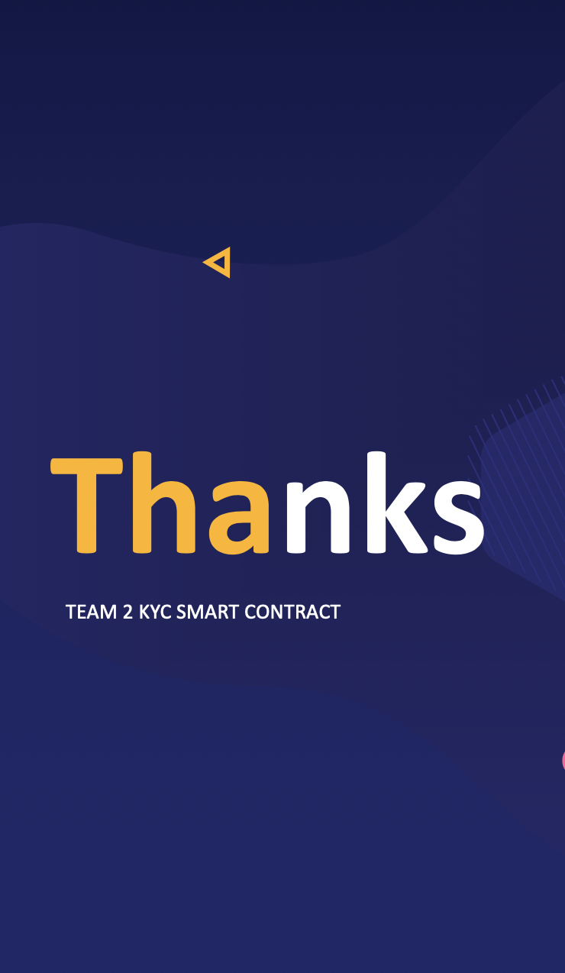
Team 2
KYC Smart Contract
Q & A

Slide 10
Team 2
KYC Smart Contract .
01
ADDENDUM 1
RESEARCH STUDY
https://www.mdpi.com/1999-5903/12/2/41/pdf
RESEARCH & DEEVLOPMENT
REFERENCE
02
DEVELOPMENT REFERENCE
https://github.com/karlmunchaussen/kyc-blockchain
https://github.com/servntire/KYC
03
UI REFERENCE
Automate the processes
Lower the cost
Reduce receptiveness

Slide 11
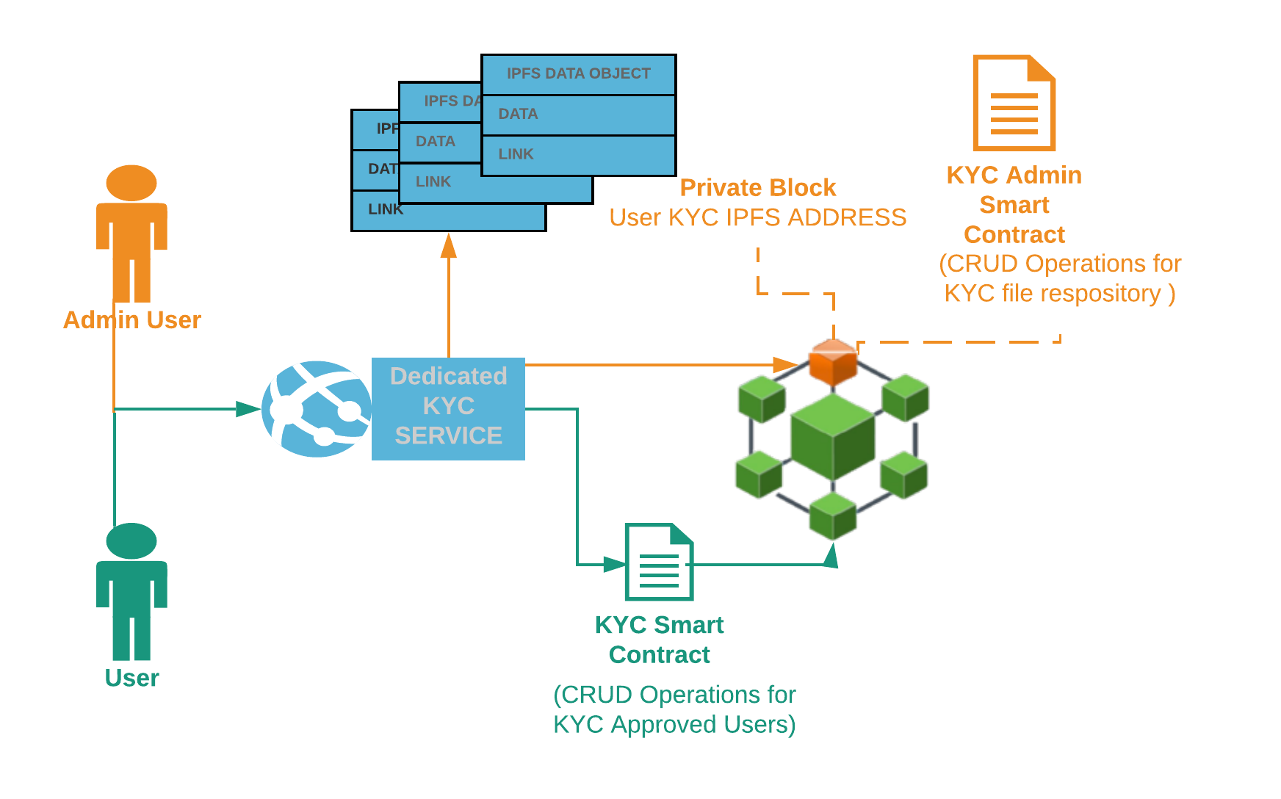
Team 2
KYC Smart Contract .
ADDENDUM 2
Private & Public Smart Contract

