Slide 1
Team name : Epsilon team number : 19
Team Members : Prajwal, Preethi, Shreesha, Syed zain

Slide 2
Problem statement
Our main goal is to stop food wastage that happens on a daily basis in marriage halls, restaurants, etc.
This is a major problem in India, large amount of food is thrown to bins and is wasted.
It can be utilized for different things.

Slide 3
Solution to this problem:
The foods that are thrown away can be supplied to poverty centers, orphanages, animal shelters, etc.
We have developed a prototype for doing this purpose.
Our prototype is a website, where the people who wants to donate off extra food can sign up and login to give information about the extra food.
There will be a non-profit team which will assist in delivering the food to the required places.

Slide 4



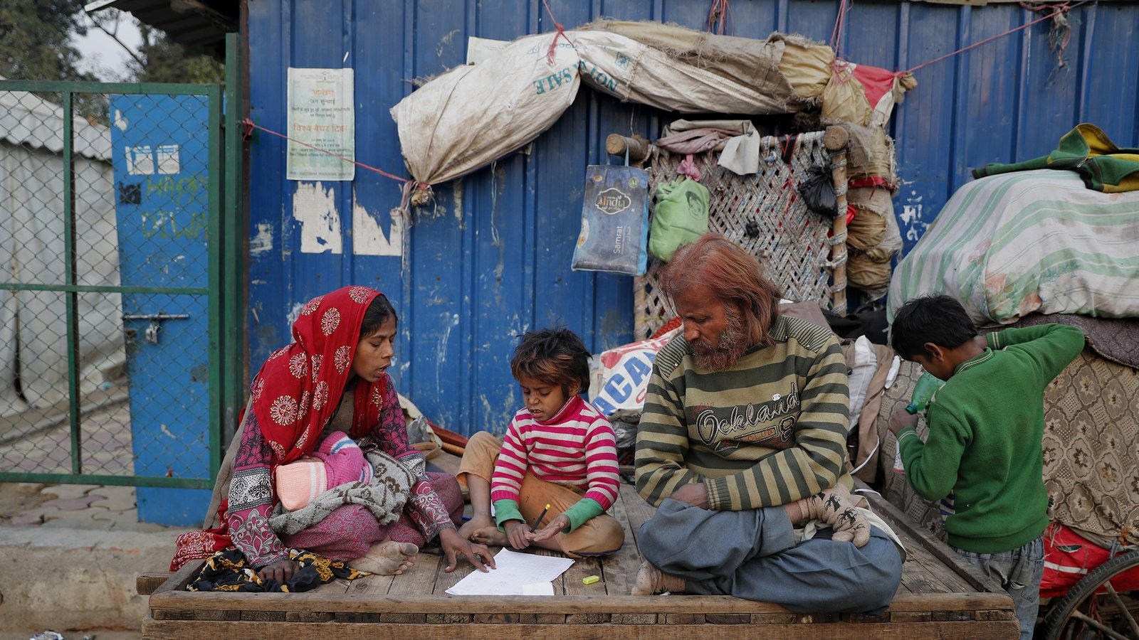
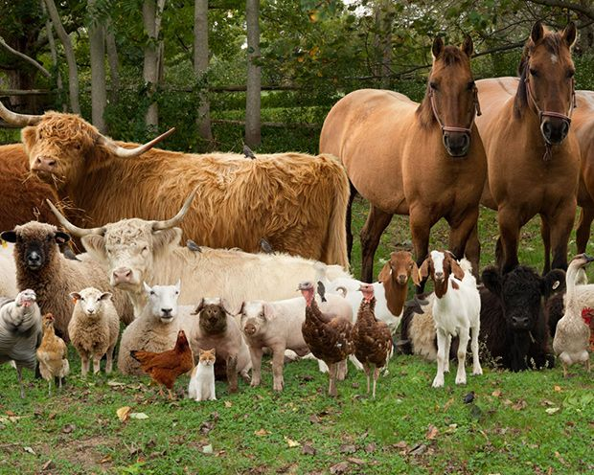
How the website works

Slide 5
Working of our website:
The donor should login to the website and give information about the food available.
After the donor uploads the information about the food to the website, the website will have an sms system that will send message informing the team members.
A database is created that stores all contact information of all the donors, including their login details.

