Slide 1
MATLAB
INTRODUCTION FOR
PERL MONGERS

Slide 2
Outline
Matlab, what is it good for
Matlab’s IDE & functions
A few words about Maple
What needs to be done to make PDL a worthy competitor to Matlab

Slide 3
What is Matlab used for
Numerical solutions
Simulations
Data fitting
Statistics
Analytical solutions
Model
analysis
Data
analysis
Matlab
Graphics
&
Visualization
Image processing
&
Signal processing

Slide 4
What does Matlab make easy?
Programming – no need to compile, build. Functions can by typed in command line (like perldl) or in
M-files (like .pl files)
Multi-dimensional array manipulation
Data display – arrays (matrices), plots, images
Complicated calculations – lots of built in functions and toolboxes
Learning Matlab is easy!
Matlab users are everything from students and academia researches to commercial companies.

Slide 5
Some linear algebra functions
Function | Operation
zeros | creates a matrix of zeros
rand | creates a matrix of random numbers
det(A) | calculates a matrix determinant
trace(A) | calculates the sum of the diagonal elements
inv(A) | matrix inverse
eig(A) | finds eigenvalues and eigenvectors
kron(A,B) | calculates Kronecker product (tensor product)
reshape | reshapes an array/matrix

Slide 6
Examples
>> A = zeros(2)
A =
0 0
0 0
>> B = [0 1; 1 0]
B =
0 1
1 0
>> [v,e] = eig(B)
v =
-0.7071 0.7071
0.7071 0.7071
e =
-1 0
0 1
>> reshape(e,1,4)
ans =
-1 0 0 1

Slide 7
Matrix and array operators
Operator | Operation
' | conjugate transpose
.' | transpose
* | matrix multiplication (dot product )
B/A | same as B*inv(A)
^ | power
.* | element by element multiplication
./ | element by element division

Slide 8
Examples
>> v = [2 3 0];
>> vt = v‘
vt =
2
3
0
>> v*vt
ans =
13
>> v.*v
ans =
4 9 0
>> M = zeros(3) + 1;
>> M*vt
ans =
5
5
5

Slide 9
Some functions for image processing
Function | Operation
imread | loads an image
rgb2gray | converts an RGB image to grayscale
conv2 | convolution of two matrices
fft | fast Fourier transform

Slide 10
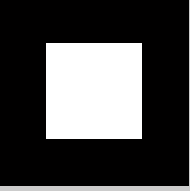


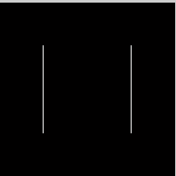
Examples
>> img = zeros(200);
>> img(50:150,50:150) = 1;
>> imshow(img);
smoothing:
>> a = [1 2 1; 2 4 2; 1 2 1]/16;
>> imshow(conv2(img,a));
edge detection:
>> imshow(abs(conv2(img,[1 -1])));

Slide 11
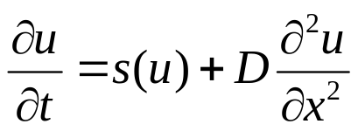
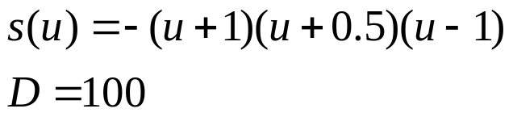
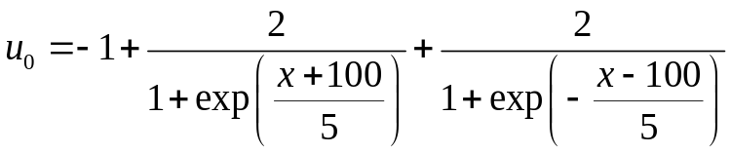

Solving differential equations
m = 0;
x = linspace(-300,300,600);
t = linspace(0,100,100);
sol = pdepe(m,@pdex1pde,@pdex1ic,@pdex1bc,x,t);
function [c,f,s] = pdex1pde(x,t,u,DuDx)
c = 1;
f =100*(DuDx);
s =-(u+1).*(u-0.5).*(u-1);
function u0 = pdex1ic(x)
u0=-1+2./(1+exp((x+100)./5))+2./(1+exp(-(x-100)./5));
function [pl,ql,pr,qr] = pdex1bc(xl,ul,xr,ur,t)
pl = ul-1;
ql = 0;
pr = ur-1;
qr = 0;
is solving the partial differential equation:
with
and with the initial condition :
and the boundary conditions:

Slide 12
A few words about Maple
Enables programming in an integrated document-like worksheet (combines functions, text, math, plots and images)
Includes advanced symbolic capabilities

Slide 13
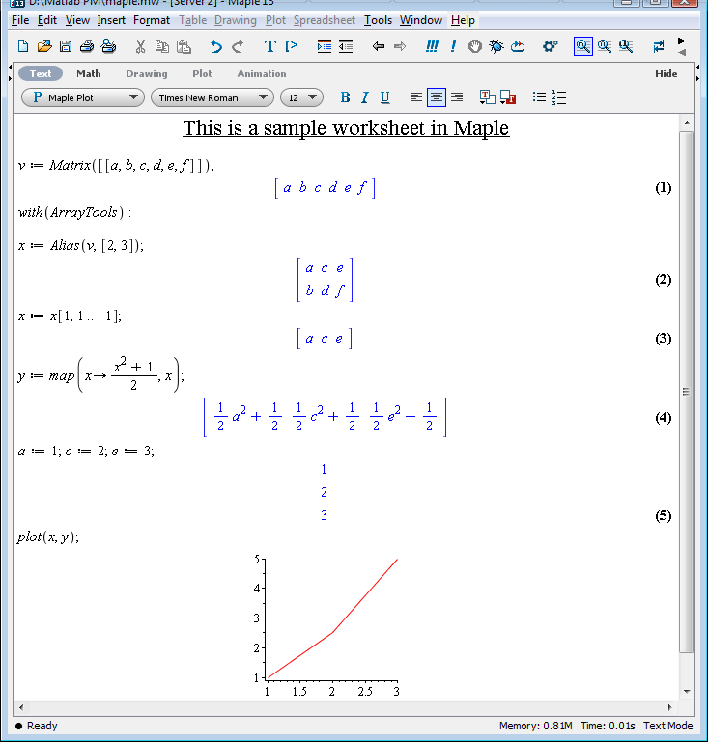

Slide 14
What Matlab and PDL/perldl share?
Easy programming
Easy basic read from/write to files
Easy basic matrix manipulation

Slide 15
What needs to be done?
Develop a nice and easy IDE
    Meaning: editor +
    debugger +
    command line +
    arrays display +
    better integrated plotting +
    help +
    history
More developed advanced libraries
    Linear algebra
    Image and signal processing
    Differential equations
    …

Slide 16
Some tips for competitors to Matlab
Easy things should be easy: easy installation – a must, reading data files/images in common formats…
Matlab is by far more popular than other tools – similar syntax is preferable
Easy data display and saving (multiple matrices in Matlab – all in one workspace, modifiable figures and plots)

Slide 17
Things you can do better than Matlab
Symbolic calculations
“See also” in the documentation – makes it easier to find the function you search for, makes people aware of the existing functions
File handling (according to David Mertens – http://mailman.jach.hawaii.edu/pipermail/perldl/2009-November/004713.html )

