Slide 1



SVG
Scalable Vector Graphics
And the SVG Perl Module
Tamir Lousky
Rehovot Perl Mongers
April 2010

Slide 2

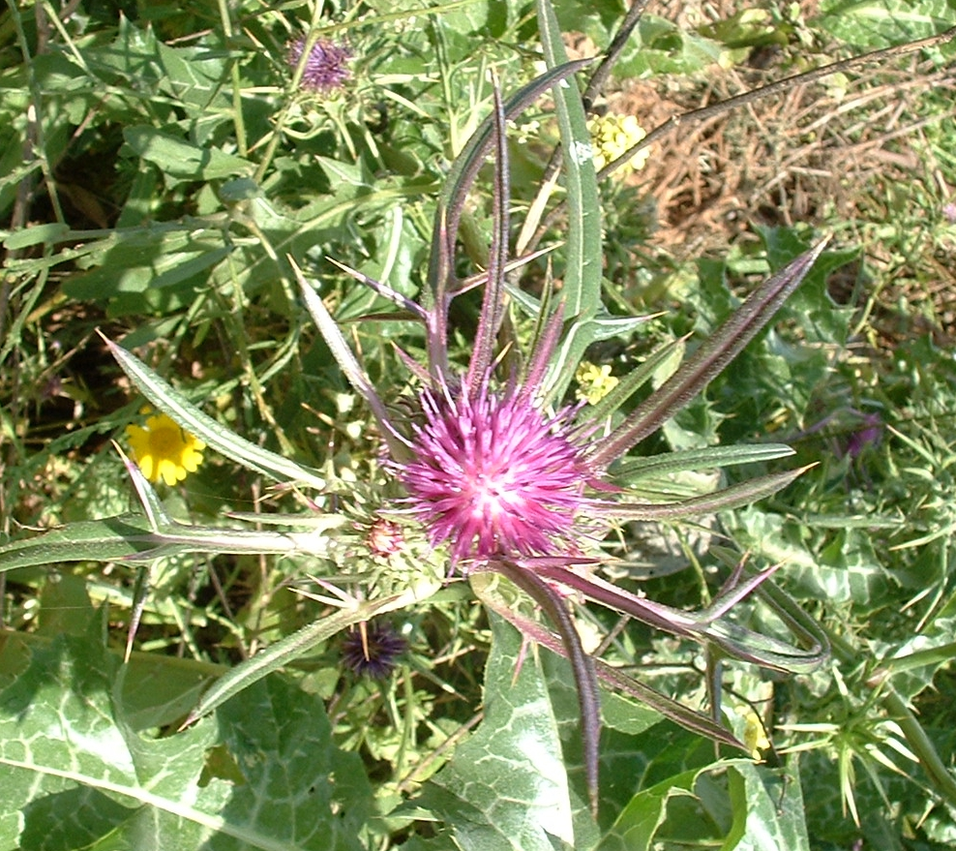
Vector vs. Raster Graphics
ID,
Position (x,y)
RGB value
(Alpha)

Slide 3

Vector vs. Raster Graphics
62 x 62 px
72 DPI
3 kb
482 x 482 px
90 DPI
33 kb

Slide 4
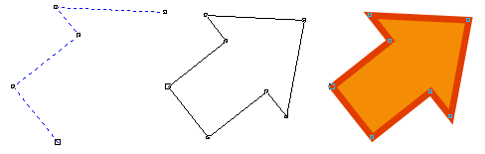
Vector vs. Raster Graphics
Bitmap ( raster ) = pixels
Vector = paths

Slide 5
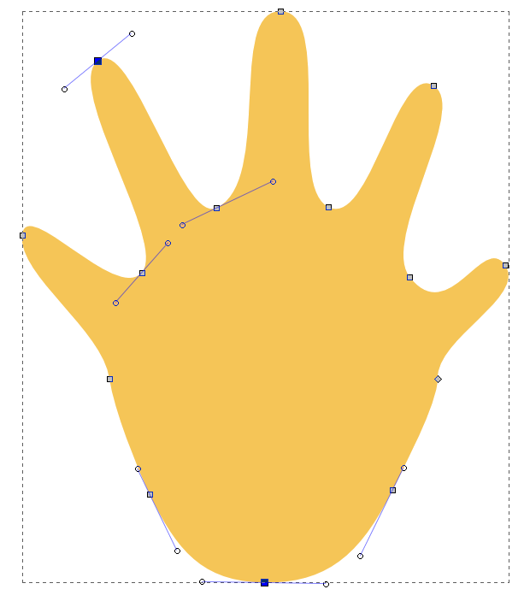
Vector vs. Raster Graphics
Handle
Control point

Slide 6
Vector vs. Raster Graphics
Infinite resize
(with small file sizes)

Slide 7
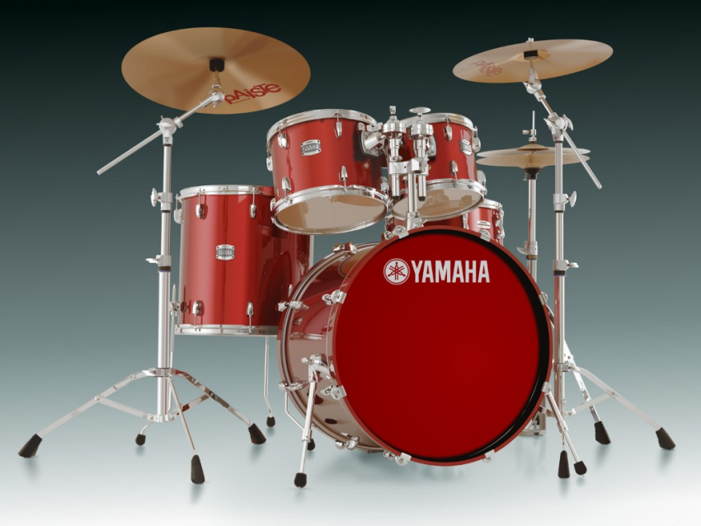

Slide 8
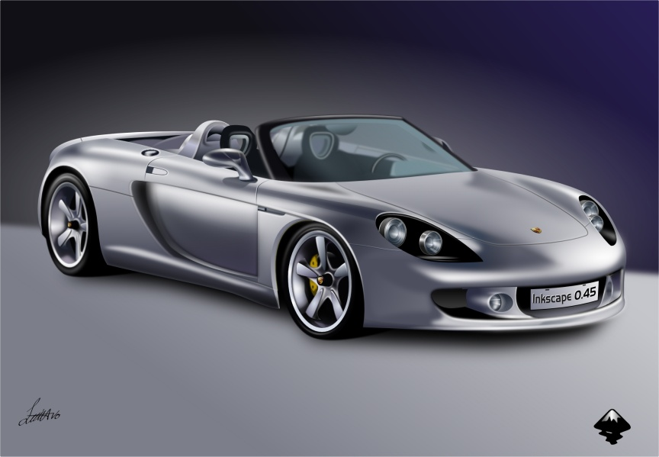

Slide 9

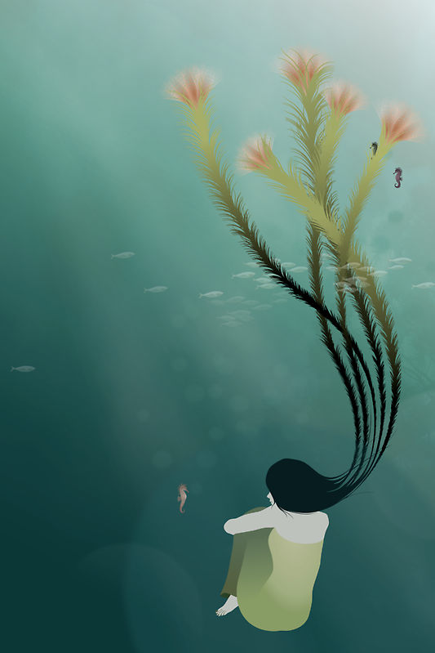

Slide 10
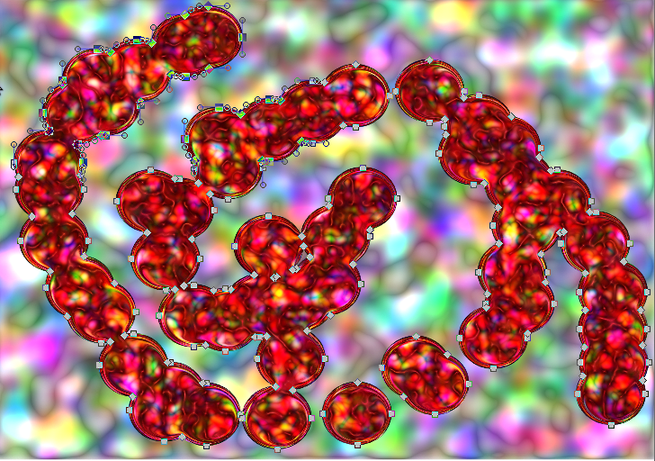
Vector vs. Raster Graphics

Slide 11


Formats of Vector Graphics: Flash
Highly popular
Closed source
Compiled to binary

Slide 12
Formats of Vector Graphics: SVG
Text-based ( XML format )
Highly readable
Easily editable
… Accessible to scripting
(embedded or external)

Slide 13
SVG Structure
XML = Markup Language
< element
property1 = value1
property2 = value2
...
/>
< element >
content
< /element >

Slide 14
SVG Structure
<XML-SVG declaration>
# Hello, I'm a SVG-XML doc
<SVG StartTag and Image Dimentions>
# Start SVG, describe Image dimensions
# ( Height, Width and Version)
<SVG Element>
<SVG Element>
<SVG Element>
…
</SVG> # SVG closing tag

Slide 15
SVG Structure
<?xml version="1.0" standalone="no"?>
<!DOCTYPE svg PUBLIC "-//W3C//DTD SVG 1.1//EN" "http://www.w3.org/Graphics/SVG/1.1/DTD/svg11.dtd">
<svg width="5cm" height="4cm" version="1.1"
xmlns="http://www.w3.org/2000/svg">
<rect x="0.5cm" y="0.5cm"
width="2cm" height="1cm"/>
<rect x="0.5cm" y="2cm" width="1cm" height="1.5cm"/>
<rect x="3cm" y="0.5cm" width="1.5cm" height="2cm"/>
<rect x="3.5cm" y="3cm" width="1cm" height="0.5cm"/>
<!-- Show canvas outline -->
<rect x=".01cm" y=".01cm" width="4.98cm"
height="3.98cm" fill="none"
stroke="blue" stroke-width=".02cm" />
</svg>

Slide 16

SVG Structure

Slide 17
SVG Structure
<svg version="1.1" baseProfile="full"
xmlns="http://www.w3.org/2000/svg">
<g fill-opacity="0.7" stroke="black"
stroke-width="0.1cm">
<circle cx="6cm" cy="2cm" r="100" fill="red"
transform="translate(0,50)" />
<circle cx="6cm" cy="2cm" r="100" fill="blue"
transform="translate(70,150)" />
<circle cx="6cm" cy="2cm" r="100" fill="green"
transform="translate(-70,150)" />
</g>
</svg>

Slide 18
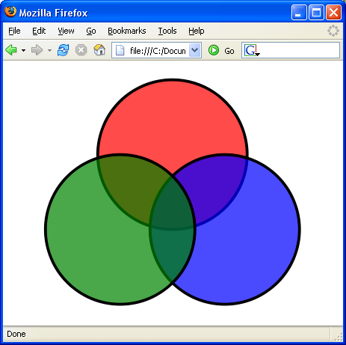
SVG Structure

Slide 19




SVG Structure
Advanced Parenting:
SVG → SVG (embedding)
Groups
Elements → Elements
?

Slide 20
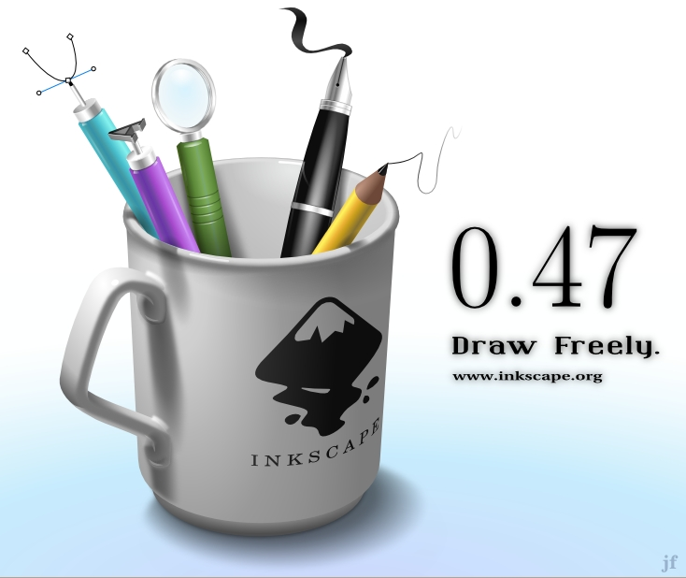
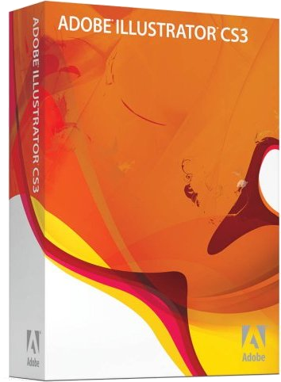
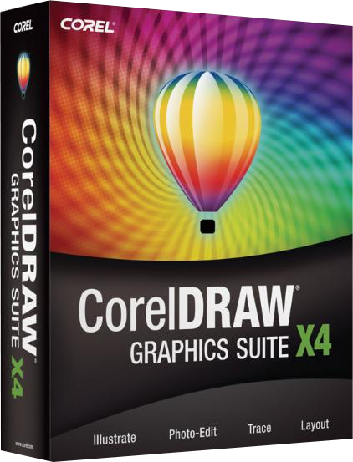


Other ways to create SVG docs

Slide 21
SVG.PM
use strict;
use SVG;
# create an SVG object
my $svg = SVG->new(
width => 200,
height => 200,
);
print $svg->xmlify;

Slide 22
SVG.PM
my $grp = $svg->group(
id => 'group_y',
style => {
stroke => 'red',
fill => 'green'
});
# add a circle to the group
$y->circle(
cx => 100, cy => 100,
r => 50, id => 'circle01'
);

Slide 23
SVG.PM
# The generic 'tag' method
my $z = $svg->tag('g',
id => 'group_z',
style => {
stroke => 'rgb(100,200,50)',
fill => 'rgb(10,100,150)'
}
);

Slide 24
SVG in practice
Supported in all web browsers
.... Except Internet Explorer
(will be included in IE9)
Mobile: SVG-tiny / SVG-basic
Compression: SVGZ ( tar-gz)
HTML5 audio and video elements

Slide 25
More to Explore
Animations!
3D with WebGL!
Tons of other features
www.w3.org/Graphics/SVG
http://search.cpan.org/~ronan/SVG-2.50/lib/SVG/Manual.pm

Slide 26
Exercise: File Size Blocks
use strict;
use warnings;
use SVG;
my $directory = 'C:\UrFolder';
opendir(my $dirh, $directory);
my @files = readdir( $dirh );
my $num_of_files = scalar @files;
my $svg = SVG->new(
width => 800,
height => 600,
);
my $block_width =
int( 800 / $num_of_files );
# <Create group with specific style>
my $start_x = 0;
foreach my $file ( @files ) {
my $path = "$directory\/$file";
my $size = -s $path;
print "$file => $size bytes\n";
my $height =
int ( $size / 1000000 );
# < Create rectangle with a height
corresponding to the size,
and an X value incrementally
growing, and the fixed width >
} # End of Foreach Loop
my $output = $svg->xmlify;
open my $output_file, '>', 'output.svg';
print $output_file $output;
close $output_file;

