Slide 1


Android App Dev. Basics
April 2014 – Yossi Shmulevitch

Slide 2
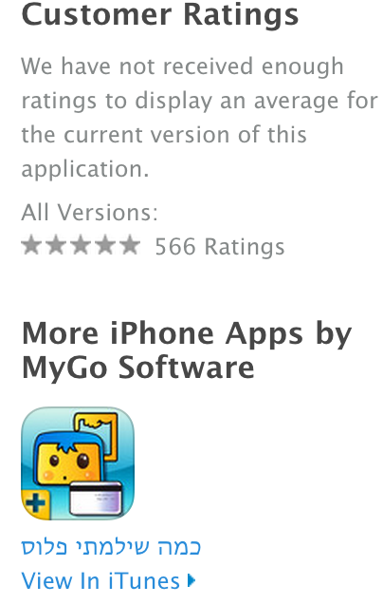
About Me
14 years as Software (Mostly Java) professional
3 years in Mobile development – iOS & Android
Owner of Kama Shilamti and LoginBox
Software/Architecture consultant
Technion MBA graduate
Hobbies: Basketball player + coach
Business : US real estate

Slide 3

Agenda
Background – Android vs iOS
Eclipse and Android & SDK
Project structure – Manifest +
Activities VS Fragments
Views and Layouts
Demo App
Security and Error Tracking
Server Side for mobile Apps – cloud
Monetization $$

Slide 4
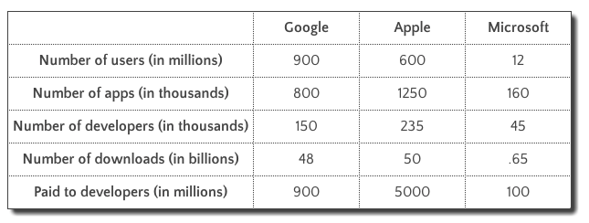
Android vs iOS
Revenues (Source : Forbes)
App Sessions (Source : Forbes)

Slide 5
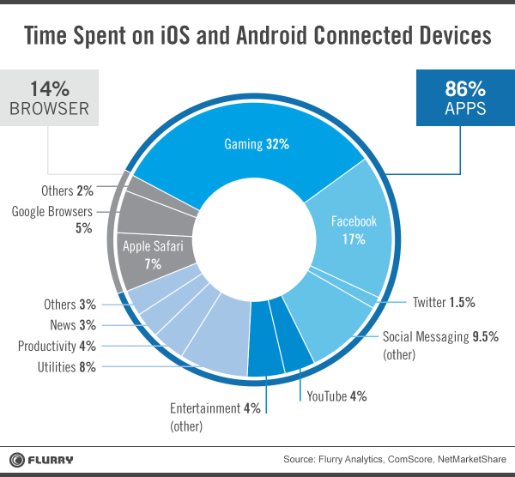
Time Spent

Slide 6
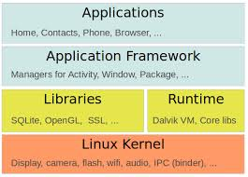
Android - Architecture
Linux
Libraries
Dalvik VM – dex
ART in 4.4 (KitKat)
Is it Java (JSE)?
Libraries
Open Source!

Slide 7
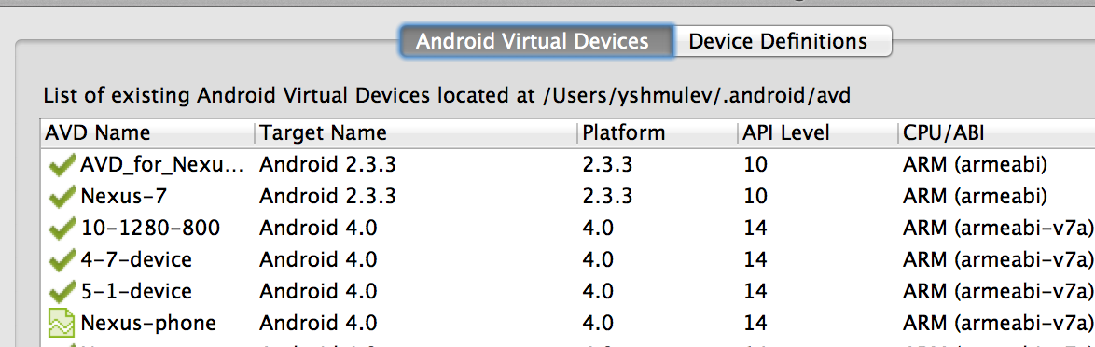
Eclipse and Android SDK
DDMS perspective
Android SDK
Devices – API Level
LogCat
Running App
Debugging

Slide 8
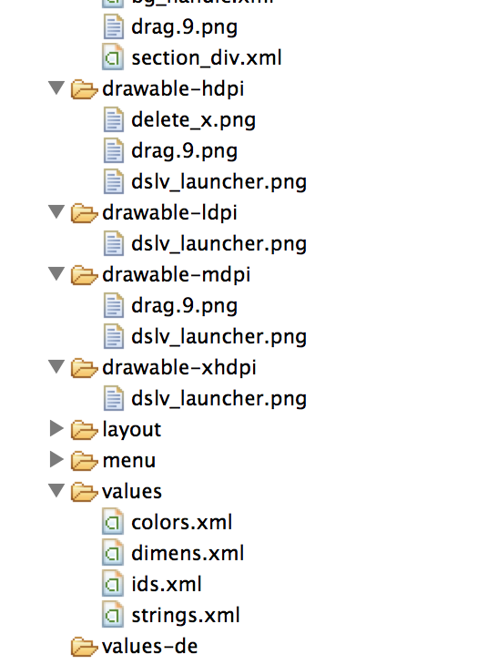
Project Structure
Manifest File
Assets
Bin & Dex
Generated code (gen dir)
Resources
drawables (resolutions)
Menu
Values
Layouts

Slide 9
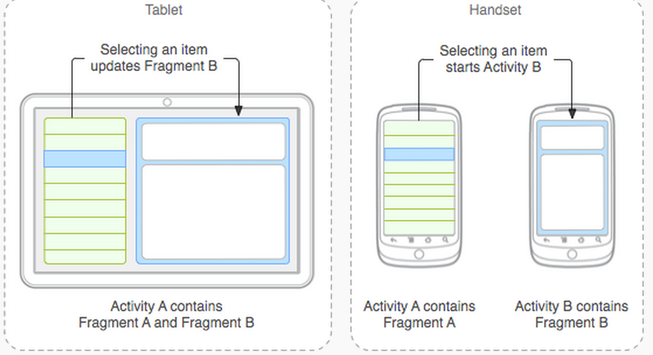
Activities VS Fragments +
Application class
Activity LifeCycle and Intents
Fragment usage and “transaction”
Fragments advantages:
Tablet (landscape) support
Action Bar
Smart back (last fragment state)
View Pager (swipe)
Services, Recievers, and Providers

Slide 10
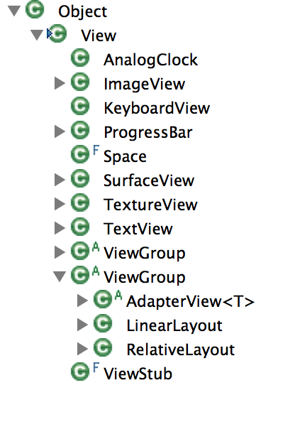
Views and Layouts
View – view hierarchy
Custom View
Layouts
Relative layout
Linear Layout
AbsoluteLayout
Padding & Margins
Other attributes

Slide 11
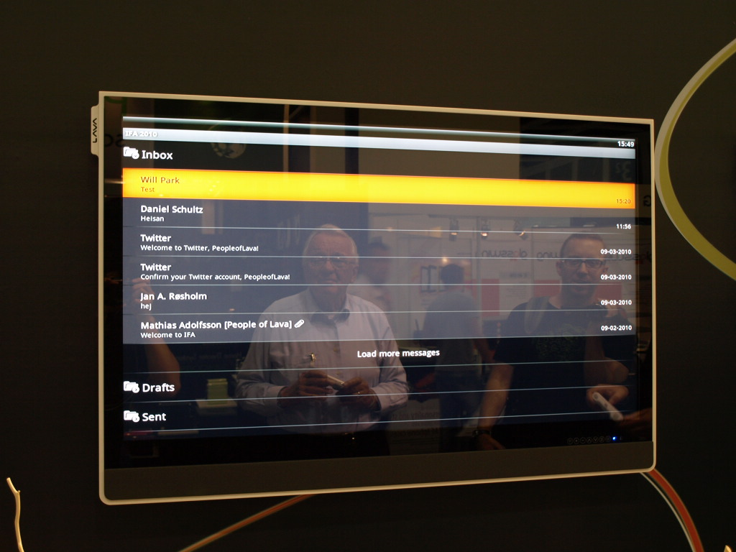
Demo

Slide 12
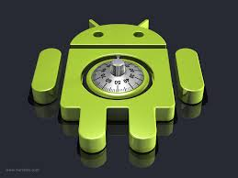
Security and Tracking +
Security in Android – challenging!
File usage options – Ext. Vs Int.
Encryption
Tracking – GA or Flurry?
Crashes
Support?

Slide 13
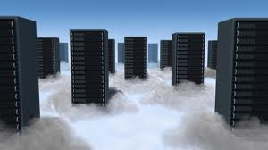
Server side
JSON/REST
RoR
Google App engine (Cloud platform)
JEE/.NET/whatever on EC2 (other cloud plaf.)
Tones of 3rd Parties(Aplicasa)
User data on cloud – iCloud, google drive,dropbox

Slide 14
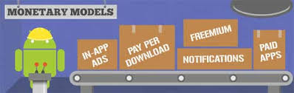
Monetization
Freemium?
In-App Purchases?
Ads?
Subscription?
Pricing
Israeli summit

Slide 15
Q&A

