Slide 1
Why the f!@# do I use Windows on my notebook?
While I would prefer to use Linux on my notebook, it will introduce some interoperability issues when going to business meetings abroad.
The notebook had a license on it, which if removed will not be supported by IBM.
Too much work, no time to start installing everything from scratch.
99% of my clients use Exchange, so using anything other than Outlook messes e-Mails like hell.
If you still have a problem with it, you are welcome to take it outside with me after the lecture ;-)

Slide 2

Asterisk AGI Programming using PHPAGI
Nir Simionovich, CTO
Dimi Telecom

Slide 3
Welcome to Asterisk™
Asterisk™ is a complete PBX in software. It runs on Linux, BSD and MacOSX and provides all of the features you would expect from a PBX and more. Asterisk does voice over IP in many protocols, and can interoperate with almost all standards-based telephony equipment using relatively inexpensive hardware.

Slide 4
AGI Cont…
Once of the advantages of utilizing the AGI interface is the ability to develop proprietary applications and platforms while utilizing an dually licensed, Open Sourced, PBX core.
While any change inflicted upon an Asterisk internal module or application MUST be contributed and disclaimed back to Digium™, AGI applications are external from Asterisk and do not require such disclaiming and contribution.

Slide 5
Asterisk Gateway Interface - AGI
With the introduction of the Asterisk Open Source PBX, it was required to establish a method for 3rd party programs to interact with Asterisk, while not changing the Asterisk core – hence the AGI interface.
Asterisk Gateway Interface (AGI) enables the development of Asterisk enabled applications without the need of modifying the Asterisk core.

Slide 6
AGI Basics
AGI is loosely based upon the old CGI model of operation. Asterisk communicates with AGI scripts via STDIN/STDOUT.
Anything sent from Asterisk to the AGI script will be considered as STDIN to the AGI script.
Anything sent from the AGI script back to Asterisk will be considered as STDOUT of the AGI script.

Slide 7
AGI Basics – Cont…
While the AGI API itself is fairly minimal (only 37 functions), the binding of these functions with external programming languages provides a powerful tool for development of any IVR enabled application.
There is no limitation on the programming language of choice. You can use C, JAVA, PHP, PERL, PYTHON or even BASH (if you really feeling like it) – it’s all up to you and your desires.

Slide 8
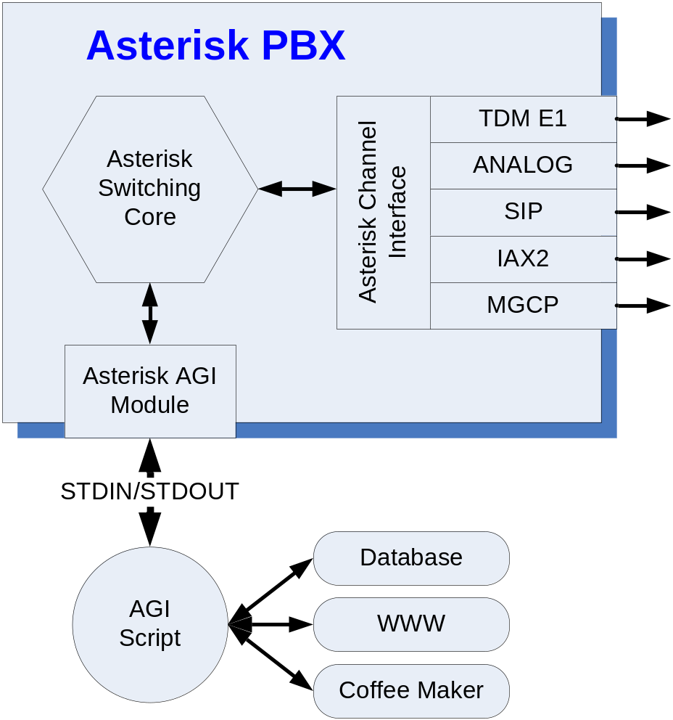
AGI Basics – Information Flow
The main advantage of using Asterisk to develop IVR type applications is the lack of need to know and understand the various types of connectivity mediums.
Asterisk will take of
all switching related tasks,
completely abstracting
them from you.

Slide 9
AGI – What happens when?
When an AGI is invoked from within the Asterisk dial-plan, the following steps always happen:
  Asterisk forks out and runs the application is it’s own user space.
  All channel variables that were available to the Asterisk dial-plan, prior to executing the AGI script are available to the AGI script.
  Asterisk sends out a bunch of information that must be handled before the script actually starts running. This information usually can be completed disregarded,
  but it is important to handle it.
  Your logic runs at this point.

Slide 10
AGI – Simple Example
#!/usr/bin/php4 -q
<?php
ob_implicit_flush(true);
set_time_limit(6);
$in = fopen("php://stdin","r");
$stdlog = fopen("/var/log/asterisk/my_agi.log", "w");
$debug = false;
function read() {
global $in, $debug, $stdlog;
$input = str_replace("\n", "", fgets($in, 4096));
if ($debug) fputs($stdlog, "read: $input\n");
return $input;
}
while ($env=read()) {
$s = split(": ",$env);
$agi[str_replace("agi_","",$s[[0])] = trim($s[[1]);
if (($env == "") || ($env == "\n")) {
break;
}
}
echo "VERBOSE \"Here we go!\" 2\n";
read();
write("SAY DIGITS 22 1234567890#*");
read();
write("SAY NUMBER 2233 1234567890#*");
read();
// clean up file handlers etc.
fclose($in);
fclose($stdlog);
exit;
?>

Slide 11
AGI – Internal functions
answer: Asserts answer
channel status: Returns status of the connected channel
control stream file: Send the given file, allowing playback to be controled by the given digits, if any. (Asterisk 1.2)
database del: Removes database key/value
database deltree: Removes database keytree/value
database get: Gets database value
database put: Adds/updates database value
exec: Executes a given Application. (Applications are the functions you use to create a dial plan in extensions.conf ).
get data: Gets data on a channel
get option: Behaves similar to STREAM FILE but used with a timeout option. (Asterisk 1.2)
get variable: Gets a channel variable
hangup: Hangup the current channel
noop: Does nothing
receive char: Receives one character from channels supporting it
receive text: Receives text from channels supporting it
record file: Records to a given file
say alpha: Says a given character string (Asterisk 1.2)
say date: Say a date (Asterisk 1.2)

Slide 12
AGI – Internal functions
say datetime: Say a formatted date and time
(Asterisk 1.2)
say digits: Says a given digit string
say number: Says a given number
say phonetic: Say the given character string.
say time: Say a time
send image: Sends images to channels supporting it
send text: Sends text to channels supporting it
set autohangup: Autohangup channel in some time
set callerid: Sets callerid for the current channel
set context: Sets channel context
set extension: Changes channel extension
set music: Enable/Disable Music on hold generator, example
"SET MUSIC ON default"
set priority: Prioritizes the channel
set variable: Sets a channel variable
stream file: Sends audio file on channel
tdd mode: Activates TDD mode on channels supporting it, to
enable communication with TDDs.
verbose: Logs a message to the asterisk verbose log
wait for digit: Waits for a digit to be pressed

Slide 13
Confused? PHPAGI to the rescue
PHPAGI is a PHP class for the Asterisk Gateway Interface. The package is available for use and distribution under the terms of the GNU Public License.
While PHPAGI is licensed under the terms of the Lesser GPL. Any application created with PHPAGI can be distributed and sold as long as PHPAGI is disclaimed.
Goto http://www.gnu.org/copyleft/lesser.html to find out more.

Slide 14

Enough Bullshit, lets code…

Slide 15
PHPAGI – General Structure
PHPAGI is an AGI wrapper classes, basically intended to make AGI programming with PHP painless and fast.
PHPAGI is built from 3 different classes for programming AGI scripts.
phpagi.php – includes the classes for writing PHP scripts based on the standard AGI interface, with hooks for performing Asterisk Manager functions.
phpagi-asmanager.php – An Asterisk Manager only interface, usually used from outside of AGI scripts.
phpagi-fastagi.php – An Asterisk FastAGI server implementation in PHP (not discussed in this presentation)

Slide 16
phpagi.php – Simple example
#!/usr/local/bin/php
<?
set_time_limit(30);
require('phpagi.php');
$agi = new AGI();
$agi->answer();
$cid = $agi->parse_callerid();
$agi->playback("Hello");
$agi->saydigits({$cid['name']},””);
$agi->hangup();
?>
This is as close as you would get to “Hello World”
on PHPAGI… Now, lets deal with some input
The above example simply initiates the phpagi class, performs an answer to the currently ringing extension, then plays back a welcome message followed by the callers CallerID.

Slide 17

NEED INPUT… INPUT…
….
if (($keyPressed['result'] == 0) && ($flag > 0)) {
$keyPressed = $agiWrapper->stream_file("silence","123#",0);
if ($keyPressed['result'] == 0) {
$keyPressed = $agiWrapper->stream_file("langselect","123#",0);
}
} else {
$keyPressed = $agiWrapper->stream_file("langselect","123#",0);
}
// The character presses on the keypad is now stored in chr($keyPressed['result'])
….
When a method is invoked from phpagi, the result of a user input
is usually represented by an array of variables. Depending on
the method called, the result may be contained within the
‘result’ key or the ‘data’ key. This information can be obtained
from the PHPAGI class documentation enclosed with the
PHPAGI class.

Slide 18
Invocation from extensions.conf
exten => _XXX.,1,Answer
exten => _XXX.,n,Set(TIMEOUT(digit)=2) ; Set Digit Timeout to 2 seconds
exten => _XXX.,n,Set(TIMEOUT(response)=5) ; Set Response Timeout to 5 seconds
exten => _XXX.,n,ResetCDR(vw)
exten => _XXX.,n,Wait,0.5
exten => _XXX.,n,AGI(phpagiScript1.php,var1)
exten => _XXX.,n,AGI(phpagiScript2.php,var2)
Invocation of an AGI script from the extensions.conf dialplan file is performed by initiating the AGI applications followed by the actual name of the AGI script, located at /var/lib/asterisk/agi-bin.
It is possible to pass to an AGI script only a single parameter, so use it widely.

Slide 19
AGI and Channel Variables
When Asterisk answers a call or originates a call, the call is enclosed within its own fork. The result is the ability to associate channel variables with an existing call, creating a stateful variable storage.
When writing AGI scripts and combining the stateful variable storage, the result is a method to bypass the single variable to AGI limitation.

Slide 20
Example – AGI and Channel Variables
exten => _XXX.,1,Answer
exten => _XXX.,n,Set(TIMEOUT(digit)=2) ; Set Digit Timeout to 2 seconds
exten => _XXX.,n,Set(TIMEOUT(response)=5) ; Set Response Timeout to 5 seconds
exten => _XXX.,n,SetCDRuserfield(${statusid})
exten => _XXX.,n,Wait(0.5)
exten => _XXX.,n,ResetCDR(vw)
exten => _XXX.,n,AGI(ServiceCheckBilling.php)
exten => _XXX.,n,Gotoif($["${billingType}" = "0"]?NoAuthOn0:Authorization)
exten => _XXX.,n(NoAuthOn0),AGI(ServiceStart.php)
exten => _XXX.,n,AGI(PassOperatorToMeetMeRoom)
exten => _XXX.,n(Authorization),Gotoif($["${billingType}" = "1"]?NoAuthOn1:AuthorizationCC)
exten => _XXX.,n(NoAuthOn1),AGI(ServiceStart.php)
exten => _XXX.,n,AGI(PassOperatorToMeetMeRoom)
exten => _XXX.,n(AuthorizationCC),Gotoif($["${billingType}" = "3"]?Auth3Party:AuthCollect)
exten => _XXX.,n(Auth3Party),AGI(ServiceStart.php)
exten => _XXX.,n,AGI(ThirdPartyOperatorCallSecondLeg.php)
exten => _XXX.,n,Hangup()
exten => _XXX.,n(AuthCollect),Gotoif($["${billingType}" = "4"]?AuthRegular:EndScript)
exten => _XXX.,n(AuthRegular),AGI(ServiceStart.php)
exten => _XXX.,n,AGI(PassOperatorToMeetMeRoom.php)
exten => _XXX.,n(EndScript),NoOp
In this extract, the ServiceCheckBilling.php script gets
input from a source, then sets the billingType channel variable, to be used within the dialplan.

Slide 21
AGI/Dialplan Balancing
One of the first mistakes most AGI programmers tend to do is to initiate a HUGE AGI script that does everything, instead of using the dialplan state machine.
This is especially problematic when you are programming in a VM environment such as JAVA/C#.
When possible, make your AGI scripts as short as possible, down to an atomic level, have them simply set a channel variable, and then initiate another AGI script according to the result of the previous one.
If your AGI script becomes long and cluttered, you must be doing something wrong – and in the words of a friend of mine: “you are in desperate need of re-factoring”.

Slide 22
PHPAGI Wrapping
Most AGI programmers tend to write their AGI scripts as self enclosed scripts – this usually leads to code duplication and hard code maintenace.
By utilizing the channel variables as a methodology to pass variable from one script to another, is it possible to write your own AGI script invoker, thus, making your AGI scripts more stream lined.

Slide 23
Wrapper Example…
#!/usr/bin/php -q
<?php
require "phpagi/phpagi.php";
define_syslog_variables();
// Initiate an array for local channel variable keeping
$agiVariables = array();
// Initiate an AGI instance
$agiWrapper = new AGI("/var/lib/asterisk/agi-bin/include/phpagi.conf");
openlog("[".$sessionId['data']."/".$argv[1]."]", LOG_PID | LOG_PERROR, LOG_LOCAL2);
// Lets parse the parameters from AGI execution
$agiParameters = $argv[1];
$agiList=array();
$agiList=explode("^",$agiParameters);
syslog(LOG_INFO, "agiParameters: ".$argv[1]);
// Now that we have the AGI parameters list, lets see what we are going to execute
// echo "Executing ".$agiList[0]." AGI\n";
syslog(LOG_INFO, "Initiating : ".$agiList[0]." execution");
include "/var/lib/asterisk/agi-bin/modules/".$agiList[0].".inc.php";
?>

Slide 24
Why wrap at all?
By utilizing an PHPAGI wrapper you gain the ability to invoke your scripts in a uniformed way.
You can initialize your AGI environment before hand, thus, negating the need to reinitiate your class in every PHP script.
All your scripts enjoy a single, unified, class naming convention access, thus, making your scripts more readable.
The PHPAGI wrapper script can also be used to initiate required variables for later on scripts.

Slide 25
Syslog is your friend
For a reason beyond me, most script writers neglect the need to use syslog.
Syslog is a wonderful facility to use for script logging and script debugging purposes.
By initiating the syslog environment from the PHPAGI wrapper script, you can utilize syslog facility messages with great ease.

Slide 26
Lets write a silly AGI script
We shall now write a silly AGI script using PHPAGI.
The script purpose would be to play a little joke.
A caller would call a predefined telephone number. Our AGI script would then randomize a number from 1 to 20, which according to the number randomized would play a predefined voice file, indicated by an Array.
We shall use our PHPAGI invoker in order to write this script.
The predefined files shall be stored in /var/lib/asterisk/sounds/silly/

Slide 27
Our dial plan configuration
exten => _XXX.,1,Answer
exten => _XXX.,n,Set(TIMEOUT(digit)=2)
; Set Digit Timeout to 2 seconds
exten => _XXX.,n,Set(TIMEOUT(response)=5)
; Set Response Timeout to 5 seconds
exten => _XXX.,n,ResetCDR(vw)
exten => _XXX.,n,Wait,0.5
exten => _XXX.,n,AGI(agiSetSessionId.php)
; Inidicate a new user to the log
exten => _XXX.,n,AGI(phpagiWrapper.php,Randomize)
; Randomize a number and set a channel variable named ${sillyFile}
exten => _XXX.,n,Playback(silly/${sillyFile})
exten => _XXX.,n,Hangup

Slide 28
agiSetSessionId.php
#!/usr/bin/php -q
<?php
require "phpagi/phpagi.php";
$sessionId = uniqid();
$agiWrapper = new AGI("/var/lib/asterisk/agi-bin/include/phpagi.conf");
$agiWrapper->set_variable("session_id",$sessionId);
$call_cli = $agiWrapper->get_variable(“CALLERIDNUM");
define_syslog_variables();
openlog("[".$sessionId."/".basename($argv[0],".php")."]", LOG_PID | LOG_PERROR, LOG_LOCAL2);
syslog(LOG_INFO, "Creating session: [".$sessionId."] for CLID: ".$call_cli['data']);
?>
We run this script externally from the wrapper due to the fact that it would feed information into the PHPAGI wrapper,
such as the session ID.

Slide 29
Randomize.inc.php
<?php
// Lets randomize a number from 1 to 15
$RandomNumber=rand(1, 15);
$session_id = $agiWrapper->get_variable("session_id");
syslog(LOG_INFO, "Starting Session for ".$session_id['data']);
$agiWrapper->set_variable("sillyFile",$RandomNumber);
syslog(LOG_INFO, "Setting sillyFile ENVVAR as: ".$RandomNumber);
?>
Now, everybody, pickup your phone and call 09-9611241

Slide 30
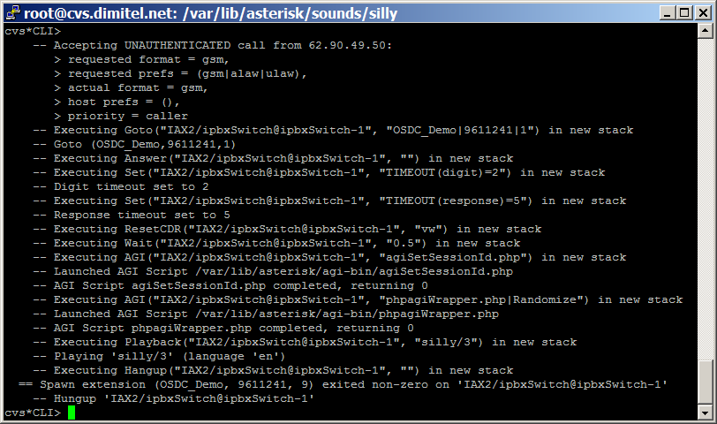
What does the CLI show?

Slide 31
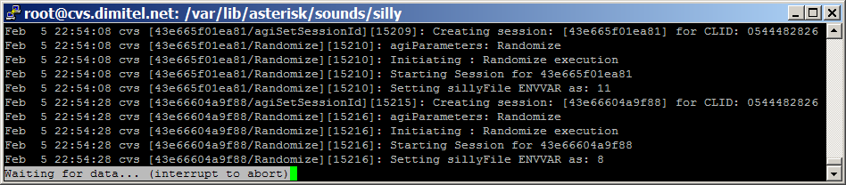
Syslog says…
In other words: “use the log luke, use the log!”

Slide 32
A touch of management skills
The Asterisk Manager Interface is a TCP based server, capable of communicating directly with the Asterisk application core from an external system.
Almost any kind of AGI application can be converted to an Asterisk Manager based application.
PHPAGI includes a manager connection facility, directly available from the PHPAGI class, or as a standalone class.

Slide 33
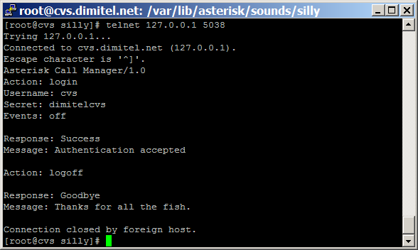
Manual Interaction
Manual interaction with the Asterisk Manager can be performed by performing a telnet to port 5038, and interacting directly.
Each interaction with the manager looks like this:

Slide 34
While inside the manager
While inside the manager interface, a list of 32 manager based functions is available at your disposal.
Remember, a careful usage of Manager, AGI and Dialplan can create a very powerful application.
Misusage will create a havoc application and an un-maintainable code base.

Slide 35
Manager Commands
AbsoluteTimeout: Set Absolute Timeout (privilege: call,all)
ChangeMonitor: Change monitoring filename of a channel (privilege: call,all)
Command: Execute Command (privilege: command,all)
Events: Control Event Flow
ExtensionState: Check Extension Status (privilege: call,all)
GetVar: Gets a Channel Variable (privilege: call,all)
Hangup: Hangup Channel __(privilege: call,all)
IAXpeers: List IAX Peers (privilege: system,all)
ListCommands: List available manager commands
Logoff: Logoff Manager
MailboxCount: Check Mailbox Message Count (privilege: call,all)
MailboxStatus: Check Mailbox (privilege: call,all)
Monitor: Monitor a channel (privilege: call,all)
Originate: Originate Call (privilege: call,all)
ParkedCalls: List parked calls
Ping: Ping

Slide 36
Manager Commands (Cont.)
QueueAdd: Queues (privilege: agent,all)
QueueRemove: Queues (privilege: agent,all)
Queues: Queues
QueueStatus: Queue Status
Redirect: Redirect (privilege: call,all)
SetCDRUserField: Set the CDR UserField (privilege: call,all)
SetVar: Set Channel Variable (privilege: call,all)
SIPpeers: List SIP Peers (chan_sip2 only. Not available in chan_sip as of 9/20/2004) (privilege: system,all)
Status: Status (privilege: call,all)
StopMonitor: Stop monitoring a channel (privilege: call,all)
ZapDialOffhook: Dial over Zap channel while offhook
ZapDNDoff: Toggle Zap channel Do Not Disturb status OFF
ZapDNDon: Toggle Zap channel Do Not Disturb status ON
ZapHangup: Hangup Zap Channel
ZapTransfer: Transfer Zap Channel
ZapShowChannels: Show Zap Channels

Slide 37
Questions anyone?
For more information about Asterisk please refer to http://www.asterisk.org.il
For information about Asterisk programming and Open Source VoIP revolution, please refer to http://www.voip-info.org
PHP/MySQL/PERL Talents are welcome to hand in your CV’s after the lecture.

Slide 38
Thank you
Your Asterisk™ Partner in Israel

