Slide 1
Multilingual programming techniques
OSDC::Israel::2006
February 28, 2006
Jason Elbaum
Freescale Semiconductor Israel

Slide 2
Multilingual programming techniques
15 reasons to choose a programming language
Compiled or interpreted?
Getting the best of both worlds
3 interpreted languages compared
12 languages in 12 minutes

Slide 3

Choosing a programming language

Slide 4
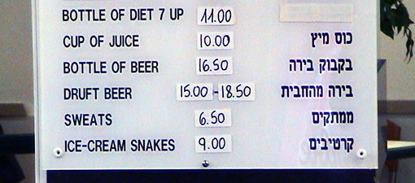
The Question
When deciding which programming language to use for a project, what characteristics should we consider?
The importance of learning another language… correctly!

Slide 5
15 reasons to choose a programming language
In no particular order...
Language issues:
  Paradigms and abstractions
  Performance (CPU, memory)
  Clarity and expressiveness
  Maintainability
  Development speed
  Accessibility to users
  Application-domain support
    (mathematics, GUI, string handling, networking, parallelism...)

Slide 6
15 reasons to choose a programming language
Environmental issues:
  Platforms / platform independence
  Tools
  Libraries
Business issues:
  Popularity
  Familiarity (you, developers, users)
  Support
  Price
  Business policy

Slide 7
Languages we won't be discussing
Special-purpose languages such as:
  Make
  Lex / Yacc
  SQL
  TeX
  HTML
  Postscript
  Verilog
  And there's that other type of language programmers rarely use but should all be familiar with...

Slide 8
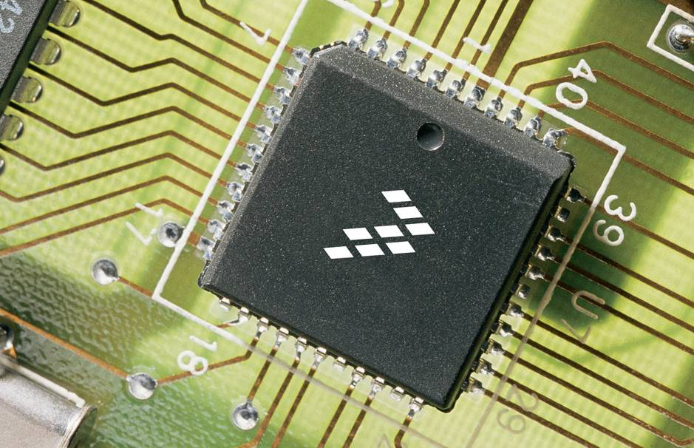
Compiled or interpreted

Slide 9
Common languages in my neck of the woods
  “Compiled languages” (Fortran-like)
  C
  C++
  Java*
  “Interpreted languages” (Lisp-like)
    “scripting”, “dynamic”...
  Unix Shells
  Perl
  Tcl
  Python

Slide 10
Compiled vs. interpreted languages
“Compiled”
“Interpreted”
Compile source to object files, link to libraries & executables
Execute source code immediately on parsing
Long modify-build-test cycle
Fast modify-build-test cycle
Data types checked by compiler
Types, if any, checked at runtime
Generic programming through templates, STL, inheritance
Built-in high-level generic data types (lists, hashes, functions)
Hard to let users write code
Easy for users to extend system
Memory can be managed manually or garbage collected
Memory managed automatically
Easy to call native code libraries
Native code libraries must be wrapped

Slide 11
Compiled vs. interpreted languages (cont)
“Compiled”
“Interpreted”
Executable code can be highly optimized and fine tuned
Runtime overhead limits performance
Large platform-dependent binary files to distribute
Distribute compact platform-independent source files. May need to distribute interpreter & libraries
Data type changes can force large recompilation
Data type changes usually require only local modifications
Public libraries less extensive, more platform-dependent
Often have vast public repositories of open-source libraries
Cumbersome to debug at runtime
Easy to add debug code and inspect data structures.

Slide 12
Strengths: Compiled vs. interpreted languages
  Each type of language has its strengths:
  Compiled: High performance, fine optimization
  Good for intense computation, data management
  Interpreted: Fast development cycle, flexible source code, powerful libraries, compact distribution, fewer memory errors
  Good for user interfaces, high-level logic, system interaction
  Wouldn’t it be nice to combine the advantages of each kind of language?

Slide 13
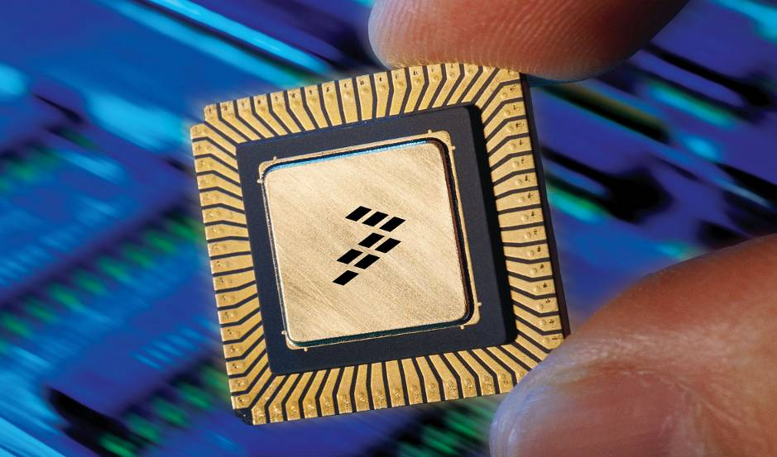
Getting the best of both worlds

Slide 14
My dream language...
  For development:
    Rapid modify / run cycle for agile development
    Compact source code without redundant constructs
    GUI development and refactoring tools
    Clear syntax and high abstraction level
    Extensive open-source libraries and user community
    Easy to call native code libraries
  For release and deployment:
    Portability and platform-independence
    Easy preparation of all-in-one release package
  For performance:
    High-performance optimizer and potential for low-level fine tuning

Slide 15
Getting the best of both worlds
  Back in the real world, there are three possible approaches:
  1. Improve the development speed, flexibility and reliability of a compiled language
  2. Improve the efficiency of an interpreted language
  3. Combine two (or more) languages in a single system, using a compiled language for the computational core and an interpreted language for user interfaces and high-level logic
I’ll discuss 3. first, then talk a bit about 1. and 2.

Slide 16
When not to combine languages
If your application does not require
high-performance computing
fine-tuned memory management, or
linking with existing code libraries…
there may be no reason to use a compiled language!
Just write it in Perl (or Python, if you insist)

Slide 17
Combining languages
Typical structure:
  C / C++ for the computational backend
  Tcl / Perl / Python for user interfaces and high-level logic
The classic example:
  Emacs (C / Lisp)
Many commercial tools in my field have user interfaces based on Tcl, or some other interpreted language

Slide 18
Diagram: combining languages
Note: If you heard my talk last year, you can take a nap now.
User interaction
Tcl / Perl / Python front end
Glue layer
C / C++ back end
Either language can be the main program: The back end can
launch the front end, or vice versa.

Slide 19
“Glue layer” can be tight
1. Front end linked directly with compiled back end libraries
  Interpreted language interacts directly and transparently with compiled library
  Need to wrap functions from compiled library so they can be called by interpreted language
  Technical issues: Compiler flags, dynamic linking, etc.
  Data (arguments, return values) must be translated between language environments: different data structures, binary representations, memory management techniques
  Release must include language interpreter binaries / libraries, or require end user to install them, or assume they exist
  Wrapper generators:
    SWIG - http://www.swig.org/
    boost.python - http://www.boost.org/

Slide 20
Sample function wrapper for Tcl
  int CloxTclCmds::myNew(ClientData clientData, Tcl_Interp* interp,
  int argc, char *argv[]) {
  if (!IDMOccTclCmdsSvc::checkNumArgs(interp, argc, 0, 2,
  "Usage: Clox_new cmdLine"))
  return TCL_ERROR;
  const char* cmdline = (argc == 1) ? "" : argv[1];
  int argcCmdLine;
  char** argvCmdLine;
  if (Tcl_SplitList(interp, cmdline, &argcCmdLine, &argvCmdLine) == TCL_ERROR)
  return TCL_ERROR;
  CloxPlusInteractive* cloxInt =
  new CloxPlusInteractive(const_cast<const char**>(argvCmdLine));
  Tcl_Free((char *) argvCmdLine);
  Tcl_SetResult(interp, IDMOccTclCmdsSvc::ptr2string(cloxInt), TCL_DYNAMIC);
  return TCL_OK;
  }

Slide 21
“Glue layer” can be less tight
2. Front end and back end communicate through sockets or network access
  Client/server model
  Need to write communication layers in both languages, devise a protocol, handle communication failures
  Managing the processes can be complex
  Easy to couple different front ends to the same back end, or vice versa – just implement the same protocol
  Can be slow if a lot of data must be transferred

Slide 22
“Glue layer” can be loose
3. Front end and back end communicate via files or pipes
  Front end writes data, invokes back end to process it, reads results.
  Or back end invokes front end to get user input, display output
  You probably do this all the time anyway!
  Not possible to achieve real-time interactivity between live front end (GUI) and live back end (in-memory data model)
  High degree of flexibility; modules of the system are standalone executables
  Easy to build and test independently

Slide 23
Extending the principle
A real live system
User interaction
File I/O
Tcl GUI / command-line
Perl parsers
Direct link to back end
C++ data model

Slide 24

Comparing interpreted languages

Slide 25
3 common interpreted languages compared
Tcl
Perl
Python
Syntax
Primitive, awkward, ugly
Compact, complex, obscure
Simple, clear
Built-in data types
Strings, lists
Strings, lists, hashes, regexps, file handles, references, etc.
Strings, lists, tuples, dictionaries, objects
Regexps
Obscure function calls
Built in, powerful
Standard import module
OO
Sort of, with add-on package
Built in, but not intuitive
Built in with natural syntax

Slide 26
3 common interpreted languages compared
Tcl
Perl
Python
Libraries
Fair
Excellent
Excellent
Efficiency
Depends on the task
Depends on the task
Depends on the task
Scalability
Poor
Good
Good
End users
Easy to use
Some like it, some don’t
Unfamiliar, but not hard to learn

Slide 27
So: Tcl, Perl or Python?
(Not that anyone's asking my advice anyway)
For a user command language, Tcl has familiar shell-style syntax (to an extent)
For a user extension language, use a language they’ll know or can easily learn. Should your users learn a new programming language just to use your application?
For internal code, prefer a language with power, speed, modularity, OO, libraries: Perl or Python. Use whichever is more natural to you (or your boss!)
Tcl is not recommended for coding large systems. (Or any systems…)
Of course, the final choice may be up to company policy!

Slide 28
What about Java?
Like C++: compiled and object-oriented, with static type checking
But incorporates some of the strengths of interpreted languages:
  Compiles to compact platform-independent bytecode
  Links dynamically at runtime
  Memory is garbage collected
  Code changes can’t force a general recompile and link cycle
  Extensive free libraries support graphics, networking, etc.
  Optimizing compilers can (allegedly) approach C++ speeds
  Regular syntax supports extensive suites of development tools (class browsers, auto-documentation, even code manipulation)
  Combines many advantages of both types of languages
(Or so they say - I haven’t used it much myself…)

Slide 29
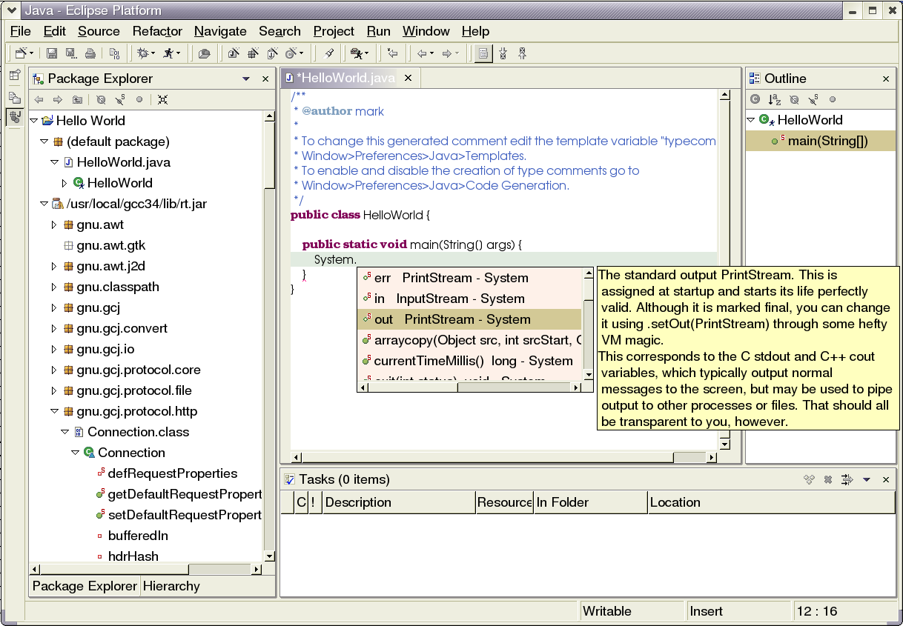
Java screenshot

Slide 30

12 languages in 12 minutes

Slide 31
12 languages in 12 minutes
A lightning introduction to an arbitrary selection of interesting languages, all of them worth learning.
Some of them have pioneered software engineering techniques.
Others are attempts to qualify as my dream language...
I've even used a few of them now and then!
  Ruby
  Eiffel
  Smalltalk
  Self
  Fortran
  Lisp
  Forth
  ML
  Prolog
  Haskell
  J
  Erlang

Slide 32
Ruby
What Perl would be if it were fully object-oriented
Everything is an object
Simple OO syntax is natural, built in
Multiplatform, easily extended
Code blocks can be passed as objects
Large user base, extensive libraries
Free, open source (with some questions about fine points of license)
http://www.ruby-lang.org/en/

Slide 33
Ruby sample code
class Person
def initialize(name, age)
@name, @age = name, age
end
def <=>(person)
@age <=> person.age
end
def to_s
"#{@name} (#{@age})"
end
attr_reader :name, :age
end
group = [ Person.new("John", 20),
Person.new("Markus", 63),
Person.new("Ash", 16)
]
puts group.sort.reverse

Slide 34
Eiffel
Compiled, static typing – like C++
Flexible object system and generic classes – like Smalltalk
Simple, regular syntax
Fully object-oriented: Everything is an object
Design by contract
Developed by Bertrand Meyer, described in his best-selling book, Object-Oriented Software Construction
Meant for industrial-strength software engineering
Innovative linker only rebuilds code that has changed
Full version with IDE & extensive libraries costs good money; free non-commercial version available
http://www.eiffel.com/

Slide 35
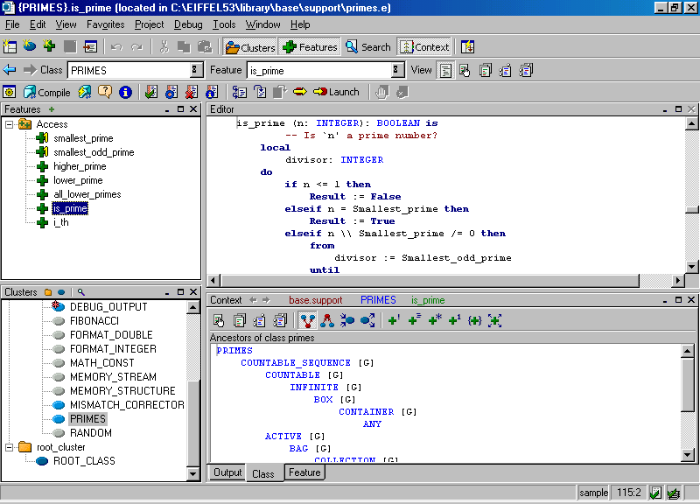
Eiffel screenshot

Slide 36
Smalltalk
Interpreted, dynamic language
Simple syntax, though unfamiliar at first
Fully object-oriented: Everything is an object, even bool and int
First language with GUI, IDE, window system, etc (early 1980s)
Both commercial and free versions available
An underappreciated language – and fun to use!
http://www.squeak.org/

Slide 37
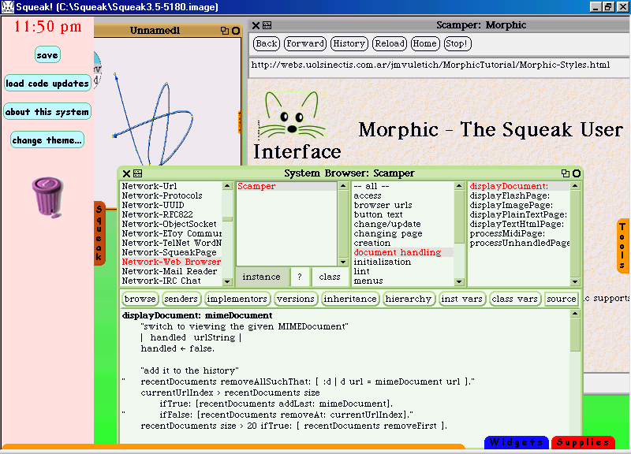
Smalltalk screenshot

Slide 38
Self
Like Smalltalk, but without classes
“Prototype-based language”
Objects are created by cloning other objects
Objects inherit behavior by pointing to parent objects
Inheritance tree can be changed dynamically
Code can be changed while system is running
Code is compiled incrementally, and optimized at runtime (including inlining) when hotspots are identified
GUI uses animation; GUI objects can be assembled and disassembled
No longer actively maintained
Valuable articles on language and GUI design at Sun's site
http://research.sun.com/self/language.html

Slide 39
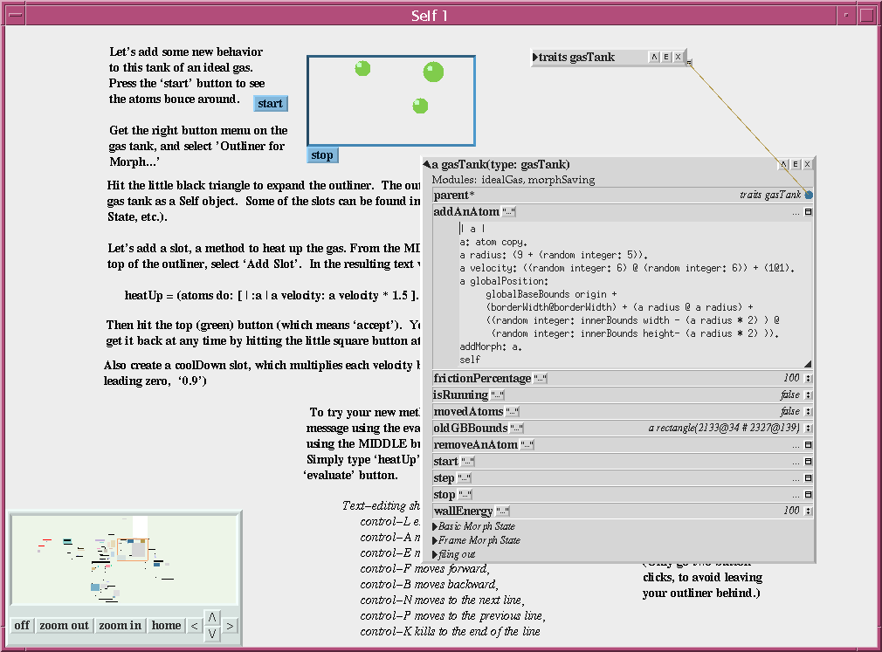
Self screenshot

Slide 40
Fortran
The first programming language
Granddaddy of all procedural languages
Still the standard in engineering and much of computational mathematics
Built-in support for multidimensional arrays
Pre-1990 Fortran: no pointers, no dynamic allocation of memory
Limited semantics enable compiler loop optimizations

Slide 41
Fortran sample code (excerpt)
PROGRAM quadratic
real a,b,c
real discrm, v, w
print*, 'Enter coefficients A, B, C:'
read*, A, B, C
print 97, A,B,C
v = -b / (2*a)
discrm = b*b - 4*a*c
if ( discrm .LT. 0 ) then
w = sqrt(-discrm) / (2*a)
print 99, 1, v, ' +', w
print 99, 2, v, ' -', w
end if
97 format(/,F8.3,' x^2 +',F8.3,' x + ',F8.3,' = 0',/)
END

Slide 42
Lisp
One of the oldest programming languages
Granddaddy of all interpreted / functional / generic languages
Interpreted and interactive, with program modified dynamically by user
Everything is a list (code and data)
Simple but annoying syntax (prefix notation, Lots of Irritating Stupid Parentheses)
Functional programming (lots of recursion), but also supports procedural paradigm, and later Lisps have objects too
Used mostly for Artificial Intelligence applications – and Emacs
Recursion, recursion, recursion
Lisp machines (1980s) were hardware-optimized for Lisp

Slide 43
Lisp sample code
(defun expon (base powr)
(cond ((zerop powr) 1)
((evenp powr)
(expon (* base base ) (truncate powr 2)))
(t (* base (expon (* base base)
(truncate powr 2))))))
(defun squash (list1)
(cond ((null list1) nil)
((atom list1) (list list1))
(t (append (squash (car list1))
(squash (cdr list1))))))
(defun count-it (itemx listx)
(setq listx (squash listx))
(cond ((null listx) '0)
((atom listx) '0)
((cond ((not (equal itemx (car listx)))
(count-it itemx (cdr listx)))
(t (1+ (count-it itemx (cdr listx))))))))

Slide 44
Forth
Stack-based environment
Postfix syntax (“reverse Polish notation”)
Simple and elegant
Compact code, lightweight system, easy to implement
Interpreted or compiled
Syntax resembles a twisted assembly language; can make you crosseyed
Granddaddy of PostScript

Slide 45
Forth sample code
Version 1:
\ CRC Checksum 07/15/83
: ACCUMULATE ( oldcrc char – newcrc)
256 * \ shift char to hi-order byte
XOR \ & xor into previous crc
8 0 DO \ Then for eight repetitions,
DUP 0< IF \ if hi-order bit is "1"
16386 XOR \ xor it with mask and
DUP + \ shift it left one place
1+ \ set lo-order bit to "1"
ELSE \ otherwise, i.e. hi-order bit is "0"
DUP + \ shift it left one place
THEN
LOOP ; \ complete the loop
Version 2:
: ACCUMULATE ( oldcrc char – newcrc)
256 * XOR 8 0 DO DUP 0< IF
16386 XOR DUP + 1+ ELSE DUP + THEN LOOP ;

Slide 46
ML
Functional language with strong typing
Type inference: Automatically determines correct type of an expression
Syntax is simple, but style of programming takes getting used to
Interactive like Lisp
Current implementations (SML, Caml, O'Caml) approach C in speed
Some people just love it!
http://www.smlnj.org/sml.html

Slide 47
ML sample code
(* Lists *)
fun length nil = 0
| length (_::t) = 1 + length t
fun append (nil, l) = l
| append (h::t, l) = h :: append (t, l)
fun rev nil = nil
| rev (h::t) = rev t @ [h]
local
fun rev_helper (nil, a) = a
| rev_helper (h::t, a) = rev_helper (t, h::a)
in
fun rev l = rev_helper (l, nil)
end

Slide 48
Prolog
Programming Logic – a logic programming language
Programs consist of a database of facts, and rules for generating new facts from old facts
Once was popular for natural language processing
No imperative commands – program is controlled by database search, instantiating variables, backtracking, recursion
Free and commercial implementations are available

Slide 49
Prolog sample code
create_tree(Niltree) :- var(Niltree).
inserted_in_is(Item, btree(Item, L_T, R_T)).
inserted_in_is(Item, btree(ItemI, L_T, R_T)) :-
Item @< ItemI,
inserted_in_is(Item, L_T).
inserted_in_is(Item, btree(ItemI, L_T, R_T)) :-
Item @> ItemI,
inserted_in_is(Item, R_T).
inorder(Niltree, [ ]) :- var(Niltree).
inorder(btree(Item, L_T, R_T),Inorder) :-
inorder(L_T, Left),
inorder(R_T, Right),
append(Left, [Item|Right], Inorder).

Slide 50
Haskell
Functional language
Lazy evaluation
Like ML, but different
Hope you heard Audrey's talk on Sunday
Other than that, I don’t know enough about it to write a slide
http://www.haskell.org/
There are always more interesting languages to learn!

Slide 51
Haskell sample code
qsort [] = []
qsort (x:xs) = qsort elts_lt_x ++ [x] ++ qsort elts_greq_x
where
elts_lt_x = [y | y <- xs, y < x]
elts_greq_x = [y | y <- xs, y >= x]

Slide 52
J
Compact code
Successor to APL
Syntax makes Perl look like Python...
Commercial software, expensive licensing (no open source version?)
Other than that, I don’t know enough about it to write a slide
http://www.jsoftware.com
There are always more interesting languages to learn!

Slide 53
J sample code
NB. m comb n generates all possible choices of m elements
NB. from i.n
comb=: [:;(,.&.><@:>:@;\.)^:(i.@>:@-~`[`(1:<@i.@{.~<:@-,2:))
comb=: 4 : 0
k=. i.>:d=.y.-x.
z=. (d$<i.0 0),<i.1 0
for. i.x. do. z=. k ,.&.> ,&.>/\. >:&.> z end.
; z
)

Slide 54
Erlang
Concurrency-oriented, distributed programming
Developed at Ericsson to control highly networked devices
Supports large, robust, failure-proof industrial systems
Available under a free software license
http://www.erlang-projects.org/
There are always more interesting languages to learn!

Slide 55
Erlang sample code
ping(0, Pong_PID) ->
Pong_PID ! finished,
io:format("ping finished~n", []);
ping(N, Pong_PID) ->
Pong_PID ! {ping, self()},
receive
pong ->
io:format("Ping received pong~n", [])
end,
ping(N - 1, Pong_PID).
pong() ->
receive
finished ->
io:format("Pong finished~n", []);
{ping, Ping_PID} ->
io:format("Pong received ping~n", []),
Ping_PID ! pong,
pong()
end.

Slide 56
Computing Language Shootout Benchmarks
Dozens of languages compared for speed, compactness, memory, etc.
Contribute your own implementations to improve the ranking of your favorite language – or to learn new ones
http://shootout.alioth.debian.org
Have fun!

