Slide 1
Perl::Tk
December 14, 2005
Dov Levenglick
Jason Elbaum

Slide 2
Perl::Tk
What is Perl::Tk?
Perl::Tk is Perl’s GUI module written in both Perl and C.
Perl::Tk is event driven, which means that is sits around waiting for something to happen so that it can react to it.
What can I do with Perl::Tk?
Create GUI for your scripts
Where can I find documentation for Perl::Tk?
http://cdserver/Volumes/PerlCD_A/tk/index.htm (Mastering Perl/Tk (the Emu book), O’Reilly)
http://aspn.activestate.com/ASPN/docs/ActivePerl/5.8/site/lib/Tk.html
http://groups-beta.google.com/group/comp.lang.perl.tk

Slide 3
Perl::Tk
Main concepts in Perl::Tk:
  Main window.
    A main window is a window as one is used to seeing. This window contains various widgets.
  Widgets.
    A widget is an element in the (hierarchy of the) main window that enables some functionality to the GUI (menu, button, text entry…). A widget will generate an event when the user does something with the GUI (moves the mouse, presses a button…) that will perform an action.
  Event driven.
    The programmer does not have to be aware at every moment what is happening with the GUI, rather you register the effect of each event with the library and allow the library to deal with it.
  Main loop.
    The Perl::Tk library runs a constant loop (MainLoop) that constantly monitors the events happening on the GUI. As long as the MainLoop isn’t exited, the GUI will still respond to events.

Slide 4


Perl::Tk
Basic example:
Notice MainWindow, MainLoop and the use of OOP
As seen in windows:
As seen in UNIX:
#!/usr/local/bin/perl5.6.1
use Tk;
my $mw = MainWindow->new;
$mw->title("Basic Example");
$mw->Button(
-text=> "That's all folks",
-command =>[sub {exit}]
)->pack();
MainLoop;

Slide 5
Perl::Tk
As demonstrated in the previous slide, each GUI must have at least one instance of MainWindow and one call MainLoop.
In the MainWindow there can be a variety of widgets, which can nest other widgets.
The user must place the widget in it's place in order to have it displayed. In the previous slide this was done with pack, however there are various ways. Until placed, the widget won't be visible.

Slide 6
Perl::Tk – Geometry Management
There are 4 forms of geometry management:
  pack – the most commonly used. Places a widget in the next available place in the parent widget (MainWindow or other), based on the placing of all other packed widgets. Overlapping of widgets is prohibited.
  grid – used for creating a grid of widgets such as in a spreadsheet. Not covered in this course.
  place – places the widget at absolute or relative coordinates in the parent widget. Not covered in this course.
  form – can be seen as a combination of place and pack. That is, the widgets may overlap however they are placed relative to each other. Not covered in this course.

Slide 7
Perl::Tk – pack
Overlapping is prohibited.
A packed widget is fitted “around” previously packed widgets, thus the order in which the widgets are packed effects the way that the widgets are displayed.
A widget is packed against the top available space in the containing widget unless otherwise specified.
Each widget is placed in an “allocation rectangle”.
A widget is placed in the center of the allocation rectangle unless otherwise specified.
An allocation rectangle will take up the size required by it (with no padding and/or resizing) unless otherwise specified.

Slide 8
Perl::Tk – pack
The pack function is performed on the reference to the widget and can be called with 0 or more parameters.
As you can see, $button holds a reference to a button packed inside the MainWindow. The button is packed with the default parameters (side and anchor).
#!/usr/local/bin/perl5.6.1
use Tk;
my $mw = MainWindow->new;
$mw->title("Basic Example");
my $button = $mw->Button(
-text=> "That's all folks",
-command =>[sub {exit}],
);
$button->pack(
-side =>’top’,
-anchor =>’center’,
);
MainLoop;

Slide 9
Perl::Tk – pack
-side => 'left' | 'right' | 'top' | 'bottom
  Puts the widget against the specified side of the window or Frame
-fill => 'none' | 'x' | 'y'| 'both'
  Causes the widget to fill the allocation rectangle in the specified direction
-expand => 1 | 0
  Causes the allocation rectangle to fill the remaining space available in the window or Frame
-anchor => 'n' | 'ne' | 'e' | 'se' | 's' | 'sw' | 'w' | 'nw' | 'center'
  Anchors the widget inside the allocation rectangle
-after => $otherwidget
  Puts $widget after $otherwidget in packing order
-before => $otherwidget
  Puts $widget before $otherwidget in packing order

Slide 10
Perl::Tk – pack
-in => $otherwindow
  Packs $widget inside of $otherwindow rather than the parent of $widget, which is the default
-ipadx => amount
  Increases the size of the widget horizontally by amount
-ipady => amount
  Increases the size of the widget vertically by amount
-padx => amount
  Places padding on the left and right of the widget
-pady => amount
  Places padding on the top and bottom of the widget

Slide 11
Perl::Tk – pack
When the widget is packed against the top or the bottom side of the containing widget, the allocation rectangle is as wide as the containing widget and as tall as the packed widget.
When the widget is packed against the right or the left side of the containing widget, the allocation rectangle is as tall as the containing widget and as wide as the packed widget.
Once a widget has been packed, the remaining space in the containing widget is reduced.
For more information on the pack geometry management, refer to :
http://cdserver/Volumes/PerlCD_A/tk/ch02_01.htm#mastperltk-CHP-2-SECT-1

Slide 12
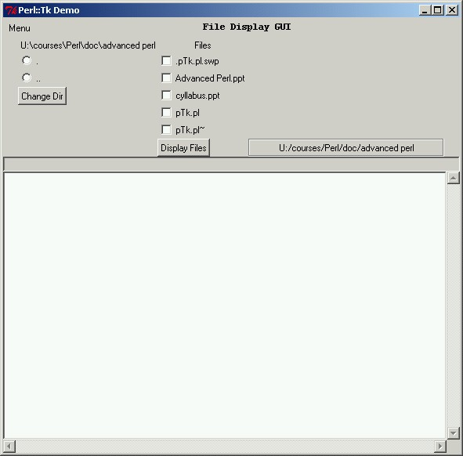
Perl::Tk
In this session we will incrementally build a Perl::Tk GUI that displays the contents of selected files as well as browses through a directory tree.

Slide 13
Perl::Tk – Widgets
The following list is of the most commonly used widgets:
Frame
Menubutton
Label
Button
Checkbutton
Radiobutton
Entry
FileSelect
Scrolled
Text
All these widgets are incorporated in to the demo.

Slide 14
Perl::Tk - Frame
In order to help you organize your widgets, the frame widget exists. It is basically an empty placeholder for other widgets to be put in to.
Generally speaking, when designing a GUI, you place frames in the main window (a frame per area) and the widgets in that frame.
Frames can be nested

Slide 15
Perl::Tk - Frame
#!/usr/local/bin/perl5.6.1
use Tk;
#######################
my $mw = MainWindow->new;
$mw->title("Perl::Tk Demo");
my $menuFrame = $mw->Frame->pack(-fill=>'x');
my $fileSelectFrame = $mw->Frame->pack;
my $manualFileFrame = $fileSelectFrame->Frame->pack(-side => 'left');
my $autoFileFrame = $fileSelectFrame->Frame->pack(-side => 'right', -fill => 'y');
my $fileDisplayFrame = $mw->Frame->pack;
#######################
MainLoop;

Slide 16

Perl::Tk Menubutton
The menu widget allows you to create menus for your GUI.
my $mainMenu = $menuFrame->Menubutton(
-tearoff => 0,
-text=>'Menu',
)->pack(
-side =>'left',
);
$mainMenu->command(
-label=>'Exit',
-command=>'exit',
);

Slide 17

Perl::Tk - Label
A label is simply a place where you can put text (or an image) to be displayed.
$menuFrame->Label(
-text=>File Display GUI',
-font=>'-adobe-courier-bold-r-normal-*-*-120-*-*-m-*-koi8-1'
)->pack(
-padx=>10
);

Slide 18
Perl::Tk - Buttons
The Button widget creates a standard “pressable” button.
The Checkbutton widget creates a button that can either be checked or not. The value of each Checkbutton is saved in a scalar variable (by default: checked=1, not checked=0).
The Radiobutton widget creates a button that can either be checked or not. The value of all related Radiobuttons is saved in a scalar variable. As all grouped Radiobuttons are related by using the same scalar variable, only one Radiobutton in a group can be checked at any given time.

Slide 19
Perl::Tk - Buttons
The following few slides will demonstrate Buttons, Radiobuttons and Checkbuttons.
The demonstration of these buttons will be implemented in a subroutine for reasons that will become clear later on.
Assume that $text has been declared. It will be explained on the slide titled Perl::Tk – Text
&displayDirAndFiles($manualFileFrame, \$curdir, \%curfiles, \$text);

Slide 20
Perl::Tk - Buttons
my $curdir = cwd;
my %curfiles;
&displayDirAndFiles($manualFileFrame, \$curdir, \%curfiles, \$text);
sub displayDirAndFiles {
my $parent = shift;
my $dirRef = shift;
my $filesRef = shift;
my $textRef = shift;
Tk::destroy($_) for ($parent->children);
chdir $$dirRef;
opendir(DIR,".") or die $!;
my @dir = sort readdir DIR;
closedir DIR;
my @dirs = grep {-d $_} @dir;
my @files = grep {-f $_} @dir;
my $mainFrame = $parent->Frame->pack;
my $entryFrame =$parent->Frame->pack;
my $dirFrame = $mainFrame->Frame->pack(-side => 'left', -anchor => 'n',);
my $fileFrame = $mainFrame->Frame->pack(-side => 'right', -anchor => 'n');

Slide 21
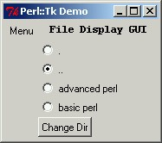
Perl::Tk - Buttons
foreach (@dirs) {
$dirFrame->Radiobutton(
-value => $_,
-variable => $dirRef,
-text => $_,
)->pack(
-anchor => 'nw'
);
}
$dirFrame->Button(
-text => 'Change Dir',
-command => [sub {&displayDirAndFiles($parent, $dirRef, $filesRef, $textRef)}],
)->pack(
-side => 'left',
);

Slide 22
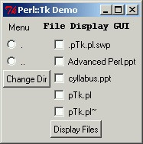
Perl::Tk - Buttons
%$filesRef = ();
foreach my $fl (@files) {
my $cb = $fileFrame->Checkbutton;
$cb -> configure(
-text => $fl,
-command => [
sub{if (${$_[0]->cget(-variable)})
{$filesRef->{$fl} = 1}
else {delete $filesRef->{$fl}}
}, $cb],
);
$cb->pack(
-anchor => 'nw',
);
}
$fileFrame->Button(
-text => 'Display Files',
-command => [sub{&displayFileContents($text, $filesRef)}],
)->pack(
-anchor => 'w',
);
Assume that displayFileContents has been defined. It will be shown on Perl::Tk – End of Example

Slide 23
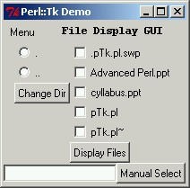
Perl::Tk - Entry
An entry is a widget that is most commonly used in order to enable the user to enter a value in to a variable.
Note: we are still in the subroutine we started for the buttons
my $entry = $entryFrame->Entry->pack(-side=>'left');
$entryFrame->Button(
-text => 'Manual Select',
-command => [
sub{ %$filesRef = ();
$filesRef->{$entry->get}=1;
&displayFileContents($text, $filesRef)
}],
)->pack(-side=>'right');

Slide 24
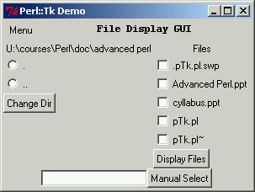
Perl::Tk
The following slides uses labels again, once again in the subroutine, in order to make it clear to the user what he/she is seeing
This marks the end of displayDirAndFiles
$dirFrame->Label(
-text => File::Spec->rel2abs("."),
)->pack;
$fileFrame->Label(
-text => 'Files'
)->pack;
} # end of the subroutine

Slide 25
Perl::Tk - FileSelect
The FileSelect widget allows the user to browse through a directory tree and choose single file. It receives as an input the directory from which to start browsing.
This widget will only be displayed when the Show() method is called on it's reference.
The widget returns either when a file is selected (in which case it return filename of the selected file) or until the 'cancel' button is pressed (in which case it returns an empty string)

Slide 26
Perl::Tk - FileSelect
my $fileSel = $autoFileFrame->FileSelect(
-directory => $curdir,
);
$autoFileFrame->Button(
-textvariable => \$curdir,
-width => 40,
-relief => 'groove',
-command => [
sub {
%curfiles = ();
my $file = $fileSel->Show;
if ($file) {
$curfiles{$file} = 1;
&displayFileContents($text, \%curfiles);
}
}],
)->pack(
-side => 'bottom',
);

Slide 27
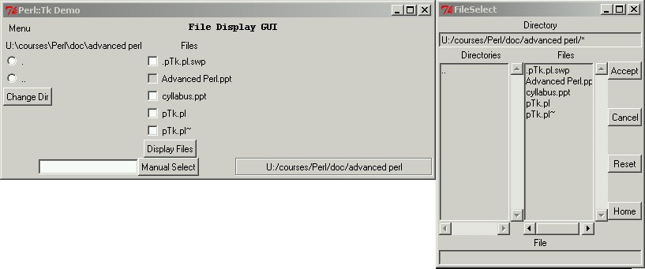
Perl::Tk - FileSelect

Slide 28
Perl::Tk - Scrolled
The Scrolled widget adds scroll bars to whichever widget is passed to it as a parameter at the places indicated.
This widget can't be used on its own.
We will demonstrate it together with the Text widget (next slide).

Slide 29
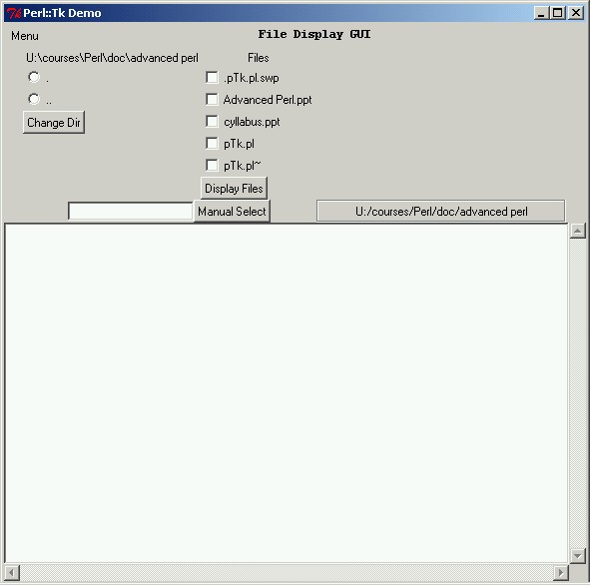
Perl::Tk – Text
The Text widget creates a window within the parent widget and allows text to be displayed and edited
Notice that this is the $text that we assumed to be declared on slide Perl::Tk - Buttons
my $text = $fileDisplayFrame->Scrolled(
'Text',
-scrollbars => 'se',
-wrap => 'none',
)->pack(
-fill => 'x',
);

Slide 30
Perl::Tk – End of Example
In order to neatly wrap thing us, we have to implement the subroutine displayFileContents that we assumed to be defined on slide Perl::Tk - Buttons

Slide 31
Perl::Tk – End of Example
sub displayFileContents{
my $textWinRef = shift;
my $filesRef = shift;
my $fileContents = '';
$textWinRef->delete('1.0','end');
local $/ = undef;
foreach (sort keys %$filesRef) {
if (-T) {
open (FILE,"$_") or next;
$fileContents .= <FILE>;
close FILE;
}
else {
$fileContents .= "$_ is not a text file\n"
}
$fileContents .= '*' x 10;
$fileContents .= " End of file: $_ ";
$fileContents .= '*' x 10 ."\n\n\n";
}
$textWinRef->insert('end',$fileContents);
}

Slide 32
Perl::Tk - bind
The bind method associates callbacks with X events. If callback is specified, bind will arrange for callback to be evaluated whenever the event(s) given by sequence occur in the window(s) identified by $widget or tag. If callback is an empty string then the current binding for sequence is destroyed, leaving sequence unbound.
You can use any number of events such as:
  Key presses, releases (and sequences thereof)
  Mouse moves
  Mouse wheel
$widget->bind("<ButtonRelease-1>", sub { });
For more information, refer to: http://cdserver/Volumes/PerlCD_A/tk/ch15_02.htm#INDEX-2175

