Slide 1


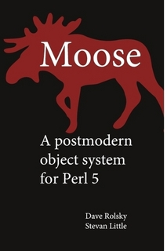


Modern Perl 5
Padre, the Perl IDE
Lightweight web framework
All things Perl
Over 20,001 packages

Slide 2



Perl 6 - Camelia
Rakudo *, June 2010
VM for Python, Ruby, PHP...
November wiki written in Perl 6

Slide 3


Perl Community
German Perl Workshop www.perl-workshop.de
German Perl Mongers www.perlmongers.de Berlin, Frankfurt, Stuttgart, Erlangen, Hannover, ...
$foo Perl Magazin
YAPC::EU, 4-6 August, Pisa

