Slide 1


YAPC::ISRAEL::2003
Programming Perl
in the .NET Environment
by Yevgeny Menaker

Slide 2
.NET Overview
Managed Code (MSIL)
CLR
JIT Compiler
Multi-Platform
Multi-Lingual (C#, VB.NET, Perl, J#, …)
Last Release: April 2003, Version 1.1

Slide 3
.NET Technologies
ADO.NET (Data Access)
ASP.NET (Web Applications)
Web Services
Mobile.NET (Mobile Web Forms)
Compact.NET
Speech.NET

Slide 4

PerlNET is not the Relativity theory,
but…

Slide 5
PerlNET: Where To Get?
PerlNET is part of ActiveState®’s Perl Development Kit (PDK) starting from version 4.0.
Available as 30-days trial or commercial version.

Slide 6
PerlNET: Prerequisites
.NET Framework (available without a fee from the Microsoft web site)
ActivePerl starting from build 628 (available without a fee from the ActiveState web site).

Slide 7
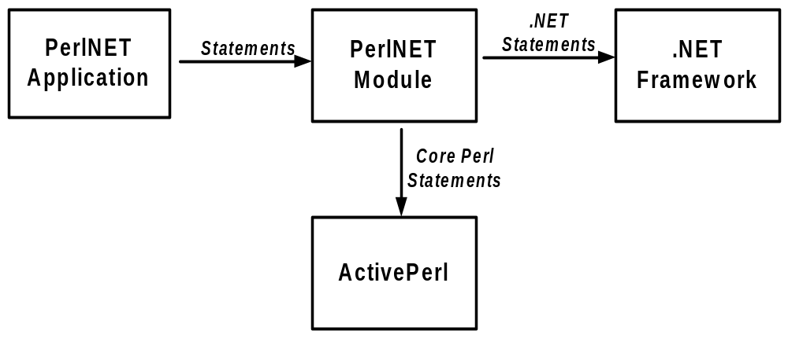
PerlNET Architecture

Slide 8
Features Overview
Create Perl packages that are fully functional both in Core Perl and .NET
Create monolithic .NET applications
Working with .NET objects
Create .NET classes (PerlNET components)
Extend existing .NET classes

Slide 9
Features Overview (Cont’d)
Implement .NET interfaces
Create GUI applications using Windows Forms
Use ADO.NET Framework to work against various Data Sources
Authoring ASP.NET Web Application with help of close PerlNET relative - the PerlASPX product

Slide 10
PerlNET says Hello
# Hello.pl
use namespace "System";
use PerlNET qw(AUTOCALL);
Console->WriteLine("Hello from PerlNET!");

Slide 11
PerlNET says Hello
# Hello.pl
use namespace "System";
use PerlNET qw(AUTOCALL);
Console->WriteLine("Hello from PerlNET!");
plc Hello.pl

Slide 12
PerlNET Module
Holds helpful constants and functions specific for usage in the .NET Environment
Importing functions and constants syntax:
use PerlNET qw(f1, …, fn);

Slide 13
Working with .NET classes
Calling methods through arrow syntax ( -> )
Accessing properties through hash-reference syntax ( ->{} )
Getting and Setting static fields with help of PerlNET::get() and PerlNET::set() helpers respectively
Constructing new object through the new method

Slide 14
Working with .NET Classes Sample
1 # fileinfo.pl
2 use strict;
3 use namespace "System";
4 use namespace "System.IO";
5 use PerlNET qw(AUTOCALL, true)
6
7 # Construct FileInfo object
8 my $file = FileInfo->new("c:\\fileinfo.pl");
9
10 # Get Length property
11 print "File Length: ", $file->{Length}, "\n";
12
13 # Copy the file to "newfile.pl" invoking CopyTo method
14 $file->CopyTo("newfile.pl", true);
15
16 # Set LastAccessTime property of the file to current time
17 $file->{LastAccessTime} = PerlNET::get("DateTime.Now");
18
19 # Output $file object
20 print $file, "\n";

Slide 15
Pure Perl Components
Provide Interface definition for .NET Framework
Implement Methods and Properties exactly as in case of Core Perl Module

Slide 16
“=for interface” POD blocks
1 package YAPC::Samples::Car;
2
3 =for interface
4 # special attribute that tells PerlNET that
5 # our class is compatible with Core Perl
6 [interface: pure]
7
8 # Constructor (should be static)
9 static Car Car(int Year);
10
11 # Method definition (returns string)
12 str GetCarInfo();
13
14 # Property definition (an integer)
15 int Year;
16 =cut
17
18 # Implementation goes here
19 . . .

Slide 17
Package Implementation
1 # Implementation goes here
2 # Constructor
sub new
{
my ($self, $Model, $Year) = @_;
my $s = bless {}, $self;
$s->Year($Year);
return $s;
}
# Get information about the car
sub OutputCarInfo
{
my $self = shift;
my $info = "Year of production: " . $self->Year();
return $info;
}

Slide 18
Package Implementation (Cont’d)
# The code for setting and getting property
sub Year
{
my($self, $value) = @_;
# decide if Year is being read or mutated
if (defined $value)
{
# Property is being mutated
$self->{Year} = $value;
}
else
{
# Property is being read
return $self->{Year};
}
}

Slide 19
Types in the Interface Definition
.NET Type (System namespace) | PerlNET type
Boolean | bool
Char | char
Sbyte | sbyte
Int16 | short
Int32 | int
Int64 | long
Byte | byte
UInt16 | ushort
UInt32 | uint
UInt64 | ulong
Single | float
Double | double or num
Decimal | decimal
Object | any
String | str

Slide 20
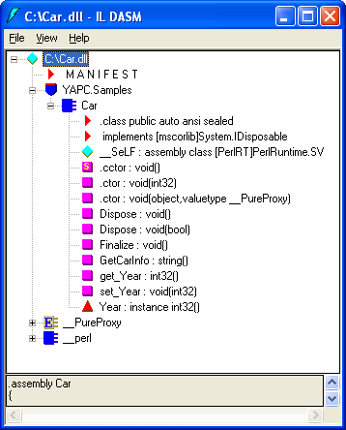
.NET Assembly: What’s inside?
plc Car.pm –target="library"
Car.dll

Slide 21
Steps for Wrapping Existing Perl Components
Download and Install an appropriate module
Create interface definition for component (“=for interface”)
Perform workarounds if needed

Slide 22
Wrapping Sample (Whitespace.pm)
1 # Whitespace.pm
2 package Whitespace;
3 use strict;
4 =for interface
5 [interface: pure]
6 static Whitespace(str infile);
7 static Whitespace(str infile, str outfile);
8 int detect();
9 int cleanup();
10 wantarray! str[] Status();
11 str error();
12 int leadclean();
13 int trailclean();
14 int indentclean();
15 int spacetabclean();
16 int eolclean();
17 =cut

Slide 23
Wrapping Sample (Cont’d)
require Whitespace;
20 # Convert Perl Hash to array
21 sub Status
{
my $self = shift;
my @arr = %{$self->status()};
return @arr;
}

Slide 24
C# Client Program
// construct object
Whitespace ws = new Whitespace("input.txt", "output.txt");
// Detect bogus whitespaces
int det = ws.detect();
string err = ws.error();
// Check if there was an error
if (err != null)
{
Console.WriteLine(err);
return;
}
Console.Write("{0} bogus whitespaces found\n", det);
if (det > 0)
{
// Output information
// about detected whitespaces
string[] stat = ws.Status();
foreach (string s in stat)
{
Console.WriteLine(s);
}
// Perform input file clean-up
ws.cleanup();
}

Slide 25
.NET Components - Characteristics
May Extend existing .NET classes
May Implement .NET interfaces
Non-sealed

Slide 26
.NET Components – Implementation Issues
No [interface: pure] attribute
Constructor Subroutine has the same name as module
First argument for non-static methods is reference and not hash:
my $this = shift;
Unable to access internal object hash

Slide 27
Mixed Components
The same characteristics as .NET Components
Mark interface definition with the following attribute:
[interface: mixed]
May store Perl structures as private data inside internal hash
Retrieving internal hash as follows:
my ($this, $self, @args) = @_;

Slide 28
Components Development Summary
3 types of PerlNET Components
  Pure Perl Type
  .NET Type
  Mixed Type

Slide 29
Web Development and ASP.NET
Dynamic Web Server Pages (similar to JSP)
Pages are compiled into .NET assemblies (better performance)
Full separation of code and presentation layers
Access all .NET Framework classes from ASP.NET pages code

Slide 30

PerlASPX Product
Adds Perl to family of ASP.NET compliant languages
Prerequisites:
  IIS Web Server
  .NET Framework
Important: .NET Framework should be installed after IIS

Slide 31
ASP.NET Page Sample
1 <!-- RandomCodeBehind.aspx -->
<%@ Page Language="Perl" Src="RandomCodebehind.aspx.pm"
Inherits=MyWebPage %>
<HTML>
<BODY>
<DIV align="center">
<H2>Random Number Generation</H2>
<asp:Label RUNAT="SERVER" id="lblNum"/>
<BR>
<FORM RUNAT="SERVER">
<asp:button RUNAT="SERVER“
id="btnGenerate"
TEXT="Generate New Number"
onClick=Generate
tooltip="Click to generate new random number"/>
</FORM>
</DIV>
</BODY>
</HTML>

Slide 32
Code-Behind
# RandomCodebehind.aspx.pm
package MyWebPage;
use namespace "System";
use namespace "System.Web";
use namespace "System.Web.UI";
use namespace "System.Web.UI.WebControls";
=for interface
[extends: System.Web.UI.Page]
public void Generate(Object source, EventArgs e);
protected field Label lblNum;
=cut
sub Generate
{
my $this = shift;
$this->{lblNum}->{Text} = "Random number is " . int(rand(37));
}

Slide 33
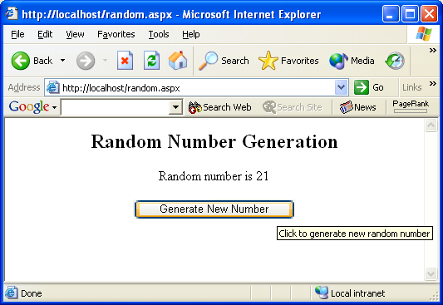
Running ASP.NET Page

Slide 34

Epilogue

Slide 35
“Programming Perl in the .NET Environment“, book by Yevgeny Menaker, Michael Saltzman and Robert J. Oberg; ISBN: 0130652067; Publisher: Prentice Hall PTR
ActiveState PerlNET reference; Web Site: http://aspn.activestate.com/ASPN/Perl/Reference/Products/PDK/PerlNET/Reference.html
“Make Your Existing Perl Apps .NET-compliant“, article by Yevgeny Menaker, Publisher: DevX Inc.;
Web Site: http://www.devx.com/dotnet/Article/8015
“PerlNET - An Introduction“, article by Srinivasan Manickam and Michael Saltzman; Publisher: CoDe Magazine - September-October 2002 issue;
Web site: http://www.devx.com/codemag/Article/8515
“Author Advanced .NET Applications in Perl“ article by Yevgeny Menaker and Srinivasan Manickam; Publisher: CoDe Magazine - November-December 2002 issue;
Web site: http://www.devx.com/codemag/Article/10306
“.NET speaks Perl now“, article by Yevgeny Menaker, Publisher: DotNetForce.com; Web Site: http://www.dotnetforce.com/SiteContent.aspx?Type=10000&Folder=article&File=article20023107001.xml

