Slide 1
Data Exploration and Statistical Analysis of Type 2 Diabetes (T2D) Dataset
Basic programming skills in Python
TA Hadar and Liron
Notes:
Today, we'll explore how to interpret datasets with tools like descriptive statistics, visualizations, and statistical tests to uncover insights into factors like BMI, blood glucose, and cholesterol. By the end of this session, you'll understand how to apply Python to real-world biological data analysis.

Slide 2
Common Types of Data in biology
Quantitative Data (Numerical): Measurable data like BMI, blood glucose, and cholesterol.
Qualitative Data (Categorical): Descriptive data like blood type or disease stage.
Time-Series Data (Temporal): Data tracked over time, such as glucose levels over months.
Spatial Data: Data with physical or geographical context, like species distribution.
Omics Data (High-Dimensional): Large-scale datasets such as genomics and proteomics.
Notes:
In biology, data can come in many forms. The five most common types are:
Quantitative Data: Numeric and measurable data, like BMI or blood glucose levels.
Qualitative Data: Descriptive categories, like blood type or disease stage.
Time-Series Data: Data collected over time, such as monitoring glucose levels daily.
Spatial Data: Data tied to physical locations, like species distribution or organ imaging.
Omics Data: Large-scale datasets, including genomics and proteomics, that provide complex molecular insights.
In today’s lecture, we’ll primarily focus on quantitative data, which includes continuous measurements relevant to T2D analysis.

Slide 3
Introduction to Type 2 Diabetes (T2D)
What is T2D? - A metabolic disorder characterized by high blood glucose levels - Linked to obesity, genetic predisposition, and lifestyle Why Study BMI, Blood Glucose, and Cholesterol? - BMI: Indicator of body fatness - Blood Glucose: Central to diabetes diagnosis - Cholesterol: Cardiovascular risk factor
Notes:
Type 2 Diabetes (T2D) is a chronic metabolic disorder characterized by high blood glucose levels due to insulin resistance and impaired insulin production. It is influenced by several risk factors:
Obesity, particularly high BMI.
Genetic predisposition, meaning family history can increase risk.
Lifestyle factors like poor diet and lack of exercise.
We study variables like BMI, blood glucose, and cholesterol because they are key indicators of diabetes progression and related health complications.

Slide 4
Types of Statistical Tests in Biology
1. Descriptive Statistics: Summarizes and describes dataset features. 2. Inferential Statistics: Draws conclusions from sample data. 3. Correlation and Regression Analysis: Examines variable relationships. 4. Multivariate Analysis: Analyzes multiple variables simultaneously.
Notes:
To analyze biological data, we apply various statistical tests:
Descriptive Statistics – Summarizes the dataset using metrics like the mean and standard deviation.
Inferential Statistics – Makes predictions about a population based on sample data using tools like t-tests and ANOVA.
Correlation and Regression Analysis – Examines relationships between variables, such as BMI and glucose levels.
Multivariate Analysis – Analyzes multiple variables simultaneously to detect patterns in complex datasets.
For today’s analysis, we will focus on descriptive statistics, correlation analysis, and hypothesis testing with t-tests.

Slide 5
Python Libraries for Data Analysis
Pandas – Data manipulation library: load, clean, and transform data in a way that’s easy to work with.
Matplotlib – Plotting library: creates visualizations, like charts and graphs, to see patterns and relationships in the data.
SciPy – Used for scientific and statistical computations. It includes tools to test relationships between variables, such as correlation, or perform hypothesis testing.
NumPy – Foundation for numerical computing. It works with arrays, which are similar to lists but allow us to do mathematical operations on large datasets more efficiently.
Notes:
Python offers powerful libraries for biological data analysis:
Pandas – Essential for data manipulation, including loading, cleaning, and transforming datasets.
Matplotlib – Used for creating plots and visualizations like histograms and box plots.
SciPy – Provides statistical tools for testing relationships between variables and conducting hypothesis tests.
NumPy – Supports efficient numerical operations and data storage using arrays.
These libraries make it easier to analyze and visualize biological data in Python.

Slide 6
Descriptive Statistics
- Summarizes and describes key dataset features. - Metrics: Mean, Median, Mode, Standard Deviation, Variance. - Provides insight into data distribution. - Python: `data.describe()` for numerical data summaries.
Notes:
Descriptive statistics summarize and describe the main features of a dataset. This includes:
Mean (average value),
Median (middle value),
Mode (most frequent value),
Standard Deviation (data spread), and
Variance (spread squared).
Using Python's data.describe(), we can quickly generate these summaries to understand our dataset’s distribution.

Slide 7
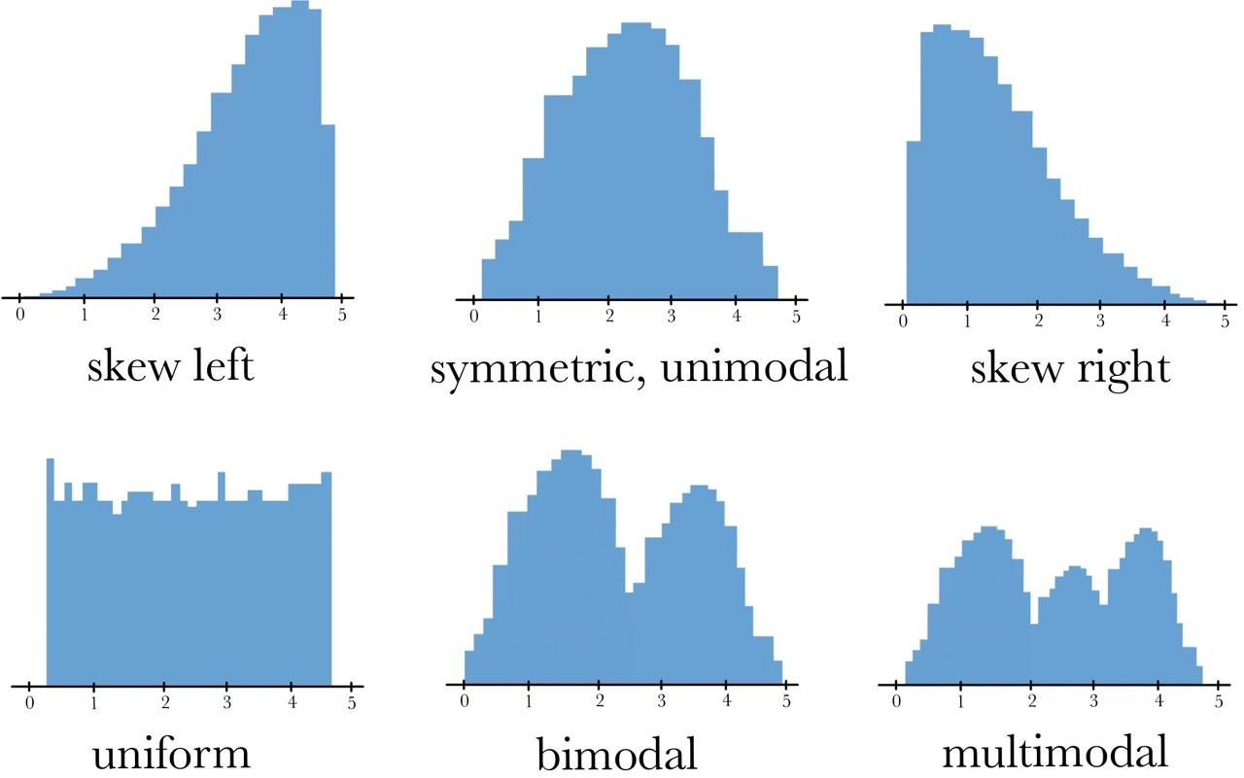
Histograms
- Visual representation of data distribution. - Reveals skewness, modality, and outliers. - Best for continuous data like BMI and Blood Glucose.
Notes:
Histograms are ideal for visualizing data distribution. They show the frequency of data within specified intervals (bins).
They reveal skewness (whether data leans towards high or low values), modality (number of peaks), and outliers.
For example, plotting blood glucose levels can show if most patients fall within normal, prediabetic, or diabetic ranges.

Slide 8
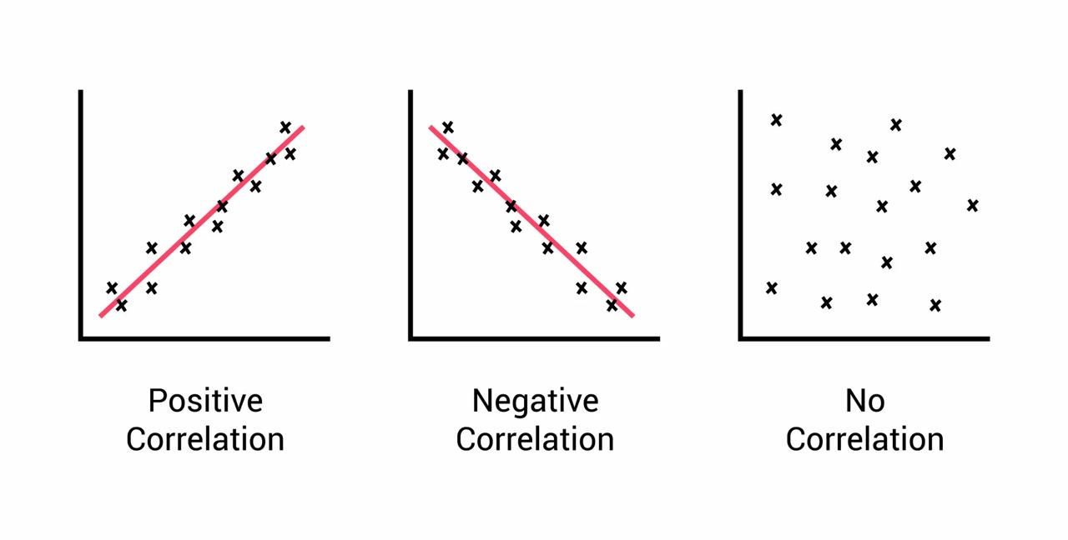
Pearson Correlation
- Measures linear relationships between two continuous variables. - Ranges from -1 to +1: +1 → Strong positive correlation 0 → No correlation -1 → Strong negative correlation - Assumes normal distribution and linearity.
Notes:
Pearson correlation measures the strength and direction of a linear relationship between two continuous variables.
A value close to +1 indicates a strong positive correlation (both increase together).
A value near 0 shows no correlation.
A value close to –1 indicates a strong negative correlation.
For example, we can analyze if a higher BMI is associated with increased blood glucose levels in diabetic patients.

Slide 9
T-Test and P-Value
- T-Test: Compares group means (e.g., Male vs. Female). - Null Hypothesis (H₀): No difference. - Alternative Hypothesis (H₁) :Significant difference. - P-Value: - p < 0.05 → Reject H₀ (Significant difference) - p ≥ 0.05 → Fail to reject H₀ (No difference)
Notes:
A t-test compares the means of two groups to determine if they are statistically different.
Null Hypothesis (H₀): There is no difference between group means.
Alternative Hypothesis (H₁): There is a significant difference.
The p-value tells us whether to reject the null hypothesis.
If p < 0.05, we reject H₀ and conclude a significant difference exists.
If p ≥ 0.05, we fail to reject H₀, indicating no significant difference.
For example, we might use a t-test to compare blood glucose levels between male and female patients.

Slide 10
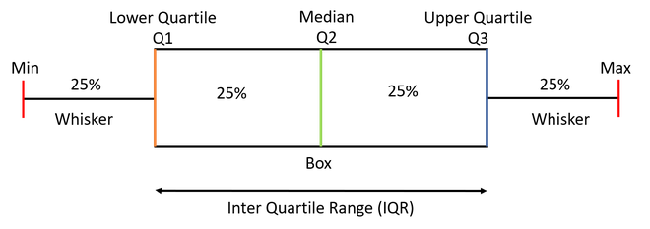
Box Plots
- Visual tool for comparing distributions across groups. - Shows median, quartiles, and outliers. - Effective for comparing blood glucose levels across demographics.
Notes:
Box plots are excellent for comparing distributions across different groups.
They display the median, quartiles, and outliers.
The box represents the interquartile range (middle 50% of data), and the whiskers extend to the rest of the data within 1.5× the IQR.
Outliers are plotted as individual points beyond the whiskers.
For example, a box plot can help us compare blood glucose levels between healthy and diabetic patients or between genders.

Slide 11


