Slide 1
DESIGN (ANTI-)PATTERNS
Coffee Break
Abstract Factory

Slide 2
WHAT ARE DESIGN PATTERNS
A software design pattern is a general, reusable solution to a commonly occurring problem. It is not a finished design that can be transformed directly into source or machine code. It is a description or template for how to solve a problem that can be used in many different situations. Design patterns are formalized best practices that the programmer can use to solve common problems when designing an application or system.
Types
Creational (singleton, builder, lazy init, abstract factory, object pool etc.)
Structural (adapter, bridge, decorator, facade, composite, proxy etc.)
Behavioral (iterator, strategy, template method, visitor, command etc.)
Concurrency (thread pool, double checked locking, monitor object, reactor etc.)

Slide 3
ABSTRACT FACTORY

Slide 4
ABSTRACT FACTORY
GoF Definition
Provide an interface for creating families of related or dependent objects without specifying their concrete classes.
Concept
The client creates a concrete implementation of the abstract factory and then uses the generic interface of the factory to create the concrete objects that are part of the theme. It doesn’t know (or care) which concrete object is returned by the factories, since it uses the generic interface of the factories.
Real-World Example
Consider a user interface toolkit that supports multiple look-and-feel standards. Different look-and-feels define different appearances and behaviour for user interface “widgets” like buttons and scrollbars. To be portable across look-and-feel standards, an application should not hard-code its widgets for a particular look-and-feel. We can solve this by creating an abstract WidgetFactory class that declares an interface for creating each basic kind of widget. There is also an abstract class for each kind of widget and concrete subclasses implement widgets for specific standards.

Slide 5
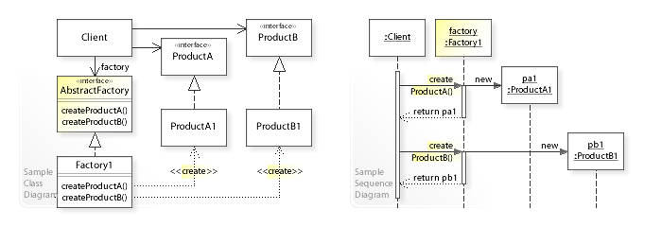
ABSTRACT FACTORY
UML
The client doesn’t define how the concrete factories are created
The client doesn’t have to know about the concrete factories or about the concrete product implementations

Slide 6
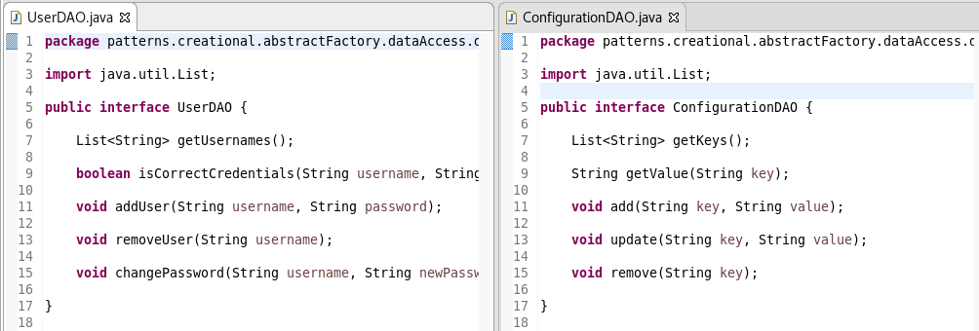
ABSTRACT FACTORY
Example implementation
Goal is to create a simple application
Doesn’t really have info about persistence yet, but let’s code anyways…
Start off by creating some basic data access objects definitions

Slide 7
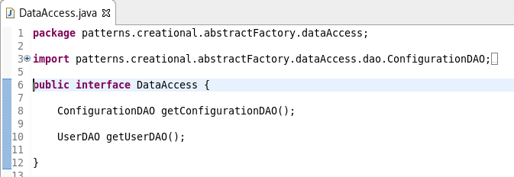
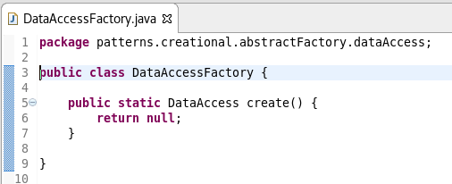
ABSTRACT FACTORY
Example implementation
DAO works fine, but I have to have an instance of it …
… and it’s an interface
Let’s create another interface!
(and a factory)

Slide 8
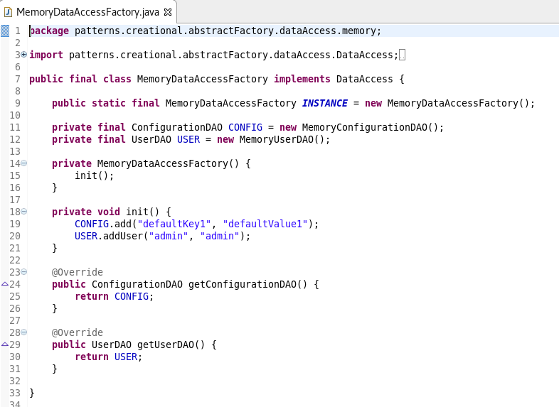
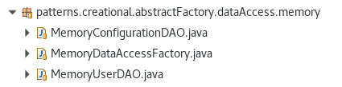
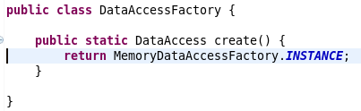
ABSTRACT FACTORY
Example implementation
At this point I am able to complete most of my development tasks
I can’t run tests however (since I’m returning null in the factory)
So let’s create a “temporary” solution for this (hashmaps FTW)

Slide 9
ABSTRACT FACTORY
Example implementation
Now my tests pass, and they are running REALLY fast
I am able to develop without being bothered by the nuances of the persistence layer (setting up a DB, creating and managing schemas, tables etc.)
I can even serialize my Maps to the disk and load them upon creating the DAO instances (thus having true data persistence)
The sky is blue, the grass is green, everything is fine
Until one day ...

Slide 10
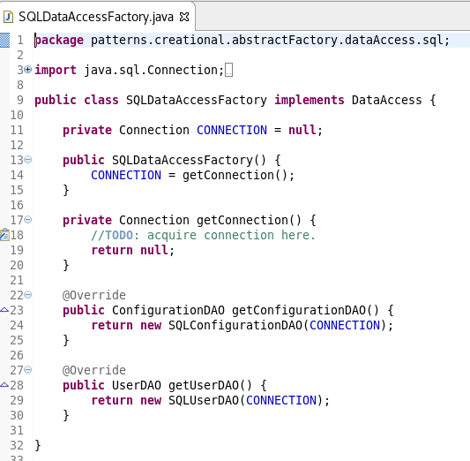
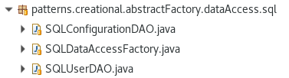
ABSTRACT FACTORY
Example implementation
… the team lead decides, that we have to have a Database for persistence
Which is fine, since my app only knows about the interfaces (and the factory class)
I still have to develop 3 new classes though (2x DAO, 1x factory)

Slide 11
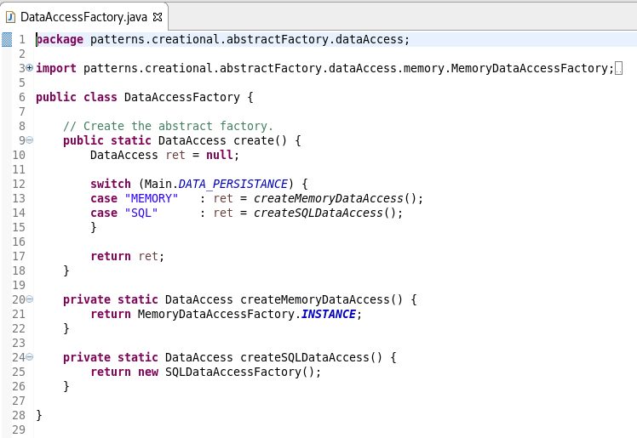
ABSTRACT FACTORY
Example implementation
The common factory class has to be altered (could even by dynamic via reflection)
I can reuse the tests created for the in-memory persistence
The database becomes a plugin into my application (and not the other way around)
I get a promotion and buy an island at the Bahamas

Slide 12
ABSTRACT FACTORY
Usage in the Java standard library
javax.xml.parsers.DocumentBuilderFactory#newInstance()
javax.xml.transform.TransformerFactory#newInstance()
javax.xml.xpath.XPathFactory#newInstance()

Slide 13
ABSTRACT FACTORY
Questions
What issues and challenges can be solved via an abstract factory?
How can an application be independent of how its objects are created.
How can a class be independent of how its objects it requires are created.
How families of realted or dependent objects can be created.

Slide 14
ABSTRACT FACTORY
Questions
What issues and challenges can be solved via an abstract factory?
How can an application be independent of how its objects are created.
How can a class be independent of how its objects it requires are created.
How families of realted or dependent objects can be created.
What are the main components of an abstract factory composition?
Abstract factory, concrete factory (0-n), abstract product, concrete product, client

Slide 15
ABSTRACT FACTORY
Questions
What issues and challenges can be solved via an abstract factory?
How can an application be independent of how its objects are created.
How can a class be independent of how its objects it requires are created.
How families of realted or dependent objects can be created.
What are the main components of an abstract factory composition?
Abstract factory, concrete factory (0-n), abstract product, concrete product, client
What is the issue of having classes hard-wired during compile time instead of using an abstract factory?
The client is not as easily reusable
It doesn’t allow changes during runtime, the code has to be recompiled
The client is hard to test, because no mock objects can be used instead of the real ones

Slide 16
ABSTRACT FACTORY
Questions
What issues and challenges can be solved via an abstract factory?
How can an application be independent of how its objects are created.
How can a class be independent of how its objects it requires are created.
How families of realted or dependent objects can be created.
What are the main components of an abstract factory composition?
Abstract factory, concrete factory (0-n), abstract product, concrete product, client
What is the issue of having classes hard-wired during compile time instead of using an abstract factory?
The client is not as easily reusable
It doesn’t allow changes during runtime, the code has to be recompiled
The client is hard to test, because no mock objects can be used instead of the real ones

