Slide 1

End of Year project
By: Temesi Szabolcs István & Szabó Levente

Slide 2
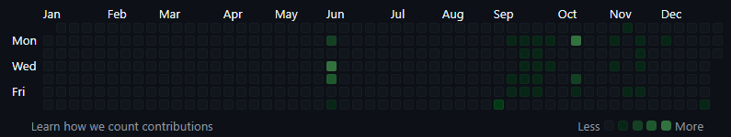
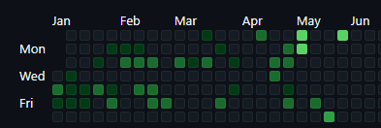







Project information
Time Investment
Programs used
Start: 2024 September
End: 2025 May
Visual Studio Code
XAMPP
paint.net
ChatGPT
Godot Engine
Audacity
Aseprite
Start date
2024
2025
End date

Slide 3
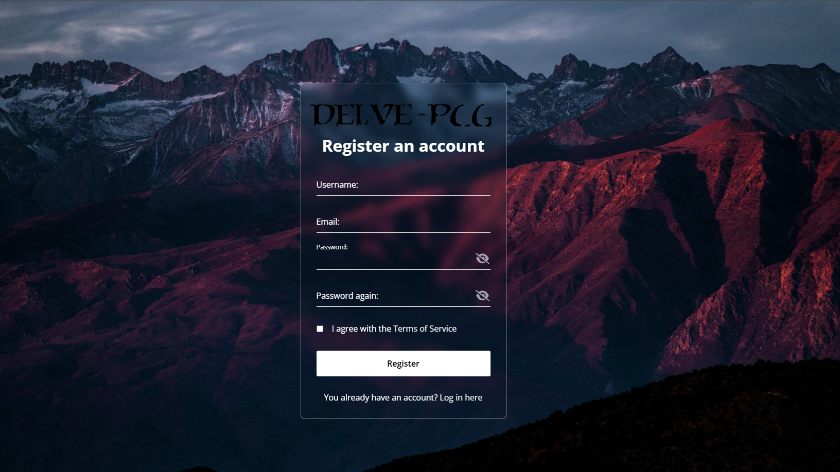
Registration page
It is available on these sites
You can
here
Simple input fields
Option to make your password visible and to hide again
In case you already have an account

Slide 4
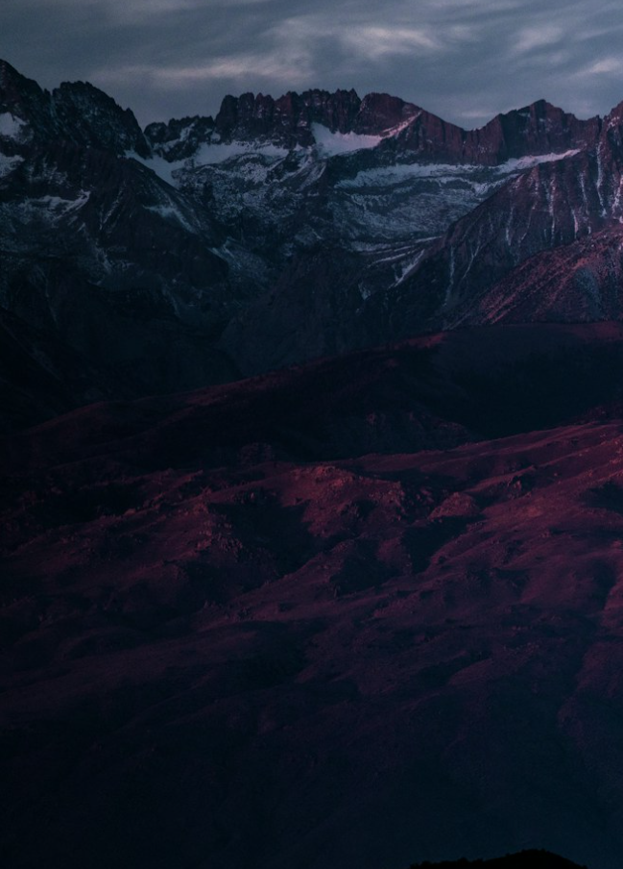
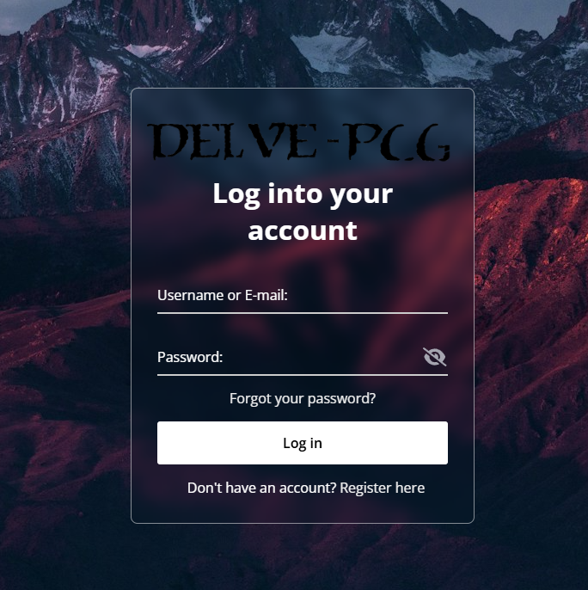
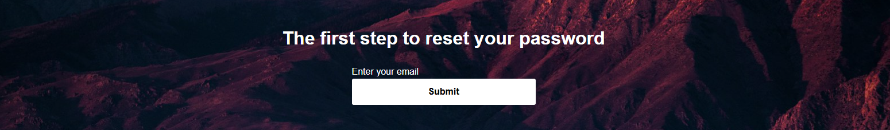
Login & Password reset page
It is available on this site
You can
here
Simple input fields
Option to make your password visible and to hide again
In case you don’t have an account
In case you forgot your password, worry non!

Slide 5
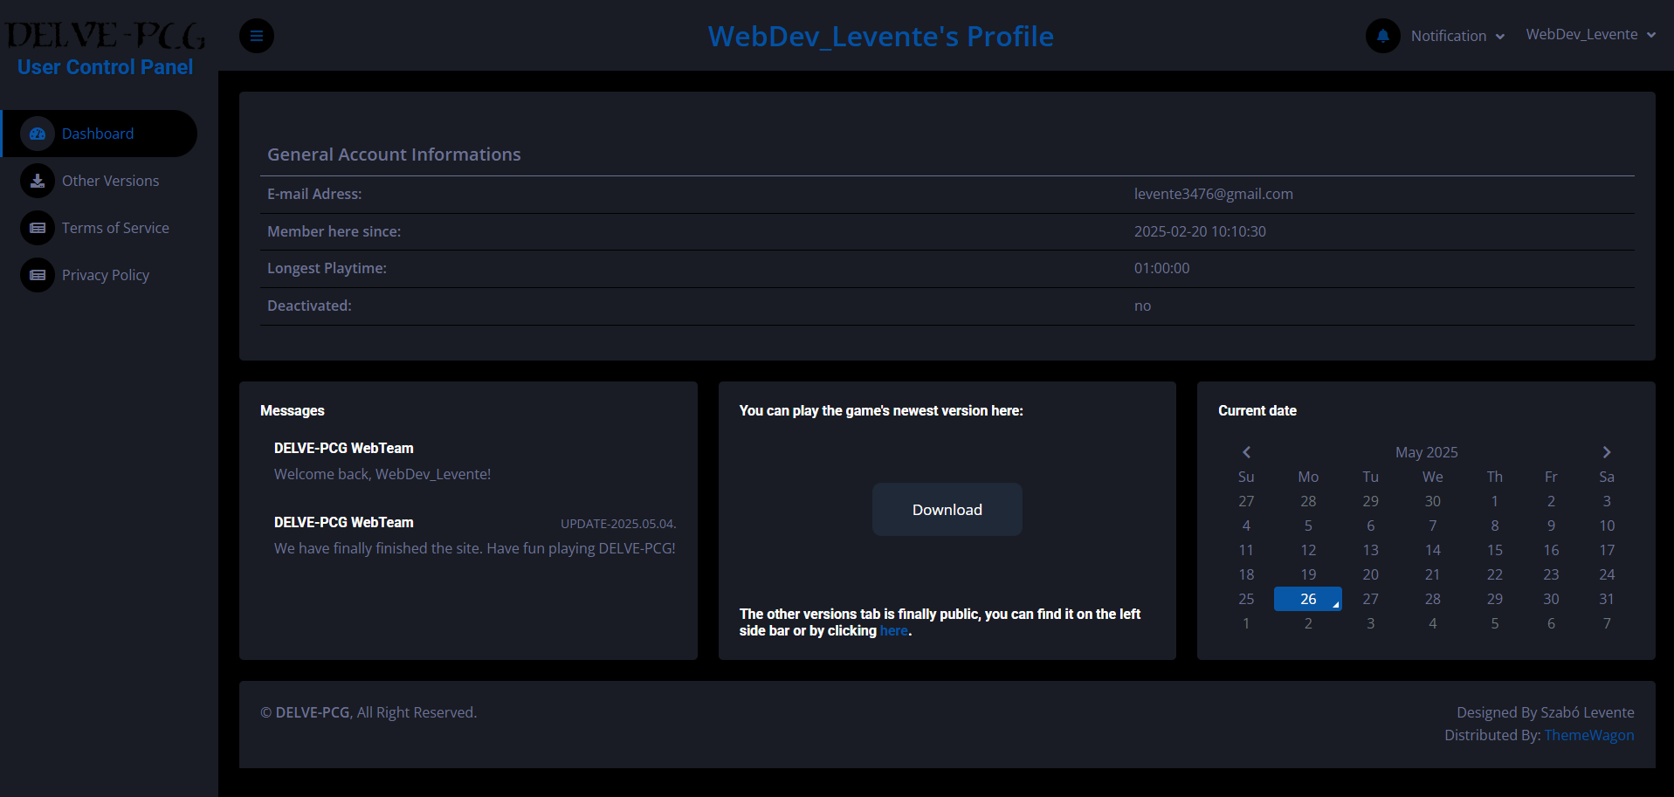
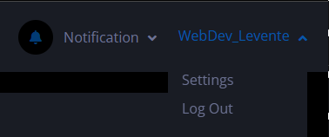

User Control Panel (UCP)
I am going to talk about this in the next slide
It is available on this site
Available after successful login
You can see some General Account Information
Download the latest version of the game
Check older versions of the game
As well as having the ability to read the Terms of Service and Privacy Policy in case there has been changes

Slide 6
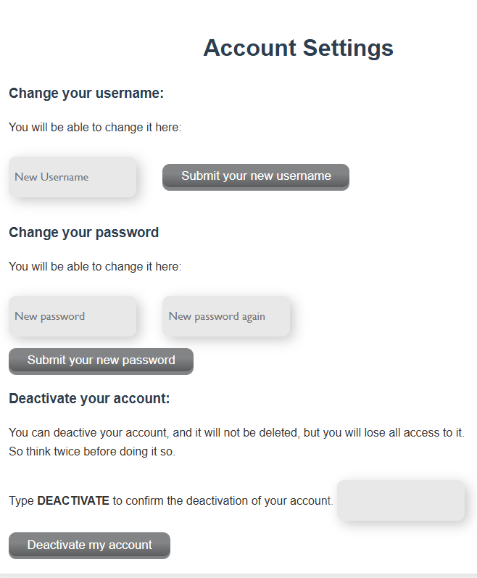
Account Settings
It is available on this site
Username changing option
Password changing option
(Proceed with Caution) Account Deactivation option

Slide 7

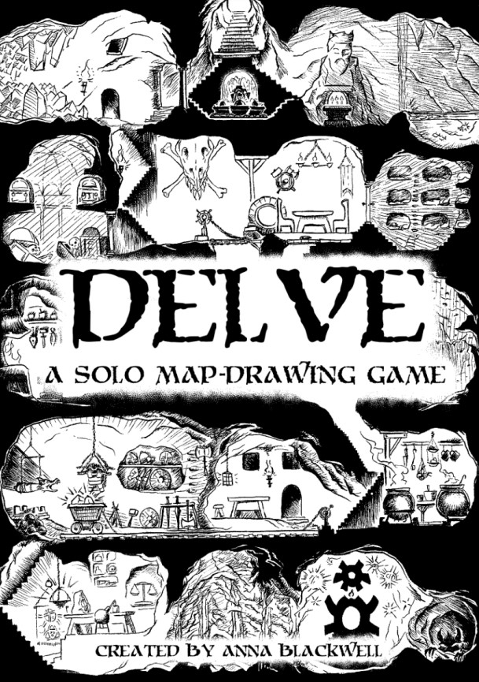
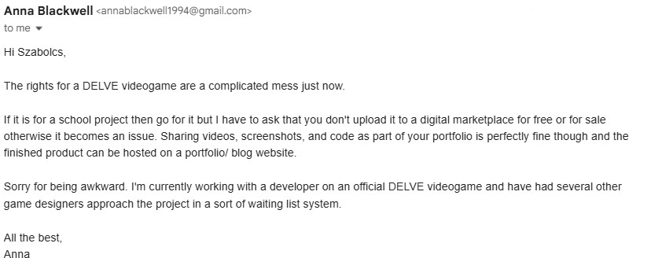
Source
The Game is based on Delve by Blackwell games, witch is a tabletop pen-and- paper game about building a fort and finding tresure.

Slide 8
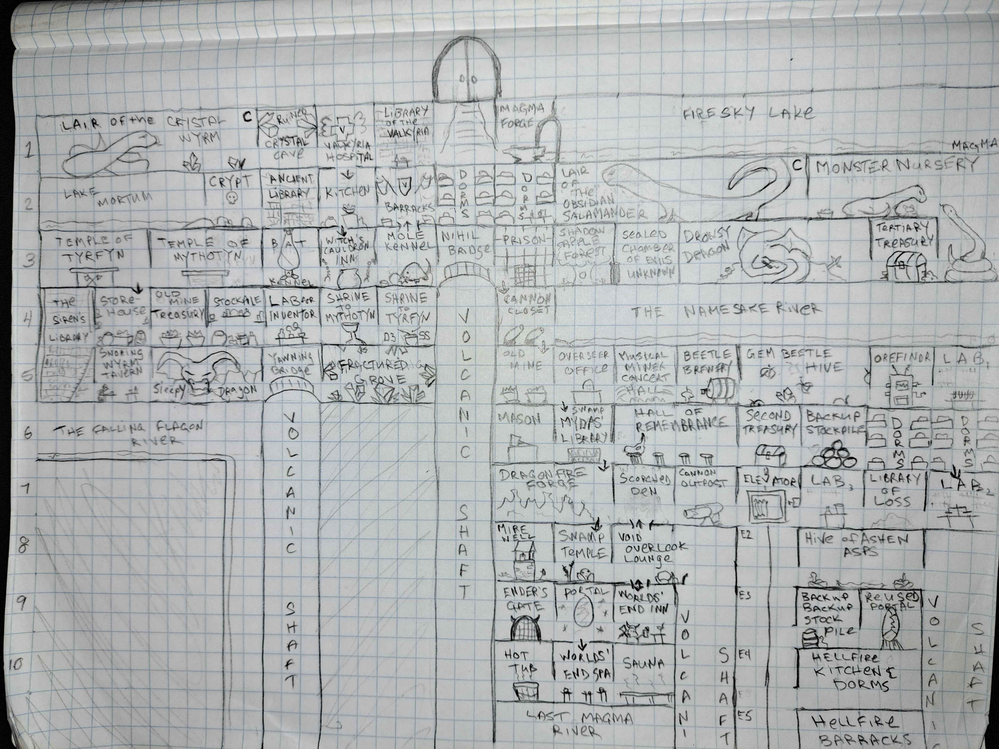
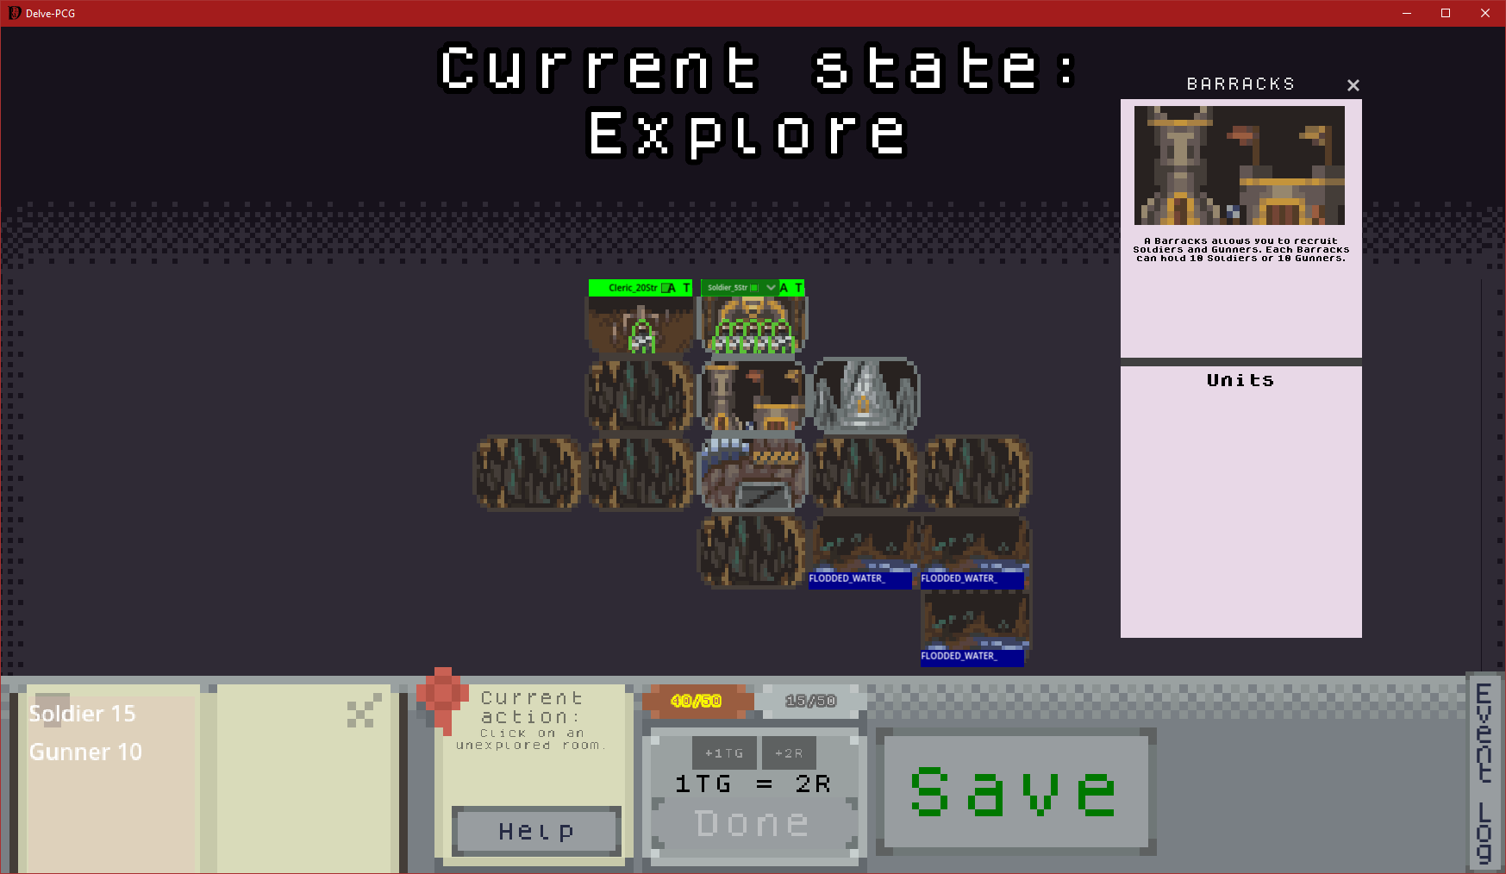
Gamaeplay
Original
Delve-PCG
Src.: „devilkept” at Blackwell Games Discord group

Slide 9
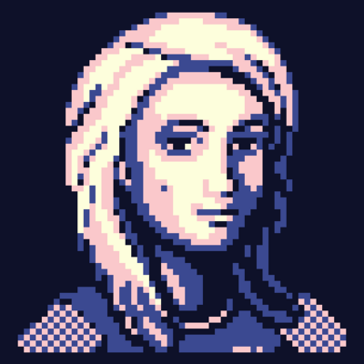
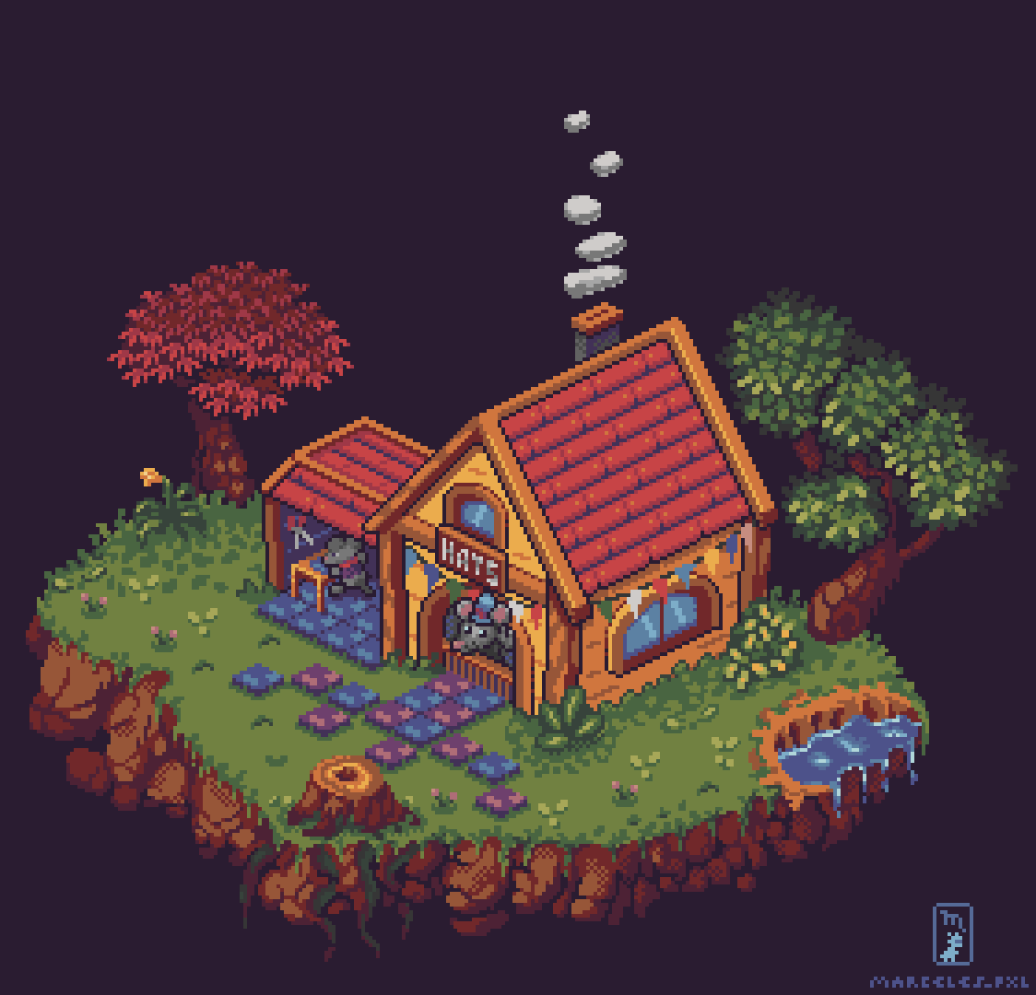
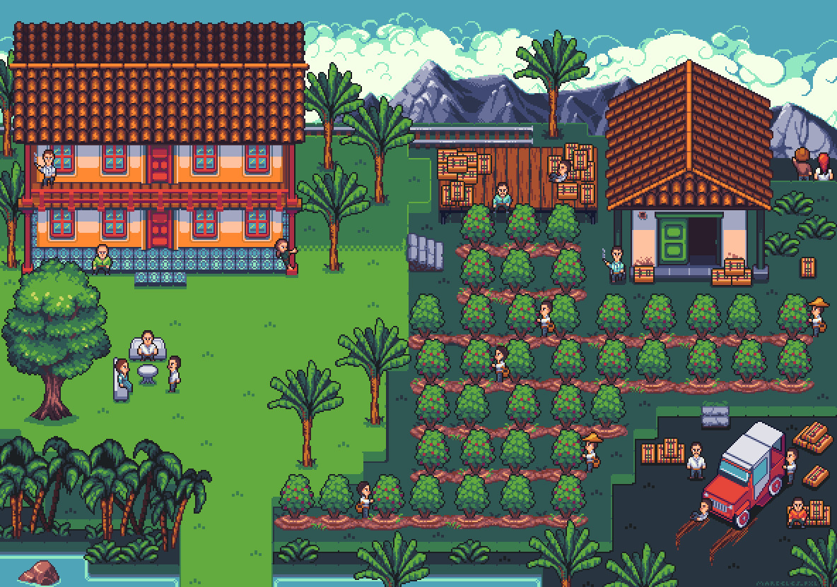
Building the game
Art:
@marceles
Temesi Szabolcs István
Music:
Soundimage.org
scottbuckley.com
We used various free and payed sources for assets.

