Slide 1
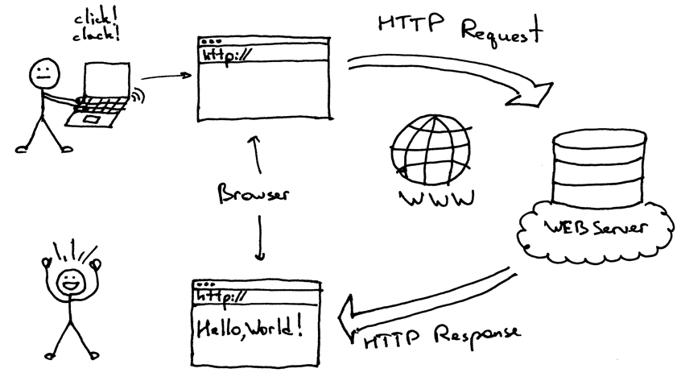
Web Scraping using Scrapy
By Zahid Shaikh

Slide 2

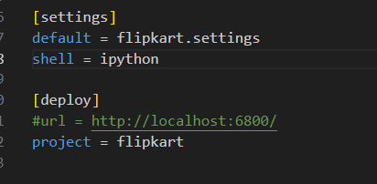



Created Virtual Environment
>python -m venv venv
Installed Scrapy, ipython & generated a spider
pip install scrapy
pip install ipython
scrapy startproject flipkart
scrapy genspider flipspider flipkart.com
Set shell as ipython
Enabled spider middlewares, downloader middlewares
& item pipelines in settings.py

Slide 3
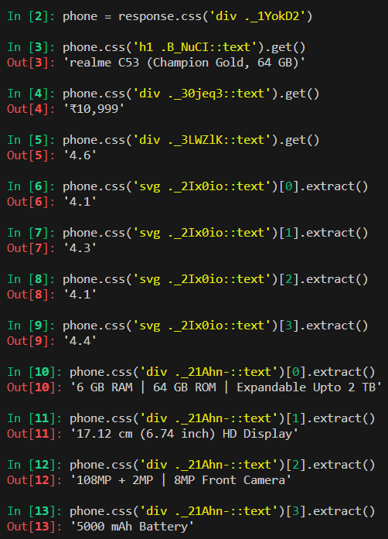
spiders>scrapy shell
Used scrapy shell to extract the text from HTMP

Slide 4
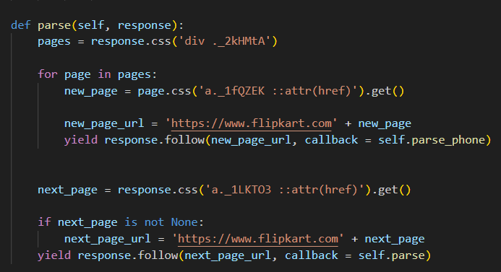
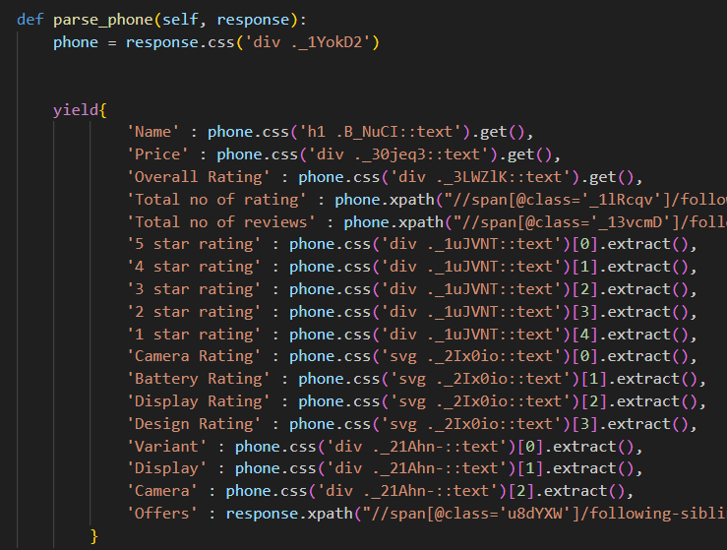
Scrapy crawl flipspider –O Flipkart_Phone_Data
Written the function to scrap the data needed from web to csv file

Slide 5
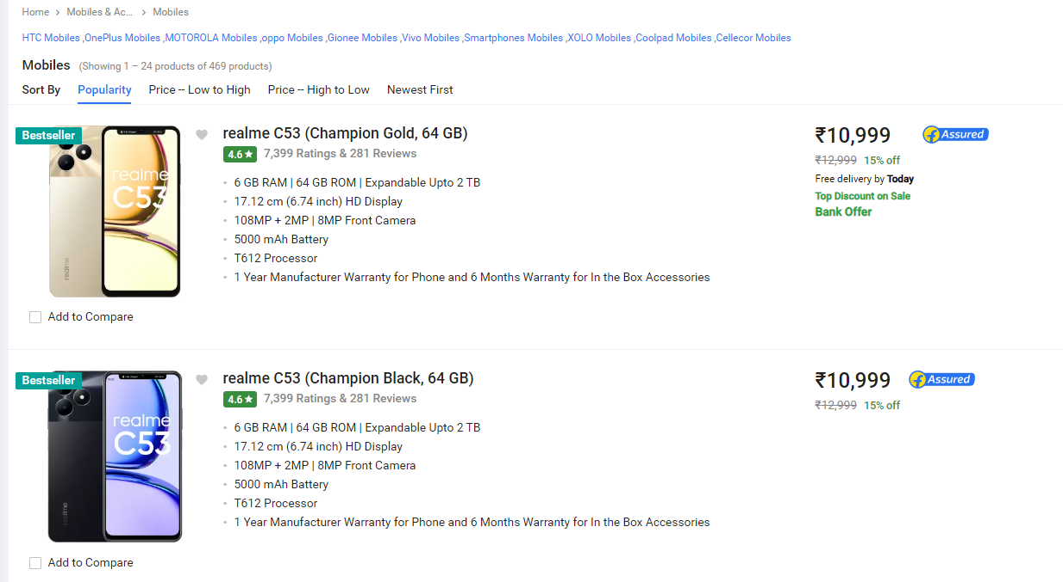
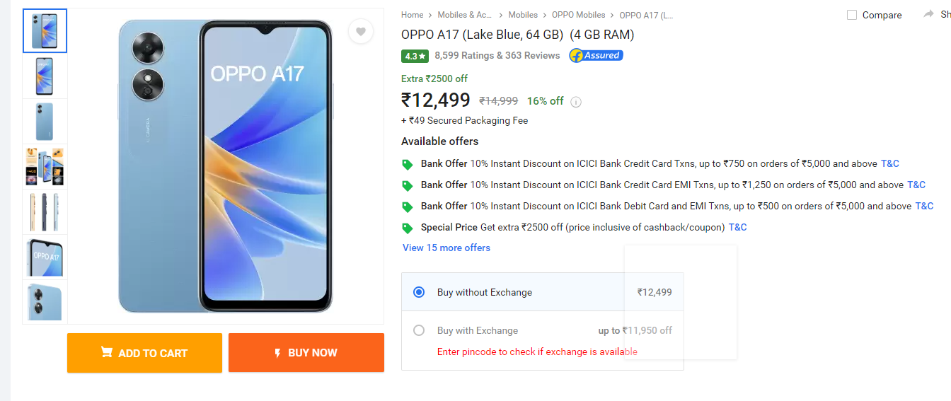
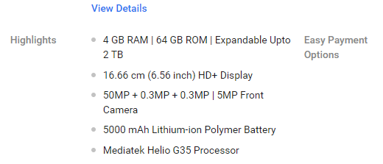
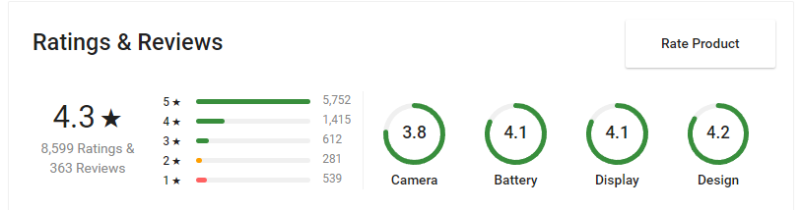
Data scrapped from website

Slide 6
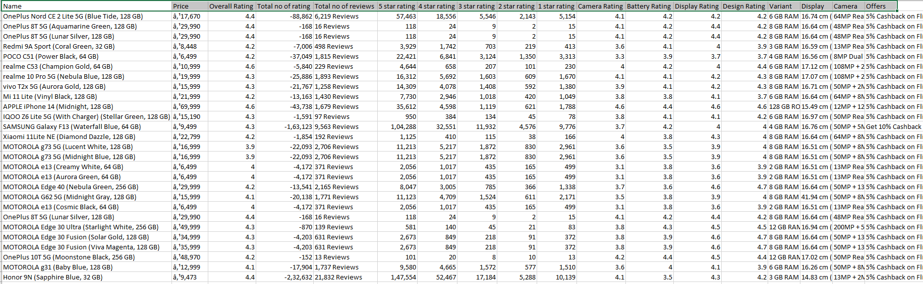
Data scrapped from website to csv

Slide 7
Thank you

