Slide 1
English Project
Celebration:Birthday

Slide 2
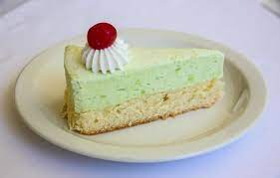

The Cake it's always a pistachio cake because I love pistachio and my family too

Slide 3
The plan First of all: my mum go buy the decoration Secondly: she buy the cake Lately: my father takes me a walk while my mother and my family finish preparing the decorations

Slide 4

Decorations We buy : Baloons,plate,plastic lid,glass(plastic or paper), candle and gift wrap to wrap the gift.

Slide 5

The Gift Last year I had three gifts 1.A helicopter 2.A nerf 3.900 V-Bucks This year I don’t know what I would get as a gift

Slide 6

Thank you for your attention

