Slide 1
Chapter 3
A brief overview of the
classical linear regression model

Slide 2
Regression
Regression is probably the single most important tool at the econometrician’s disposal.
But what is regression analysis?
It is concerned with describing and evaluating the relationship between a given variable (usually called the dependent variable) and one or more other variables (usually known as the independent variable(s)).

Slide 3
Some Notation
Denote the dependent variable by y and the independent variable(s) by x₁, x₂, ... , x_{k} where there are k independent variables.
Some alternative names for the y and x variables:
y x
dependent variable independent variables
regressand regressors
effect variable causal variables
explained variable explanatory variable
Note that there can be many x variables but we will limit ourselves to the case where there is only one x variable to start with. In our set-up, there is only one y variable.

Slide 4
Regression is different from Correlation
If we say y and x are correlated, it means that we are treating y and x in a completely symmetrical way.
In regression, we treat the dependent variable (y) and the independent variable(s) (x’s) very differently. The y variable is assumed to be random or “stochastic” in some way, i.e. to have a probability distribution. The x variables are, however, assumed to have fixed (“non-stochastic”) values in repeated samples.

Slide 5
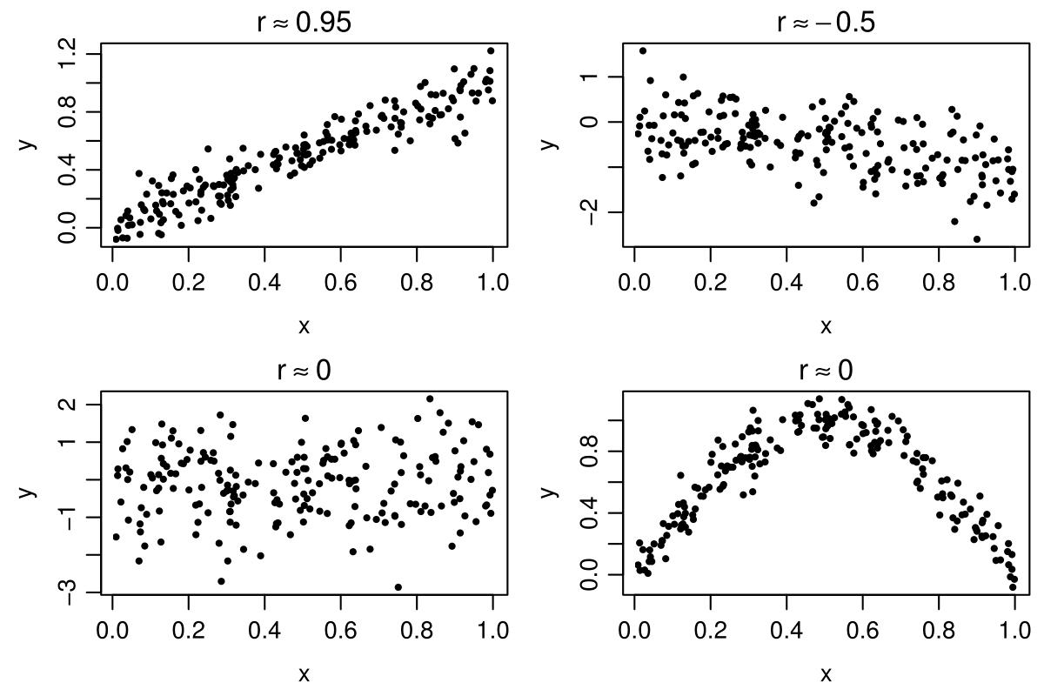
So what is correlation?
Zero correlation does not mean nonexistence of a functional relationship!
Source: http://introstat.compute.dtu.dk

Slide 6


Correlation vs. Causality…
$$r=0.99789$$
Correlation and causality are very different concepts!

Slide 7
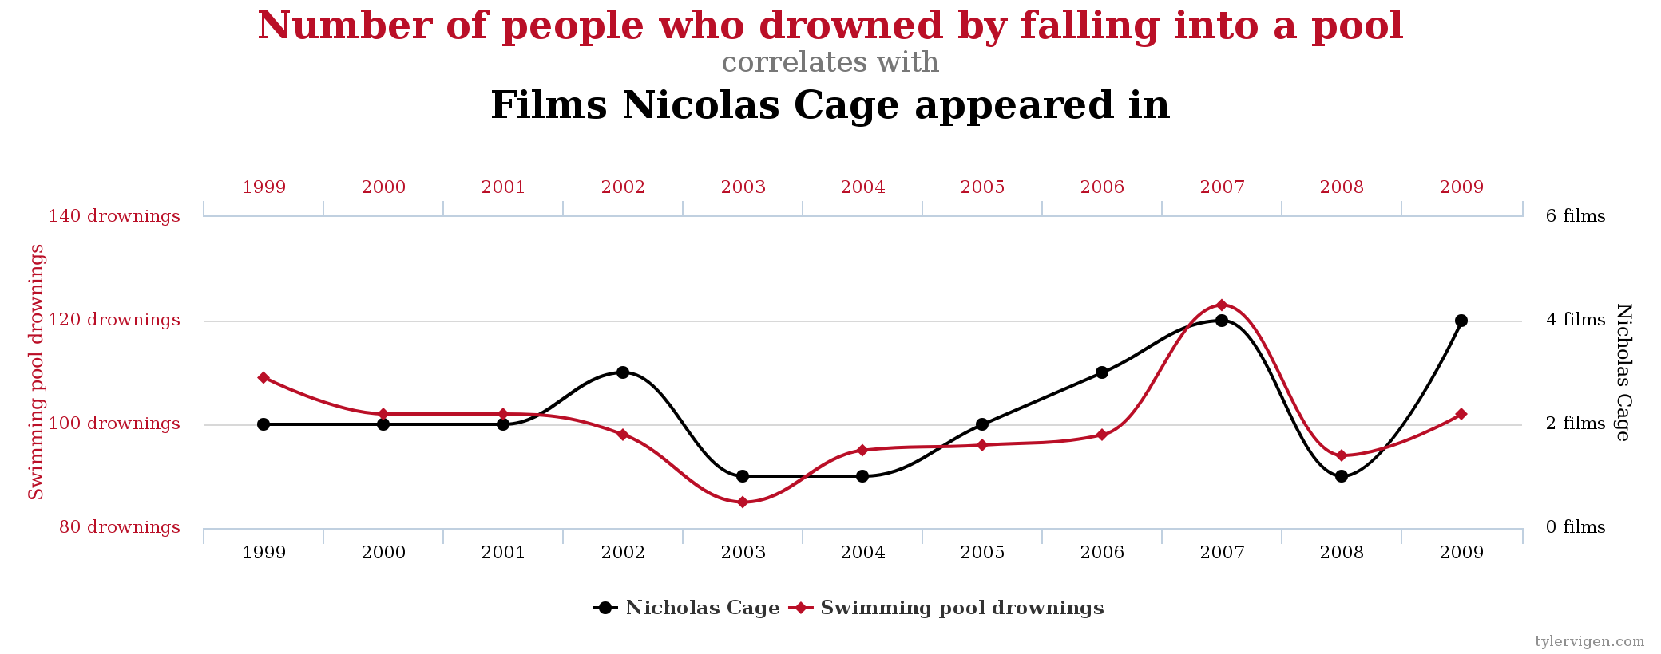

Correlation vs. Causality…
$$r=0.666$$
Correlation and causality are very different concepts!

Slide 8
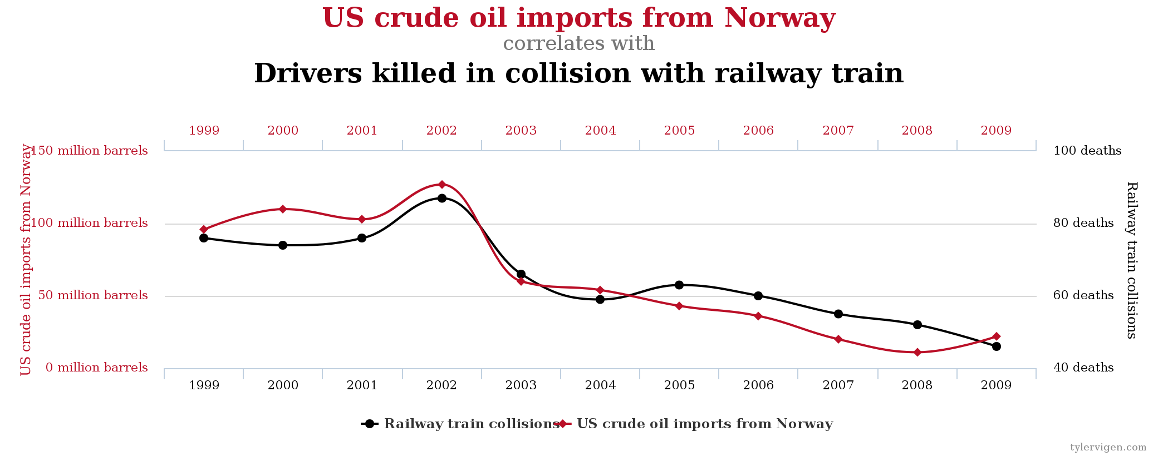

Correlation vs. Causality…
$$r=0.95451$$
Correlation and causality are very different concepts!

Slide 9
Simple Regression
For simplicity, say k=1. This is the situation where y depends on only one x variable.
Examples of the kind of relationship that may be of interest include:
How asset returns vary with their level of market risk
Measuring the long-term relationship between stock prices and dividends.
Constructing an optimal hedge ratio

Slide 10
Simple Regression: An Example
Suppose that we have the following data on the excess returns on a fund manager’s portfolio (“fund XXX”) together with the excess returns on a market index:
We have some intuition that the beta on this fund is positive, and we therefore want to find whether there appears to be a relationship between x and y given the data that we have. The first stage would be to form a scatter plot of the two variables.

Slide 11
Graph (Scatter Diagram)

Slide 12
Finding a Line of Best Fit
We can use the general equation for a straight line,
y=a+bx
to get the line that best “fits” the data.
However, this equation (y=a+bx) is completely deterministic.
Is this realistic? No. So what we do is to add a random disturbance term, u into the equation.
y_{t} = α + βx_{t} + u_{t}
where t = 1,2,3,4,5

Slide 13
Why do we include a Disturbance term?
The disturbance term can capture a number of features:
- We always leave out some determinants of y_{t}
- There may be errors in the measurement of y_{t} that cannot be
modelled.
- Random outside influences on y_{t} which we cannot model

Slide 14
Determining the Regression Coefficients
So how do we determine what α and β are?
Choose α and β so that the (vertical) distances from the data points to the fitted lines are minimised (so that the line fits the data as closely as possible):

Slide 15
Ordinary Least Squares
The most common method used to fit a line to the data is known as OLS (ordinary least squares).
What we actually do is take each distance and square it (i.e. take the area of each of the squares in the diagram) and minimise the total sum of the squares (hence least squares).
Tightening up the notation, let
y_{t} denote the actual data point t
denote the fitted value from the regression line
denote the residual, y_{t} -

Slide 16


Actual and Fitted Value
$$y_{i}$$
$${\hat{y}}_{i}$$

Slide 17


How OLS Works
So min. , or minimise . This is known as the residual sum of squares.
But what was ? It was the difference between the actual point and the line, y_{t} - .
So minimising is equivalent to minimising
with respect to and .
$$\hat{α}$$
$$\hat{β}$$

Slide 18




Deriving the OLS Estimator
But , so let
Want to minimise L with respect to (w.r.t.) and , so differentiate L w.r.t. and
(1)
(2)
From (1),
But and .
$$\hat{α}$$
$$\hat{β}$$
$$\hat{α}$$
$$\hat{β}$$

Slide 19

Deriving the OLS Estimator (cont’d)
So we can write or (3)
From (2), (4)
From (3), (5)
Substitute into (4) for from (5),
$$\hat{α}$$

Slide 20

Deriving the OLS Estimator (cont’d)
Rearranging for ,
So overall we have
This method of finding the optimum is known as ordinary least squares.
$$\hat{β}$$

Slide 21




What do We Use and For?
$$\hat{α}$$
$$\hat{β}$$
In the CAPM example used above, plugging the 5 observations in to make up the formulae given above would lead to the estimates
= -1.74 and = 1.64. We would write the fitted line as:
Question: If an analyst tells you that she expects the market to yield a return 20% higher than the risk-free rate next year, what would you expect the return on fund XXX to be?
Solution: We can say that the expected value of y = “-1.74 + 1.64 * value of x”, so plug x = 20 into the equation to get the expected value for y:
$$\hat{α}$$
$$\hat{β}$$

Slide 22
Accuracy of Intercept Estimate
Care needs to be exercised when considering the intercept estimate, particularly if there are no or few observations close to the y-axis:

Slide 23
The Population and the Sample
The population is the total collection of all objects or people to be studied, for example,
Interested in Population of interest
predicting outcome the entire electorate
of an election
A sample is a selection of just some items from the population.
A random sample is a sample in which each individual item in the population is equally likely to be drawn.

Slide 24
The DGP and the PRF
The population regression function (PRF) is a description of the model that is thought to be generating the actual data (data generation process) and the true relationship between the variables (i.e. the true values of α and β).
The PRF is
The SRF is
and we also know that .
We use the SRF to infer likely values of the PRF.
We also want to know how “good” our estimates of α and β are.

Slide 25
Linearity
In order to use OLS, we need a model which is linear in the parameters (α and β ). It does not necessarily have to be linear in the variables (y and x).
Linear in the parameters means that the parameters are not multiplied together, divided, squared or cubed etc.
Some models can be transformed to linear ones by a suitable substitution or manipulation, e.g. the exponential regression model
Then let y_{t}=ln Y_{t} and x_{t}=ln X_{t}

Slide 26
Linear and Non-linear Models
This is known as the exponential regression model. Here, the coefficients can be interpreted as elasticities.
Similarly, if theory suggests that y and x should be inversely related:
then the regression can be estimated using OLS by substituting
But some models are intrinsically non-linear, e.g.

Slide 27
Estimator or Estimate?
Estimators are the formulae used to calculate the coefficients
Estimates are the actual numerical values for the coefficients.

Slide 28
The Assumptions Underlying the Classical Linear Regression Model (CLRM)
The model which we have used is known as the classical linear regression model.
We observe data for x_{t}, but since y_{t} also depends on u_{t}, we must be specific about how the u_{t} are generated.
We usually make the following set of assumptions about the u_{t}’s (the unobservable error terms):
Technical Notation Interpretation
1. E(u_{t}) = 0 The errors have zero mean
2. Var (u_{t}) = σ² The variance of the errors is constant and finite
over all values of x_{t}
3. Cov (u_{i},u_{j})=0 The errors are statistically independent of
one another
4. Cov (u_{t},x_{t})=0 No relationship between the error and
corresponding x variate

Slide 29


The Assumptions Underlying the CLRM Again
An alternative assumption to 4., which is slightly stronger, is that the x_{t}’s are non-stochastic or fixed in repeated samples.
A fifth assumption is required if we want to make inferences about the population parameters (the actual α and β) from the sample parameters ( and )
Additional Assumption
5. u_{t} is normally distributed
$$\hat{α}$$
$$\hat{β}$$

Slide 30







Properties of the OLS Estimator
If assumptions 1. through 4. hold, then the estimators and determined by OLS are known as Best Linear Unbiased Estimators (BLUE).
What does the acronym stand for?
“Estimator” - is an estimator of the true value of β.
“Linear” - is a linear estimator
“Unbiased” - On average, the actual value of the and ’s will be equal to the true values.
“Best” - means that the OLS estimator has minimum variance among the class of linear unbiased estimators. The Gauss-Markov theorem proves that the OLS estimator is best.
$$\hat{α}$$
$$\hat{β}$$
$$\hat{β}$$
$$\hat{β}$$
$$\hat{α}$$
$$\hat{β}$$
$$\hat{β}$$

Slide 31







Consistency/Unbiasedness/Efficiency
Consistent
The least squares estimators and are consistent. That is, the estimates will converge to their true values as the sample size increases to infinity. We need the assumptions E(x_{t}u_{t})=0 and Var(u_{t})=σ² < ∞ to prove this. Consistency implies that
Unbiased
The least squares estimates of and are unbiased. That is E( )=α and E( )=β
Thus on average the estimated value will be equal to the true values. To prove this also requires the assumption that E(u_{t})=0. Unbiasedness is a stronger condition than consistency.
Efficient
An estimator of parameter β is said to be efficient if it is unbiased and no other unbiased estimator has a smaller variance. If the estimator is efficient, we are minimising the probability that it is a long way off from the true value of β.
$$\hat{α}$$
$$\hat{β}$$
$$\hat{α}$$
$$\hat{β}$$
$$\hat{α}$$
$$\hat{β}$$
$$\hat{β}$$

Slide 32






Precision and Standard Errors
$$\hat{α}$$
$$\hat{β}$$
Any set of regression estimates of and are specific to the sample used in their estimation.
Recall that the estimators of α and β from the sample parameters ( and ) are given by
What we need is some measure of the reliability or precision of the estimators
( and ). The precision of the estimate is given by its standard error. Given assumptions 1 - 4 above, then the standard errors can be shown to be given by
where s is the estimated standard deviation of the residuals.
$$\hat{α}$$
$$\hat{β}$$
$$\hat{α}$$
$$\hat{β}$$

Slide 33
Estimating the Variance of the Disturbance Term
The variance of the random variable u_{t} is given by
Var(u_{t}) = E[(u_{t})-E(u_{t})]²
which reduces to
Var(u_{t}) = E(u_{t}²)
We could estimate this using the average of :
Unfortunately this is not workable since u_{t} is not observable. We can use the sample counterpart to u_{t}, which is :
But this estimator is a biased estimator of σ².

Slide 34


Estimating the Variance of the Disturbance Term (cont’d)
An unbiased estimator of σ is given by
where is the residual sum of squares and T is the sample size.
Some Comments on the Standard Error Estimators
1. Both SE( ) and SE( ) depend on s² (or s). The greater the variance s², then the more dispersed the errors are about their mean value and therefore the more dispersed y will be about its mean value.
2. The sum of the squares of x about their mean appears in both formulae.
The larger the sum of squares, the smaller the coefficient variances.
$$\hat{α}$$
$$\hat{β}$$

Slide 35
Some Comments on the Standard Error Estimators
Consider what happens if is small or large:

Slide 36



Some Comments on the Standard Error Estimators (cont’d)
3. The larger the sample size, T, the smaller will be the coefficient variances. T appears explicitly in SE( ) and implicitly in SE( ).
T appears implicitly since the sum is from t = 1 to T.
4. The term appears in the SE( ).
The reason is that measures how far the points are away from the y-axis.
$$\hat{α}$$
$$\hat{β}$$
$$\hat{α}$$

Slide 37


Example: How to Calculate the Parameters and Standard Errors
Assume we have the following data calculated from a regression of y on a single variable x and a constant over 22 observations.
Data:
Calculations:
We write
$$\hat{β}$$
$$\hat{α}$$

Slide 38
Example (cont’d)
SE(regression),
We now write the results as

Slide 39

An Introduction to Statistical Inference
We want to make inferences about the likely population values from the regression parameters.
Example: Suppose we have the following regression results:
is a single (point) estimate of the unknown population parameter, β. How “reliable” is this estimate?
The reliability of the point estimate is measured by the coefficient’s standard error.
$$\hat{β}$$

Slide 40
Hypothesis Testing: Some Concepts
We can use the information in the sample to make inferences about the population.
We will always have two hypotheses that go together, the null hypothesis (denoted H₀) and the alternative hypothesis (denoted H₁).
The null hypothesis is the statement or the statistical hypothesis that is actually being tested. The alternative hypothesis represents the remaining outcomes of interest.
For example, suppose given the regression results above, we are interested in the hypothesis that the true value of β is in fact 0.5. We would use the notation
H₀ : β = 0.5
H₁ : β ≠ 0.5
This would be known as a two sided test.

Slide 41
One-Sided Hypothesis Tests
Sometimes we may have some prior information that, for example, we would expect β > 0.5 rather than β < 0.5. In this case, we would do a one-sided test:
H₀ : β = 0.5
H₁ : β > 0.5
or we could have had
H₀ : β = 0.5
H₁ : β < 0.5
There are two ways to conduct a hypothesis test: via the test of significance approach or via the confidence interval approach.

Slide 42



The Probability Distribution of the Least Squares Estimators
We assume that u_{t} ∼ N(0,σ²)
Since the least squares estimators are linear combinations of the random variables
i.e.
The weighted sum of normal random variables is also normally distributed, so
∼ N(α, Var(α))
∼ N(β, Var(β))
What if the errors are not normally distributed? Will the parameter estimates still be normally distributed?
Yes, if the other assumptions of the CLRM hold, and the sample size is sufficiently large.
$$\hat{β}$$
$$\hat{α}$$
$$\hat{β}$$

Slide 43
The Probability Distribution of the Least Squares Estimators (cont’d)
Standard normal variates can be constructed from and :
and
But var(α) and var(β) are unknown, so
and

Slide 44






Testing Hypotheses: The Test of Significance Approach
Assume the regression equation is given by ,
for t=1,2,...,T
And assume that H₀ : β = β*
The steps involved in doing a test of significance are:
1. Estimate , and , in the usual way
2. Calculate the test statistic. This is given by the formula
where is the value of β under the null hypothesis.
$$\hat{α}$$
$$\hat{β}$$
$$\hat{α}$$
$$\hat{β}$$
$$\hat{β}$$
$$\hat{β}$$

Slide 45
The Test of Significance Approach (cont’d)
3. We need some tabulated distribution with which to compare the estimated test statistics. Test statistics derived in this way can be shown to follow a t-distribution with T-2 degrees of freedom.
As the number of degrees of freedom increases, we need to be less cautious in our approach since we can be more sure that our results are robust.
4. We need to choose a “significance level”, often denoted α. This is also sometimes called the size of the test and it determines the region where we will reject or not reject the null hypothesis that we are testing. It is conventional to use a significance level of 5%.
Intuitive explanation is that we would only expect a result as extreme as this or more extreme 5% of the time as a consequence of chance alone.
Conventional to use a 5% size of test, but 10% and 1% are also commonly used.

Slide 46
Determining the Rejection Region for a Test of Significance
5. Given a significance level, we can determine a rejection region and non-rejection region. For a 2-sided test:

Slide 47
The Rejection Region for a 1-Sided Test (Upper Tail)

Slide 48
The Rejection Region for a 1-Sided Test (Lower Tail)

Slide 49
The Test of Significance Approach: Drawing Conclusions
6. Use the t-tables to obtain a critical value or values with which to compare the test statistic.
7. Finally perform the test. If the test statistic lies in the rejection region then reject the null hypothesis (H₀), else do not reject H₀.

Slide 50
A Note on the t and the Normal Distribution
You should all be familiar with the normal distribution and its characteristic “bell” shape.
We can scale a normal variate to have zero mean and unit variance by subtracting its mean and dividing by its standard deviation.
There is, however, a specific relationship between the t- and the standard normal distribution. Both are symmetrical and centred on zero. The t-distribution has another parameter, its degrees of freedom. We will always know this (for the time being from the number of observations -2).

Slide 51
What Does the t-Distribution Look Like?

Slide 52
Comparing the t and the Normal Distribution
In the limit, a t-distribution with an infinite number of degrees of freedom is a standard normal, i.e.
Examples from statistical tables:
Significance level N(0,1) t(40) t(4)
50% 0 0 0
5% 1.64 1.68 2.13
2.5% 1.96 2.02 2.78
0.5% 2.57 2.70 4.60
The reason for using the t-distribution rather than the standard normal is that we had to estimate , the variance of the disturbances.

Slide 53
The Confidence Interval Approach to Hypothesis Testing
An example of its usage: We estimate a parameter, say to be 0.93, and a “95% confidence interval” to be (0.77,1.09). This means that we are 95% confident that this interval is containing the true (but unknown) value of β.
Confidence intervals are almost invariably two-sided, although in theory a one-sided interval can be constructed.

Slide 54




How to Carry out a Hypothesis Test Using Confidence Intervals
$$\hat{β}$$
1. Calculate , and , as before.
2. Choose a significance level, α, (again the convention is 5%). This is equivalent to choosing a (1-α)×100% confidence interval, i.e. 5% significance level = 95% confidence interval
3. Use the t-tables to find the appropriate critical value, which will again have T-2 degrees of freedom.
4. The confidence interval is given by
5. Perform the test: If the hypothesised value of β (β*) lies outside the confidence interval, then reject the null hypothesis that β = β*, otherwise do not reject the null.
$$\hat{α}$$
$$\hat{β}$$
$$\hat{α}$$

Slide 55


Confidence Intervals Versus Tests of Significance
Note that the Test of Significance and Confidence Interval approaches always give the same answer.
Under the test of significance approach, we would not reject H₀ that β = β* if the test statistic lies within the non-rejection region, i.e. if
Rearranging, we would not reject if
But this is just the rule under the confidence interval approach.
$$\hat{β}$$
$$\hat{β}$$

Slide 56
Constructing Tests of Significance and Confidence Intervals: An Example
Using the regression results above,
, T=22
Using both the test of significance and confidence interval approaches, test the hypothesis that β =1 against a two-sided alternative.
The first step is to obtain the critical value. We want t_{crit} = t_{20;5%}

Slide 57
Determining the Rejection Region

Slide 58
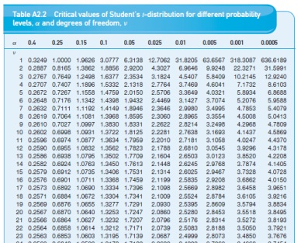
Constructing Tests of Significance and Confidence Intervals: An Example
We are looking for t_{20;5%}
Since the table contains values for 1-sided test, we look to:
row 20, column 0,025
And get the critical value
±2.0860

Slide 59


Performing the Test
The hypotheses are:
H₀ : β = 1
H₁ : β ≠ 1
Test of significance Confidence interval
approach approach
Do not reject H₀ since Since 1 lies within the
test stat lies within confidence interval,
non-rejection region do not reject H₀
$$\hat{β}$$
$$\hat{β}$$

Slide 60


Testing other Hypotheses (use for confidence intervals)
What if we wanted to test H₀ : β = 0 or H₀ : β = 2?
Note that we can test these with the confidence interval approach.
For interest (!), test
H₀ : β = 0
vs. H₁ : β ≠ 0
H₀ : β = 2
vs. H₁ : β ≠ 2
$$\hat{β}$$
$$\hat{β}$$

Slide 61


Changing the Size of the Test (use for test-of significance approach)
But note that we looked at only a 5% size of test. In marginal cases
(e.g. H₀ : β = 1), we may get a completely different answer if we use a different size of test. This is where the test of significance approach is better than a confidence interval.
For example, say we wanted to use a 10% size of test. Using the test of significance approach,
as above. The only thing that changes is the critical t-value. The test statistic remains the same.
$$\hat{β}$$
$$\hat{β}$$

Slide 62
Changing the Size of the Test: The New Rejection Regions

Slide 63
Changing the Size of the Test: The Conclusion
t_{20;10%} = 1.725. So now, as the test statistic lies in the rejection region, we would reject H₀.
Caution should therefore be used when placing emphasis on or making decisions in marginal cases (i.e. in cases where we only just reject or not reject).

Slide 64
Some More Terminology
If we reject the null hypothesis at the 5% level, we say that the result of the test is statistically significant.
Note that a statistically significant result may be of no practical significance. E.g. if a shipment of cans of beans is expected to weigh 450g per tin, but the actual mean weight of some tins is 449g, the result may be highly statistically significant but presumably nobody would care about 1g of beans.
And vice versa – statistically insignificant results might be significant practically!!!

Slide 65
The Errors That We Can Make Using Hypothesis Tests
We usually reject H₀ if the test statistic is statistically significant at a chosen significance level.
There are two possible errors we could make:
1. Rejecting H₀ when it was really true. This is called a type I error.
2. Not rejecting H₀ when it was in fact false. This is called a type II error.

Slide 66
The Trade-off Between Type I and Type II Errors
The probability of a type I error is just α, the significance level or size of test we chose. To see this, recall what we said significance at the 5% level meant: it is only 5% likely that a result as or more extreme as this could have occurred purely by chance.
Note that there is no chance for a free lunch here! What happens if we reduce the size of the test (e.g. from a 5% test to a 1% test)? We reduce the chances of making a type I error ... but we also reduce the probability that we will reject the null hypothesis at all, so we increase the probability of a type II error:
So there is always a trade off between type I and type II errors when choosing a significance level. The only way we can reduce the chances of both is to increase the sample size.

Slide 67




A Special Type of Hypothesis Test: The t-ratio
Recall that the formula for a test of significance approach to hypothesis testing using a t-test was
If the test is H₀ : β_{i} = 0
H₁ : β_{i} ≠ 0
i.e. a test that the population coefficient is zero against a two-sided alternative, this is known as a t-ratio test:
Since β _{i}* = 0,
The ratio of the coefficient to its SE is known as the t-ratio or t-statistic.
$$\hat{β_{i}}$$
$$\hat{β_{i}}$$
$$\hat{β_{i}}$$
$$\hat{β_{i}}$$

Slide 68
The t-ratio: An Example
Suppose that we have the following parameter estimates, standard errors and t-ratios for an intercept and slope respectively. β₁ β₂
Coefficient 1.10 -4.40
SE 1.35 0.96
t-ratio 0.81 -4.63
Compare this with a t_{crit} with 15-3 = 12 d.f.
(2½% in each tail for a 5% test) = 2.179 5%
= 3.055 1%
Do we reject H₀: β₁ = 0? (No)
H₀: β₂ = 0? (Yes)

Slide 69
What Does the t-ratio tell us?
If we reject H₀, we say that the result is significant. If the coefficient is not “significant” (e.g. the intercept coefficient in the last regression above), then it means that the variable is not helping to explain variations in y. Variables that are not significant are usually removed from the regression model.
In practice there are good statistical reasons for always having a constant even if it is not significant. Look at what happens if no intercept is included:

Slide 70
The Exact Significance Level or p-value
This is equivalent to choosing an infinite number of critical t-values from tables. It gives us the marginal significance level where we would be indifferent between rejecting and not rejecting the null hypothesis.
If the test statistic is large in absolute value, the p-value will be small, and vice versa. The p-value gives the plausibility of the null hypothesis.
e.g. a test statistic is distributed as a t₆₂ = 1.47.
The p-value = 0.12.
Do we reject at the 5% level?...........................No
Do we reject at the 10% level?.........................No
Do we reject at the 20% level?.........................Yes

Slide 71
An Example of the Use of a Simple t-test to Test a Theory in Finance
Testing for the presence and significance of abnormal returns (“Jensen’s alpha” - Jensen, 1968).
The Data: Annual Returns on the portfolios of 115 mutual funds from 1945-1964.
The model: for j = 1, …, 115
We are interested in the significance of α_{j}.
The null hypothesis is H₀: α_{j} = 0 .

Slide 72
Frequency Distribution of t-ratios of Mutual Fund Alphas (gross of transactions costs)
Source Jensen (1968). Reprinted with the permission of Blackwell publishers.

Slide 73
Frequency Distribution of t-ratios of Mutual Fund Alphas (net of transactions costs)
Source Jensen (1968). Reprinted with the permission of Blackwell publishers.

Slide 74
Can UK Unit Trust Managers “Beat the Market”?
We now perform a variant on Jensen’s test in the context of the UK market, considering monthly returns on 76 equity unit trusts. The data cover the period January 1979 – May 2000 (257 observations for each fund). Some summary statistics for the funds are:
Mean Minimum Maximum Median
Average monthly return, 1979-2000 1.0% 0.6% 1.4% 1.0%
Standard deviation of returns over time 5.1% 4.3% 6.9% 5.0%
Jensen Regression Results for UK Unit Trust Returns, January 1979-May 2000

Slide 75
Can UK Unit Trust Managers “Beat the Market”? : Results
Estimates of Mean Minimum Maximum Median
α -0.02% -0.54% 0.33% -0.03%
β 0.91 0.56 1.09 0.91
t-ratio on α -0.07 -2.44 3.11 -0.25
In fact, gross of transactions costs, 9 funds of the sample of 76 were able to significantly out-perform the market by providing a significant positive alpha, while 7 funds yielded significant negative alphas.

Slide 76
The Overreaction Hypothesis and the UK Stock Market
Motivation
Two studies by DeBondt and Thaler (1985, 1987) showed that stocks which experience a poor performance over a 3 to 5 year period tend to outperform stocks which had previously performed relatively well.
How Can This be Explained?
2 suggestions
1. A manifestation of the size effect
DeBondt & Thaler did not believe this a sufficient explanation, but Zarowin (1990) found that allowing for firm size did reduce the subsequent return on the losers.
2. Reversals reflect changes in equilibrium required returns
Ball & Kothari (1989) find the CAPM beta of losers to be considerably higher than that of winners.

Slide 77
The Overreaction Hypothesis and the UK Stock Market (cont’d)
Another interesting anomaly: the January effect.
Another possible reason for the superior subsequent performance of losers.
Zarowin (1990) finds that 80% of the extra return available from holding the losers accrues to investors in January.
Example study: Clare and Thomas (1995)
Data:
Monthly UK stock returns from January 1955 to 1990 on all firms traded on the London Stock exchange.

Slide 78
Methodology
Calculate the monthly excess return of the stock over the market over a 12, 24 or 36 month period for each stock i:
U_{it} = R_{it} - R_{mt}
Calculate the average monthly return for the stock i over the first 12, 24, or 36 month period:
n = 12, 24 or 36 months

Slide 79
Portfolio Formation
Then rank the stocks from highest average return to lowest and from 5 portfolios:
Portfolio 1: Best performing 20% of firms
Portfolio 2: Next 20%
Portfolio 3: Next 20%
Portfolio 4: Next 20%
Portfolio 5: Worst performing 20% of firms.
Use the same sample length n to monitor the performance of each portfolio.

Slide 80
Portfolio Formation and Portfolio Tracking Periods
How many samples of length n have we got?
n = 1, 2, or 3 years.
If n = 1year:
Estimate for year 1
Monitor portfolios for year 2
Estimate for year 3
...
Monitor portfolios for year 36
So if n = 1, we have 18 INDEPENDENT (non-overlapping) observation / tracking periods.

Slide 81
Constructing Winner and Loser Returns
Similarly, n = 2 gives 9 independent periods and n = 3 gives 6 independent periods.
Calculate monthly portfolio returns assuming an equal weighting of stocks in each portfolio.
Denote the mean return for each month over the 18, 9 or 6 periods for the winner and loser portfolios respectively as and respectively.
Define the difference between these as = - .
Then perform the regression
= α₁ + η_{t} (Test 1)
Look at the significance of α₁.

Slide 82
Allowing for Differences in the Riskiness of the Winner and Loser Portfolios
Problem: Significant and positive α₁ could be due to higher return being required on loser stocks due to loser stocks being more risky.
Solution: Allow for risk differences by regressing against the market risk premium:
= α₂ + β(R_{mt}-R_{ft}) + η_{t} (Test 2)
where
R_{mt} is the return on the FTA All-share
R_{ft} is the return on a UK government 3 month t-bill.

Slide 83
Is there an Overreaction Effect in the UK Stock Market? Results

Slide 84
Testing for Seasonal Effects in Overreactions
Is there evidence that losers out-perform winners more at one time of the year than another?
To test this, calculate the difference between the winner & loser portfolios as previously, , and regress this on 12 month-of-the-year dummies:
Significant out-performance of losers over winners in,
June (for the 24-month horizon), and
January, April and October (for the 36-month horizon)
winners appear to stay significantly as winners in
March (for the 12-month horizon).

Slide 85
Conclusions
Evidence of overreactions in stock returns.
Losers tend to be small so we can attribute most of the overreaction in the UK to the size effect.
Comments
Small samples
No diagnostic checks of model adequacy

Slide 86
The Exact Significance Level or p-value
This is equivalent to choosing an infinite number of critical t-values from tables. It gives us the marginal significance level where we would be indifferent between rejecting and not rejecting the null hypothesis.
If the test statistic is large in absolute value, the p-value will be small, and vice versa. The p-value gives the plausibility of the null hypothesis.
e.g. a test statistic is distributed as a t₆₂ = 1.47.
The p-value = 0.12.
Do we reject at the 5% level?...........................No
Do we reject at the 10% level?.........................No
Do we reject at the 20% level?.........................Yes

