Slide 1

Curenetfc Network Presentation, Structure
Created by:
Márk Szalai
Kristóf Jordán
János Klaics

Slide 2
Project Presentation
A secure network for a company dealing with football players (sales, management, data analysis)
Every member of the team is a football enthusiast.

Slide 3
What Problems Does It Solve?
Adatbiztonság garantálása
Hatékony adatkezelés
Gyors és biztonságos kommunikáció
Automatikus támadásvédelem
Jobb láthatóság a piacon

Slide 4
How Is It Better Than Others?
Secure network protection
Simple and easy to use
Accessible to anyone, for both teams and players

Slide 5
Opportunities
Teams can view player data and performance
Players can register to get noticed by teams
Available for both small and large clubs

Slide 6
Work Distribution
Kristóf Jordán: Project Manager , Building D, Building B
Márk Szalai: Testing Building A
János Klaics: Documentation Building D

Slide 7
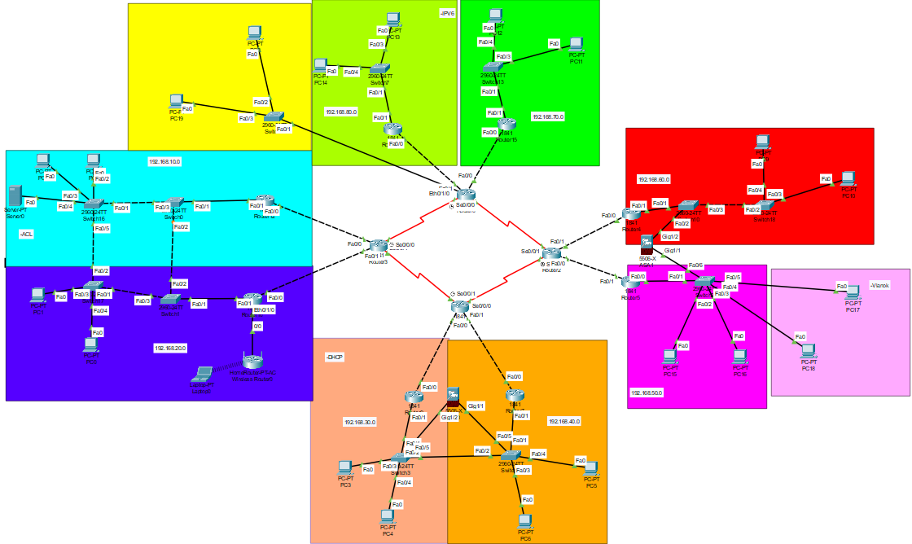
Hálózati Topology

Slide 8
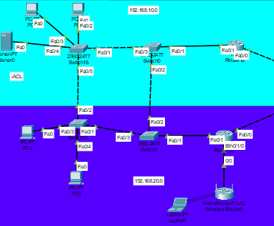
"A" épület
IPV4
ACL
Server

Slide 9
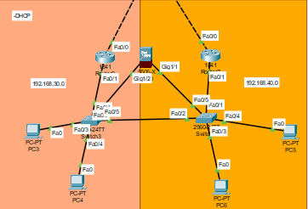
"B" épület
IPV4
DHCP
Firewall

Slide 10
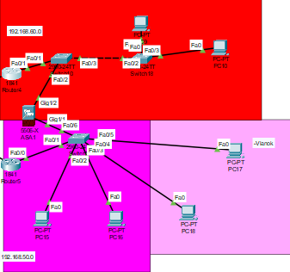
"C" épület
IPV4
Firewall
VLAN

Slide 11
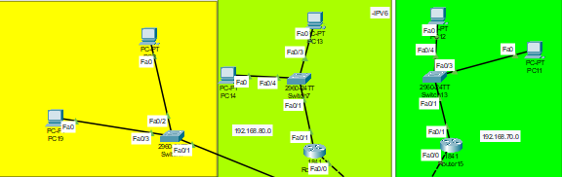
"D" épület
IPV4
IPV6

Slide 12
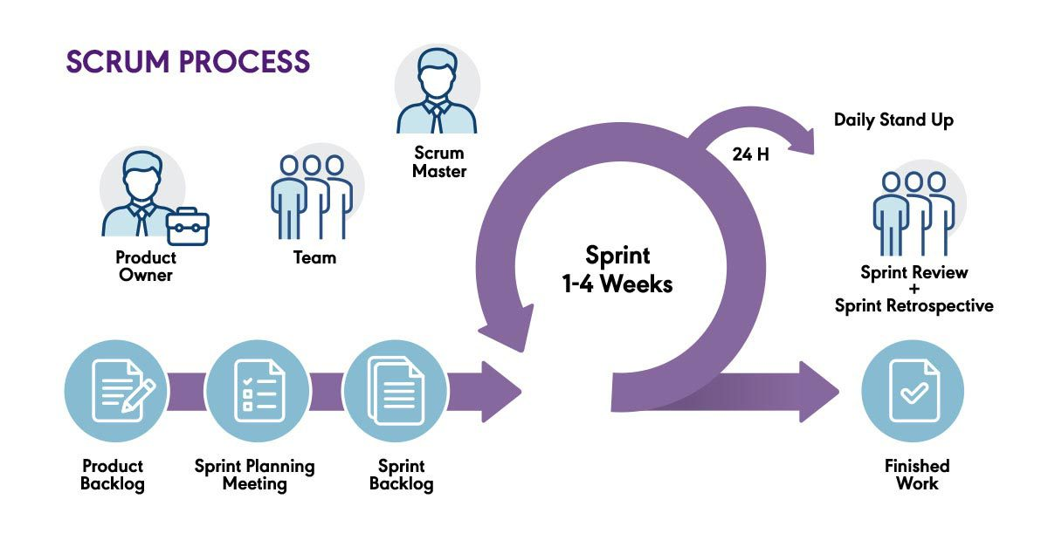
Scrum
Based on agile software development principles and the Lean approach.
Scrum is an agile project management framework.

Slide 13
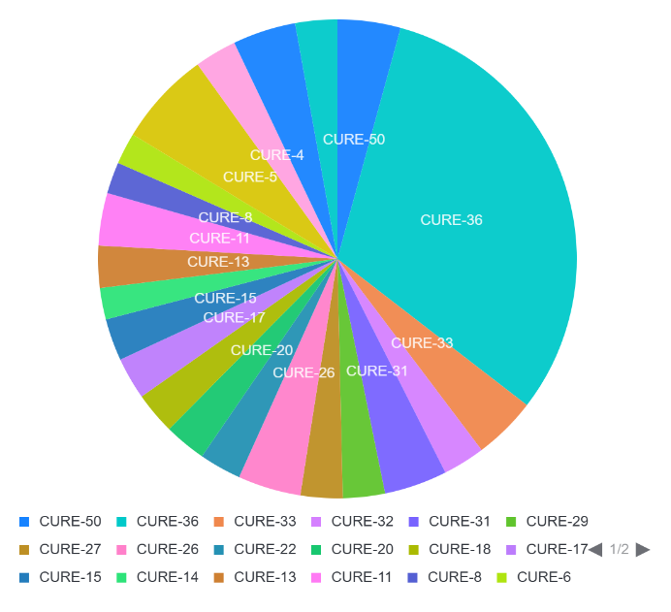
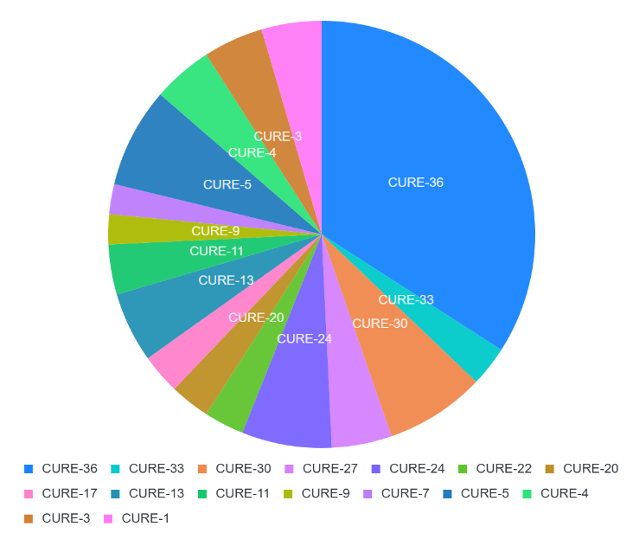
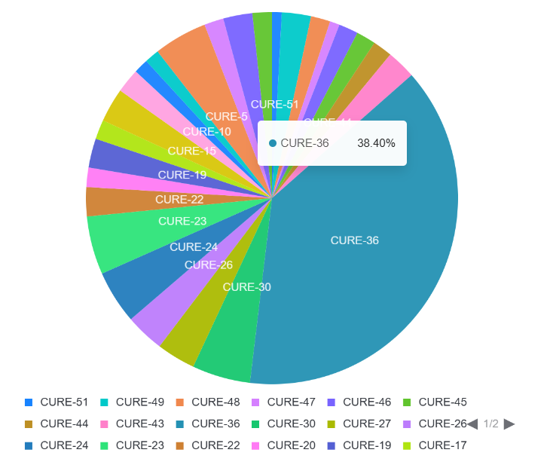
Jira
Jira egy projekt- és feladatkezelő szoftver
Mi arra használtuk hogy az időt amit beleszántunk a projektbe idő rögzitettük

Slide 14

Git
Git is a distributed version control system.
It is mainly used for version control and teamwork.

Slide 15
Thank you for your attention!

