Slide 1
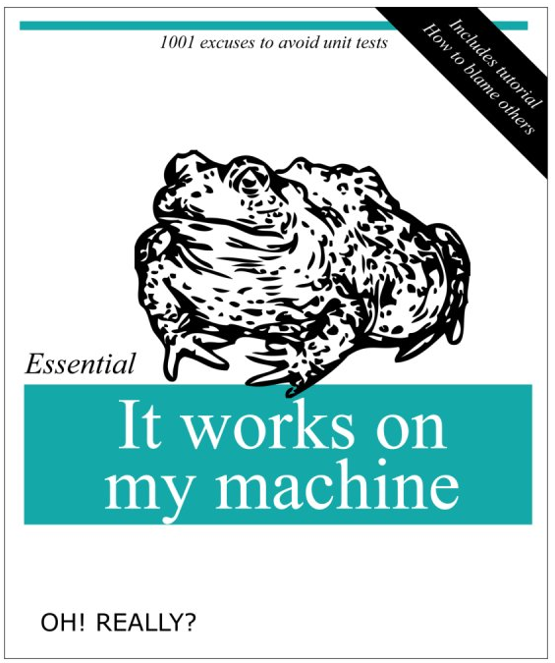

Slide 2
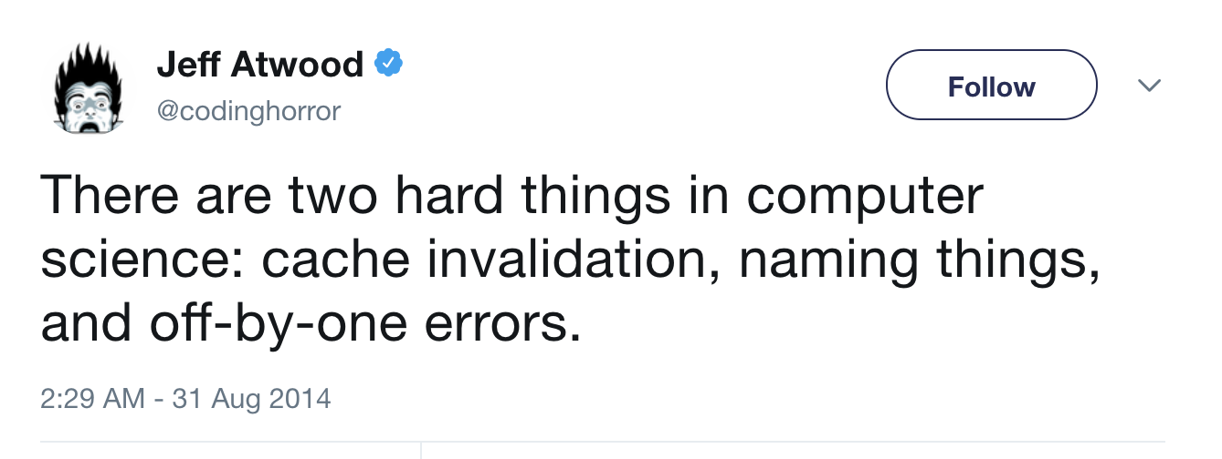

Slide 3
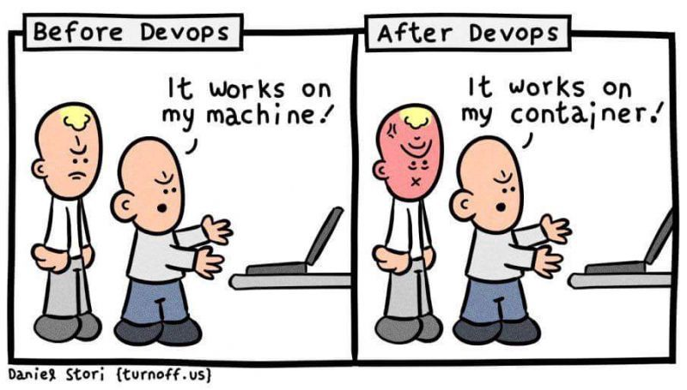

Slide 4
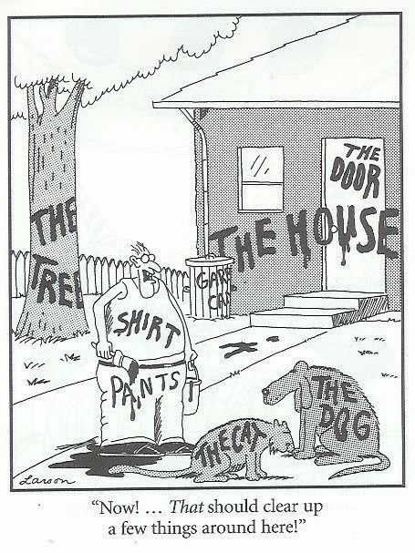

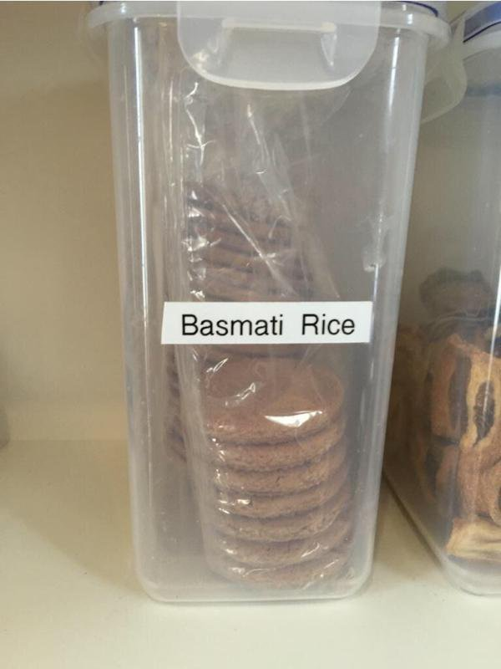

BAD COMMENTS…

Slide 5
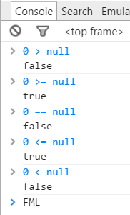
JAVASCRIPT

Slide 6
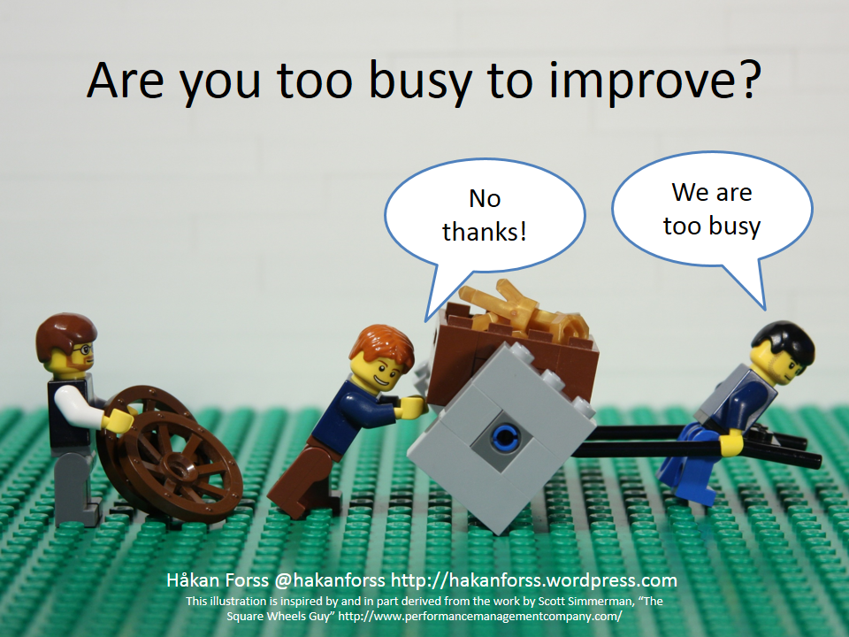

Slide 7
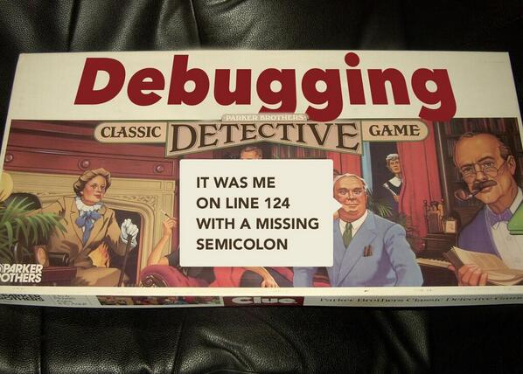

Slide 8
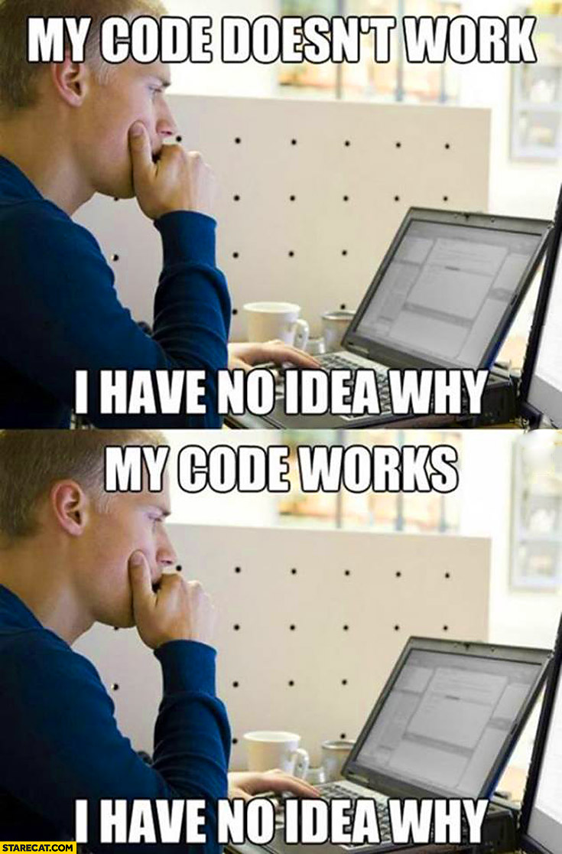

Slide 9
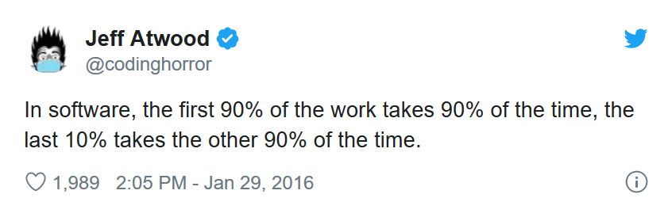

Slide 10
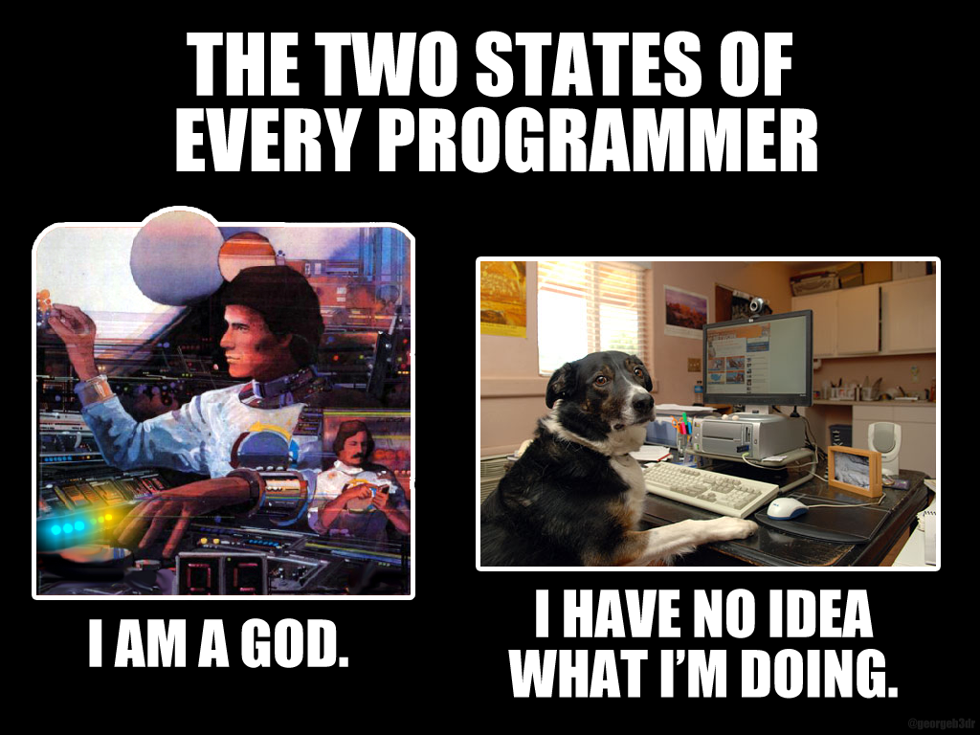

Slide 11
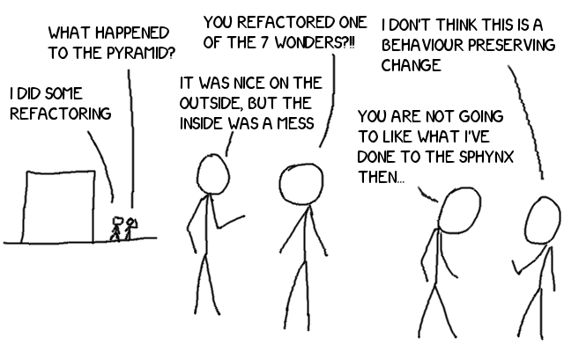

Slide 12
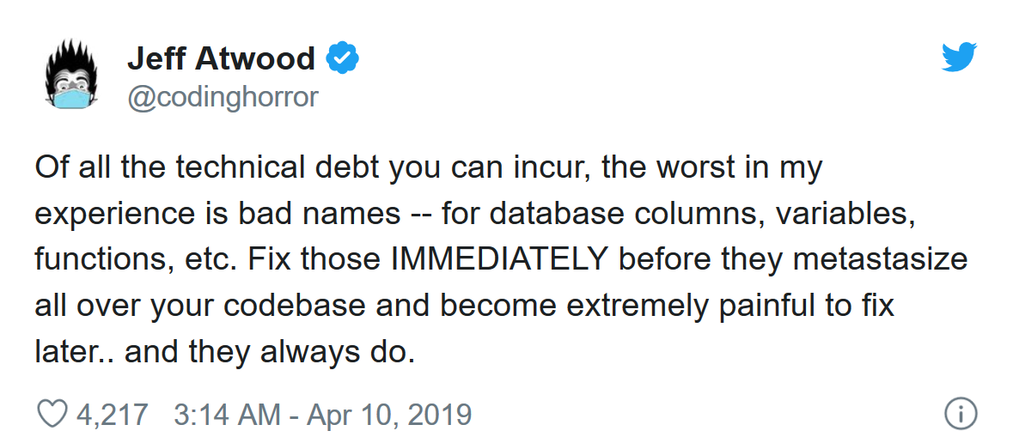

Slide 13
PRACTICAL REFACTORING
Patrick Szalapski
@Szalapski | szalapski.com
Fill out the Survey please

Slide 14
To refactor is to make code better without changing its behavior
Behavior usually means output or side effects
but also could be performance or resources

Slide 15
The main benefit of refactoring is increased maintainability
The best code to refactor
is the code you’re
most likely to work with the most often
Notes:
- Easier to read, harder to misread
- Easier to enhance
- Easier to find further opportunities for further or broader refactoring
2. Find bugs
2. Make code testable

Slide 16
The only good way to refactor
Is in a small easy step
Then repeat in tight loops
Five refactors at 99% confidence
are better than one big refactor at 80% confidence
Notes:
Don’t be eager to skip small and picky intermediate

Slide 17
Reckless refactoring can introduce defects
Wise refactoring reveals and prevents more bugs than it causes
Notes:
Refactoring is not something to explain and plan. Refactoring

Slide 18
REFACTOR AS YOU GO
If I'm not willing to refactor
while I am changing related code,
surely I won't be willing when I'm not.
Notes:
Do not plan with stakeholders; make it a part of the work
Eagerly and relentlessly refactor new code—it will save you time, even right-away time.

Slide 19
Scope of refactoring
Code cleanup & fix-up
Reorganize & refine
Rearchitect

Slide 20
The most important refactoring: RENAME (Ctrl+R Ctrl+R)

Slide 21
DEMo
Please call out “too fast” if you want to see a refactoring over again
Notes:
Tool-assisted refactoring is not about less typing

Slide 22
The refactorings I do most often
Tool-assisted:
Rename
Extract method
Move
Remove unused usings
Reduce nesting: Invert if; combine singly-nested Ifs;
Extract interface
Restrict access modifiers
Code against nonexisting members then generate
Manual:
Simplify boolean logic
Early return
Reduce newline usage
Convert If-else to ternary
Eliminate/simplify loops with LINQ
Iterate instead of repeat code (try lambdas or private classes)
Replace Start/Stop methods with an IDisposable
7 steps to add dependency injection
Patrick Szalapski | @szalapski | szalapski.com

Slide 23

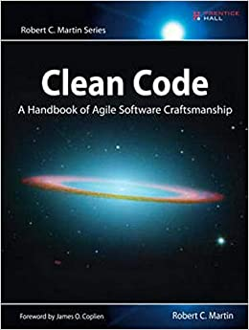
For more…
Code, slides, my favorite refactorings, and more links are posted on Szalapski.com: the direct link is
tinyurl.com/refactor2020
See also books by Feathers and Martin
Fill out the Survey please
Patrick Szalapski | @szalapski | szalapski.com

