Slide 1


Slide 2
TDD WITHOUT THE OMG
Patrick Szalapski
Application Development, GBS
go/sz

Slide 3
TDD is Test-Driven Development
We drive our development with tests
After this session, you will be able to:
Find an opportunity to do TDD
Discipline yourself to do nothing but red-green-refactor for a little while

Slide 4
I stink at TDD
I don’t like TDD
I don’t think in TDD very well
I still do it
Notes:
Audience experience with TDD?
Barriers?

Slide 5
Bad TDD
is better than
“Code and Pray”

Slide 6
1. TDD is slower than “Code and pray”
2. So we resort to “Code then test”
3. But TDD is faster than “Code then test”
You should only avoid TDD
if you want to avoid unit testing
TDD isn’t a “more mature” way of doing unit testing, it is a technique for getting better results faster.

Slide 7
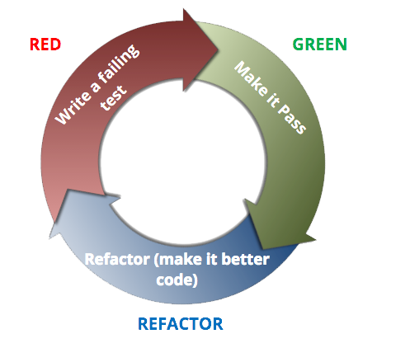


What is Test-Driven Development?
…spin faster and faster as you go

Slide 8
Do you think you can test your code better days or weeks after writing it?
Notes:
The easiest time to write a test is when the code under test is fresh in your mind and well-understood
The only time that happens is when you first write it

Slide 9
TDD begs for:
Good design
Refactoring
Notes:
“When you look at the TDD evangelists, all of them share something: they are all very good – probably even great – at design and refactoring. They see issues in existing code and they know how to transform the code so it doesn't have those issues, and specifically, they know how to separate concerns and reduce coupling.
“If you have those skills, TDD works great; you see what the issues are as the arise and fix them incrementally, and your simple tests prove that your design has low coupling. And, you have the tests to lean on in the future.”

Slide 10
Myth of TDD | Reality
TDD is the right way to write unit tests | TDD is one technique for writing tested code
TDD takes a full commitment (I have to drink the Kool-Aid) | TDD can be used piecemeal (I have to dip my toe in)
TDD is slower than non-TDD | TDD is slower than code-and-pray, but not slower than other robust testing practices
TDD is painstaking | TDD can give you coding satisfaction sooner
In TDD you don’t think about design upfront | You can do test-driven development without test-driven design
TDD is only for new code | TDD can be used for any code change

Slide 11

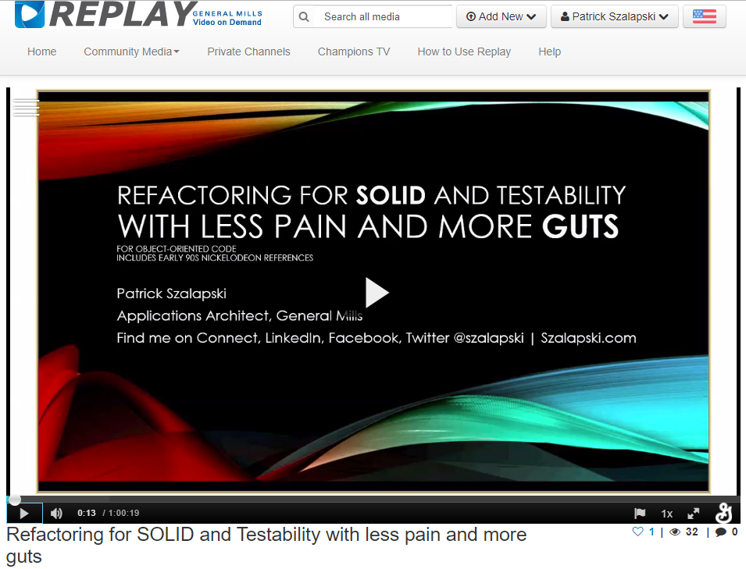

enhancing LEGACY CODE
Before you can do TDD on legacy code, it may need to be refactored for testability
Untested high-confidence refactorings are better than no tests
From Code Camp 4
go/TDDRefactoring
Notes:
Demo

Slide 12
DEMO: enhancing LEGACY CODE (OR fixing bugs) VIA TDD
Request:
“Shifting a project more than ten years to the past shouldn’t be allowed.”
Notes:
var mockProjectRepository = new Mock<IProjectRepository>();
var mockDataUtilities = new Mock<IProjectDataUtilities>();
var mockAdminRepository = new Mock<IAdminRepository>();
var mockResourceRepository = new Mock<IResourceRepository>();
var sut = new ResourcePlanService(
mockProjectRepository.Object,
mockDataUtilities.Object,
mockAdminRepository.Object,
mockResourceRepository.Object);

Slide 13
PERSONAL ALGORITHM FOR TDD
Get the class under test with untested high- confidence refactoring.
Write a failing test. I suggest you use Resharper Continuous Testing Session (optional)
Get it to compile.
Make it pass, changing as little as possible. Avoid the temptation to implement too much.
Refactor, especially regarding duplication.
GOTO 2

Slide 14
DEMO: Retroactive TDD on legacy code
Notes:
Add second test to complement first
Refactor
Add third test on other error conditions

Slide 15
Find an opportunity to do TDD
Discipline yourself to do nothing but red-green-refactor for a little while
Ask for help from me or go/SoftwareQuality
These slides, links, and more info are at go/TDD
Read my blog at go/sz

