Slide 1
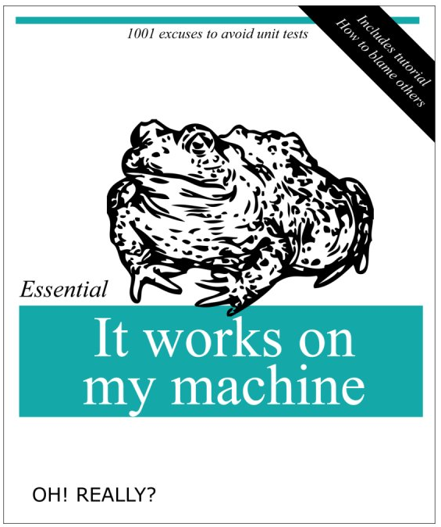

Slide 2
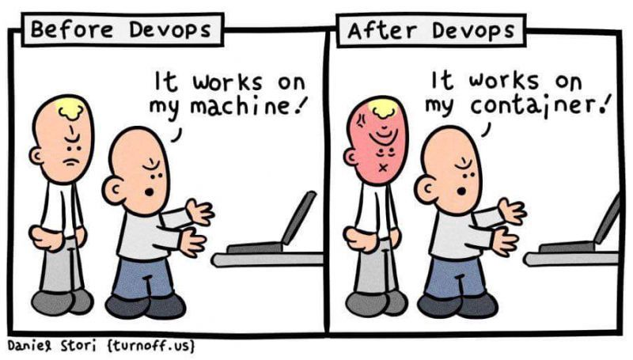

Slide 3
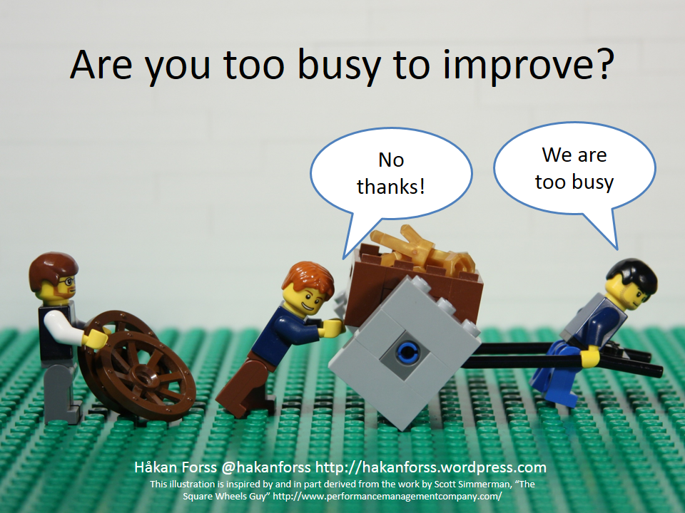

Slide 4
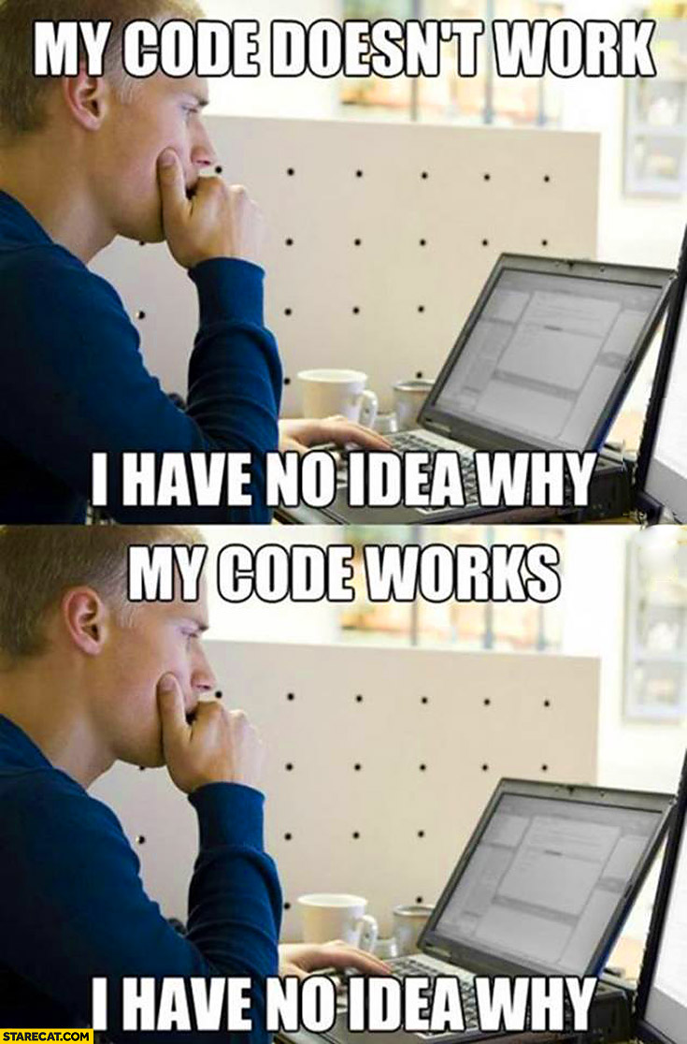

Slide 5
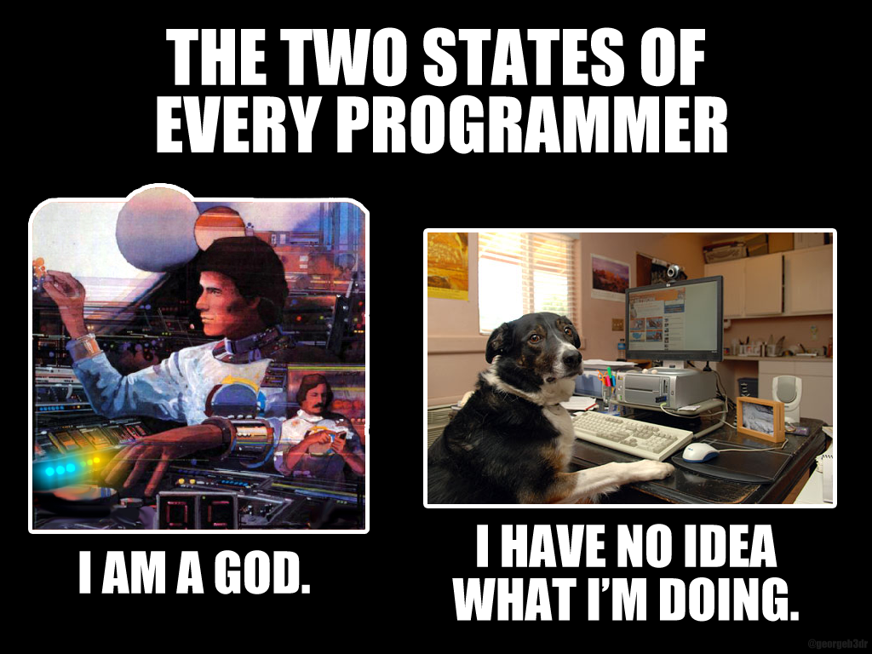

Slide 6
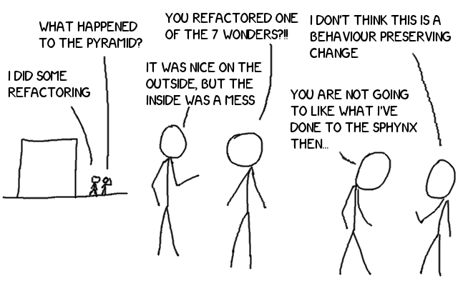

Slide 7
PRACTICAL REFACTORING
Patrick Szalapski
@Szalapski | szalapski.com

Slide 8
To refactor is to make code better without changing its behavior
Behavior usually means output or side effects
but also could be performance or resource

Slide 9
The main benefit of refactoring is increased maintainability
The best code to refactor
is the code you’re
most likely to work with the most often
Notes:
- Easier to read, harder to misread
- Easier to enhance
- Easier to find further opportunities for further or broader refactoring
2. Find bugs
2. Make code testable

Slide 10
The only good way to refactor
Is in a small easy step
Then repeat in tight loops
Five refactors at 99% confidence
are better than one big refactor at 80% confidence
Notes:
Don’t be eager to skip small and picky intermediate

Slide 11
Reckless refactoring can introduce defects
Wise refactoring reveals and prevents more bugs than it causes
Notes:
Refactoring is not something to explain and plan. Refactoring

Slide 12
REFACTOR AS YOU GO
If I'm not willing to refactor
while I am changing related code,
surely I won't be willing when I'm not.
Notes:
Do not plan with stakeholders; make it a part of the work
Eagerly and relentlessly refactor new code—it will save you time, even right-away time.

Slide 13
Scope of refactoring
Code cleanup & fix-up
Reorganize & refine
Rearchitect

Slide 14
DEMo
Please call out “too fast” if you want to see a refactoring over again
Notes:
Tool-assisted refactoring is not about less typing

Slide 15
The refactorings I do most often
Tool-assisted:
Rename
Extract method
Move
Remove unused usings
Reduce nesting: Invert if; combine singly-nested Ifs;
Extract interface
Restrict access modifiers
Code against nonexisting members then generate
Manual:
Simplify boolean logic
Early return
Reduce newline usage
Convert If-else to ternary
Eliminate/simplify loops with LINQ
Iterate instead of repeat code (try lambdas or private classes)
Replace Start/Stop methods with an IDisposable
6 steps to add dependency injection
Patrick Szalapski | @szalapski | szalapski.com

