Slide 1
ACC compensation user manual Project - Akari
14th – Jun - 2023

Slide 2
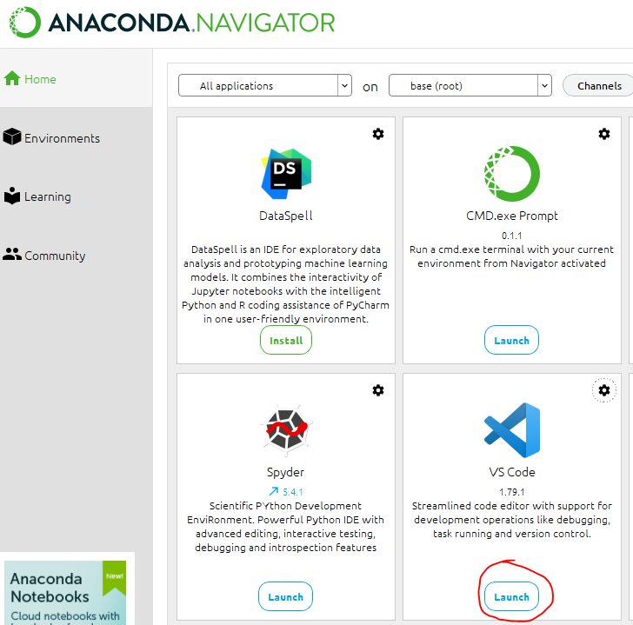
program running environment
from ANACONDA Launch VS code
load the program folder.
grogram file is Jupyter.

Slide 3
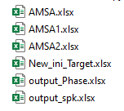
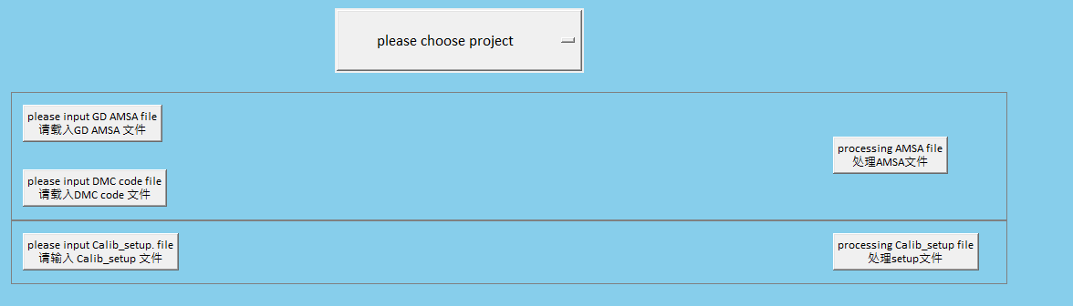
Prepare documents or folder
before program running, please delete all result files and New ACC folder
demo only， no function
1. click this one
loading set up file
2. click this one

Slide 4
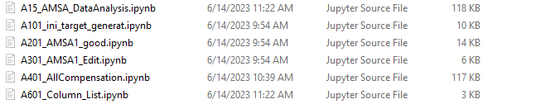
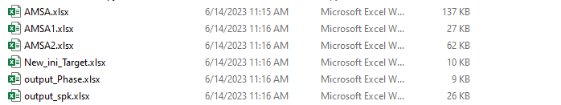
Information
program start from this file
Run GUI from this TP
Program folder
results come out after program run
before running program, please remove these files

Slide 5
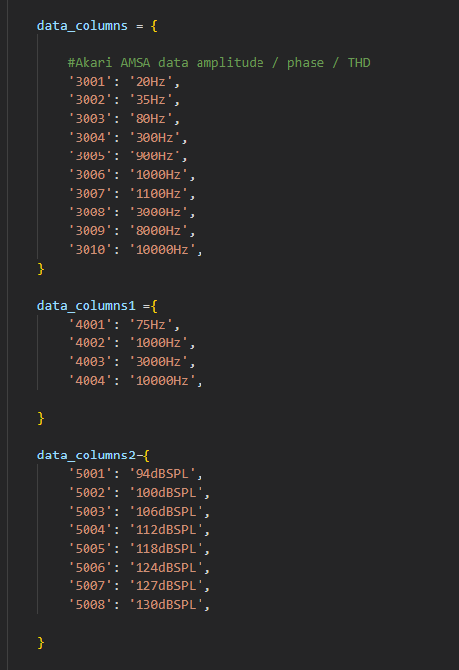
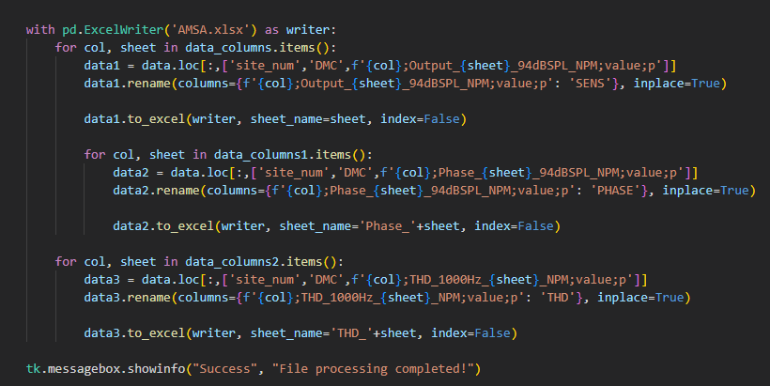
remember to change 1
！ remember to change file folder
Based on the different project, need to change the definition, you can check program or AMSA results to change it
remember to change NPM to HPM for digital device, if not change, cannot search the data in AMSA raw data
Amplitude
Phase
THD

Slide 6
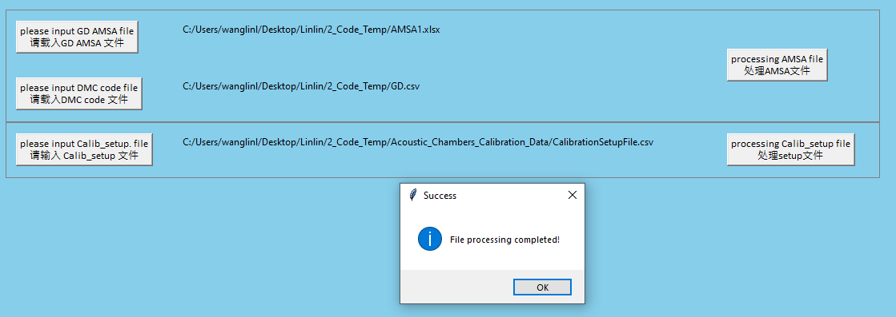
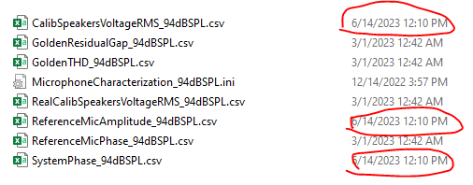
results come out
Get new ACC Folder
can monitor file generate time to confirm

