Slide 1
Critical Design Review
Subhia Zaroura , Ahmad Adawi , Hazem Kurdi

Slide 2
Agenda
Presenting the students ?
The project
Theoretical Review
QUIC implementations
Work plan

Slide 3
Security Analysis of the QUIC Protocol
Project objective
Examine the resiliency of the QUIC protocol to cyber attacks

Slide 4
What is QUIC ?
QUIC (Quick UDP Internet Connections) is a transport layer protocol that was developed by Google to improve the performance of web applications. It is designed to replace the traditional transport layer protocols such as TCP (Transmission Control Protocol) and UDP (User Datagram Protocol) that are used for data transmission over the Internet.
QUIC combines the features of both TCP and UDP and is implemented on top of the UDP protocol. It offers several advantages over TCP, such as reduced latency, faster connection establishment, and improved congestion control. Additionally, QUIC provides enhanced security features, including encryption and authentication, to protect against various types of attacks

Slide 5
What is QUIC ?
It offers several advantages over TCP, such as reduced latency, faster connection establishment, and improved congestion control. Additionally, QUIC provides enhanced security features, including encryption and authentication, to protect against various types of attacks

Slide 6
Theoretical Review
Paper Overview
Revisiting QUIC attacks: A comprehensive review on QUIC security and a hands-on study." International Journal of Information Security (2022).
1. Introduction
2. Background
3. Related work
4. Comprehensive Review
5.Hands-on Study
6. Discussion

Slide 7

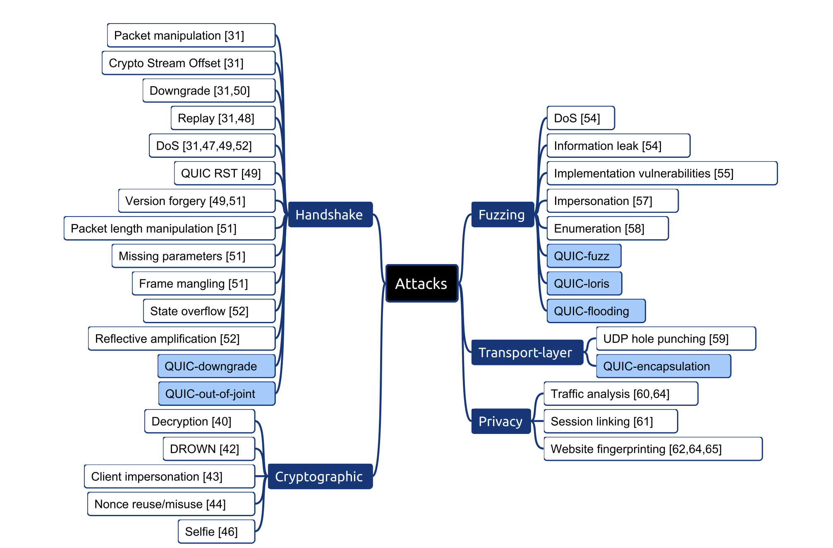

Slide 8
QUIC implementation Review
Ahmad Adawi
We will be using Picoquic .

Slide 9
Advantages of Using Picoquic Protocol
1. Improved Performance :
Picoquic uses modern congestion control algorithms that are optimized for high-speed networks, allowing for faster and more reliable data transfer.
•Picoquic reduces latency by minimizing the number of round trips required to establish a connection, which can result in faster data transfer for time-sensitive applications.
•Picoquic is designed to handle network disruptions, such as changes in network conditions or loss of connectivity, more efficiently, ensuring smoother and more reliable data transfer.

Slide 10
Advantages of Using Picoquic Protocol
2. Enhanced Security :
•Picoquic incorporates encryption using Transport Layer Security (TLS), which can protect data from eavesdropping and tampering, ensuring data privacy and integrity.
•Picoquic supports authentication and server certificate validation, helping to prevent man-in-the-middle attacks and ensuring that data is exchanged with trusted endpoints.
•Picoquic implements forward secrecy, which generates unique session keys for each connection, providing an additional layer of security by ensuring that past communications remain secure even if the session keys are compromised.

Slide 11
Advantages of Using Picoquic Protocol
3. Flexibility and Scalability :
•Picoquic can be easily deployed and integrated into existing applications and systems with minimal modifications, making it a versatile choice for various use cases, including web browsing, real-time communication, file transfer, and IoT applications.
•Picoquic is not tied to any specific application or protocol, making it adaptable to different environments, network types, and devices.
•Picoquic supports dynamic and adaptive congestion control mechanisms, allowing it to adapt to changing network conditions and providing reliable performance even in challenging network scenarios.

Slide 12
Advantages of Using Picoquic Protocol
4. Support for Multipath and Multi-streaming :
•Picoquic allows for simultaneous data transfer over multiple paths or streams, increasing throughput and improving overall performance.
•Picoquic can take advantage of multiple network interfaces, such as Wi-Fi and cellular, for data transfer, enhancing resilience and reliability in diverse networking environments.
•Picoquic can dynamically adjust the amount of data sent over each path or stream, optimizing data transfer based on network conditions and improving efficiency.

Slide 13
Security Vulnerabilities
•Vulnerabilities in encryption: As with any encryption protocol, there is a risk of vulnerabilities in the encryption algorithms or key management that could potentially be exploited by attackers. Regular updates and patches should be applied to ensure the use of the latest secure encryption practices.
•Denial of Service (DoS) attacks: Picoquic, like any other protocol, may be susceptible to DoS attacks that can overwhelm the server or network resources, causing disruption or unavailability of the service. Implementing proper DoS mitigation techniques, such as rate limiting and throttling, is important to protect against such attacks.
•Implementation flaws: Any software implementation, including Picoquic protocol, may have implementation flaws or coding errors that could lead to security vulnerabilities. Thorough code reviews, security audits, and regular software updates can help identify and fix such vulnerabilities.
•Transport layer attacks: As a transport layer protocol, Picoquic may be vulnerable to attacks such as man-in-the-middle attacks, replay attacks, and other network-level attacks. Proper encryption, authentication, and integrity checks should be implemented to mitigate these risks.

Slide 14
Overall
•Picoquic protocol offers a combination of performance, reliability, flexibility, security, and community-driven development that makes it a compelling choice for modern communication applications that demand efficient, robust, and secure data transfer over the internet.
•Picoquic is an open-source protocol with an active community that fosters continuous improvement, innovation, and community contributions, making it a collaborative choice for ongoing development and support.
•Written in C: Picoquic is implemented in the widely used C programming language, which may be familiar to us, allowing for easier customization, optimization, and integration into existing C-based applications.

Slide 15
Overall
•Picoquic protocol offers a combination of performance, reliability, flexibility, security, and community-driven development that makes it a compelling choice for modern communication applications that demand efficient, robust, and secure data transfer over the internet.
•Picoquic is an open-source protocol with an active community that fosters continuous improvement, innovation, and community contributions, making it a collaborative choice for ongoing development and support.
•Written in C: Picoquic is implemented in the widely used C programming language, which may be familiar to us, allowing for easier customization, optimization, and integration into existing C-based applications.

Slide 16
Quic security vulnerabilities
Hazem Kurdi
•Denial-of-service (DoS) attacks: DoS attacks aim to overwhelm a website or network with traffic to make it unavailable to legitimate users.
• Server side: attackers can send a large volume of packets to the server or flood it with requests, causing resource exhaustion and service disruption.
•To mitigate the impact of DoS attacks, it's important for QUIC implementations to incorporate measures such as rate limiting, traffic filtering, and resource allocation to prevent excessive resource consumption by malicious traffic.
Client side: attackers can also use amplification attacks, where a small request is sent to a server, and the server responds with a much larger response, thus overwhelming the client's resources.

Slide 17
Quic security vulnerabilities
Hazem Kurdi
•2- Packet forging attacks: packet forging attacks can be launched by an attacker who intercepts and modifies packets in transit. This can involve modifying the header or payload of a packet, or even creating entirely new packets. By doing this, the attacker can attempt to trick the receiver into accepting or processing the forged packets, leading to various security issues such as data corruption, unauthorized access, or even a full system compromise.
•One specific type of packet forging attack on QUIC is the spoofing attack. In this attack, the attacker spoofs the IP address of a legitimate endpoint in order to impersonate it and send malicious packets to the other endpoint. By doing this, the attacker can bypass any security mechanisms that rely on IP address authentication, such as firewall rules or access controls.
•An example measure to mitigate these attacks is to implement cryptographic mechanisms, such as digital signatures or message authentication codes, to verify the authenticity and integrity of packets.

Slide 18
Quic security vulnerabilities
Hazem Kurdi
3- Timing attacks: Timing attacks involve an attacker attempting to learn sensitive information about a communication by observing the timing of packets being sent and received.
•an attacker can measure the time it takes for a server to respond to a client's request and use that information to infer the size or content of the response. This can be done by repeatedly sending requests and measuring the time it takes for each response to arrive. By doing this, the attacker can build a profile of the server's behaviour and use it to deduce information about the communication.
•Another type of timing attack on QUIC is the side-channel attack. In this attack, the attacker can infer information about the encryption keys used by QUIC by measuring the time it takes for the server to perform cryptographic operations. By analysing the timing of these operations, the attacker can gain information about the keys used by the server and use it to decrypt or modify the communication.
To protect against timing attacks, QUIC implementations can use a variety of countermeasures. For example, they can add random delays to the transmission of packets.

Slide 19
Quic security vulnerabilities
Hazem Kurdi
•4- A downgrade attack on QUIC is a type of security exploit in which an attacker forces a connection to use an older or weaker version of the protocol. This can be done by intercepting and modifying the packets exchanged between the client and the server, in order to make it appear as though the newer, more secure version of QUIC is not supported.
•In a downgrade attack, the attacker may try to force the connection to use an earlier version of the protocol that has known vulnerabilities or weaknesses, or they may try to disable or weaken security features that are present in newer versions of the protocol. This can put the communication at risk of various attacks, including eavesdropping, man-in-the-middle attacks, and data tampering.
•To protect against downgrade attacks on QUIC, the protocol includes various mechanisms to ensure that both the client and the server agree on a common version of the protocol and its associated security parameters. For example, QUIC uses a version negotiation mechanism during the initial handshake to ensure that both parties support the same version of the protocol. If a version mismatch is detected, the connection will not proceed.

Slide 20
Worklpan
Hazem Kurdi
We will be recreating the following attacks :

Slide 21


