Slide 1
s-t Graph Cuts for Binary Energy Minimization
data term
prior term
Now that we have an energy function, the big question is how do we minimize it?
Exhaustive search is exponential: if n is the number of pixels, there are 2^{n} possible labelings L

Slide 2
Maximum flow problem
a flow F
Max flow problem:
Each edge is a “pipe”
Find the largest flow F of “water” that can be sent from the “source” to the “sink” along the pipes
Source output = sink input = flow value
Edge weights give the pipe’s capacity
“source”
“sink”
S
T
A graph with two terminals

Slide 3
Minimum cut problem
a cut C
Min cut problem:
Find the cheapest way to cut the edges so that the “source” is separated from the “sink”
Cut edges going from source side to sink side
Edge weights now represent cutting “costs”
“source”
“sink”
S
T
A graph with two terminals

Slide 4
Max flow/Min cut theorem
Max Flow = Min Cut:
Proof sketch: value of a flow is value over any cut
Maximum flow saturates the edges along the minimum cut
Ford and Fulkerson, 1962
Problem reduction!
Ford and Fulkerson gave first polynomial time algorithm for globally optimal solution
“source”
“sink”
S
T
A graph with two terminals

Slide 5
Fast algorithms for min cut
Max flow problem can be solved fast
Many algorithms, we’ll sketch one
This is not at all obvious
Variants of min cut are NP-hard
Multiway cut problem
More than 2 terminals
Find lowest cost edges separating them all

Slide 6
“Augmenting Path” algorithms
Find a path from S to T along non-saturated edges
“source”
“sink”
Increase flow along this path until some edge saturates
S
T
A graph with two terminals

Slide 7
“Augmenting Path” algorithms
Find a path from S to T along non-saturated edges
“source”
“sink”
Increase flow along this path until some edge saturates
S
T
Find next path…
A graph with two terminals
Increase flow…

Slide 8
“Augmenting Path” algorithms
Find a path from S to T along non-saturated edges
“source”
“sink”
Increase flow along this path until some edge saturates
S
T
Iterate until … all paths from S to T have at least one saturated edge
A graph with two terminals

Slide 9
Implementation notes
There are many fast flow algorithms
Augmenting paths depends on ordering
Breadth first = Edmonds-Karp
Vision problems have many short paths
Subtleties needed due to directed edges
[BK ’04] gives an algorithm especially for vision problems
Software is freely available

Slide 10
Basic construction
One non-terminal vertex per pixel
Each pixel connects directly to s,t
Severing these edges corresponds to giving labels 0,1 to the pixel
Cost of cut is the cost of the entire labeling
D_{p}(0)
t
a cut
s
D_{p}(1)

Slide 11
Example
For clarity, let’s look at 1 dimensional example but everything works in 2 or higher dimensions. Suppose our image has 4 pixels:
p
q
r
s
We build a graph:
The cut in red corresponds to labeling
black
0
p
q
r
s
The cut in green corresponds to labeling
1
white

Slide 12
Beyond binary faxes
All we really need is a cost function
Suppose that label 1 means “foreground” and label 0 means “background”
How do we figure out if a pixel prefers to be in the foreground or background?
Predefined intensities: for instance, the foreground object tends to have intensities in the range 50-75
So if we observed an intensity in this range at p, D_{p}(1) is small
This is not image thresholding!

Slide 13
Better intensity models
We can compute the range of intensities dynamically rather than statically
Both for foreground and for background
User marks some pixels as being foreground, and some as background
Compute a D_{p} based on this
For instance, D_{p}(1) is small if p looks like pixels marked as being foreground
Based on the resulting segmentation, mark additional pixels

Slide 14
A serious implementation
This basic segmentation algorithm is now in a Microsoft product
SIGGRAPH paper on “GrabCut”
Same basic idea, but simpler UI
Assume the background is outside and the foreground is inside a user-supplied box
D_{p}(1) is small if p looks like the pixels inside the box, large if like the pixels outside
Create a new segmentation and use it to re-estimate foreground and background

Slide 15
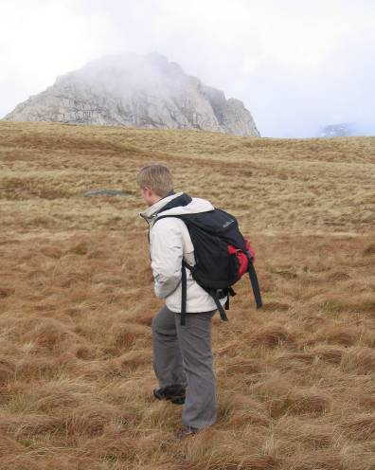
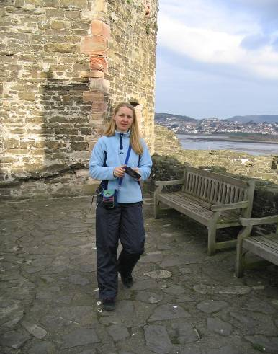
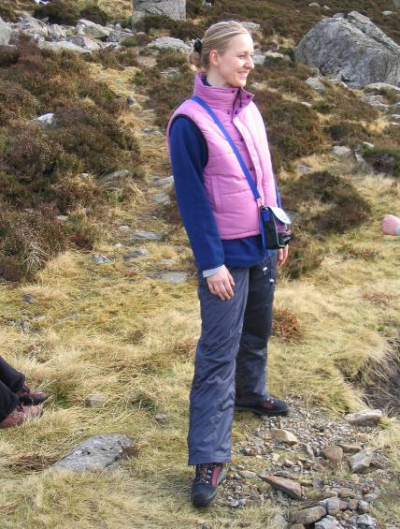
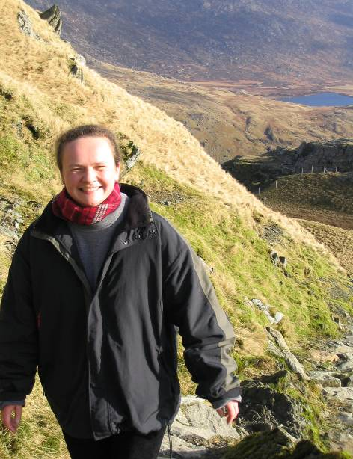
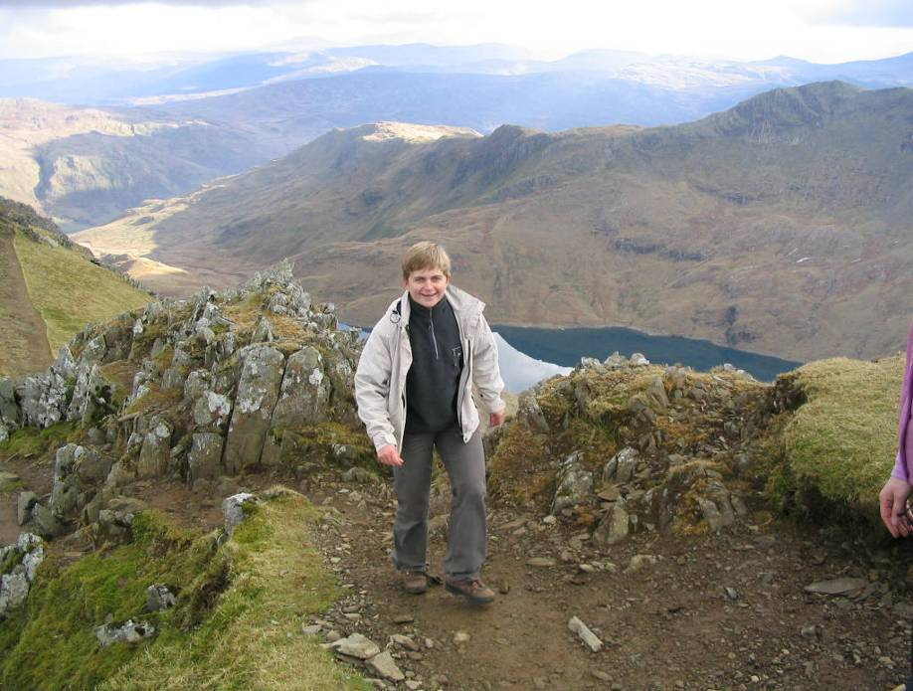
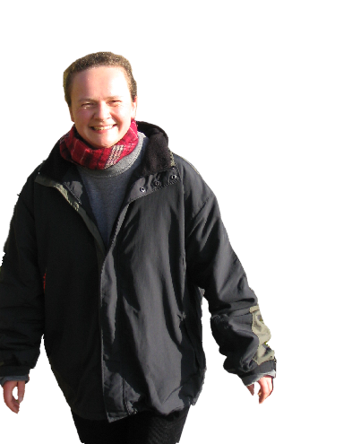
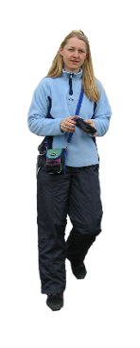



GrabCut
GrabCut – Interactive Foreground Extraction
Notes:
Here are some images from my last hiking trip in England. And would it be great if we could just do the following. Drag rectangle. Create a nice photomontage with an extreamly simple user interface.

Slide 16



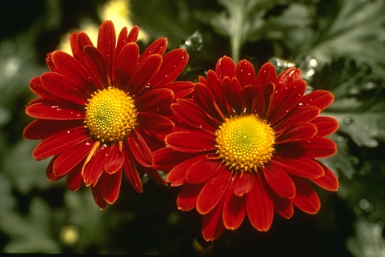

Iterated Graph Cuts
Guaranteed to converge
1
2
3
4
Result
See: http://www.youtube.com/watch?v=9jNB6fza0nA&feature=related
GrabCut – Interactive Foreground Extraction
Notes:
Iterations are not shown to the user; Converges: proof in the paper.

Slide 17
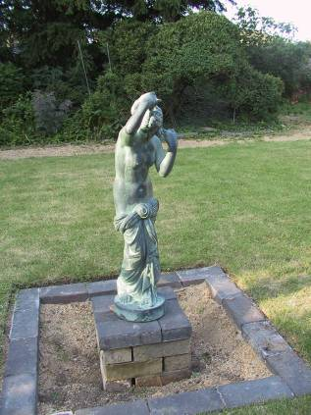
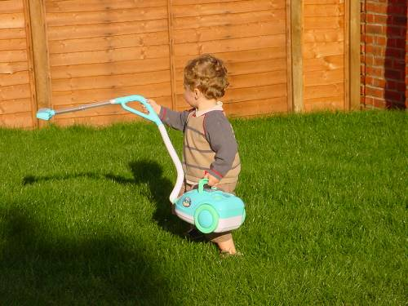
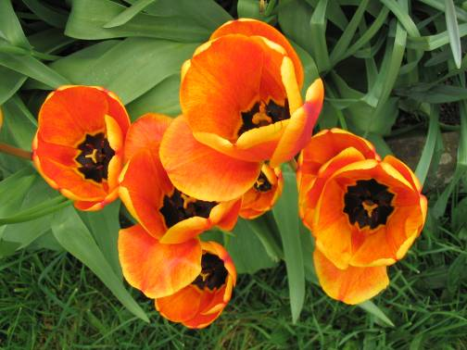
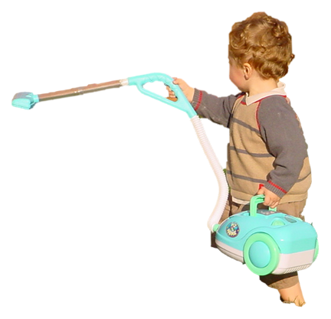
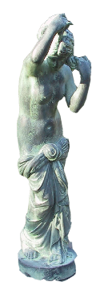

Moderately straightforward examples
… GrabCut completes automatically
GrabCut – Interactive Foreground Extraction
Notes:
Moderately straightforward examples- after the user input automnatically

Slide 18
Important properties
Very efficient in practice
Lots of short paths, so roughly linear
Construction is symmetric (0 vs 1)
Specific to 2 labels
Min cut with >2 labels is NP-hard

Slide 19
Can this be generalized?
NP-hard for Potts model [K/BVZ 01]
Two main approaches
1. Exact solution [Ishikawa 03]
Large graph, convex V (arbitrary D)
Not the considered the right prior for vision
2. Approximate solutions [BVZ 01]
Solve a binary labeling problem, repeatedly
Expansion move algorithm

