Slide 1
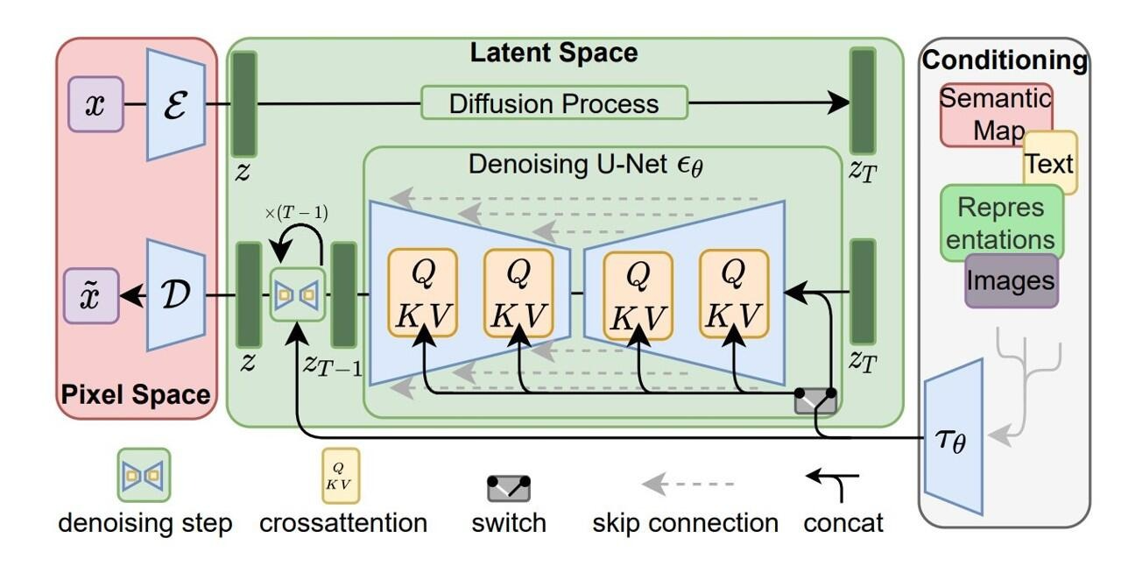

Slide 2
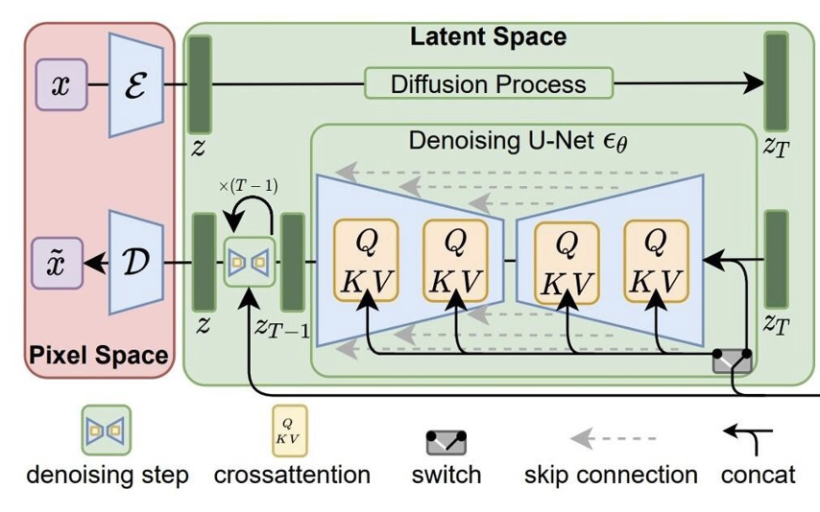
Input Image
Original Stable Diffusion Architecture
CLIP
Clip embedding (768, )
Fully-connected layer
(771x768)
Concatenate
Light position embedding (3,)
Rotation & translation of the light source
θ
sin(α) cos(α)
θ – polar angle
α – azimuth angle

