Slide 1
OEI Takeoff

Slide 2
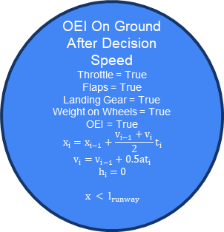
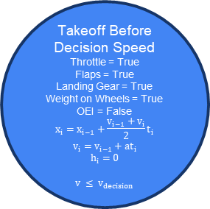
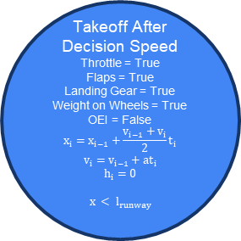
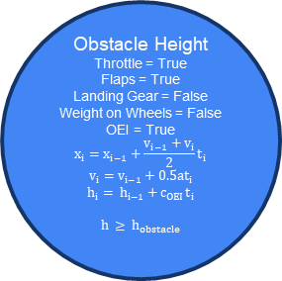
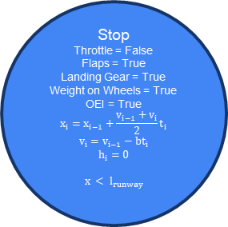
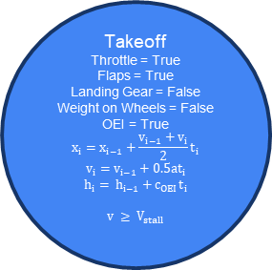
Stop
Throttle = False
Flaps = True
Landing Gear = True
Weight on Wheels = True
OEI = True
$$x_{i}=x_{i−1}+\frac{v_{i−1}+v_{i}}{2}t_{i}$$
$$v_{i}=v_{i−1}−bt_{i}$$
$$h_{i}=0$$
$$x < l_{runway}$$
$$x_{i} = x_{OEI}$$
Takeoff Before Decision Speed
Throttle = True
Flaps = True
Landing Gear = True
Weight on Wheels = True
OEI = False
$$x_{i}=x_{i−1}+\frac{v_{i−1}+v_{i}}{2}t_{i}$$
$$v_{i}=v_{i−1}+at_{i}$$
$$h_{i}=0$$
$$v ≤ v_{decision}$$
Takeoff After Decision Speed
Throttle = True
Flaps = True
Landing Gear = True
Weight on Wheels = True
OEI = False
$$x_{i}=x_{i−1}+\frac{v_{i−1}+v_{i}}{2}t_{i}$$
$$v_{i}=v_{i−1}+at_{i}$$
$$h_{i}=0$$
$$x < l_{runway}$$
OEI On Ground After Decision Speed
Throttle = True
Flaps = True
Landing Gear = True
Weight on Wheels = True
OEI = True
$$x_{i}=x_{i−1}+\frac{v_{i−1}+v_{i}}{2}t_{i}$$
$$v_{i}=v_{i−1}+0.5at_{i}$$
$$h_{i}=0$$
$$x < l_{runway}$$
Takeoff
Throttle = True
Flaps = True
Landing Gear = False
Weight on Wheels = False
OEI = True
$$x_{i}=x_{i−1}+\frac{v_{i−1}+v_{i}}{2}t_{i}$$
$$v_{i}=v_{i−1}+0.5at_{i}$$
$$h_{i}= h_{i−1}+c_{OEI}t_{i}$$
$$v ≥ V_{stall}$$
Obstacle Height
Throttle = True
Flaps = True
Landing Gear = False
Weight on Wheels = False
OEI = True
$$x_{i}=x_{i−1}+\frac{v_{i−1}+v_{i}}{2}t_{i}$$
$$v_{i}=v_{i−1}+0.5at_{i}$$
$$h_{i}= h_{i−1}+c_{OEI}t_{i}$$
$$h ≥ h_{obstacle}$$
$$x_{i}=x_{decision}$$
$$x_{i} = x_{OEI}$$
$$v_{i} = {1.1V}_{stall}$$
$$x_{i} = x_{c}$$

Slide 3
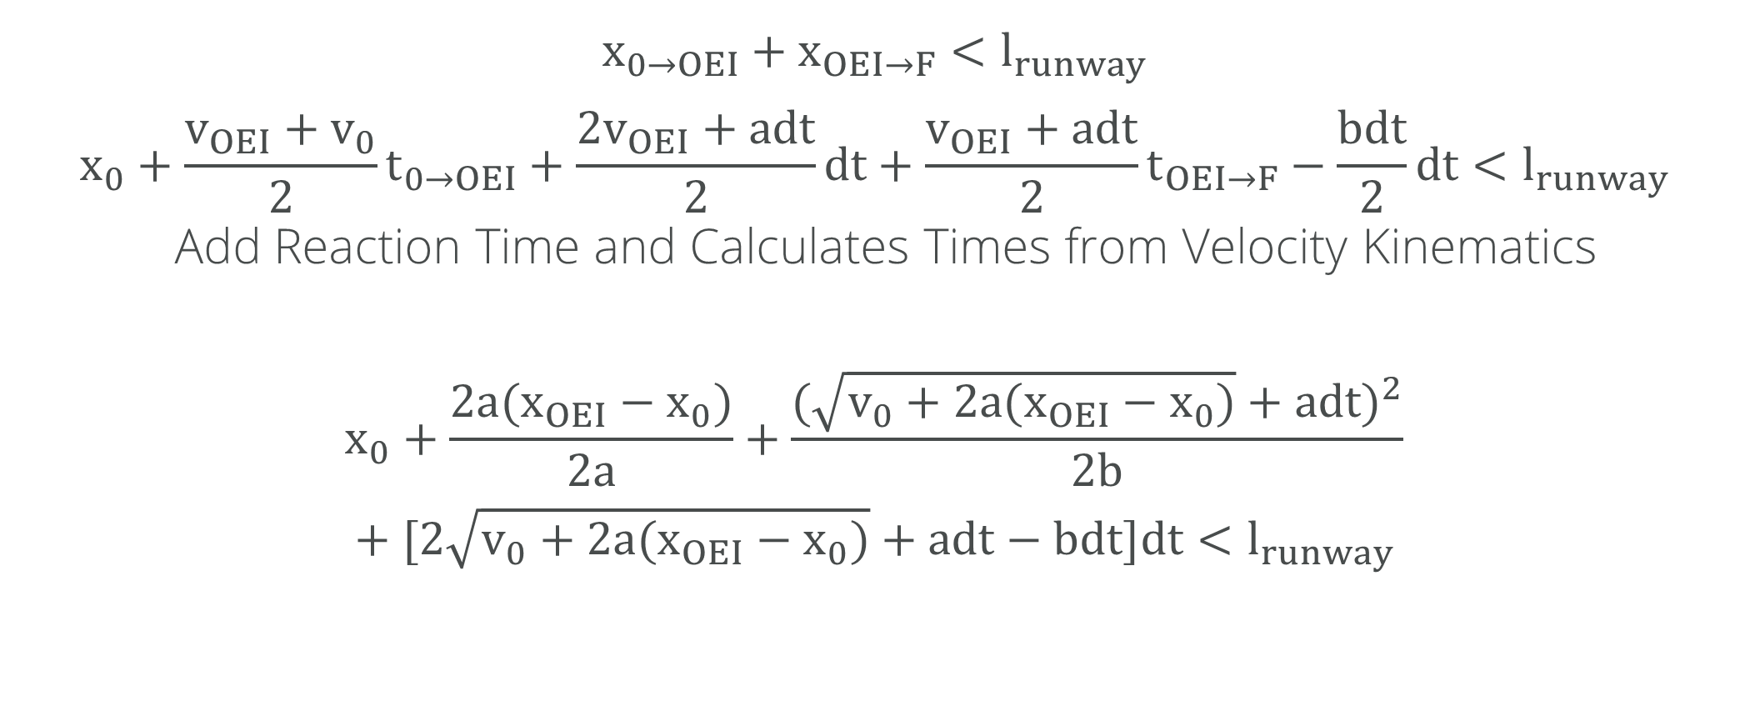
OEI Before Decision Speed
$$x_{0→OEI}+x_{OEI→F}<l_{runway}$$
$$x_{0}+\frac{v_{OEI}+v_{0}}{2}t_{0→OEI}+\frac{2v_{OEI}+adt}{2}dt+\frac{v_{OEI}+adt}{2}t_{OEI→F}−\frac{bdt}{2}dt<l_{runway}$$
Add Reaction Time and Calculates Times from Velocity Kinematics
$$x_{0}+\frac{2a(x_{OEI}−x_{0})}{2a}+\frac{{(\sqrt{v_{0}+2a(x_{OEI}−x_{0})}+adt)}^{2}}{2b}$$
$$+ [2\sqrt{v_{0}+2a(x_{OEI}−x_{0})}+adt−bdt]dt<l_{runway}$$

Slide 4
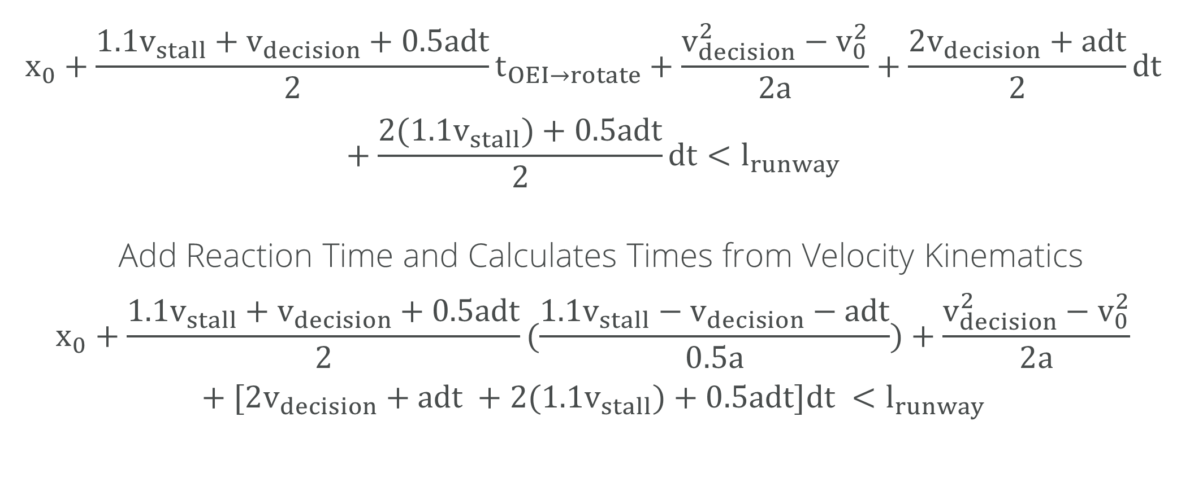
OEI After Decision Speed Runway Length
$$x_{0}+\frac{{1.1v}_{stall}+v_{decision}+0.5adt}{2}t_{OEI→rotate}+\frac{v_{decision}^{2}−v_{0}^{2}}{2a}+\frac{2v_{decision}+adt}{2}dt+\frac{2{(1.1v}_{stall})+0.5adt}{2}dt<l_{runway}$$
Add Reaction Time and Calculates Times from Velocity Kinematics
$$x_{0}+\frac{{1.1v}_{stall}+v_{decision}+0.5adt}{2}(\frac{{1.1v}_{stall}−v_{decision}−adt}{0.5a})+\frac{v_{decision}^{2}−v_{0}^{2}}{2a}+[2v_{decision}+adt +2{(1.1v}_{stall})+0.5adt]dt <l_{runway}$$

Slide 5
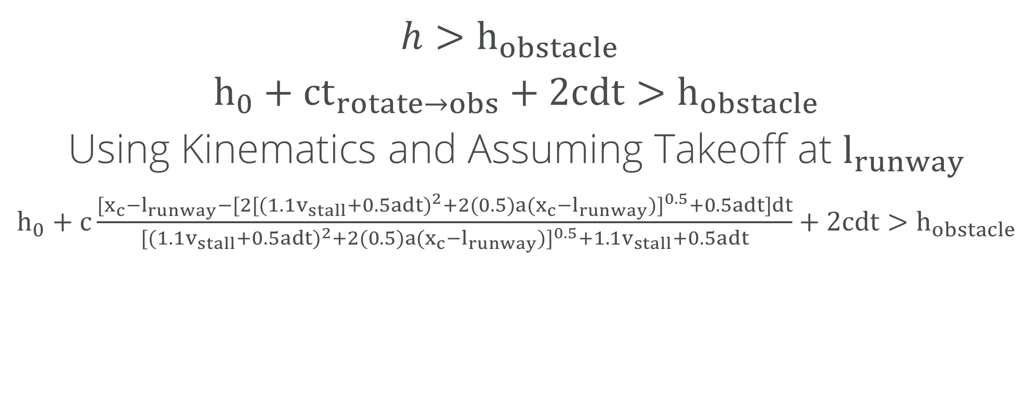
OEI After Takeoff Obstacle Clearance
$$h>h_{obstacle}$$
$h_{0}+ct_{rotate→obs}+2cdt>$ $h_{obstacle}$
Using Kinematics and Assuming Takeoff at $l_{runway}$
$h_{0}+c\frac{[x_{c}−l_{runway}−[2{[{({1.1v}_{stall}+0.5adt)}^{2}+2(0.5)a(x_{c}−l_{runway})]}^{0.5}+0.5adt]dt}{{[{({1.1v}_{stall}+0.5adt)}^{2}+2(0.5)a(x_{c}−l_{runway})]}^{0.5}+{1.1v}_{stall}+0.5adt}+2cdt>$ $h_{obstacle}$
Notes:
Solve for velocity at obstacle height, then find xc-lrunway length using ballistic kinematics

