Slide 1
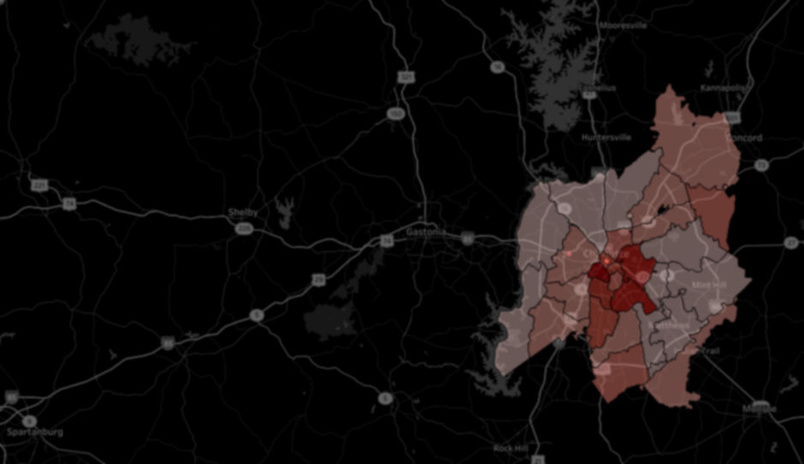
Yelp Dataset Analysis by Scott Zhang (sz8ace@gmail.com)
Background
Data: 54K Yelp reviews for 1.4k restaurants in Charlotte, NC from 16K users
Time: 2004~2015
Insights
Restaurants with lower noise level and wheelchair access got higher stars
Bars got more reviews than other categories
16% of restaurants changed at least half a star from 2013 to 2014
“valuable user” ratio of new Yelpers each year dropped from 60% to 6%
Misc.: on average each user wrote 8 reviews and each restaurant got 19 reviews; the average stars was 3.46
restaurants near downtown got more reviews…
Recommendation for search results page
Add filter for Noise Level (among other features) and bring to front on the page
Add filter for time range of stars and review counts shown on the page
Click here for full analysis and code

