Slide 1
GraphGame ggl008-Fire
Plakátok, részecskerendszerek
Szécsi László

Slide 2
Particle osztály
#include "Egg/Math/math.h"
class Particle {
public:
Egg::Math::Float3 position;
Egg::Math::Float3 velocity;
float lifespan;
float age;
};

Slide 3
Particle osztály
void reborn() {
using namespace Egg::Math;
position =
Float3::Random(-1,1);
velocity = position * 5;
age = 0;
lifespan =
Float1::Random(2,5).x;
}
Particle(){ reborn(); }

Slide 4
ggl008App.h
#include "Particle.h"
#include <vector>

Slide 5
ggl008App.h
std::vector<Particle> particles;
Egg::Mesh::Shaded::P
fireBillboardSet;

Slide 6
LoadAssets
for(int i=0; i<40; i++)
particles.push_back(Particle());

Slide 7
ConstantBufferTypes
__declspec(align(16)) struct PerFrameCb {
Float4x4 viewProjTransform;
Float4x4 rayDirTransform;
Float4 cameraPos;
Float4 lightPos;
Float4 lightPowerDensity;
Float4 billboardSize;
};

Slide 8
Update
perFrameCb->billboardSize = Float4(0.1, 0.1, 0, 0);

Slide 9
Geometry
D3D12_PRIMITIVE_TOPOLOGY_TYPE GetTopologyType() const {
switch (topology) {
case D3D_PRIMITIVE_TOPOLOGY_POINTLIST:
return D3D12_PRIMITIVE_TOPOLOGY_TYPE_POINT;
case D3D_PRIMITIVE_TOPOLOGY_LINELIST:
case D3D_PRIMITIVE_TOPOLOGY_LINESTRIP:
return D3D12_PRIMITIVE_TOPOLOGY_TYPE_LINE;
case D3D_PRIMITIVE_TOPOLOGY_TRIANGLESTRIP:
case D3D_PRIMITIVE_TOPOLOGY_LINELIST_ADJ:
case D3D_PRIMITIVE_TOPOLOGY_LINESTRIP_ADJ:
case D3D_PRIMITIVE_TOPOLOGY_TRIANGLELIST_ADJ:
case D3D_PRIMITIVE_TOPOLOGY_TRIANGLESTRIP_ADJ:
case D3D_PRIMITIVE_TOPOLOGY_TRIANGLELIST:
return D3D12_PRIMITIVE_TOPOLOGY_TYPE_TRIANGLE;
default:
return D3D12_PRIMITIVE_TOPOLOGY_TYPE_PATCH;
}
}

Slide 10
Shaded constructor
gpsoDesc.PrimitiveTopologyType = geom->GetTopologyType();

Slide 11
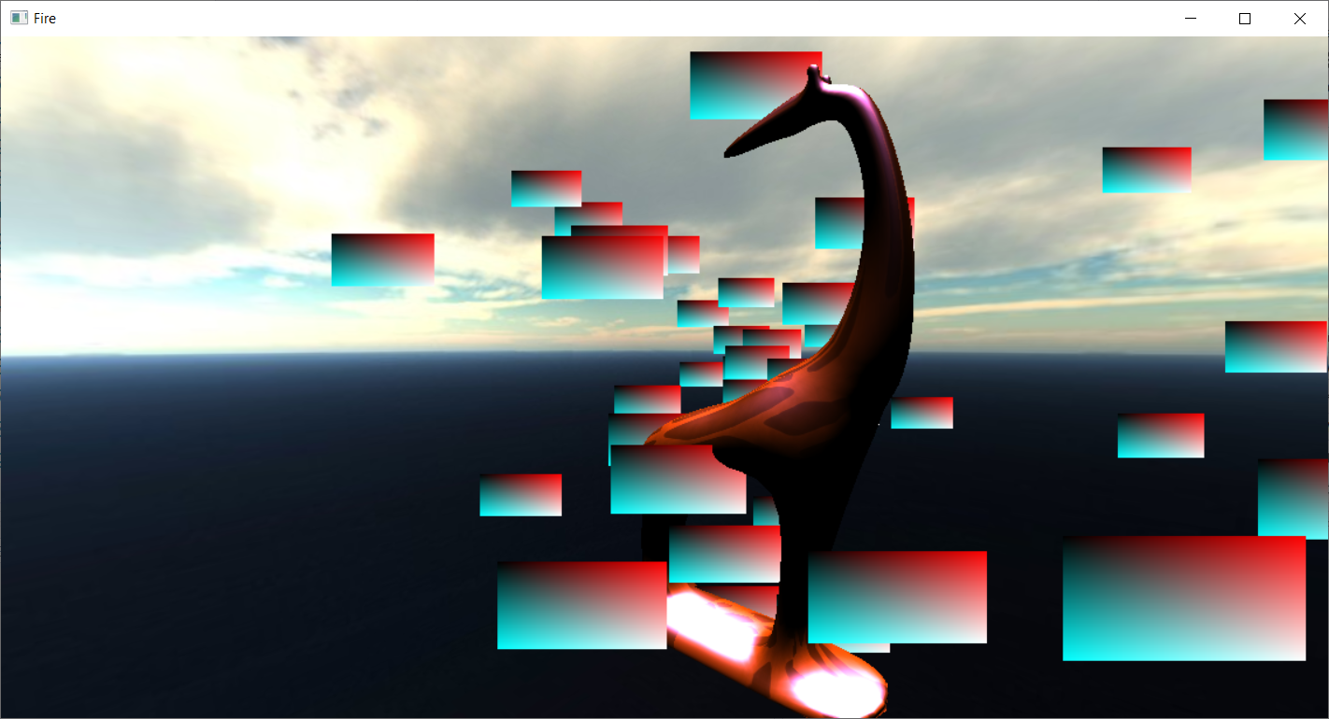
Eredmény

