Slide 1
Geometries and algebras 1. Classical geometries
”In jeder besonderen Naturlehre nur so viel eigentliche Wissenschaft angetroffen werden könne, als darin Mathematik anzutreffen ist.”
Immanuel Kant
Szirmay-Kalos László

Slide 2
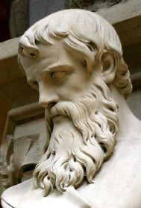
Euclidean planar geometry
Axioms of Euclidean geometry of the plane:
Two points define a line.
A line has at least two points.
There is exactly one line that goes through a point and does not intersect a given line (parallelism).
Movement does not modify size.
Size of the whole is the sum of its parts.
…
Axioms
Basic truth (experience)
Implicit definition of basic concepts
Definitions and theorems
T1. Two different lines intersect each other
at most one point
T2. Two lines are parallel if and only if the angles in which a third line intersects them are equal.
T3. The sum of angles of a triangle is the half angle, i.e. 180 degrees.
Is Euclidean geometry good for earth (Geo) measuring (meter)?
Notes:
Computer graphics works with shapes. The field of mathematics that describes shapes is the geometry, so geometry is essential in computer graphics.
Geometry, like other fields of formal science, has axioms that are based on experience and cannot be argued but must be accepted as true statements without arguments. From axioms other true statements, called theorems, can be deducted with logic reasoning.
For example, axioms of the Euclidean geometry include the postulates shown above.
Axioms have two purposes, on the one hand, they are accepted as true statements. On the other hand, axioms implicitly define basic concepts like points, lines etc. because they postulate their properties.
Euclidean geometry is metric, i.e. we can talk of the distance between points or separation of lines, called the angle, and size is an important concept. Additional axioms introduce the properties of metric quantities (distance and angle).
Having defined the axioms, we can start establishing theorems using logic inference. Such theorems will constitute the geometry. For example, theorems are:
T1: Two different lines may intersect each other at most one point.
T2: Two lines are parallel if and only if the angles in which a third line intersects them are equal.
T3: The sum of angles of a triangle is the half angle, i.e. 180 degrees.
T4: Theorem of Pythagoras.
Prove them using axioms and already proven theorems!

Slide 3

Earth (Geo) measurement (meter)?
North
Equator
South pole
South
Equator
North pole
North
Equator
South

Slide 4
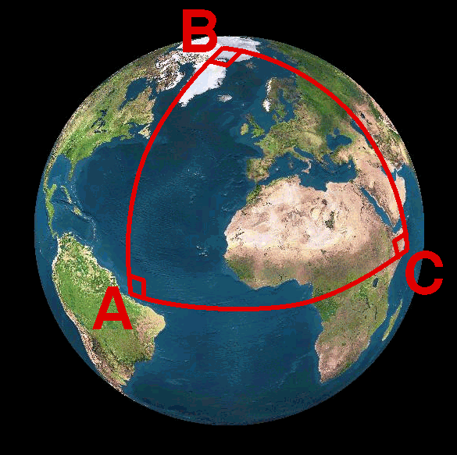
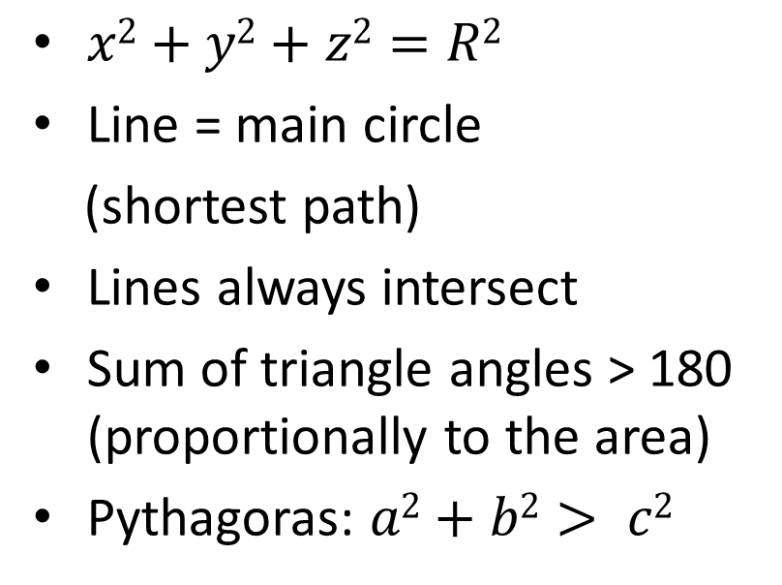
Spherical geometry
Euclidean axioms are wrong:
Two points not always define a line.
A line has at least two points.
Two lines always intersect.
Movement does not modify size
Size of the whole is the sum of its parts.
…
$x2+y2+z2=R2$
Line = main circle
(shortest path)
Lines always intersect
Sum of triangle angles > 180 (proportionally to the area)
Pythagoras: $a2+b2> c2$
Notes:
The axioms of the Euclidean geometry are based on experience gathered on walking on a flat terrain or not too large distances.
If Euclid had travelled through continents of the spherical Earth, he would have different experience and would have established different axioms. For example, on the Earth parallel lines meet at exactly 10 million km from start .
The line on a sphere, using the concept of the shortest path between two points, is the main circle, which is the intersection of the sphere and the plane defined by the two points and the center of the sphere. Airplanes fly along these spherical lines.
If we interpret spherical points as diameters, the first two axioms of the Euclidean geometry remain valid. However, the third axiom is invalid for spherical lines and points. Here lines always intersect in a diameter. Consequently, the theorems of Euclidean geometry are not true. For example, the sum of the angles of a triangle is always larger than 180 degrees.
Maps are Euclidean unfolding of the non-Euclidean (spherical) plane. As the curvature of the sphere is not zero, a map must distort distances and/or angles. There are different options, but all of them distort somehow. Mercator’s map, for example, preserves angles but apply drastic distance distortions

Slide 5
Maps: Sphere to plane projection
Central projection
Only the half sphere
Lines to lines
Does not preserve circles, angles and distances
Stereographic projection
The whole sphere except for the south pole
Circles to circles, preserves angles
Does not preserve lines and distances

Slide 6
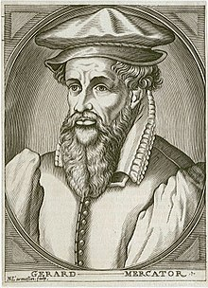
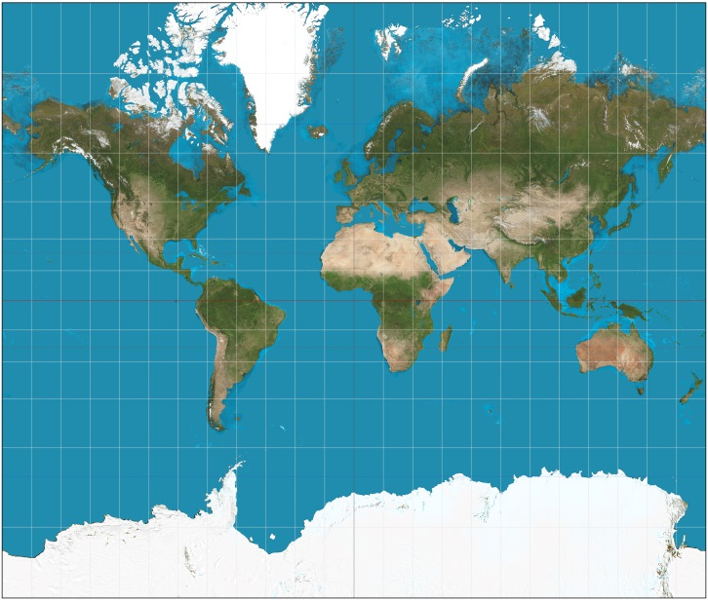
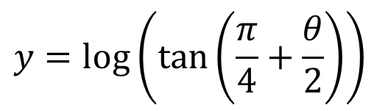









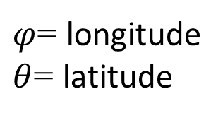


(Gerardus) Mercator map
Preserves angles but distorts distances
$$y(φ)$$
$$p′′$$
$$y({85}^{o})$$
$φ$= longitude
$θ$= latitude
$$p$$
$$p′$$
$$θ$$
$$φ$$
$$y({−85}^{o})$$
$$x=−π$$
$$x=π$$
$$x=φ$$
$$y=log⁡\left(\tan\left(\frac{π}{4}+\frac{θ}{2}\right)\right)$$

Slide 7
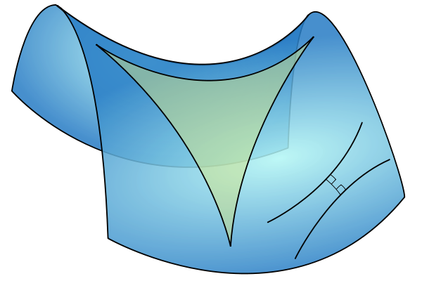
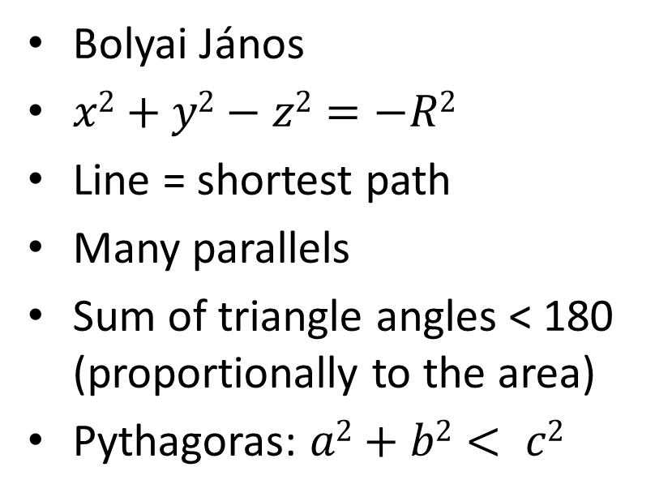
Hyperbolic geometry
Axioms of hyperbolic geometry:
Two points define a line.
A line has at least two points.
There are many lines that go through a point and do not intersect a given line (parallelism).
Movement does not modify size
Size of the whole is the sum of the sizes of its parts
…
Bolyai János
$x2+y2−z2=−R2$
Line = shortest path
Many parallels
Sum of triangle angles < 180 (proportionally to the area)
Pythagoras: $a2+b2< c2$
Notes:
Spaces of negative curvature need another geometry called hyperbolic geometry. We should change just a single word in the axioms: there can be more than one parallel line crossing a given point. This small modification may invalidate most of the theorems of Euclidean geometry and lead into a “new world”.
In hyperbolic geometry the sum of angles of a triangle is less than 180 degrees, proportionally to the size.
Hyperbolic geometry is also often studied with maps. Here we show the Beltrami-Poincare disc as a map, which is a conformal, i.e. angle preserving map of the hyperbolic plane. However, it is not distance preserving, infinity is at the boundary of the base circle. Esher loved this model and created many different artworks according to its rules.
How can we figure it out whether our universe has positive, negative or zero curvature? This is an important question since it determines whether the universe will expand without limits or will start shrinking sooner or later.

Slide 8
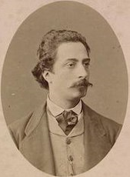
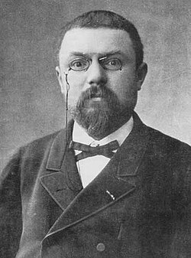
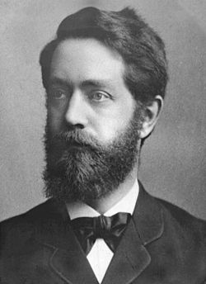
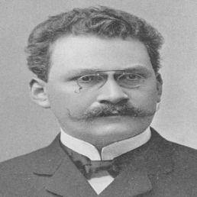
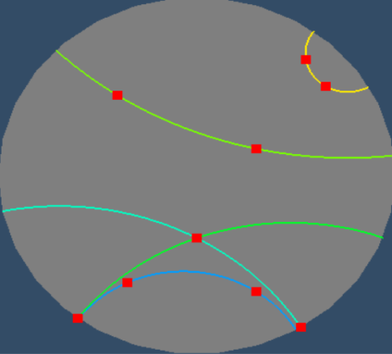
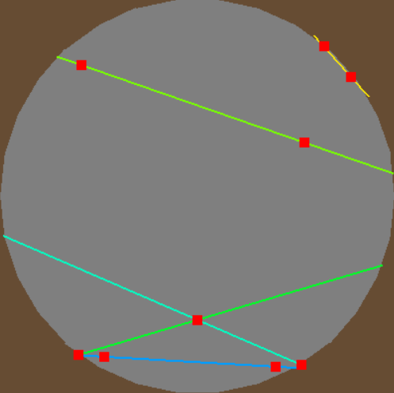
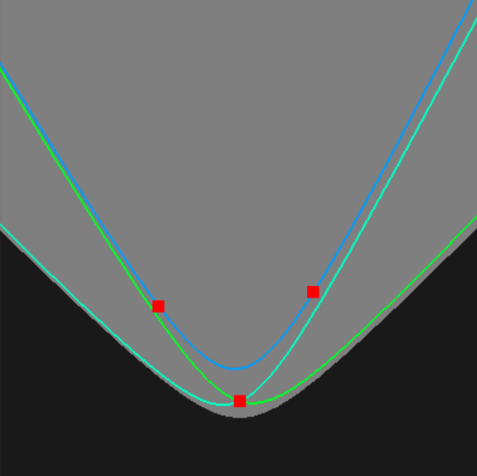









Beltrami – Poincaré/Klein disc
z
$$x2+y2−z2=−R2$$
z
$$z=R$$
$$z=R$$
$$y$$
$$y$$
$$z=0$$
$$x$$
$$z=−R$$
$$x$$
Poincaré: Angles and circles are preserved; Lines are circular arcs
Klein: Lines are preserved
Minkowski space
This is a sphere!

Slide 9
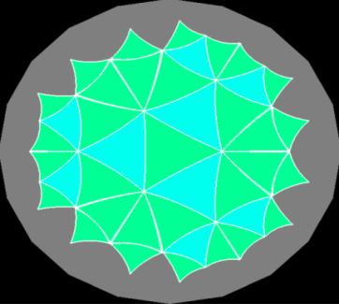
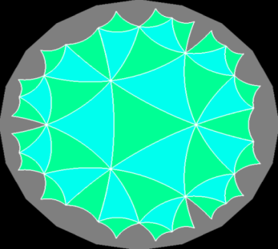
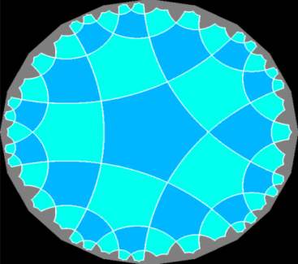
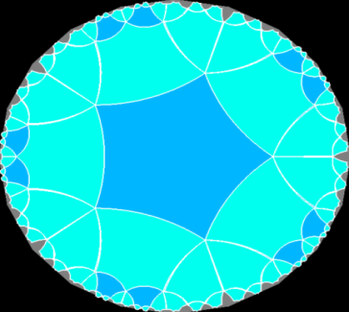
Tiling with regular, congruent polygons
Euclidean geometry
36°
108°
120°
60°
90°
(3, 6)
(4, 4)
(6, 3)
Hyperbolic geometry
(3, 7)
(3, 8)
(5, 4)
(5, 5)
Notes:
The richness and beauty of hyperbolic geometry is often demonstrated with tiling, i.e. tessellation of the plane with, for example, regular, congruent polygons. The Euclidean plane has only three such tessellations: with triangles, squares, and hexagons. However, thanks to the fact that sum of angles of a triangle can be smaller than 180 degrees in hyperbolic geometry, a regular polygon with any number of vertices can tile the plane, and can do it with infinitely many ways. Just the size of the polygon should be set properly.

Slide 10
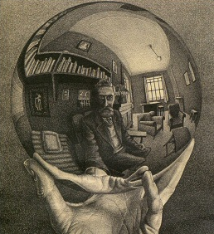
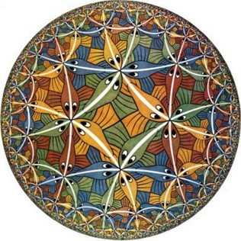
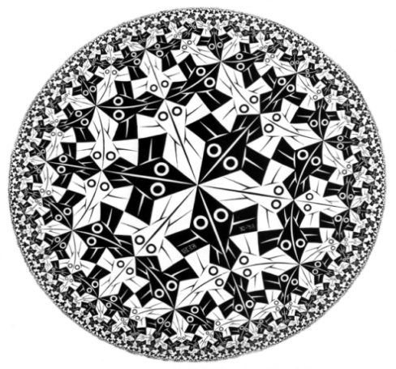
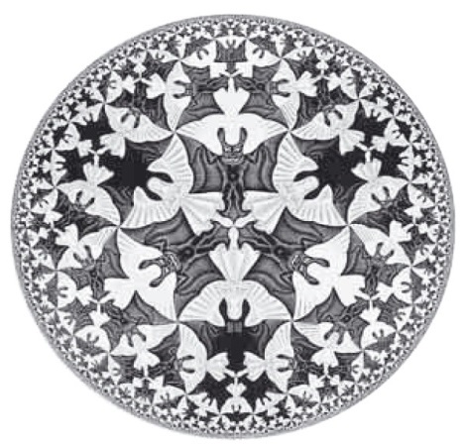
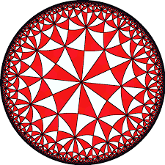
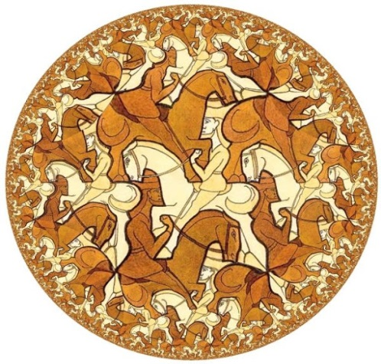
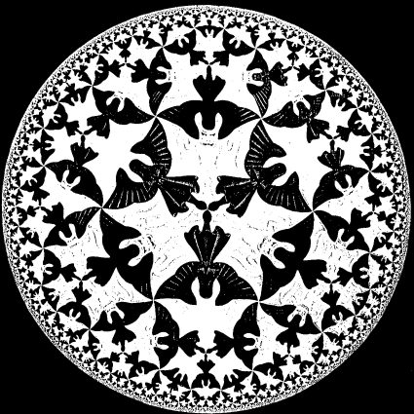
Escher and the Poincaré disc
Circle limit III
Circle limit I
Circle limit IV

Slide 11
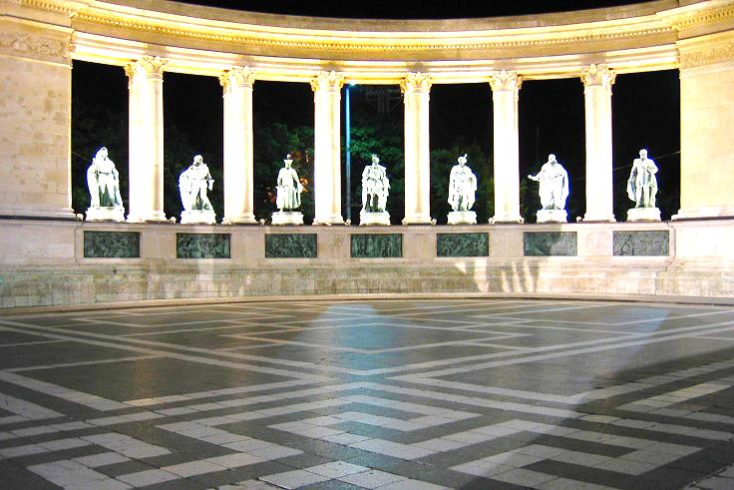

Projective geometry
Axioms of projective geometry:
Two points define a line.
A line has at least two points.
Two different lines always intersect in a single point.
Infinity is also part of our world
There are no parallel lines
Programming advantage: no singularity
Cartesian or polar coordinates are not good (no distance)
Geometry of shadows or of the straight edge without scale
Notes:
In Euclidean geometry parallel lines do not intersect, that is, a point at infinity (where parallel line would meet) is not part of the Euclidean plane. However, we can see the intersection of parallel lines, so a geometry where infinity is also included makes sense.
If we define axioms differently, we can add points at infinity to the plane making all lines, even parallel lines, intersecting. Clearly, this is a different geometry with different axioms and theorems, which is called the projective geometry. Projective geometry is not metric since distance cannot be defined in it. The reason is that the distance from points at infinity is infinite, but infinite is not a number. As a result, we cannot use coordinate systems that are based on the concept of distance, e.g. Cartesian coordinate systems are useless here. We should find another algebraic basis.
Note that the first three axioms of projective geometry are identical to those of the spherical geometry. They are close relatives. As a result, a projective line has similar properties to a circle. You can go around it.

Slide 12
Euclidean → Projective plane
Axioms of projective geometry:
Two points define a line.
A line has at least two points.
Two different lines always intersect in a single point.

Slide 13
Model geometries
Euclidean
1 non-intersecting line (parallel)
Zero curvature
Spherical
0 non-intersecting line
Positive curvature
Hyperbolic
More than one non-intersecting line
Negative curvature
Projective
0 non-intersecting line
Not metric: includes infinity

Slide 14
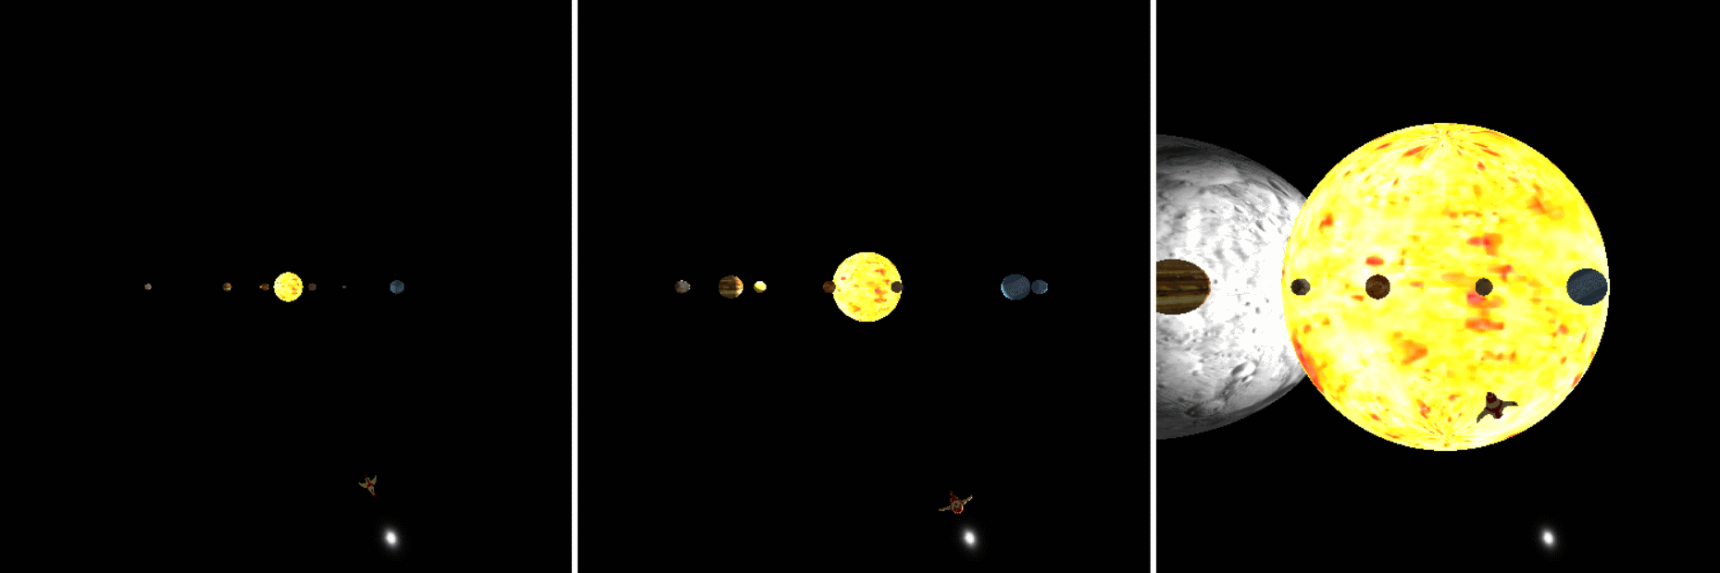
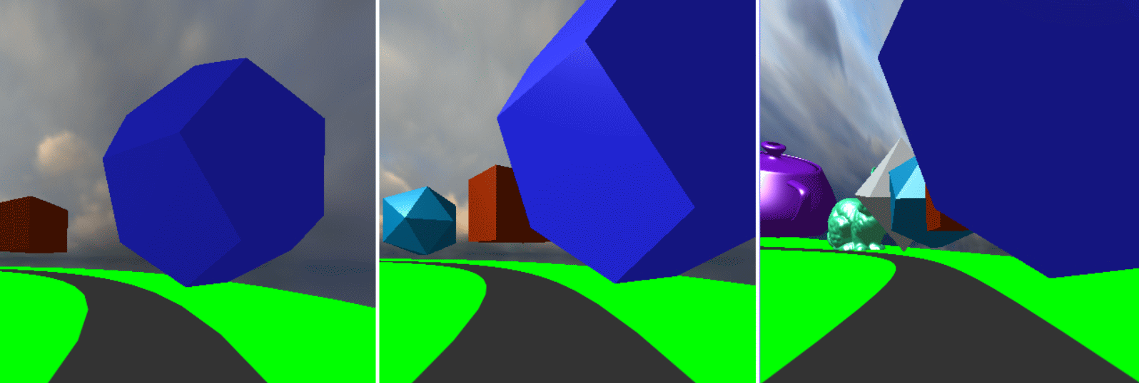
Feeling
Hyperbolic
Euclidean
Spherical
Gömbi

Slide 15
“Tant que l’Algèbre et la Géométrie ont été séparées, leurs progrès ont été lents et leurs usages bornés; mais lorsque ces deux sciences se sont réunies, elles se sont prêté des forces mutuelles et ont marché ensemble d’un pas rapide vers la perfection.”
Joseph-Louis Lagrange
Geometries and algebras 2. Vector algebra
Szirmay-Kalos László

Slide 16
With numbers: analytic geometry
Two points define a line.
A line has at least two points.
If a is a line and A is a point not on this line, then there is exactly one other line that crosses point A but not line a.
axioms
point
plane
number
line
correspondence
operation
equation
intersect
is on
function
geometry
algebra
Notes:
In computer graphics, we should also take into account that a computer is programmed, which cannot do anything else but making calculations with numbers. A computer is definitely not able to understand abstract concepts like point, line etc. So for the application of a computer, geometric concepts must be translated to numbers, calculation and algebra.
A geometry based on algebra, equations and numbers is called analytic geometry or coordinate geometry. To establish an analytic version of a geometry, we have to find correspondences between geometric concepts and concepts of algebra in a way that axioms of the geometry will not contradict to the concepts of algebra. If it is done, we can forget the original axioms and work only with numbers and equations.

Slide 17

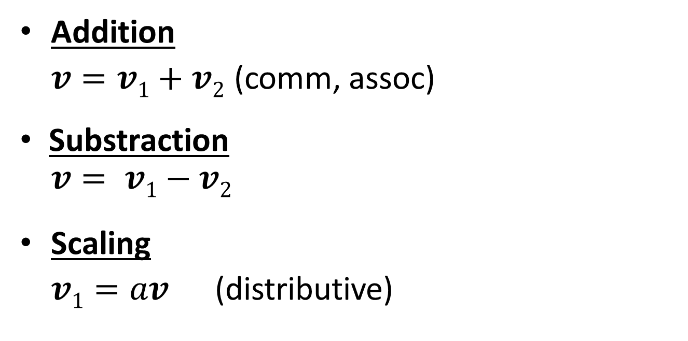





Operations of vectors
$$v1$$
Addition
$v=v1+v2$ (comm, assoc)
Substraction
$$v= v1−v2$$
Scaling
$v1=av$(distributive)
$$v2$$
$$v1$$
$$v2$$
$$v$$
$$av$$
Notes:
Concerning vector operations, we can talk of addition that means the execution of the two translations one after the other. The resulting translation is independent of the order, so vector addition is commutative (parallelogram rule). If we have more than two vectors, parentheses can rearranged so it is also associative. Vector addition has an inverse, because we can ask which vector completes the translation of v2 to get a resulting translation v.
Vectors can be multiplied by a scalar, which scales the length but does not modify the direction. Scaling is distributive, i.e. scaling a sum of two vectors results in the same vector as adding up the two scaled versions.
We have to emphasize that the nice properties of commutativity, associativity, and distributivity are usually not evident and sometimes not even true for vector operations. They must be proven using the axioms of Euclidean geometry.

Slide 18

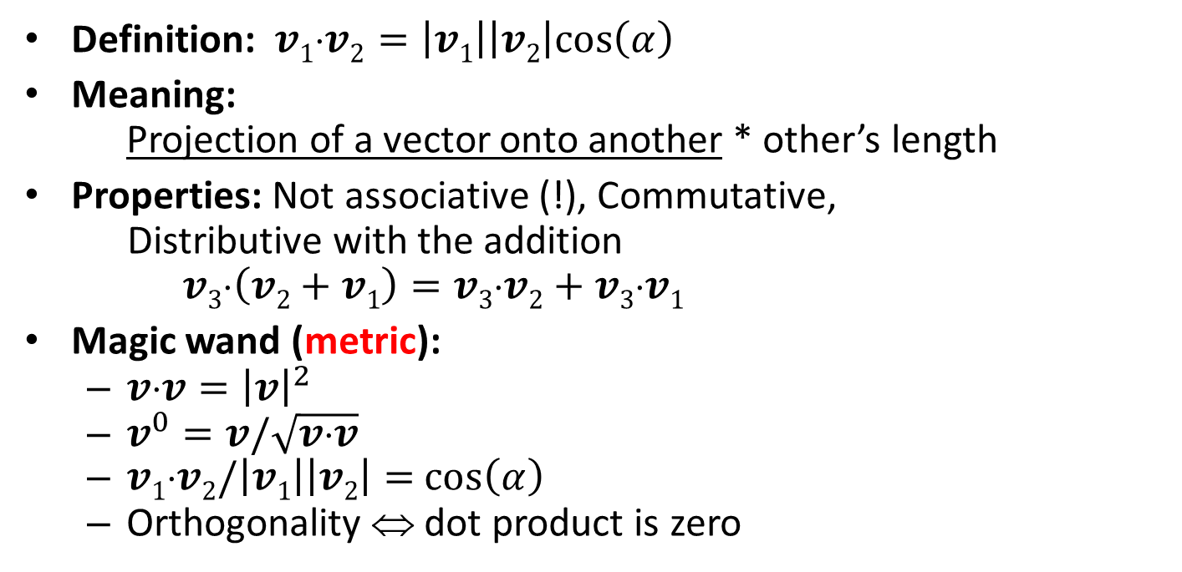






Dot product
$$v1$$
$$α$$
$$v2$$
Definition: $v1⋅v2=\left|v1\right|\left|v2\right|cos\left(α\right)$
Meaning:
Projection of a vector onto another * other’s length
Properties: Not associative (!), Commutative,
Distributive with the addition
$v3⋅\left(v2+v1\right)=v3⋅v2+v3⋅v1$
Magic wand (metric):
$v⋅v={\left|v\right|}^{2}$
$v^{0}=v/\sqrt{v⋅v}$
$v1⋅v2/\left|v1\right|\left|v2\right|=$ $cos\left(α\right)$
Orthogonality ⇔ dot product is zero
$$|v1|cos(α)$$
$$v2$$
$$v1$$
$$v3$$
Notes:
Vectors can be multiplied in different ways. The first possibility is the scalar product (aka dot or inner product) that assigns a scalar to two vectors. By definition, the resulting scalar is equal to the product of the lengths of the two vectors and the cosine of the angle between them.
The geometric meaning of scalar product is the length of projection of one vector onto the other, multiplied by the lengths of the others.
Scalar product is commutative (symmetric), which is obvious from the definition.
Scalar product is distributive with the vector addition, which can be proven by looking at the geometric interpretation. Projection is obviously distributive (the projection of the sum of two vectors is the same as the sum of the two projections.
Scalar product is NOT associative!
There is a direct relationship between dot product and the absolute value. The scalar product of a vector with itself is equal to the square of its length according to the definition since cos(0)=1.

Slide 19
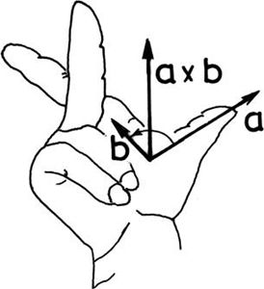








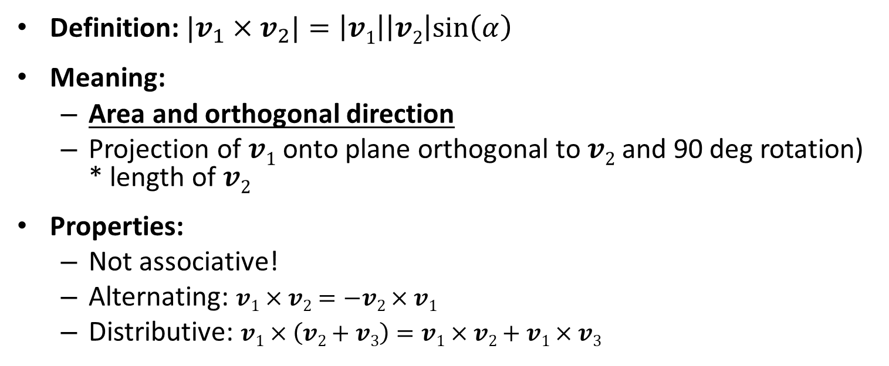

Cross product
$$v1×v2$$
Definition: ${|v}_{1}×v_{2}|=\left|v1\right|\left|v2\right|sin\left(α\right)$
Meaning:
Area and orthogonal direction
Projection of $v1$ onto plane orthogonal to $v2$ and 90 deg rotation) * length of $v2$
Properties:
Not associative!
Alternating: $v1×v2=−v2×v1$
Distributive: $v1×\left(v2+v3\right)=v1×v2+v1×v3$
$$v2$$
$$$$
$$v1$$
$$v1$$
$$v2$$
$$$$
$$\left|v1\right|sin\left(α\right)$$
90 deg
$$v_{1}×v_{2}$$
Notes:
Vectors can be multiplied with the rules of the vector (aka cross) product as well. The result is a vector of length equal to the product of the lengths of the two vectors and the sine of their angle. The resulting vector is perpendicular to both operands and points into the direction of the middle finger of our right hand if our thumb points into the direction of the first operand and our index finger into the direction of the second operand (right hand rule).
Cross product can be given two different geometric interpretations. The first is a vector meeting the requirements of the right hand rule and of length equal to the area of the parallelogram of edge vectors of the two operands.
The second geometric interpretation is the projection of the second vector onto the plane perpendicular to the first vector, rotating the projection by 90 degrees around the first vector, and finally scaling the result with the length of the first vector.
Cross product is NOT commutative but anti-symmetric or alternating, which means that exchanging the two operands the result is multiplied by -1.
Cross product is distributive with the addition, which can be proven by considering its second geometric interpretation. Projection onto a plane is distributive with addition, so are rotation and scaling. Cross product is NOT associative.

Slide 20
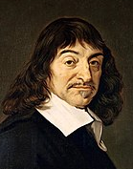
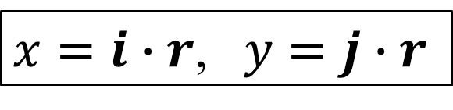



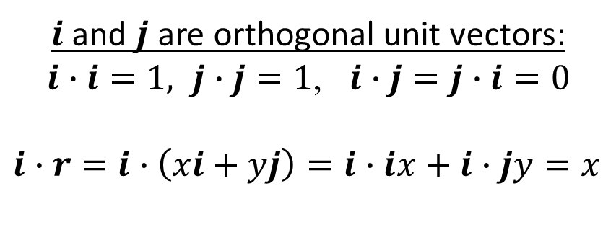

Cartesian coordinate system
y
$$r(x,y)$$
$i$ and $j$ are orthogonal unit vectors:
$i∙i=1, j∙j=1$, $i∙j=j∙i=0$
$i∙r=$ $i∙\left(xi+yj\right)=i∙ix+i∙jy=x$
$$j$$
$$i$$
x
$$r\left(x,y\right)=xi+yj$$
$x=i∙r$, $y=j∙r$
Notes:
Having vectors and operations, we are ready to establish a Cartesian coordinate system. Let us select one point of the plane and two unit (length) vectors i and j that are perpendicular to each other. A vector has unit length if its scalar product with itself is 1 and two vectors are perpendicular if their scalar product is zero since cos(90)=0 (formally:i ⋅i =j ⋅j =1 and i ⋅j= 0).
Now, any position vector v can be unambiguously given as a linear combination of basis vector i and j, i.e. in the form v = xi + yj, where x and y are scalars, called the coordinates. Having v, scalar products determine the appropriate coordinates: x = v⋅i, y = v⋅j . To prove this, let us multiply both sides of v = xi + yj by i and j.

Slide 21
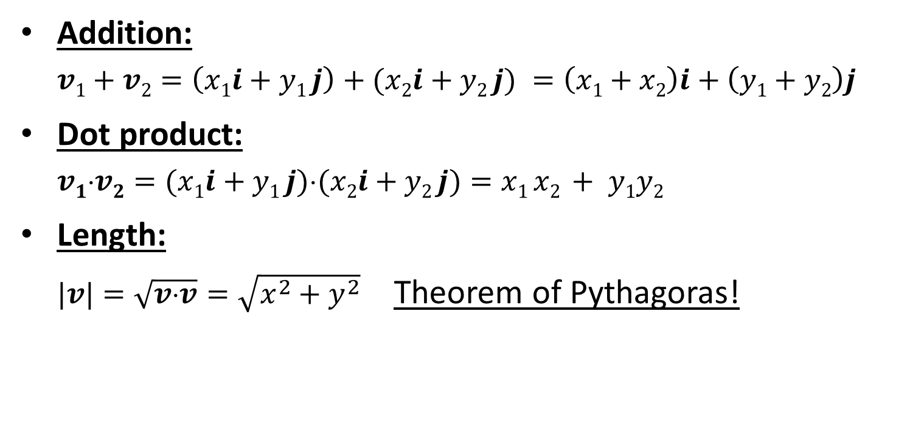
Operations in Cartesian coordinates
Addition:
$$v1+v2=\left(x1i+y1 j\right)+(x2i+y2 j) =\left(x1+x2\right)i+\left(y1+y2\right)j$$
Dot product:
$$v1v2=(x1i+y1 j)(x2i+y2 j)=x1 x2 + y1y2$$
Length:
$|v|=\sqrt{v⋅v}=\sqrt{x^{2}+y^{2}}$Theorem of Pythagoras!
Notes:
As there is a one-to-one correspondence between vectors and coordinate pairs in 2D (and coordinate triplets in 3D), vectors can be represented by coordinates in all operations.
Based on the associative property of vector addition and on distributive property of multiplying a vector by a scalar with addition, we can prove that coordinates of the sum of two vectors are the sums of the respective coordinates of the two vectors.
Similarly, based on the distributive property of dot product with vector addition, we can prove that the dot product equals to the sum of the products of respective coordinates. Here we also exploit that i ⋅i =j⋅j=1 and i ⋅j= 0.
The absolute value of a vector is the square root of the scalar product of the vector with itself. Note that we get the Pythagoras theorem for free.

Slide 22
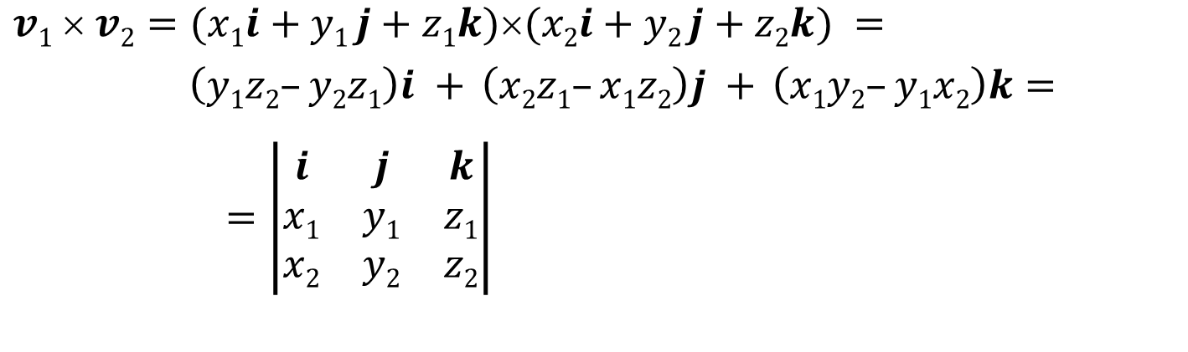
Cross product
$$v1  v2=(x1i+y1 j+z1k)(x2i+y2 j+z2k) =$$
$$\left(y1z2–y2z1\right)i + \left(x2z1–x1z2\right)j + \left(x1y2–y1x2\right)k=$$
$=\left|\begin{matrix}i & j & k \\ x\text{1} & y\text{1} & z\text{1} \\ x\text{2} & y\text{2} & z\text{2}\end{matrix}\right|$
Notes:
Finally, based on the distributive property of the cross product with vector addition, we can also express the cross product of two vector with their coordinates. We should also use the cross products of the base vectors i ×i =0, i ×j=k, etc. The result can be memorized as a determinant where the first row contains the three basis vectors, the second the coordinates of the first operand, the third the coordinates of the second operand.
The absolute value of a vector is the square root of the scalar product of the vector with itself. Note that we get the Pythagoras theorem for free.

Slide 23
Geometries and algebras 3. Analytic geometry
“Algebra is the offer made by the devil: Give me your soul, give up geometry and you will have this marvelous machine.” Michael Francis Atiyah
Szirmay-Kalos László

Slide 24
With numbers: analytic geometry
Two points define a line.
A line has at least two points.
If a is a line and A is a point not on this line, then there is exactly one other line that crosses point A but not line a.
axioms
point
plane
number
line
correspondence
operation
equation
intersect
is on
function
geometry
algebra
Notes:
In computer graphics, we should also take into account that a computer is programmed, which cannot do anything else but making calculations with numbers. A computer is definitely not able to understand abstract concepts like point, line etc. So for the application of a computer, geometric concepts must be translated to numbers, calculation and algebra.
A geometry based on algebra, equations and numbers is called analytic geometry or coordinate geometry. To establish an analytic version of a geometry, we have to find correspondences between geometric concepts and concepts of algebra in a way that axioms of the geometry will not contradict to the concepts of algebra. If it is done, we can forget the original axioms and work only with numbers and equations.

Slide 25
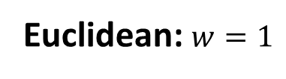






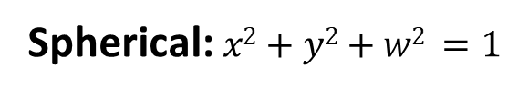

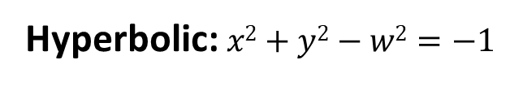









External view
$$a=[x,y,w]$$
Ambient space
addition
scaling
$$a=[x,y,w]$$
$$w$$
$$w$$
Euc
$$w=1$$
$$w=1$$
Not
metric
$$p=[x,y,1]$$
$$y$$
$$y$$
$$x$$
$$x$$
Euclidean: $w=1$
Projective
$$w$$
w
$$w=1$$
Minkowski
Euc
$$w=1$$
y
$$y$$
x
$$x$$
Spherical: $x2+y2+w2 =1$
Hyperbolic: $x2+y2−w2=−1$

Slide 26

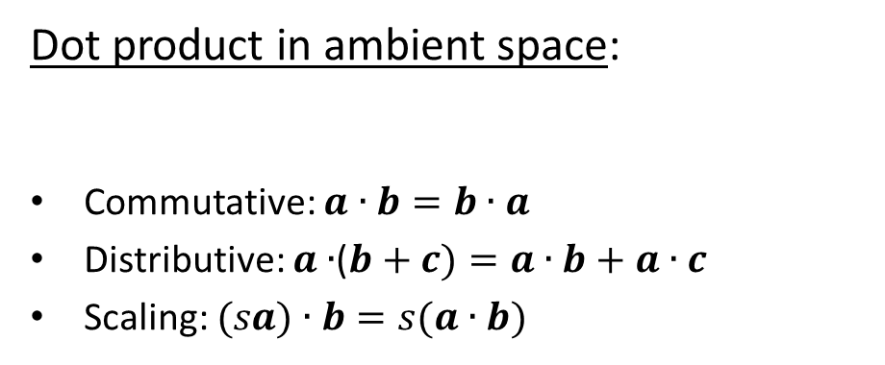



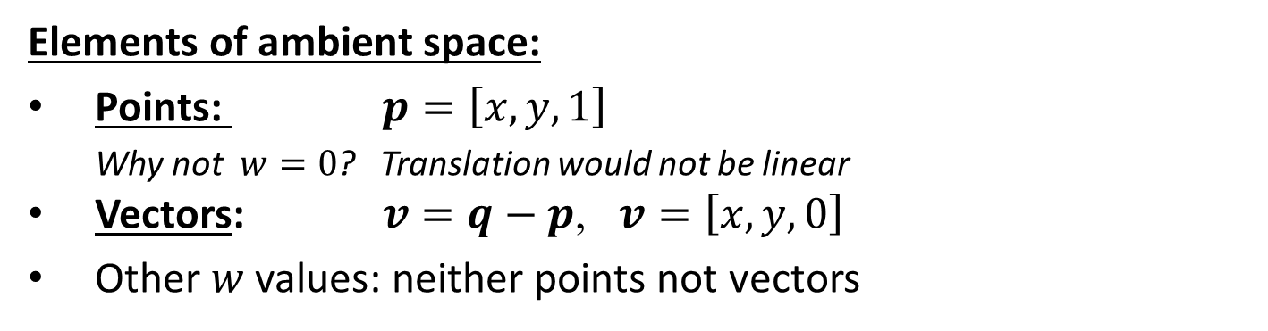




Euclidean planar geometry
$$a=\left[x,y,w\right]$$
Dot product in ambient space:
Commutative: $a∙b=b∙a$
Distributive: $a∙$($b+c)=a∙b+a∙c$
Scaling: $(sa)∙b=s(a∙b)$
$$w$$
$${a_{1}∙a}_{2}=x_{1}x_{2}+y_{1}y_{2}{+w}_{1}w_{2}$$
$$w=1$$
$$q$$
$$p$$
$$y$$
$$x$$
Elements of ambient space:
Points: $p=\left[x,y,1\right]$
Why not $w=0$? Translation would not be linear
Vectors: $v=q−p$, $v=\left[x,y,0\right]$
Other $w$ values: neither points not vectors

Slide 27
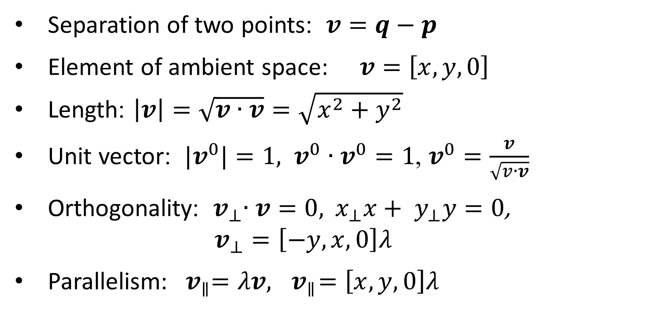
Properties of vectors
Separation of two points: $v=q−p$
Element of ambient space: $v=\left[x,y,0\right]$
Length: $\left|v\right|=\sqrt{v∙v}=\sqrt{x^{2}+y^{2}}$
Unit vector: ${ |v}^{0}|=1, { v}^{0}∙v^{0}=1$, $v^{0}=\frac{v}{\sqrt{v∙v}}$
Orthogonality: ${ v}_{⊥}∙v=0,$ ${ x}_{⊥}x+{ y}_{⊥}y=0$, $v_{⊥}=\left[−y,x,0\right]λ$
Parallelism: ${ v}_{∥}=λv,{ v}_{∥}=\left[x,y,0\right]λ$

Slide 28



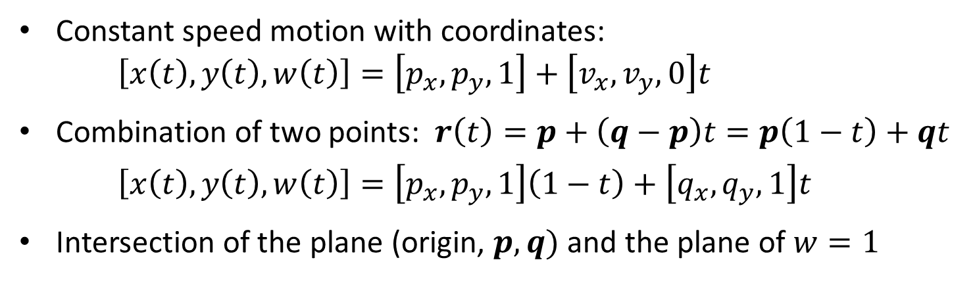




Lines: parametric equation
Constant speed motion:
$r\left(t\right)=p+vt$
$\text{Velocity}\text{:}$ $\dot{r}\left(t\right)=v$
Acceleration: $\ddot{r}\left(t\right)=0$
$$r$$
w
$$v≠0$$
$$w=1$$
$$q$$
$$v$$
$$p$$
y
Zero
curvature
x
Constant speed motion with coordinates: $\left[x\left(t\right),y\left(t\right),w\left(t\right)\right]=\left[p_{x},p_{y},1\right]+\left[v_{x},v_{y},0\right]t$
Combination of two points: $r\left(t\right)=p+\left(q−p\right)t=p\left(1−t\right)+qt$
$\left[x\left(t\right),y\left(t\right),w\left(t\right)\right]=\left[p_{x},p_{y},1\right]\left(1−t\right)+\left[q_{x},q_{y},1\right]t$
Intersection of the plane (origin, $p, q)$ and the plane of $w=1$

Slide 29




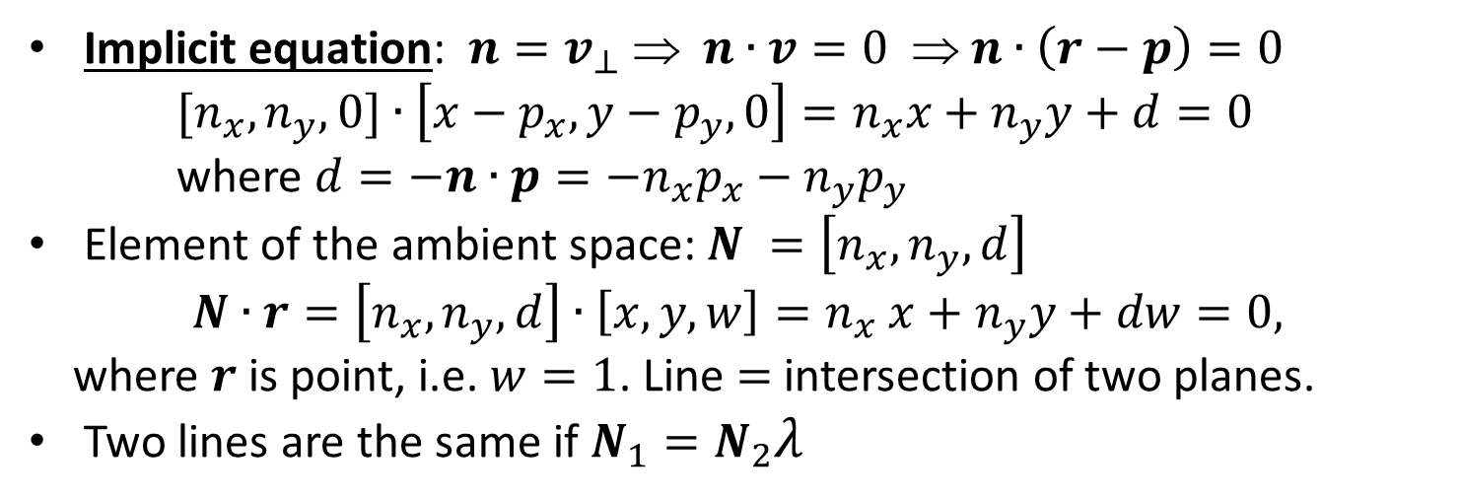
Lines: implicit equation
$$r$$
w
$$v$$
$$p$$
$$n$$
y
x
Implicit equation: ${n=v}_{⊥}$ ⇒ $n∙v=0$ ⇒ $n∙\left(r−p\right)=0$ ${[n}_{x},n_{y},0]∙\left[x−p_{x},y−p_{y},0\right]=n_{x}x+n_{y}y+d=0$ where $d=−n∙p=−n_{x}p_{x}−n_{y}p_{y}$
Element of the ambient space: $N =\left[n_{x},n_{y},d\right]$
$$N∙r=\left[n_{x},n_{y},d\right]{∙\left[x,y,w\right]=n}_{x}x+n_{y}y+dw=0,$$
where $r$ is point, i.e. $w=1$. Line $=$ intersection of two planes.
Two lines are the same if $N_{1}=N_{2}λ$

Slide 30
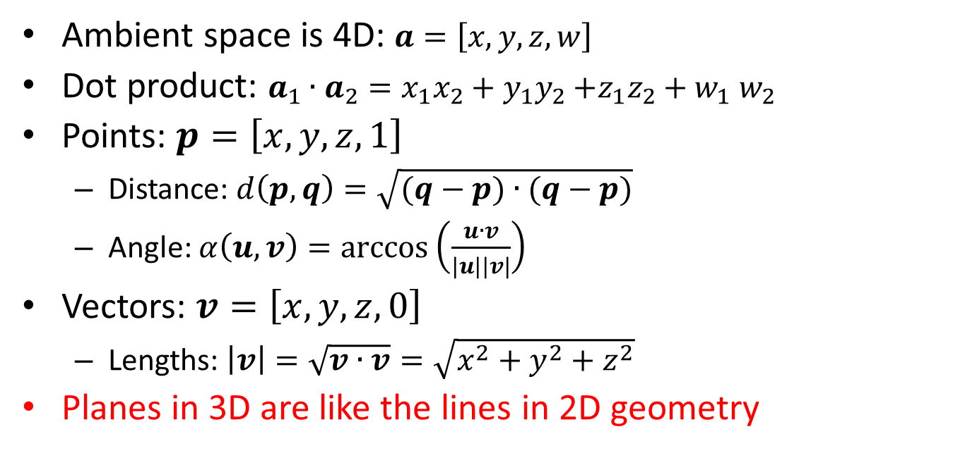
Euclidean geometry of the 3D space
Ambient space is 4D: $a=\left[x,y,z,w\right]$
Dot product: ${a_{1}∙a}_{2}=x_{1}x_{2}+y_{1}y_{2}{+z_{1}z_{2}+w}_{1}w_{2}$
Points: $p=\left[x,y,z,1\right]$
Distance: $d\left(p,q\right)=\sqrt{(q−p)∙(q−p)}$
Angle: $α\left(u,v\right)=arccos⁡\left(\frac{u∙v}{\left|u\right||v|}\right)$
Vectors: $v=\left[x,y,z,0\right]$
Lengths: $\left|v\right|=\sqrt{v∙v}=\sqrt{x^{2}+y^{2}+z^{2}}$
Planes in 3D are like the lines in 2D geometry

Slide 31












Projective planar geometry
$$[X,Y,w]$$
$$w$$
$$w=1$$
$$\left(x,y\right)$$
$$y$$
$$x$$
$$Y$$
$$X$$
$$[X,Y,0]$$
Euclidean points:
$$\left(x,y\right)→\left[x,y,1\right] \sim \left[x∙w,y∙w,w\right]=[X,Y,w]$$
Homogenous division: $x=\frac{X}{w}, y=\frac{Y}{w}$
$$w≠0$$
Ideal points:
$$[X,Y,0]$$

Slide 32








Homogeneous coordinates
Möbius
Ideal
point
Direction + inverse distance scaling
$$\left[x,y,0\right]$$
$$\left[x,y,1/3\right]$$
$$\left[x,y,1\right]$$
$$\left[2x,2y,1\right]\sim \left[x,y,1/2\right]$$
y
x
$$\left[−x,−y,1\right]\sim \left[x,y,−1\right]$$
Ideal
point
$$\left[x,y,−1/2\right]$$
$$\left[x,y,0\right]$$
Notes:
Homogeneous coordinates [Xh, Yh, h] can also be interpreted in the following way: (Xh, Yh) specify the direction of the point, and h is a scaling of the distance.
Let us consider a point of Cartesian coordinates x,y, which can be given in homogeneous coordinates as [x,y,1].
Now, let us consider another point that is in the same direction, but twice as far as (x,y). This farther point is (2x,2y) in Cartesian coordinates, [2x,2y,1] in homogeneous coordinates, or [x,y,1/2] in homogeneous coordinates. Similarly, the point that is also in the same direction but is f times farther away is [x,y,1/f]. So the interpretation of a homogeneous triplet is that the first two coordinates are Cartesian ones and show the direction, and the third coordinate is an inverse scaling of the distance. When f is infinity, so 1/f is zero, then we get [x,y,0], which is at the direction of (x,y), but at infinity.
With homogeneous coordinates we can express ideal points, i.e. points at infinity that are the intersections of parallel lines. Note that in Euclidean geometry parallel lines do not intersect. So, when we work with homogeneous coordinates instead of Cartesian ones, we describe the projective plane that contains the ideal points as well, and not the Euclidean plane.

Slide 33






Parametric equation of the projective line
$$[X_{1},Y_{1},w_{1}]$$
$$w$$
$$[X_{2},Y_{2},w_{2}]$$
$$Y$$
$$w=1$$
$$X$$
$$\left[X\left(t\right),Y\left(t\right),w\left(t\right)\right]=\left[X_{1},Y_{1},w_{1}\right]\left(1−t\right)+\left[X_{2},Y_{2},w_{2}\right]t$$

Slide 34



Implicit equation of the projective line
Euclidean line, Cartesian coordinates: $n_{x}x+n_{y}y+d=0$
Euclidean line, homogeneous coordinates: $n_{x}X/w+n_{y}Y/w+d=0$ $w≠0$
Euclidean line: $n_{x}X+n_{y}Y+dw=0$ $w≠0$
×
Projective line:
$$\left[\begin{matrix}n_{x} \\ n_{y} \\ d\end{matrix}\right]$$
Line:
Column vector
Point: raw vector
$$\left[X,Y,w\right] =0$$

