Slide 1
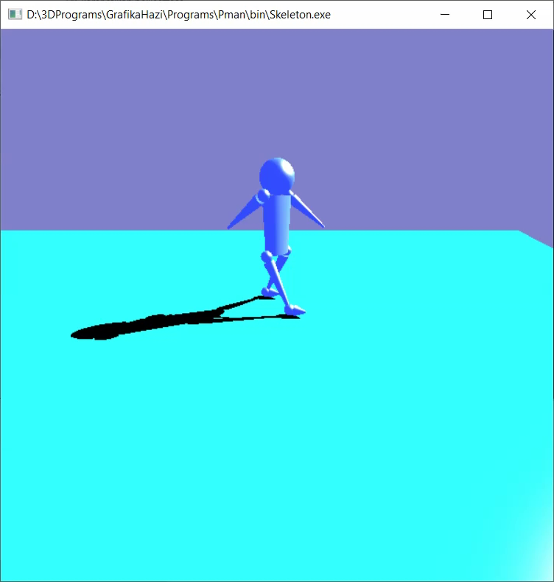
Transformations
”τὰ πάντα ῥεῖ καὶ οὐδὲν μένει.”
Ἡράκλειτος
Szirmay-Kalos László

Slide 2













Transformations
Assigns a point to a point (coordinates to coordinates)
$$\left(x^{′},y^{′}\right)=T(x,y)$$
$$\left(x^{′},y^{′}\right)=T(x,y)$$
$$x^{′}$$
$$T$$
$$y$$
$$y$$
$$\left(x^{′},y^{′}\right)$$
$$T$$
$$y^{′}$$
$$(x,y)$$
$$(x,y)$$
$$x$$
$$x$$
May destroy the equation defining the shape!
Notes:
Geometric transformations assign a point to a point, so it is a point valued function of points. Geometric transformation may destroy the equation and the type of an object. Even simple scaling turns a sphere into an ellipsoid, so the equation, program, representation will change. To avoid this, we limit the allowed transformations and object types to those which guarantee that the object type is preserved. Linear elements, like points, line segments, and polygons may approximate any 0,1 or 2 dimensional object.
Affine transformations that can be expressed as linear functions of the Cartesian coordinates map lines to lines and also preserve parallel lines. This theorem can be proved by realizing that a line can have a linear equation and with linear equation only lines can be described. So, if a linear equation of a line is combined with the linear function of the transformation, we get a linear equation, which thus must be a line. If this transformation could make parallel lines intersecting or intersecting lines parallel, then this transformation would create a point out of nothing or would make a point disappear. A linear function is not able to do that..
Affine transformations are not the widest set of transformations preserving lines and polygons. The widest set is homogeneous linear transformations (homogeneous coordinates are multiplied by a matrix), which includes central projection as well. To find this wider set of transformations, we should understand that no transformation of the Euclidean plane can make two parallel lines intersecting, since that would create a point from nothing. The problem is the Euclidean geometry itself and its property that parallel lines do not intersect. To consistently discuss how lines can be transformed to lines without keeping the parallelism, we should step out of the Euclidean geometry. The proper geometry is the projective geometry.

Slide 3
Transformations
In addition to points, we transform line segments and triangles with transformations preserving these (Formula?).
Examples:
Translation, rotation, mirroring = congruence
Isotropic scaling = similarity (angle preservation)
Direction dependent scaling
Shearing
Perspective (destroys parallelism)
Counter example:
Inversion
= Affine transformations (keeps parallel lines)

Slide 4










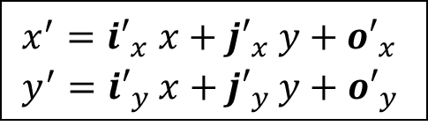

Affine transformations
$$T\text{(2,1)}$$
$$T\text{(1,1)}$$
$$(1, 1)$$
$$(2, 1)$$
(0,1)
T(0,1)
T(1,0)
(0,0)
(1,0)
T(0,0)
$$T\left(1,1\right)=T\left(0,0\right)+\left(T\left(1,0\right)−T\left(0,0\right)\right)+(T\left(0,1\right)−T\left(0,0\right))$$
$$T\left(2,1\right)=T\left(0,0\right)+2\left(T\left(1,0\right)−T\left(0,0\right)\right)+(T\left(0,1\right)−T\left(0,0\right))$$
$\left(x^{′},y^{′}\right)=T\left(x,y\right)=T\left(0,0\right)+x\left(T\left(1,0\right)−T\left(0,0\right)\right)+y(T\left(0,1\right)−T\left(0,0\right))$ $=o′+xi′+yj′$
$$o′$$
$$i′$$
$$j′$$
$$\left[\begin{matrix}{i′}_{x}^{} & {i′}_{y}^{} \\ {j′}_{x}^{} & {j′}_{y}^{} \\ {o′}_{x}^{} & {o′}_{y}^{}\end{matrix}\right]$$
$$\left[\begin{matrix}{i′}_{x}^{} & {i′}_{y}^{} & 0 \\ {j′}_{x}^{} & {j′}_{y}^{} & 0 \\ {o′}_{x}^{} & {o′}_{y}^{} & 1\end{matrix}\right]$$
$$x^{′}={i′}_{x}^{}x+{j′}_{x}^{}y+{o′}_{x}^{}$$
$$y^{′}={i′}_{y}^{}x+{j′}_{y}^{}y+{o′}_{y}^{}$$
$$\left[x^{′},y^{′}\right]=[x,y,1]$$
$$\left[x^{′},y^{′},1\right]=[x,y,1]$$
Notes:
Vectors are translations. However, we also need other transformations as well, like rotatin, scaling, shearing, mirroring, orthogonal projection, etc. All these transformations have the property that they map lines to lines and preserve parallel lines. Such transformations are called affine transformations.
So, our question is what algebraic form can represent general affine transformations. Let us consider the axis parallel rectangle of one corner in the origin and the other corner in the point to be transformed (x,y). This rectangle is transformed into a parallelogram by an affine transformation, since lines and parallels are preserved. The transformed point can be reached by walking the image of the origin and then along the two edges.
The next crucial question is how the edges depend on the length of the original rectangle. So examine this question, let us add a second congruent rectangle touching the first one. Its transformation is another parallelogram that touches the first one, but we are not sure whether it can be shorter or not. It cannot be shorter since diagonals of the two rectangles are parallel, so diagonals of the two parallelograms must also be parallel. Therefore, we can conclude that the two parallelograms are congruent, and generally the lengths of parallelogram edges linearly depend on the original coordinates. Putting all these together, the transformed coordinates and a 1 value can be obtained from the original coordinates with a 1 value by a matrix multiplication. Such coordinates with an extra 1 value are called homogeneous coordinates. We have just proven that any affine transformation is just a matrix multiplication with homogeneous coordinates.

Slide 5





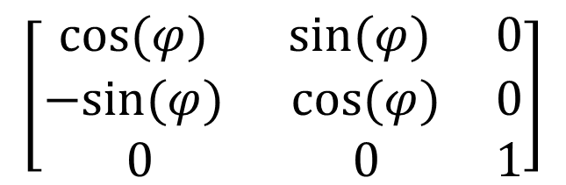






2D rotation
$$−sin⁡(φ)$$
$$j$$
$$j′$$
$$i′$$
$$φ$$
$$sin⁡(φ)$$
$$φ$$
$$−i$$
$$i$$
$$cos⁡(φ)$$
$$\left[\begin{matrix}cos⁡(φ) & sin⁡(φ) & 0 \\ −sin⁡(φ) & cos⁡(φ) & 0 \\ 0 & 0 & 1\end{matrix}\right]$$
$$\left[x^{′},y^{′},1\right]=[x,y,1]$$

Slide 6
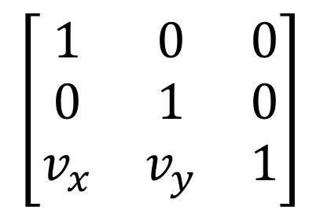
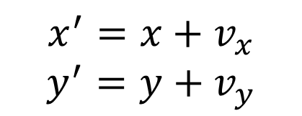


2D translation
$$x^{′}=x+v_{x}$$
$$y^{′}=y+v_{y}$$
$$v$$
$$\left[\begin{matrix}1 & 0 & 0 \\ 0 & 1 & 0 \\ v_{x} & v_{y} & 1\end{matrix}\right]$$
$$\left[x^{′},y^{′}, 1\right]=[x,y, 1]$$

Slide 7
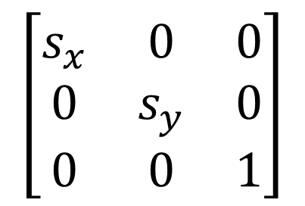
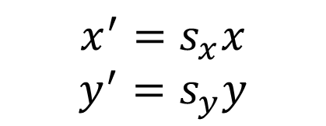

2D scaling
$$x^{′}=s_{x}x$$
$$y^{′}=s_{y}y$$
$$\left[\begin{matrix}s_{x} & 0 & 0 \\ 0 & s_{y} & 0 \\ 0 & 0 & 1\end{matrix}\right]$$
$$\left[x^{′},y^{′}, 1\right]=[x,y, 1]$$

Slide 8

Pivot (fix) point
Pivot point of the rotation and scaling is the origin

Slide 9
Pivot (fix) pont
Pivot to origin
Rotation and scaling with respect to the origin
Origin back to pivot

Slide 10
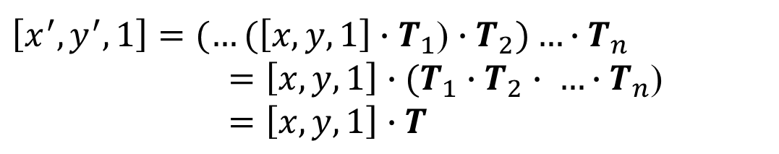
We love matrices (very much)
Concatenation of transformations: Associative
$\left[x^{′},y^{′}, 1\right]=(…(\left[x,y, 1\right]∙T_{1}$) $∙T_{2})…∙T_{n}$
$=\left[x,y,1\right]∙(T_{1}∙T_{2}∙ …∙T_{n}$)
$=\left[x,y,1\right]∙T$

