Slide 1
3D kamera
Szécsi László
3D Grafikus Rendszerek
9. előadás

Slide 2
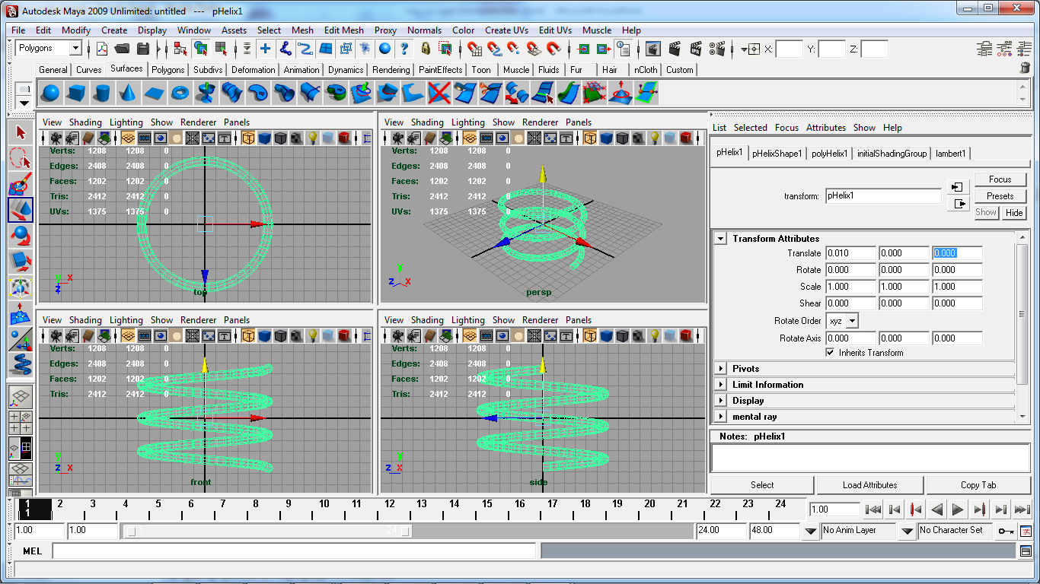
Modelltér
Notes:
What coordinate systems are there to speak of? What are the coordinate systems we need to transform between?
In incremental rendering, we can think of the virtual world as a collection of triangles. Triangles form objects. Several objects may be identical, but placed at different positions and orientations. We say that these objects share the same geometric model. The most typical virtual world setups can be composed of instances of such models, instead of independent triangles.
Models are typically pre-made, and they do not change in runtime, even when rendering long sequences of images for an animation. They are authored using modeling software. The modeler artist can place triangle mesh vertices in a reference coordinate system called the model space. The triangle mesh is of course often obtained by tessellating analytic or free-form surfaces.
When we load the definition of a model from a file (e.g. the *.obj file format), the coordinates used in there are model coordinates. When we specify some geometry to be drawn for OpenGL, the coordinates we give in glVertex are also model coordinates. Coordinates of points in other spaces must be found starting from these.

Slide 3
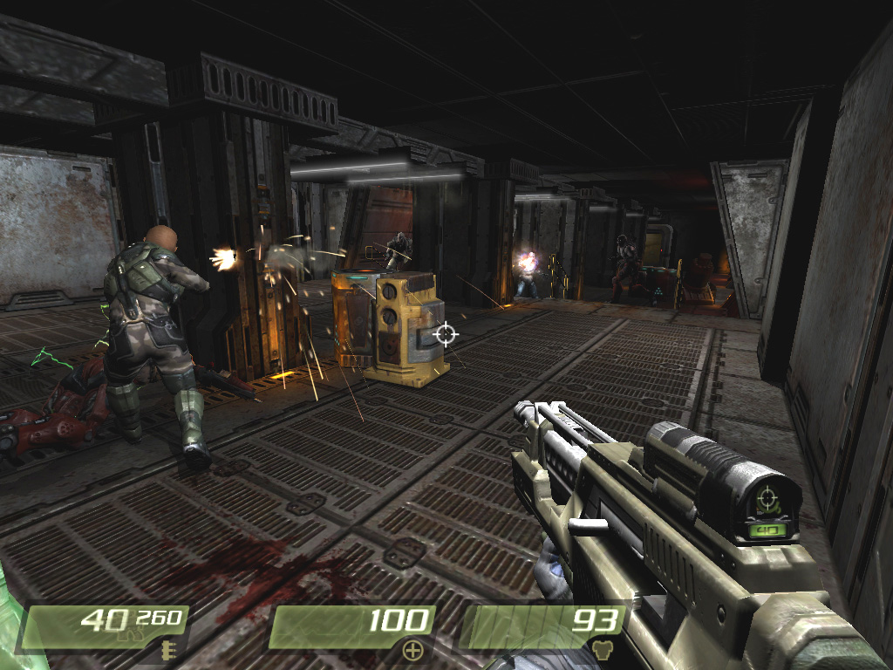
Világtér
Notes:
As said before, the virtual world is a collection of model instances. Where they are located and how they are oriented is given in world space. This is one single absolute coordinate system, in which everything in the virtual world can be given, including light sources, camera parameters, etc. It is safe to perform computation for illumination using world coordinates. Recall that these computations include finding the distance between a light source and a shaded point, the incoming light angle, etc. For these, all parameters have to be expressed in the same coordinate system, of course.
In ray tracing, everything was given in this world space, and we even found the ray direction from the pixel coordinates using world space logic.

Slide 4

Kameratér
up
right
ahead
y
eye
x
z
Notes:
Remember the camera model of ray tracing? In incremental rendering, we use the very same camera model, with some additional conventions to be discussed later. With the origin at the eye, the ahead, right and up vectors form a frame of reference known as the camera space. Expressing a point with camera coordinates tells us where it is located relative to the camera.

Slide 5
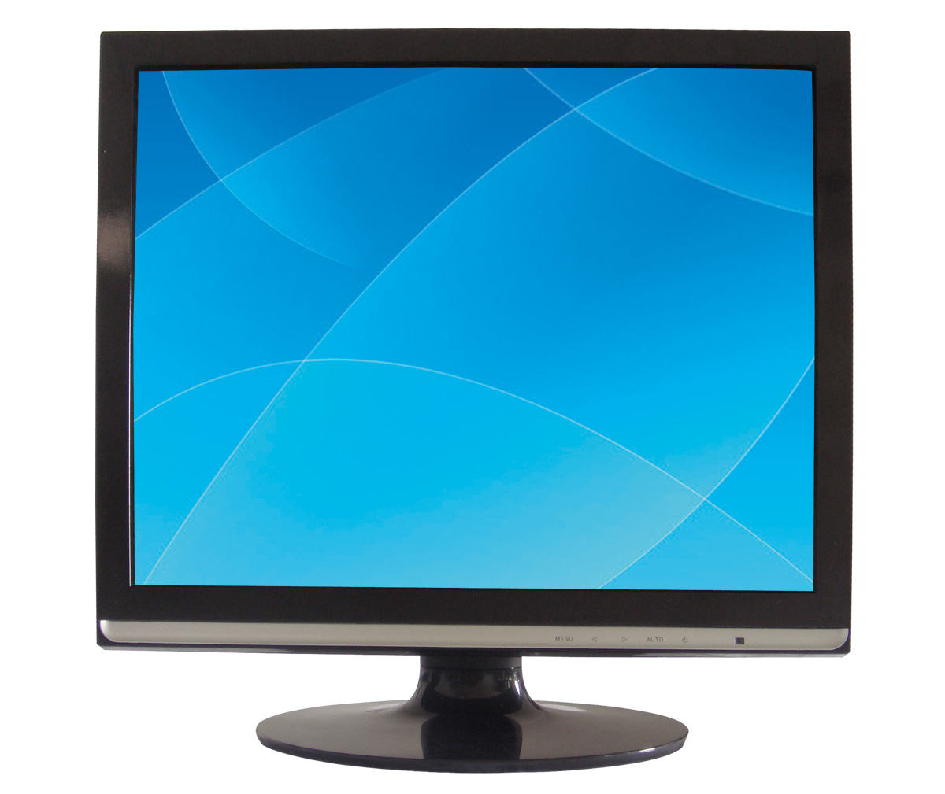
Eszköztér
1
1
x
-1
-1
Notes:
Remember the normalized device space? NDC coordinates tell us where a point appears in the viewport.

Slide 6
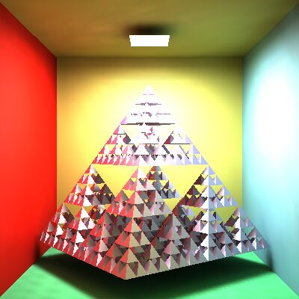
Nézetablak-tér
pixel_{x}
resolution_{x}
pixel_{y}
p
resolution_{y}
Notes:
Pixel coordinates are the integer row and column indices of a pixel. To draw something, we eventually have to able to tell which pixels are to be colored.

Slide 7
Transzformációk
?
?
Ha egy térben adottak egy pont koordinátái, mik a koordinátái a másik térben?
statikus interpretáció
Mit tegyek az eredeti ponttal, hogy a másik térbeli helyére kerüljön?
dinamikus interpretáció
Notes:
Transformations are operations on points. The point is expressed by a set of coordinates. A transformation will yield a new set of coordinates. This can simultaneously be seen to:
a, calculate coordinates for the same point in a different space (this I will call the static interpretation)
b, change the coordinates of the point, moving it (the dynamic interpretation).
Both interpretations are valid. The static one tells us what the purpose of the computation is, the dynamic often helps us in its construction.
Transformations are a way to compute answers to questions we will be encountering in graphics, and incremental image synthesis in particular. Questions like:
If the modeler has drawn this vertex here, and the object is standing here, where in the world is the vertex?
If the triangle was modeled here, where should we draw it on screen?

Slide 8
Az inkrementális képalkotási probléma
adott a tesszellált 3D modell
háromszögek csúcspontjai [modellezési koordináták]
adott egy 2D háromszögrajzoló algoritmus
képpontokat színez [viewport koordináták]
a feladat:
a csúcspont modellezési koordinátáiból számoljuk ki, mely pixelben jelenik meg
Notes:
Incremental image synthesis just draws triangles on-screen (and lines and points, but those hardly make 3D objects). The task really is, given the triangle mesh models in the reference model spaces, where to draw those 2D triangles on-screen, what pixels to color.
For a single triangle vertex point, this means a long journey of computations (transformations!) to find out where it actually appears on the display device.
Also, the transformations must take triangles and yield triangles. The class of transformations which has this property is called the class of homogeneous linear transformations. As they are linear, they can be written as a multiplication with a matrix. It is a 4x4 matrix, as it works on homogeneous coordinate quadruplets.

Slide 9
Mi befolyásolja ezt?
Hova, hogyan helyezzük el a modellt a virtuális világban
modellezési trafó, model, world
Hol van, merre néz a kamera
kamera trafó, view
Mekkora a látószög (és képméretarány)
perspektív projekció
Hányszor hány pixel az ablak és hol van
viewport trafó
Notes:
What are the parameters of such a computation? What influences where a vertex ends up on the screen?
Where our model is placed in the virtual world.
This is defined by the model transformation parameters, a.k.a. (world transformation).
Where the camera is, which way it looks
Defined by some of the camera parameters. The computation using these is the camera transformation.
How big the field-of-view (and aspect ratio) are
This plays are role in where the points are projected on-screen according to 3D perspective.
How large pixels are
Handled by the viewport transformation.

Slide 10
Bónusz feladat: árnyalás
Felületi pont, fények koordinátái, szempozíció, felületi normálisok...
ugyanabban a 3D koordináta rendszerben legyenek
logikusan a modellezési transzformáció után
de a kamera trafó szög és távolságtartó

Slide 11
Bónusz feladat: takarás
takarási probléma
a 2D pixel koordináták mellett kell egy mélységértéket is számolni
fix pontos z-buffer
[0, 1]-beli értékeket tud összehasonlítani
a távolság, amihez a 0-t rendeljük: első vágósík
amihez az 1-et: hátsó vágósík

Slide 12







Transzformációs csővezeték
model
transform
view
transform
proj
transform
model space
world space
camera space
clip space
norm. device space
pixel
coordinates
viewport
space
modelling
viewport
transform
Notes:
The task of computing the pixel coordinates of a vertex from the modeling coordinates is performed by a series of transformations. Originally, the vertices are given in model space, then transformed to world space using the model transform, to camera space using the view transform, to NDC (a.k.a. clip space, for clipping will be performed using these coordinates), and finally to pixel coordinates using the viewport transform.
All the transformations take a 4-element homogenous 3D coordinate vector, and return a 4-element homogenous 3D coordinate vector. All transformations are linear in homogenous coordinates, they can all be written as 4x4 matrices. Transformation is multiplication by that matrix. A series of transformations can be performed as a single multiplication by a single compound transformation matrix obtained as a product of the element transformations.

Slide 13
Modellezési és világkoordináták (statikus interpretáció)
model
world
Notes:
Recall that the virtual world contains model instances in different poses. The model transformation computes the world space coordinates of a model vertex for an object in a certain pose.
This interpretation tells us what we want to compute, but how the pose should be specified is not intuitive.

Slide 14
Modellezési és világkoordináták (dinamikus interpretáció)
Notes:
We can see this computation to move the model from its original reference position and orientation to its proper world pose. The transformation can be constructed a rotation for the orientation, and a translation for the position.
So, performing a rotation and a translation will compute world space coordinates from model space coordinates. The transformation can be said to take the model from model space to world space. This interpretation is useful for the construction of the model transform.

Slide 15



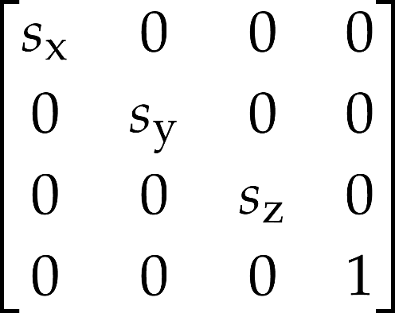
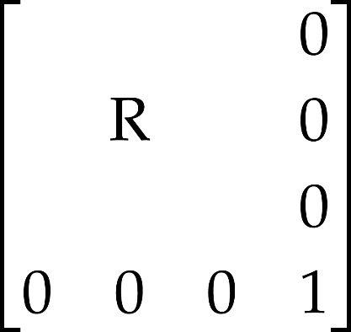
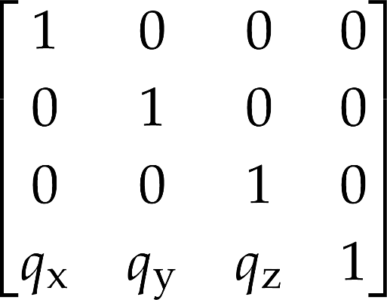

Modelezési transzformáció
z
y
1. scaling:
2. orientation:
3. position:
x
model
trafo
matrix
Notes:
Model transformation sets up the object in the virtual world. This means scaling to set its size, then rotation to set its orientation, and finally translation to place it at its position. All three transformations are affine and can be given as homogeneous transformation matrices. Concatenating the matrices, we obtain a single modeling transformation matrix, which maps the object from its reference state to its actual state.

Slide 16





Transzformációs csővezeték
✓
modellezési transzformáció:
nézeti transzformáció:
vetítési transzformáció:
együtt:
Notes:
Using the modeling transform, the object is mapped to world coordinates. The transformation of the shading normals requires the application of the inverse-transpose of the 4x4 matrix. (Note that normals are invariant to translation, so we should set h to 0. Why? Remember how translation worked!)
From world coordinates, we go to camera space, where the camera is at the origin and looks at the –z direction. The transformation between world and camera coordinates is a translation and a rotation.
After camera transformation, the next step is perspective transformation, which distorts the objects in a way that the original perspective projection will be equivalent to the parallel projection of the distorted objects. This is a non-affine transformation, so it will not preserve the value of the fourth homogeneous coordinates (which has been 1 so far).
The three transformation matrices (model, camera, perspective) can be concatenated, so a single composite transformation matrix takes us from the reference state directly to normalized screen space.

Slide 17
Hova kell ezt rajzolni a képernyőn?
Az összes többi transzformáció ennek a kiszámolására megy
kamera transzformáció
hol van a pont a kamerához képest
vetítési transzformáció
hova vetül ez az ablak téglalapjára
viewport transzformáció
melyik pixel
[1 1]
[-1 -1]
[0 0]
[345 234]

Slide 18
Kameramodell
eye
screen
front clipping plane
up
eye
fov
asp
back clipping plane
y
lookat
x
z
Camera obscura
Notes:
The definition of the camera and projection transformations depends on the parameters of the camera. In computer graphics the camera is the eye position that represents the user in the virtual world and a window rectangle that represents the screen.
It is often more intuitive to think of a virtual camera as being similar to a real camera. A real camera has a focus point or pin-hole, where the lens is, and a planar film were the image is created in a bottom-up position. In fact, this model is equivalent to the model of the user’s eye and the screen, just the user’s eye should be imagined in the lens position and the film mirrored onto the lens as the screen.
The camera model used for incremental image synthesis is not different from that used in ray tracing, but instead of explicitly giving the ahead, right and up vectors of the camera frame (which are required to be unit length and orthogonal), a more intuitive set of equivalent parameters is customary. Instead of the ahead direction, we give a lookat point in that direction (this point should appear in the center of the image).
So in both cases, we need to define a virtual eye position and a rectangle in 3D. The eye position is a vector in world coordinates. The position of the window is defined by the location of its center, which is called lookat point or view reference point. We assume that the main viewing direction that is between the eye and the lookat positions is perpendicular to the window. To find the vertical direction of the window, a view up (vup) vector needs to be specified. If it is not exactly perpendicular to the viewing direction, then only its perpendicular component is used.
The vectors defined so far specify the window plane and orientation, but not the size of the rectangle. To set the vertical size, the field of view angle (fov) is given. For the horizontal size, the aspect ratio of the vertical and horizontal window edge sizes should be specified.
To solve the visibility problem later, we will only be able to handle a bounded range of depth. Anything in front of the front clipping pane or behind the back clipping plane will be discarded, and not visible on screen. Where these planes are is also part of the camera definition.

Slide 19
Nézeti transzformáció (statikus interpretáció)
camera
world
Notes:
The camera transform computes vertex coordinates relative to the camera. This is a similar setup to that of the model (the camera can also be characterized by a world space position and orientation, just like a model instance), only backwards.

Slide 20
Emlékeztető – 2D trafó
Hova kerül a pont a képernyőn?
illetve:
Mit csináljunk a pontokkal, hogy a kívánt részek kerüljenek a kérenyőre?
1
1
Notes:
Screen projection maps the window rectangle, which is the camera in 2D, onto the viewport rectangle, which can be imagined as the photograph. This simple projection is usually executed in two steps, first transforming the window onto a normalized square, and then transforming the square to the viewport.
Transforming the window to a origin centered square of corners (-1,-1) and (1,1) is a sequence of three transformations: a translation that moves the bottom-left corner of the window to the origin; a scaling that modifies the window width and height to 2; a translation that moves the origin to (-1,-1). This is an affine transformation that can also be given as a matrix.
Transformation of the origin centered square to the viewport is similar.

Slide 21
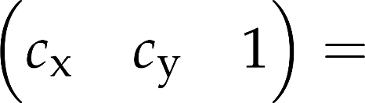
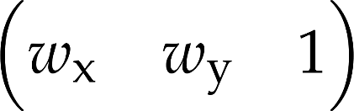


1
1

Slide 22

1
1

Slide 23
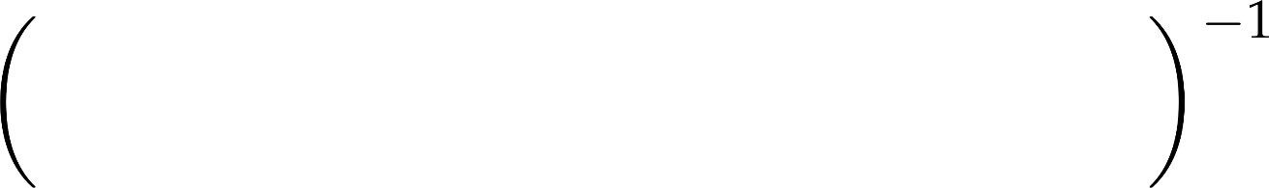
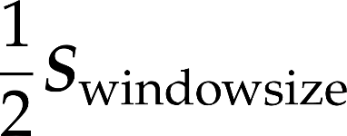


1
1

Slide 24

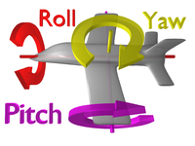
Kameraorientáció geometriája
y
jobbkezes
főirányok
x: jobbra
y: fel
z: hátra (előre a -z)
elforgatási szögek:
yaw – legyezés
pitch – menetemelkedés
roll - orsózás
x
z

Slide 25
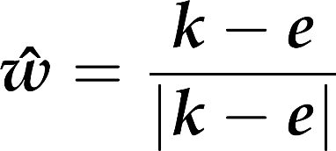
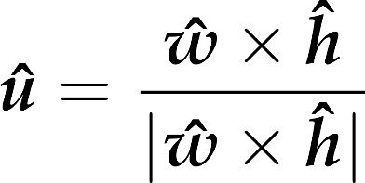






Nézeti transzformáció: főirányok nézett pontból
generic upwards
ahead
right
up
eye
z
lookat
y
x
Notes:
The dynamic interpretation is less intuitive than it was for the model transform, but it is similar: a translation and a rotation. This applies to ALL objects in the virtual world, camera included.
First we apply a transformation for the scene, including objects and the camera, that moves the camera to the origin and rotates it to make the main viewing be axis –z and the camera’s vertical direction be axis y. To find such transformation, we assign an orthonormal basis to the camera so that its first basis vector, u, is the camera’s horizontal direction, the second, v, is the vertical direction, and the third, w, is the opposite of the main viewing direction (we reverse the main viewing direction to maintain the right handedness of the system).
Vector w can be obtained from the main viewing direction by a simple normalization. The application of normalization to get v is also tempting, but simple normalization would not guarantee that basis vector v is orthogonal to basis vector w. So instead of directly computing v from vup, first we obtain u as a vector that is orthogonal to both w and vup. Then, v is computed indirectly through w and u to get it orthogonal to both of them.
The transformation we are looking for is a translation then a rotation. The translation moves the eye position to the origin. The translation has a simple homogeneous linear transformation matrix. Having applied this translation, the orientation should be changed to align vector w with axis z, vector v with axis y, and vector u with axis x. Although this transformation is non-trivial, its inverse that aligns axis x with u, axis y with v, and axis z with w is straightforward.
Its basic idea is that the rows of an affine transformation (fourth column is [0,0,0,1]^{T}) are the images of the three basis vectors and the origin respectively.
So, the transformation of x,y,z axes to u,v,w is the matrix that contains u,v,w as the row vectors of the 3x3 minor matrix of the 4x4 transformation matrix.
As we need the inverse transformation, this matrix needs to be inverted. Such matrices – called orthonormal matrices – are easy to invert, since their transpose is their inverse.
The complete calculation is executed by the gluLookat function of the OpenGL utility library.

Slide 26
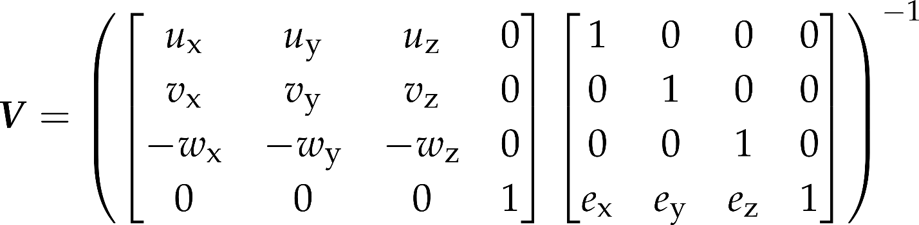



Nézeti transzformáció: mátrix a főirányokból és a pozícióból
generic upwards
ahead
right
camera up
eye
z
y
x
Notes:
The dynamic interpretation is less intuitive than it was for the model transform, but it is similar: a translation and a rotation. This applies to ALL objects in the virtual world, camera included.
First we apply a transformation for the scene, including objects and the camera, that moves the camera to the origin and rotates it to make the main viewing be axis –z and the camera’s vertical direction be axis y. To find such transformation, we assign an orthonormal basis to the camera so that its first basis vector, u, is the camera’s horizontal direction, the second, v, is the vertical direction, and the third, w, is the opposite of the main viewing direction (we reverse the main viewing direction to maintain the right handedness of the system).
Vector w can be obtained from the main viewing direction by a simple normalization. The application of normalization to get v is also tempting, but simple normalization would not guarantee that basis vector v is orthogonal to basis vector w. So instead of directly computing v from vup, first we obtain u as a vector that is orthogonal to both w and vup. Then, v is computed indirectly through w and u to get it orthogonal to both of them.
The transformation we are looking for is a translation then a rotation. The translation moves the eye position to the origin. The translation has a simple homogeneous linear transformation matrix. Having applied this translation, the orientation should be changed to align vector w with axis z, vector v with axis y, and vector u with axis x. Although this transformation is non-trivial, its inverse that aligns axis x with u, axis y with v, and axis z with w is straightforward.
Its basic idea is that the rows of an affine transformation (fourth column is [0,0,0,1]^{T}) are the images of the three basis vectors and the origin respectively.
So, the transformation of x,y,z axes to u,v,w is the matrix that contains u,v,w as the row vectors of the 3x3 minor matrix of the 4x4 transformation matrix.
As we need the inverse transformation, this matrix needs to be inverted. Such matrices – called orthonormal matrices – are easy to invert, since their transpose is their inverse.
The complete calculation is executed by the gluLookat function of the OpenGL utility library.

Slide 27
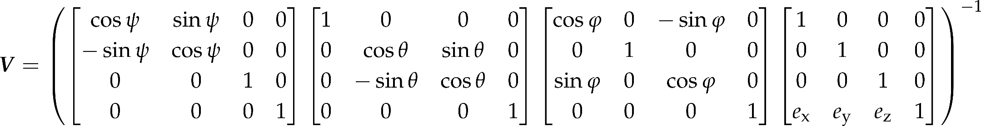
Yaw-pitch-roll: másik mód a kameraorientáció megadására
egérrel vezérléshez kényelmesebb
egérmozgás változtatja a szöget
roll
pitch
yaw

Slide 28
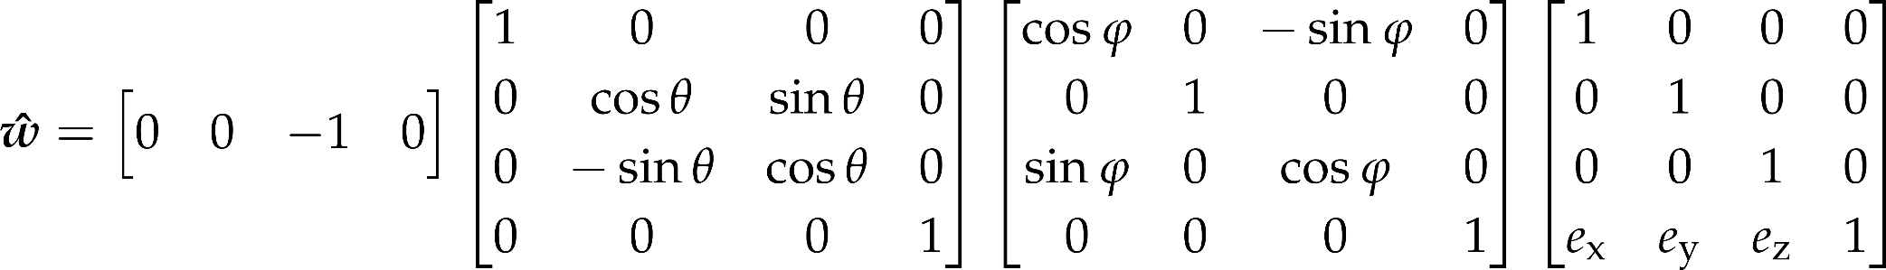
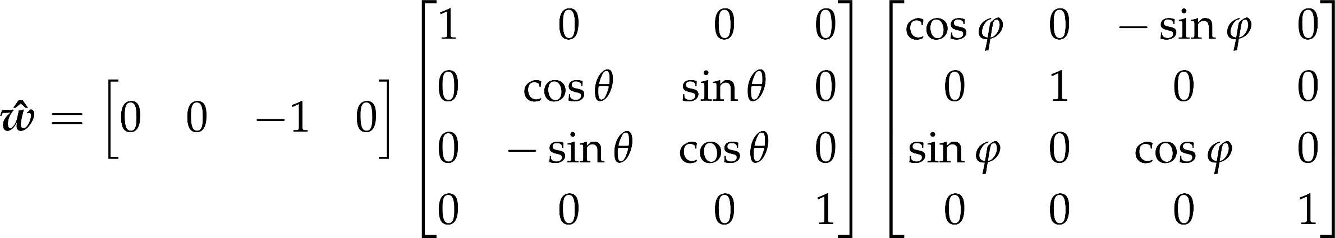
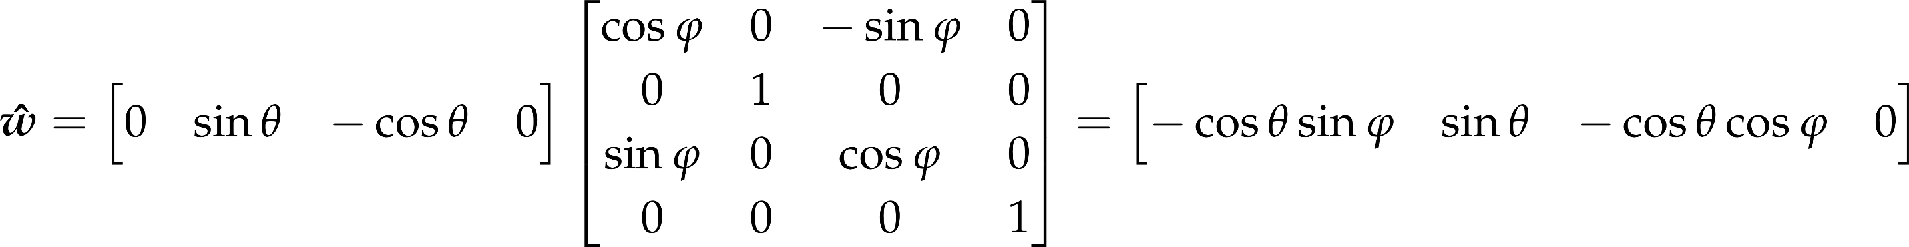
Előreirány a yaw-pitch-ből (nulla roll)

Slide 29
Vetítési transzformáció (statikus interpretáció)
1
y
1
-1
z
képernyőkoordináták: (y/z, 1)
homogén koordinátákban (y/z, 1, 1)
vagyis (y, z, z)
Notes:
Projection computes where the point is seen on-screen (NDC coordinates, -1, 1). Already having the camera z and camera y, this is not a complicated task. Consider the similar right angled triangles to find that the (camera space) distance for the screen centre is y/z. If the FOV is 90 degrees, this is identical to NDC coordinate, otherwise we have to scale according to the virtual screen size (tan FOV/2).
So, the NDC coordinates of a point projected to the screen are (y/z, 1). In homogeneous coordinates, this can be written as (y, z, z). Without division! That is because we rely on the homogeneous division to do that for us, should anyone ever want to get the Cartesian coordinates.
Note that in this slide we did not care about the signs of the coordinates (it is actually –z, not z), and we just computed the projected z to be one (assuming a screen at unit distance), which is not a useful piece of information. The actual projected depth has to be something we can use for depth comparisons.

Slide 30
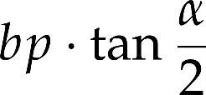
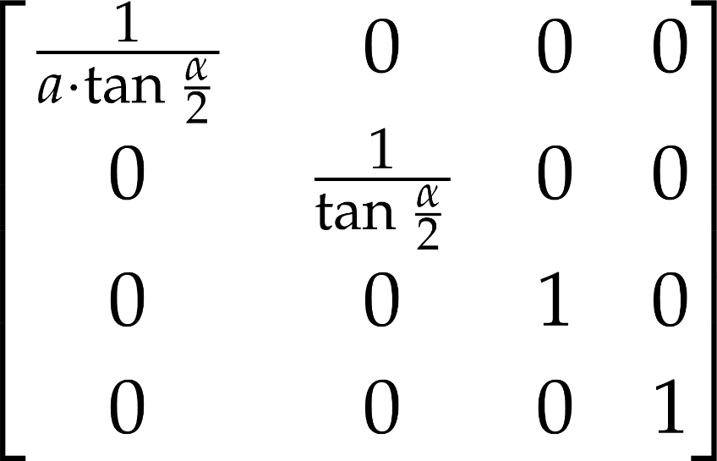
Normalizálás
field of view angle (FOV)
fp
bp
aspect ratio
90 degrees
field of view
Notes:
In camera space, the camera is in the origin and the main viewing direction is axis –z. The normalization step distorts the space to make the viewing angle be equal to 90 degrees. This is a scaling along axes y and x. Considering scaling along axis y, before the transformation the top of the viewing pyramid has y coordinate bp·tg(fov/2), and we expect it to be bp. So, y coordinates must be divided by tg(fov/2). Similarly, x coordinates must be divided by tg(fov/2)·asp.

Slide 31
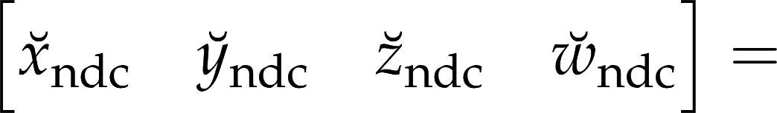
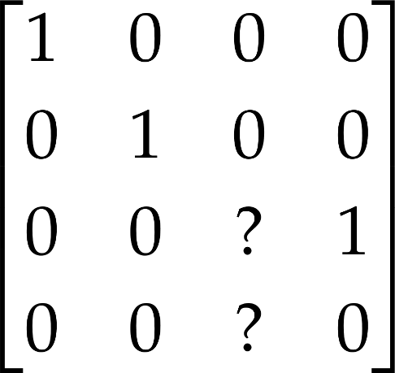

Osztás mátrixszorzással? Csak homogén koordinátákban!
milyen mátrix jön ide?

Slide 32
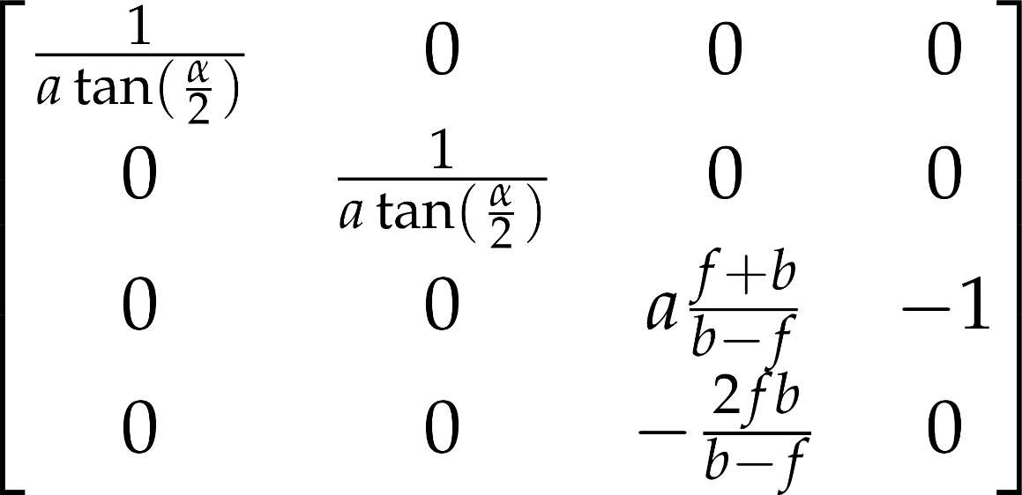


Perspektív vetítés mélységgel
y
z
1
Notes:
Normalization and perspective transformation are usually combined and the composed transformation is set directly. In OpenGL, the gluPerspective function will do it.
It is worth noting that this transformation sets the fourth homogeneous coordinate to the camera coordinate depth value. It is also notable that this transformation maps the eye ([0,0,0,1] in homogeneous coordinates) to the ideal point of axis z, i.e. to [0,0, -2fp ·bp/(bp-fp), 0] ∼[0,0, 1, 0].

Slide 33
Kameraparaméterek
class PerspectiveCamera(vararg programs : Program) : UniformProvider("camera") {
val position by Vec3(0.0f, 0.0f, 0.0f)
var roll = 0.0f
var pitch = 0.0f
var yaw = 0.0f
var ahead = Vec3(0.0f, 0.0f,-1.0f)
var right = Vec3(1.0f, 0.0f, 0.0f)
var up = Vec3(0.0f, 1.0f, 0.0f)
jobbkezes koordinátarendszer:
x jobbra, y fel, z hátrafelé

Slide 34
Kameraparaméterek
var fov = 1.0f
var aspect = 1.0f
var nearPlane = 0.1f
var farPlane = 1000.0f

Slide 35
Tagváltozók mozgatáshoz
var speed = 0.005f
var isDragging = false
val mouseDelta = Vec2(0.0f, 0.0f)

Slide 36
Mátrixok
val rotationMatrix = Mat4()
val viewProjMatrix by Mat4()
val rayDirMatrix by Mat4()

Slide 37
Világ felfelé iránya
companion object {
val worldUp = Vec3(0.0f, 1.0f, 0.0f)
}

Slide 38
View mátrix számítása
rotationMatrix.set().
rotate(roll).
rotate(pitch, 1.0f, 0.0f, 0.0f).
rotate(yaw, 0.0f, 1.0f, 0.0f)
viewProjMatrix.set(rotationMatrix).
translate(position).
invert()

Slide 39
Proj mátrix számítása
val yScale = 1.0f / tan(fov * 0.5f)
val xScale = yScale / aspect
val f = farPlane
val n = nearPlane
viewProjMatrix *= Mat4(
xScale , 0.0f , 0.0f , 0.0f,
0.0f , yScale , 0.0f , 0.0f,
0.0f , 0.0f , (n+f)/(n-f) , -1.0f,
0.0f , 0.0f , 2*n*f/(n-f) , 0.0f)

Slide 40
Mozgatás: yaw, pitch drag
yaw y körül forgat balra
ha jobbra húzom, jobbra forduljon
fun move(dt : Float, keysPressed : Set<String>) {
if(isDragging) {
yaw -= mouseDelta.x * 0.002f
pitch -= mouseDelta.y * 0.002f
if(pitch > 3.14f/2.0f) { pitch = 3.14f/2.0f }
if(pitch < -3.14f/2.0f) {
pitch = -3.14f/2.0f
}
mouseDelta.set()
}
pitch x körül forgat felfelé
ha lefelé húzom, lefelé forduljon

Slide 41
Mozgatás: főirányok a szögekből
ahead = (Vec3(0.0f, 0.0f, -1.0f).xyz0 * rotationMatrix).xyz
right = (Vec3(1.0f, 0.0f, 0.0f).xyz0 * rotationMatrix).xyz
up = (Vec3(0.0f, 1.0f, 0.0f).xyz0 * rotationMatrix).xyz

Slide 42
Mozgatás gombokkal
if("W" in keysPressed) { position += ahead * (speed * dt) }
if("S" in keysPressed) { position -= ahead * (speed * dt) }
if("D" in keysPressed) { position += right * (speed * dt) }
if("A" in keysPressed) { position -= right * (speed * dt) }
if("E" in keysPressed) { position += up * (speed * dt) }
if("Q" in keysPressed) { position -= up * (speed * dt) }

Slide 43
Eseménykezelők – meg is kell hívni őket!
fun mouseDown() {
isDragging = true
mouseDelta.set()
}
fun mouseMove(event : MouseEvent) {
mouseDelta.x += event.asDynamic().movementX as Float
mouseDelta.y += event.asDynamic().movementY as Float
event.preventDefault()
}
fun mouseUp() {
isDragging = false
}
}

Slide 44
Képméretarány állítása – ezt is meg kell hívni!
fun setAspectRatio(ar : Float) {
aspect = ar
update()
}

Slide 45

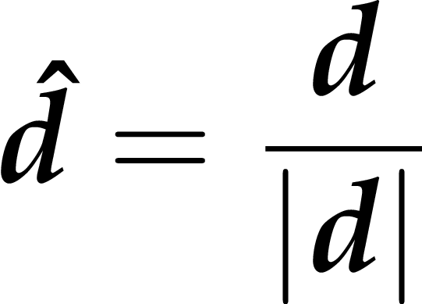
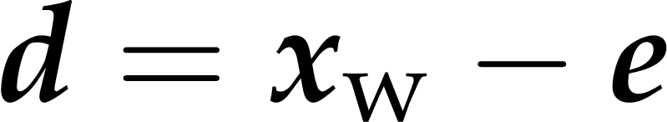
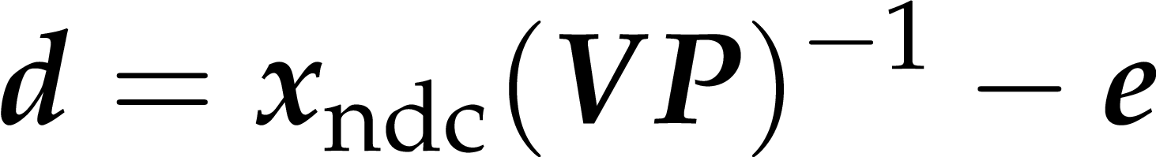
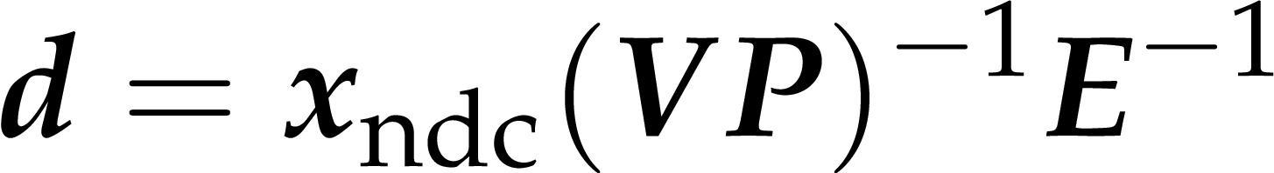
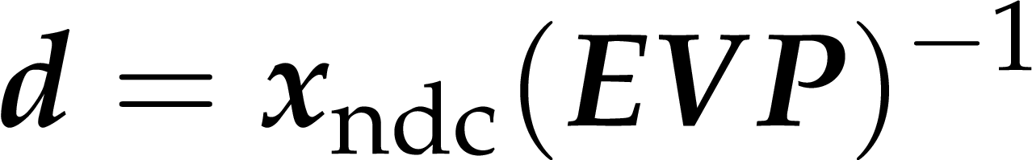
Sugárirány kiszámítása NDC-ből
(EVP)⁻¹ -et nevezzük rayDirMatrix-nak

Slide 46
Konstruktorban, ill. mozgatás után
rayDirMatrix.set().translate(position)
rayDirMatrix *= viewProjMatrix
rayDirMatrix.invert()

