Slide 1
Árnyalás
Szécsi László
3D Grafikus Rendszerek
10.5 előadás

Slide 2
Mennyiségek és mértékegységek
radiometriai egy (vagy három) hullámhosszon | fotometriai hullámhosszokat észlelőre súlyozva
Mennyiség | Mértékegység | Mennyiség | Mértékegység
sugárzott teljesítmény radiant power, radiant flux | W watt | fényáram luminous flux | lm lumen

Slide 3

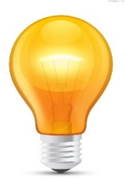
Watt [ W ]
~ átlépő fotonok száma másodpercenként
Notes:
A well-known measure of light is wattage, or power. A light bulb is characterized by its electrical power uptake, given in watts. Admittedly, much of that wattage goes to heating the bulb, but some of it is converted to light.
We can imagine light as lots of identical photons travelling along straight lines --- wave properties of light need not be considered for 3D rendering, and the fact that real photons have different wavelengths we can address later, when we already have a system for uniform-wavelength photons, i.e. monochromatic light.
Every photon carries the same amount of energy. The power is therefore propertional to the number of photons leaving the bulb., or, more accuratelty put, the number of photons crossing the surface of the bulb. In a similar manner, we can talk about the power of light arriving at a wall (or the surface of any object). We can talk about the power of light reflected from the same wall. We can talk about the power flowing through any surface. For that reason, radiant power is also called radiant flux.
This, of course, does not directly tell us what a piece of surface appears like. Power can be distributed on the surface arbitrarily, and the same can be said for the directions: there might be more photons crossing at some directions than others.

Slide 4
Mennyiségek és mértékegységek
radiometriai egy (vagy három) hullámhosszon | fotometriai hullámhosszokat észlelőre súlyozva
Mennyiség | Mértékegység | Mennyiség | Mértékegység
sugárzott teljesítmény radiant power, radiant flux | W watt | fényáram luminous flux | lm lumen
s. teljesítménysűrűség r. power density, radiosity, r. exitance, irradiance | W/m² | megvilágítás, fénykibocsátás l. emittance, illuminance | lx lux

Slide 5
Watt per négyzetméter [ Wm⁻² ]
Notes:
It is a straightforward improvement to measure the power emitted per unit area instead of the total power. This removes the total surface area of the emitter from the measure. We get a density-like measure, which is often called power density. As we are talking about photons leaving a surface, the term radiant exitance is the proper one. Of course, emission might be not homogenous over the surface, making this measure a function of position x. The symbol for radiant exitance is M, and the SI unit is Watts over square meters.
Is this measure telling us how bright some surface point appears to be? It tells us how densely photons are emitted from around the point, but not if they are emitted towards our eye.

Slide 6
Watt per négyzetméter [ Wm⁻² ]
Notes:
If we are referring to the density of photons incident on a surface, then we call the same measure irradiance. The symbol is E, and the unit is of course the same. Giving these different names and symbols is quite useful for clarity, as the power density arriving at a surface is of course typically not the same as the power density leaving a surface.

Slide 7

Han lőtt előbb
Notes:
Let us measure the irradiance of Captain Solo’s laser beam as its pierces through the table board and as it hits Greedo’s vest. We are going to assume piercing that hollow barrel of a table did little enough to the power of the ray so that can be neglected.

Slide 8
Számoljuk meg a felületen áthaladó fotonokat!
Greedo felülete
10
20
25
15
5
0
40
30
35
45
27
az asztal felülete
Notes:
We model the blaster beam as a coherent, unidirectional beam of photons. Let us count the number of photons crossing a unit area of both the table surface and Greedo’s surface, for the same duration of time. The blaster pierces the table at an angle, so its power is distributed on a larger area (5 units here), whereas it hits Greedo quite directly, over 3 units of area.
Counting the photons we see that the irradiance on the two surfaces is not the same at all, even though it is the same beam of photons and the “density of light” has of course not changed. This is because irradiance is defined over unit surface, and the surfaces are not the same. Their orientation matters. Thus, we cannot talk about irradiance at a point in space without specifying a surface orientation there. When a well-defined direction is known – as is the case with a coherent blaster beam or when the source of light is very distant – it is natural to take a perpendicular surface to express power density, but this does not just go without saying.

Slide 9
Mennyiségek és mértékegységek
radiometriai egy (vagy három) hullámhosszon | fotometriai hullámhosszokat észlelőre súlyozva
Mennyiség | Mértékegység | Mennyiség | Mértékegység
sugárzott teljesítmény radiant power, radiant flux | W watt | fényáram luminous flux | lm lumen
s. teljesítménysűrűség r. power density, radiosity, r. exitance, irradiance | W/m² | megvilágítás, fénykibocsátás l. emittance, illuminance | lx lux
sugárerősség r. intensity | W/sr | fényintenzitás l. intensity | cd candela

Slide 10


Hogyan jellemezhetjük, hogy adott irányba milyen erősen ad egy rádióadó?
A teljesítménysűrűség a mérés távolságától is függ
Itt az irányok szerinti eloszlás az érdekes
?
?
Notes:
Although it is tempting to use the word ‘intensity’ as synonymous to any measure of light, the term is actually taken and has well-defined meaning. It is somewhat less prevalent in computer graphics, but it is a very basic measure in radiofrequency technology.
An important property of a radio transmitter antenna is in which directions it emits more radiation. Imagine a GPS transmitter on the roof of your home: you might be comforted to know that the downward radiation is practically zero.
Measuring the power density at some point is meaningful of course, but it does not characterize the transmitter itself. The further you measure, the less the power density is going to be, as power is distributed over a larger area. At double the distance, the area grows double in both dimensions, diminishing power density by a factor of four – this is the inverse square law.
Thus, what RF engineers are interested in when characterizing the antenna is not the distribution of power over surface, but distribution of power over directions. The measure called radiant intensity is thus going to be a function of direction ω. But how do we express directions in 3D, and what is the analogue to what was the area of a surface, and what units is it measured in?

Slide 11
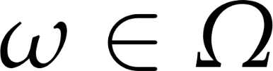
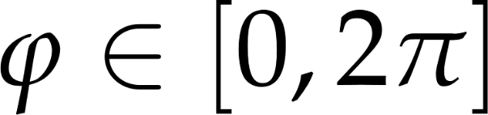
Az iránytartomány
2D
3D
θ
ϕ
az irányok az egységkör pontjaihoz rendelhetők
az irányok az egséggömb pontjaihoz rendelhetők
Notes:
Everyone is familiar with directions and the measure of direction sets in 2D. Directions correspond to points on the unit circle. A direction can always be given as an angle from the reference direction. In 3D, we need three reference directions, and both the polar and azimuthal angles. Directions correspond to points on the unit sphere. Of course, directions can be represented by the position vectors of the points, i.e. unit-length vectors.
A direction could either be represented by a vector or the two angles, but it is a geometrical entity on its own right, and of course it admits itself to different operations than a vector. Thus, we usually just use the symbol ω for a direction – and only write a direction as a vector when sets of directions are no longer involved. The symbol Ω is used for the complete set of directions.

Slide 12
Sík- és térszögek mértékei
2D
3D
radian [rad]
ívhossz az egségkörön
a teljes tartomány: 2π
steradian [sr]
a térszögben látszó felület az egységgömbön
a teljes tartomány: 4π
Notes:
In 2D, a contiguous set of directions makes an angle. The measure of that angle is the length of the arc subtended on the unit circle. This measure also has an SI unit, the radian, even though it is dimensionless. We all know that the measure of the complete domain is 2π.
In 3D, a contiguous set of directions -- called a solid angle -- makes some kind of shape on the surface of the unit sphere. The measure of the solid angle is the area of this shape. The dimensionless SI unit is called the steradian. You may be uncomfortable with the fact that we do not specify the shape of the solid angle in any way. You should not be. Just as the pint is a perfect measure of volume without a relation to a measure of lower dimension or having an established shape, so is the steradian perfect for measuring solid angles. Just as we can talk about the number of bubbles per pint, we can also talk about the number of photons per steradian. Or watts per steradian, of course.

Slide 13

Watt per steradian [ W(sr)⁻¹ ]
Notes:
Radiant intensity has the unit of watts per steradian. It is a density-like measure, but instead of distribution over area, it measures distribution over directions. The symbol is I, and intensity is a function of direction ω.
It we split the directional domain into small solid angles, and count the number of photons exiting in them, we can plot radiant intensity. With infinitely small solid angles, the get a function with a continuous domain..
Now, is radiant intensity the measure we are looking for? Does it characterize the appearance of a surface point? Well, it seems to work for the radio transmitter or the light bulb, but only if those are so small they can be considered point-like. If we consider an extended surface, knowing the overall directional distribution of photons is not enough, as light emitted from different surface points in the same direction will travel different paths.
To be able to tell what light hits our eye, we need a measure that takes both directional and area distribution into account.

Slide 14
Mennyiségek és mértékegységek
radiometriai egy (vagy három) hullámhosszon | fotometriai hullámhosszokat észlelőre súlyozva
Mennyiség | Mértékegység | Mennyiség | Mértékegység
sugárzott teljesítmény radiant power, radiant flux | W watt | fényáram luminous flux | lm lumen
s. teljesítménysűrűség r. power density, radiosity, r. exitance, irradiance | W/m² | megvilágítás, fénykibocsátás l. emittance, illuminance | lx lux
sugárerősség r. intensity | W/sr | fényerősség l. intensity | cd candela
sugársűrűség, radiancia radiance | W/srm² | fénysűrűség, luminancia luminance | cd/m² nit

Slide 15
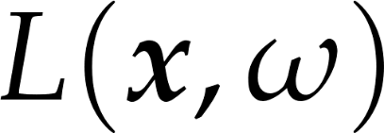

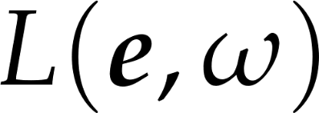
Radiancia
Sűrűség a pozícióra és az irányokra nézve egyaránt
Kifejezi, mennyi fény halad
a tér egy bizonyos pontjában
egy bizonyos irányba
szem
=
felületi pont
Notes:
This measure is radiance. This is absolutely the most important measure in computer graphics, and when less educated graphics programmers talk about light intensity, they most often should say radiance instead.
Radiance is density of radiant power with respect to both position and direction. We are going to examine it more rigorously, but let us first consider intuitively what it can express and why it is a good measure for us.
Radiance is a function of both position and direction. Although we have been talking and will continue to talk in terms of surfaces, radiance can be interpreted at any point in space (if there is no surface there, just image we put one there). Thus, our complete virtual world can be imagined as a continuous, five-dimensional (3D for position, +2D for directions) radiance field. Of course we will only be interested in the radiance at certain points and directions, but the field is still there.
Now consider two points in space, and their radiances along the line that connects them. We know that light travels along straight lines. So what is the relation between the radiance at those two points? If there is no object in between to block the light, no medium that scatters the light, and no interfering light source that adds more radiance, the flock of photons travelling along one arrow will be the same as the photons travelling at the other. Radiance will not change along rays of light.
Now imagine at one point is our eye, and at the other a surface point. If we manage to find the radiance exiting the surface toward the eye, than we have also managed to find the radiance arriving at the eye from that given direction.
Let us look at the proper definition of radiance, and see that the above properties indeed are true and radiance can be used to characterize the appearance of surface points.

Slide 16
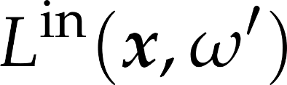
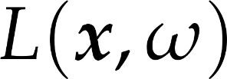





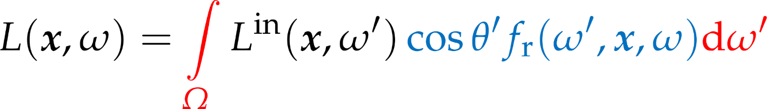
Az árnyalási egyenlet
Notes:
The Holy Grail of computer graphics is the rendering equation. This expresses how much light a certain surface point reflects into a certain direction, i.e. what color a surface appears under given lighting conditions.
Although the rendering equation is a formidable-looking integral equation with term yet unexplained, its meaning can be put in words quite simply. Also, after simplifying assumpltions andwith simple lighting and material models, the rendering equation will turn in pretty simple and swiftly computable formulas.
The rendering equation expressed the outgoing radiance L towards direction ω from shaded surface point x, as the radiance incoming from all directions, times the probability it is reflected towards the outgoing direction.
The factor cosθ’ f_{r}(ω’, x, ω) expresses the probability density of a photon incoming from ω’ refected towards ω. We will examine it further in the following slides.
In the real world, in most situations, some radiance is going to be incoming from all directions, reflected from the surrounding surfaces. However, actually computing this integral (an approach called global illumination) would lead to immense computational costs and very slow, if realistic, rendering. Thus, we consider a simpler theoretical case: when all light is incoming from a single direction.

Slide 17

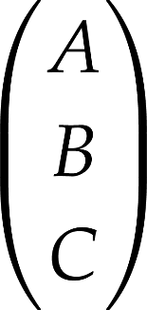
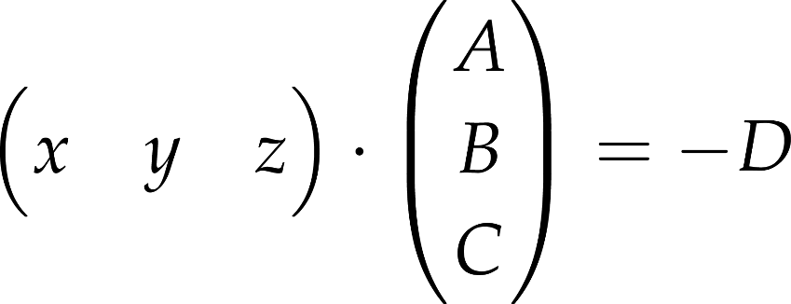

Miért az inverzzel, miért balról? 1 rész: a síkegyenlet
a sík explicit egynlete
ahol A, B, C csak számok
könnyen átírható a sík implicit egyenletévé
ahol A, B, C, D csak számok
az x,y,z pont a síkon van, ha kielégíti az egyenletet
a skalárszozattal így írható
a sík normálvektora

Slide 18
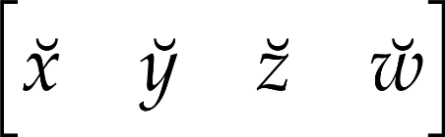
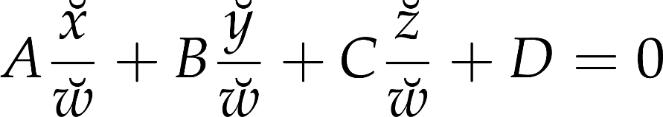


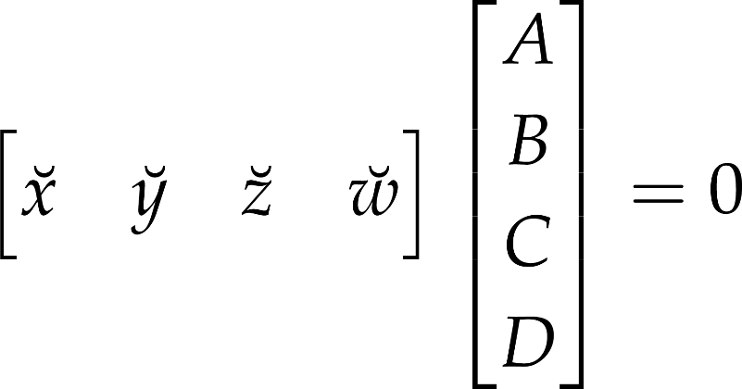
Miért az inverzzel, miért balról? 2.rész: homogén koordinátákkal
A Descartes-koordinátás egyenlet ez volt
helyettesítsük be a homogén koordinátákat
szorozzunk -vel és engedjük meg, hogy
mátrixszorzással így írható
a sík normálvektora
az origótól vett távolsággal

Slide 19


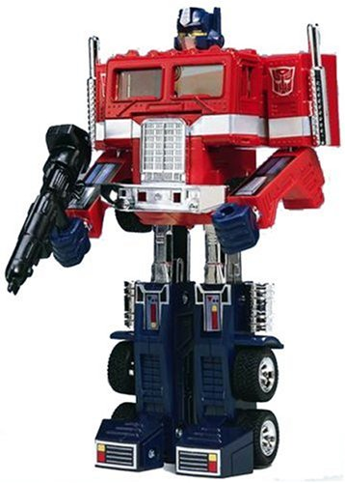



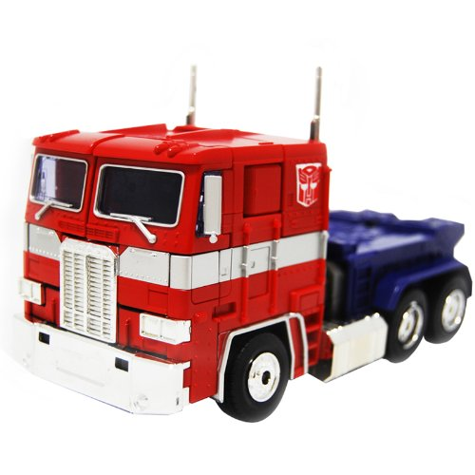
Miért az inverzzel, miért balról? 3. rész: invertálható transzformációk
eredeti alakzat
transzformált alakzat

Slide 20
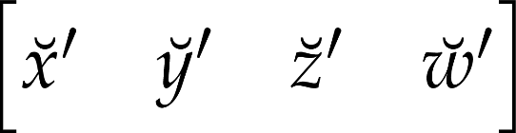
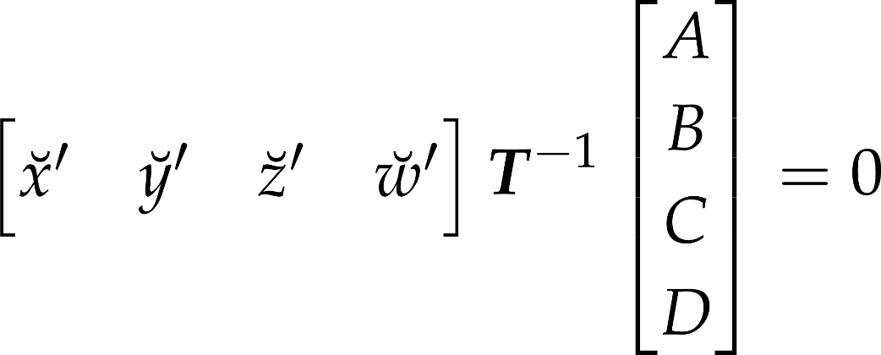
Miért az inverzzel, miért balról? 4, rész: a transzformált síkegyenlet
az eredeti alakzat egyenlete
az pont akkor van a transzormált alakzaton, ha az inverzzel visszatranszformálva rajta van az eredetin
a transzformált sík normálvektora
az origótól vett távolsággal

Slide 21
Különleges esetek
ideális, sima felület
csak egy adott irányból bejövő fény verődhet vissza a kimenő irányba
csak egy adott irányból bejövő fény törhet a kimenő irányba
csak egy irányból jön be fény
nem kell integrál

Slide 22



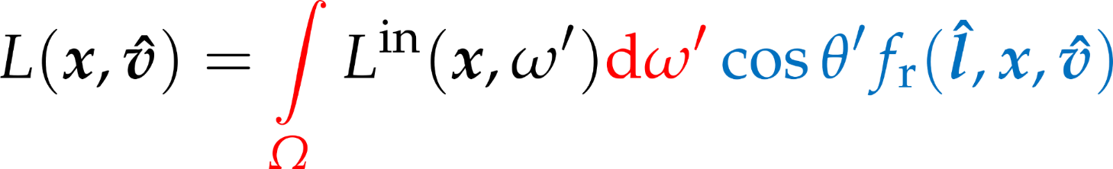

Ha egyetlen irányból jön fény
teljesítménysűrűség
irradiancia
Notes:
If all light is incoming from a single direction, the incoming radiance function has zero value for every direction but the light direction l. At the same time, we want the total incoming power per unit area be something finite. All this finite power density is concentrated on a zero-size solid angle, making the incoming radiance from l infinite. Thus, the radiance is a Dirac-delta function.
The reflection probability factor is now only required for incoming light direction l, as for all other directions, it is multiplied by zero incoming radiance. The factor now devoid of the integration variable ω’ can be moved out of the integral. What remains is the directional integral of the radiance, which is the power density of the incoming light, on a surface perpendicular to the light direction.
Now we can start to explain why we separated the reflection probability factor into a cosine factor and the rest. The cosine of the incoming light angle gives the ratio of the perpendicular surface area over the actual surface area . Mutiplying the power density with this cosine factor, we get the irradiance on the surface.
The factor f_{r}(l, x, ω) therefore must express the outgoing radiance as a function of incoming irradiance., which depends on the optical properties (i.e. the material) of the surface.

Slide 23


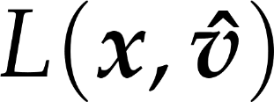
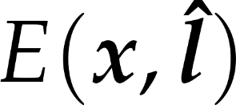




Szemirányú radiancia egy irányból érkező irradiancia hatására
a szemirányú radiancia
a fényirányból bejövő irradiancia szorozva
a nézeti irányba történő visszaverődés valószínűségsűrűségével
Notes:
In the previous slide, we have already taken the liberty of denoting directions with unit length vectors, namely light direction l is a unit length vector. As we no longer have to deal with integration over directions, the distinction between directions and unit vectors becomes irrelevant, and we can write all our quantities as function of vectors instead of directions.
The concrete case of reflection that is of interest to us is when we wish to compute the eye-directional radiance of a surface point visible in a pixel. The view direction we denote by unit vector v, the light direction with unit vector l, the surface point is at x. If the incoming irradiance in known, the eye-directional radiance can be computed with this formula. Now it is time to reveal what Fr is.

Slide 24


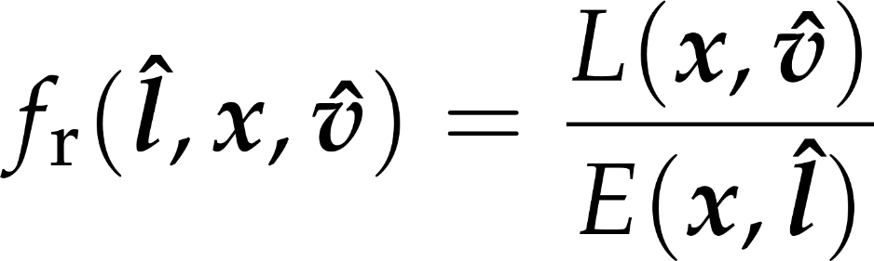
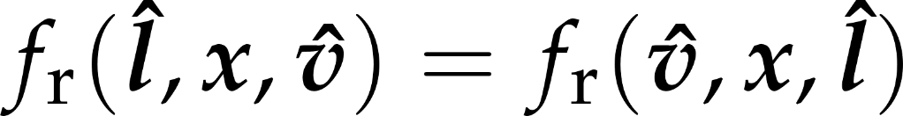
A kétirányú visszaverődés valószínűségsűrűség-függvénye - BRDF
az felületi pontban az irányból belépő egységnyi teljesítménysűrűség hatására a irányba kilépő radiancia
ez a felület optikai jellemzője
Helmholz-törvény
[ (sr)⁻¹ ]
Notes:
Fr is the BRDF, or bideirectional reflectance distribution function. It expresses the outgoing reflected radiance in a certain direction in response to unit irradiance from a certain incoming direction. The BRDF can of course also depend on the surface point: not only materials or colors may be different at different surface points, but also the surface may have different orientation, meaning that the same incoming and outgoing directions might be very different with respect to the surface.
The BRDF is a physical property of surfaces. It should obey certain laws of physics. Energy conservation is one such law: a surface should not reflect more light than incident on it. Another is Helmholz’s law: the BRDF is symmetrical, the incoming and outgoing directions interchanges should result in the same reflectance value.

Slide 25







Egy felületi pont árnyalása
fényforrás-modellből
anyagmodellből
Notes:
Now we have an outline of an algorithm for shading a surface point (shading here means finding the eye-directional radiance, i.e. the color of the pixel in which the surface is visible.)
We need as inputs the surface point position, the surface normal there, the eye and light positions.
View and light directions can be computed by subtracting the surface point position from eye and light positions, and normalizing the vectors.
Then, we need to find the incoming power density (on a surface perpendicular to the light direction). This will depend on the lighting model we use,
Then, we compute the cosine of the light angle.. This is the dot product of the surface normal and the light direction.
The product of the power density and the cosine factor given the incoming irradiance.
The irradiace multiplied by the BRDF given the eye-directional radiance. The BRDF comes form the optical material model we use,
Thus, to make this outline a complete shaing algorithm, we are missing two components: the model of light sources and the model of optical material properties.

Slide 26



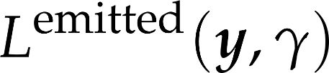
Valós fényforrások
nem egyetlen bejövő fényirány van
ki kel értékelni az integrált
Notes:
Real light sources are defined by their emission radiance, L^{emitted}. When the reflected radiance of a point is considered, the contribution of all those light source points should be added which are visible from the point of interest. This means integration. Thus, we often prefer abstract light source models, that can illuminate a surface just from a single direction, which saves integration.

Slide 27

Absztrakt fényforrásmodell: irányfény
Notes:
In case of directional light sources, the radiance is constant everywhere, so is the illumination direction. In other words, the illumination rays are parallel. The Sun is an example for directional light source if we are on the Earth.

Slide 28




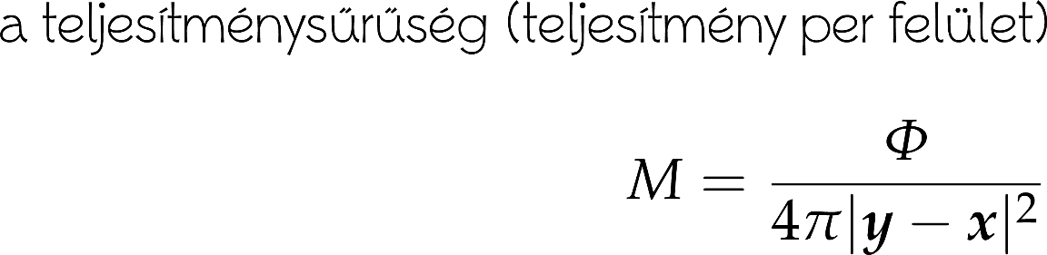
Absztrakt fényforrásmodell: pontfény
Notes:
For point light sources, the illumination direction points from the location of the source to the illuminated point. The radiance decreases with the square of the distance.

Slide 29
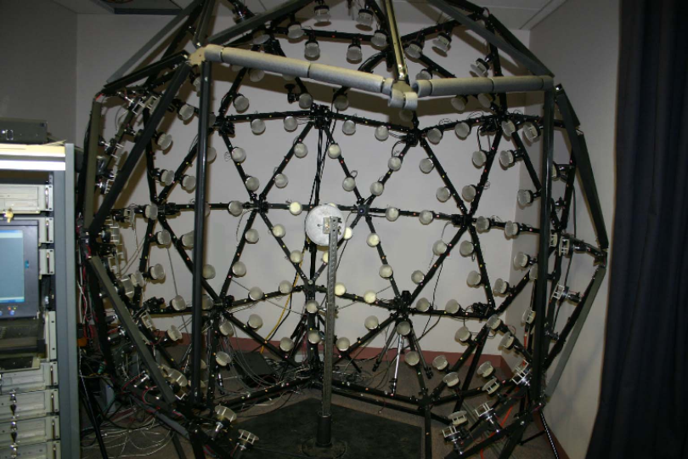
BRDF mérése

Slide 30
BRDF mérése
512 kamera
512 vaku
3 hullámhossz
kb. 3 Mbytes adat felületi pontonként
szorozva a képfelbontással
csak akkor van értelme, ha feltétlenül pontosan szeretnénk reprodukálni a valós felület tulajdonságait
pl. a gépjárműiparban

Slide 31
Analitikus BRDF modellek
nagy táblázat helyett egyszerű képlet
több tucat ilyen van
Lambert BRDF model
diffúz visszaverődés, matt felületek
Phong és Phong-Blinn BRDF modellek
spekuláris visszaverődés, fényes műanyagok
Ideális visszaverődés és fénytörés
tükrök, fényes fémek, üveg, víz

Slide 32





Diffúz visszaverődés
radiancia:
független a nézeti iránytól
így a BRDF is független kell legyen a nézeti iránytól
Helmholtz: BRDF független a megvilágítás irányától is
vagyis a BRDF konstans:
a diffúz felület optikailag durva felület
Notes:
Our first model is for very rough surfaces where all photons get reflected multiple times. Such materials (snow, sand, wall, chalk, cloth etc) have a matte look, they look the same from all viewing directions. Thus, the radiance, which equals to the incident radiance times the BRDF times the geometry term, is independent of the viewing direction. Incident radiance and the geometry term are already independent of the viewing direction, thus the BRDF must also be independent of the viewing direction. According to Helmholtz reciprocity, if the BRDF is independent of the viewing direction, it must be independent of the illumination direction as well, so the BRDF is direction independent.
Diffuse surfaces correspond to very rough surfaces where a photon collides many times. The Fresnel depends on the wavelength, which is strong for metals and weak for non-metals. Even if a single reflection changes the spectrum just a little, multiple reflections amplify this effect, so the final reflected light will have a modified spectrum. Diffuse reflection is primarily responsible for the “own color” of the surface.

Slide 33

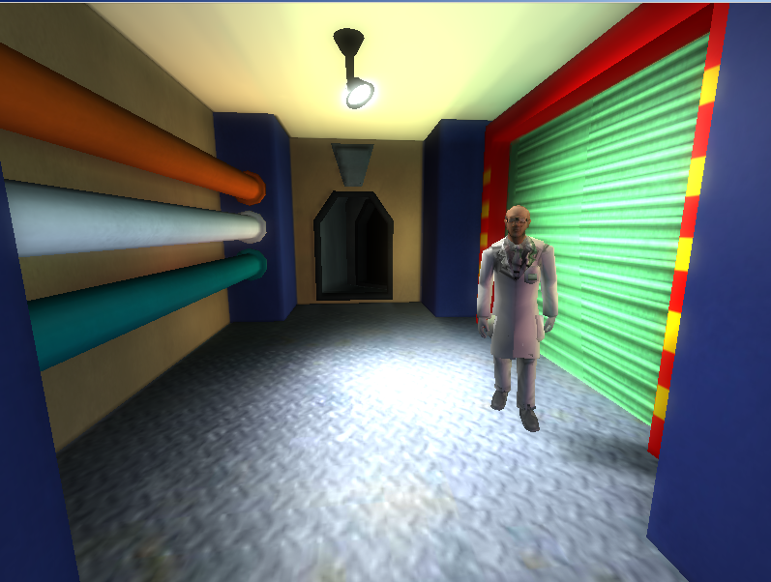
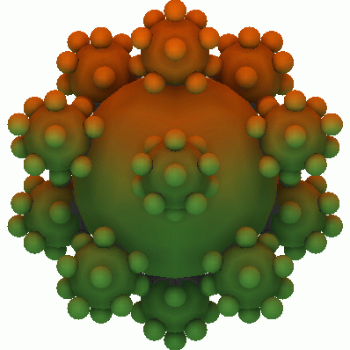
Lambert-törvény
a BRDF független az iránytól, DE a kimenő radiancia függ a megvilágítás irányától
Notes:
The reflected radiance is the incident radiance times the BRDF, which is constant now, and the geometry term. So for diffuse surfaces, the reflected radiance is proportional to the cosine of the orientation angle. This cosine can be computed as a dot product of the unit surface normal and the unit illumination direction.
If the cosine is negative, i.e. the angle between the surface normal and the illumination direction is greater than 90 degrees, then the illumination is blocked by the object whose surface is considered. In such cases, the negative value is replaced by zero.

Slide 34


A Lambert-törvény RGB hullámhosszokkal
elemenkénti szorzat
vektor és skalár szorzása
kimenő radiancia
[RGB vektor]
[skalár]
diffúz szín
[RGB vektor]
a fényforrásból érkező teljesítménysűrűség
[RGB vektor]
Notes:
It is now time to consider that light measures are not only scalar quantities when monochromatic light is measured, Otherwise, they are distributed on a continuous spectrum of wavelengths. There are of course spectral measures that consider the distribution of wattage not only over surface area of solid angles, but also over the spectrum. However, we do not need to consider them, as our light simulation will be performed on only three wave length: red, green, and blue. The human eye has three kinds of receptors, thus three wavelength can be used to reproduce most color sensations. Thus, we assume all light is composed of monochromatic red, green, and blue. Even though this a gross simplification of reality, it works for the most prevalent lighting scenarios perfectly.
Radiance L, power density from light M, and diffuse BRDF coefficient kd are, from now on, three-element vectors, with elements being the values on the RGB wavelength. There are not geometric vectors (even if we can image a color space in which they are). Teking the cross product of two RGB vectors makes little sense. However, as we need to multiply there quantities with each other on all wavelength, elementwise multiplication must be used.

Slide 35
Legegyszerűbb eset
irányfény és diffúz felület

Slide 36
Feltételezések
a megvilágítás mindenhol azonos
kisszámú irányfényforrás
a teljesítménysűrűség és az irány adott, mindenhol ugyanannyi
minden felület diffúz
nem számít, honnan nézünk rájuk
nem fényes vagy tükröző
a megjelenése csak ezektől függ:
a fény teljesítménysűrűsége
a felület színe
a fény beesési szöge

Slide 37
Absztrakt fényforrásmodell: irányfény
Notes:
In case of directional light sources, the radiance is constant everywhere, so is the illumination direction. In other words, the illumination rays are parallel. The Sun is an example for directional light source if we are on the Earth.

Slide 38
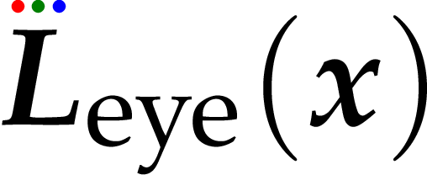


Felületi pont árnyalása, egyszerű eset
Notes:
In the previous slide, we have already taken the liberty of denoting directions with unit length vectors, namely light direction l is a unit length vector. As we no longer have to deal with integration over directions, the distinction between directions and unit vectors becomes irrelevant, and we can write all our quantities as function of vectors instead of directions.
The concrete case of reflection that is of interest to us is when we wish to compute the eye-directional radiance of a surface point visible in a pixel. The view direction we denote by unit vector v, the light direction with unit vector l, the surface point is at x. If the incoming irradiance in known, the eye-directional radiance can be computed with this formula. Now it is time to reveal what Fr is.

Slide 39
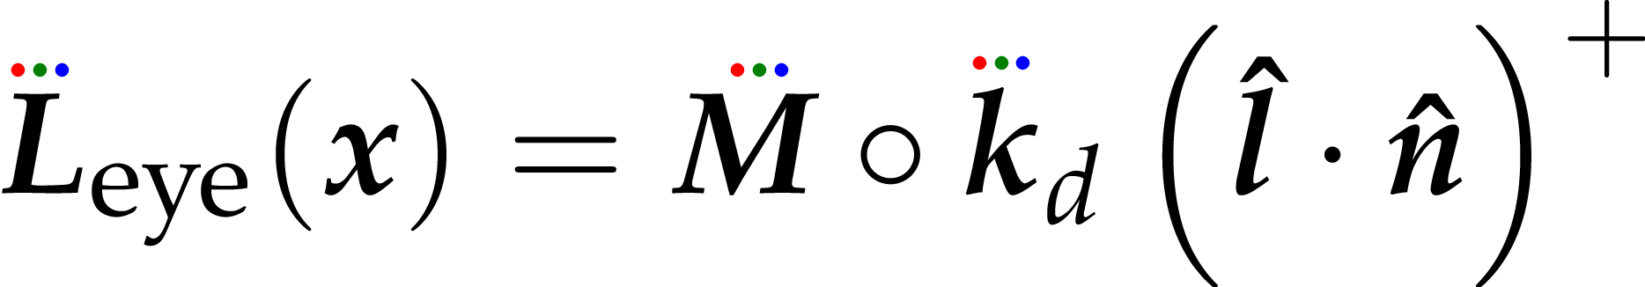
Árnyalási képlet, egyszerű eset
a felület “színe” vagyis a diffúz visszaverődési tényező
elemenkénti szorzat
negatív nem lehet, helyette nulla
a felületi pont látható “színe”
vagyis a szemirányú sugársűrűség
a fény “színe”
vagyis az irányfényforrás teljesítménysűrűsége
a fény beesési szögének koszinusza, ha pozitív
a fényirány és felületi normális skalárszorzata

Slide 40
Kicsit összetettebb eset
pontszerű fényforrással

Slide 41
Absztrakt fényforrásmodell: pontfény
Notes:
For point light sources, the illumination direction points from the location of the source to the illuminated point. The radiance decreases with the square of the distance.

Slide 42
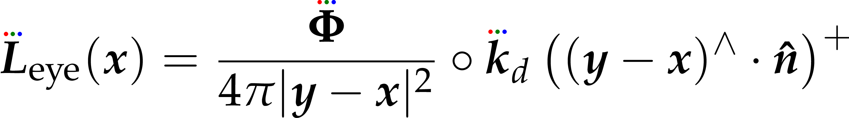
Árnyalási képlet, pontszerű fényforrás
a fény “színe”
vagyis a pontfényforrás teljesítménye
a felület “színe” vagyis a diffúz visszaverődési tényező
negatív nem lehet, helyette nulla
a felületi pont látható “színe”
vagyis a szemirányú sugársűrűség
elemenkénti
szorzat
a fény beesési szögének koszinusza, ha pozitív
a fényirány és felületi normális skalárszorzata
az árnyalt felületi pont pozíciója
a fényforrás pozíciója

Slide 43
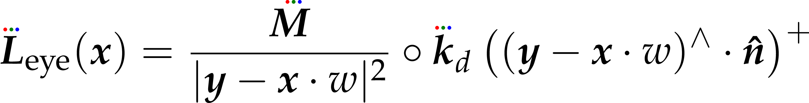
Egységes képlet irány- és pontszerű fényforrásokra
a fény “színe”
a pontfény teljesítménye / 4 pi
VAGY
az irányfény teljesítménysűrűsége
a felület “színe” vagyis a diffúz visszaverődési tényező
negatív nem lehet, helyette nulla
a felületi pont látható “színe”
a fény beesési szögének koszinusza, ha pozitív
a fényirány és felületi normális skalárszorzata
fény pozíciója
VAGY
fény iránya (egységhosszú)
1 pontfényre
VAGY
0 irányfényre

Slide 44

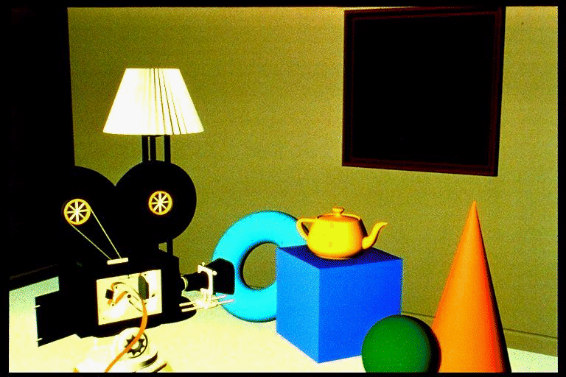
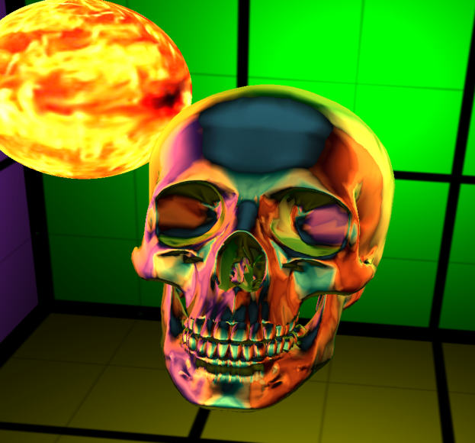
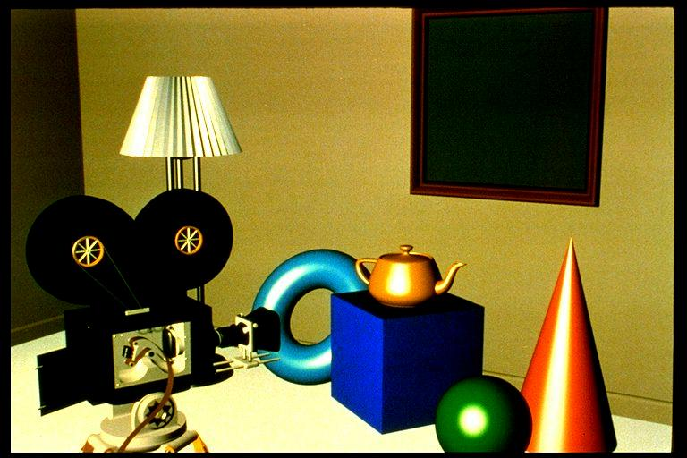
Fényes felületek
pixelben látszó felület
tapasztalati modell
Notes:
Surfaces are usually not smooth, so they reflect light not just in the ideal reflection direction but practically in all possible directions. Physically, we can imagine these rough surfaces as a random collection of ideal mirror microfacets that reflect light according to their random orientation.
As we see not a single microfacet in a pixel, but a large collection of them, we perceive the average radiance reflected by this collection.
Photons may have a single scattering on these microfaces when the average is maximum around the ideal reflection direction of the mean surface. On the other hand, photons may get scattered multiple times, when they “forget” their original direction, so the reflection lobe will be roughly uniform.
Instead of following a probabilistic reasoning, we handle these rough surfaces as a black-box, i.e. empirical model. That is, we describe the behavior of the surface based on everyday experience without any structural analysis. By experience, we say that a rough surface reflects light into all directions, but more light is reflected into the neighborhood of the ideal reflection direction.

Slide 45




Irányok jelölése
árnyalt felületi pont
felületi normálvektor
nézeti irány
fényirány
félúton a nézeti- és fényirány között
eltérés az ideális esettől

Slide 46
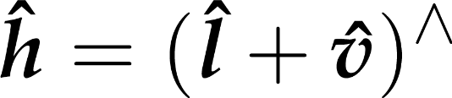





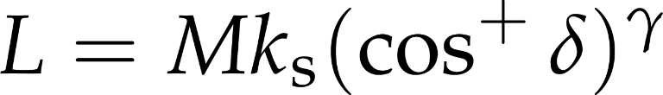

Phong-Blinn model
felezővektor
maximális, ha
Notes:
Phong-Blinn is an empirical BRDF model. Glossy surfaces reflect more light around the "ideal reflection direction", i.e. the light direction reflected over the surface normal. The more the view direction deviates from this ideal case, the less the reflection should be. We compute the halfway vector h between the view and light directions. The angle between the normal and h is delta. The higher delta is, the further we are from the ideal reflection case. Thus, the reflected radiance should be less. A cosine function of delta achieves this. If we introduce an exponent gamma, we can control how fast the radiance falls off for direction further away from the ideal case. The faster the fall-off, the more concentrated the reflected light is.
In case of directional illumination, the reflections of the light appear as glossy highlights. Higher gamma means smaller, less smeared highlights. The factor ks can be used to control how bright the highlights are. Typically, when increasing gamma, you also want to increase ks. Both gamma and ks are parameters you can choose relatively freely. gamma is often called "shininess", and ks is the "specular color", as its values may be different for the red, green, and blue wavelengths.

Slide 47
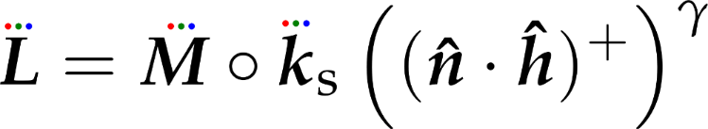
Spektrális (RGB) Phong-Blinn BRDF
spekuláris exponens
vagyis
Phong exponens
vagyis
fényesség
Notes:
For the spacular case, the Phong-Blinn reflection formula look like the above.

Slide 48
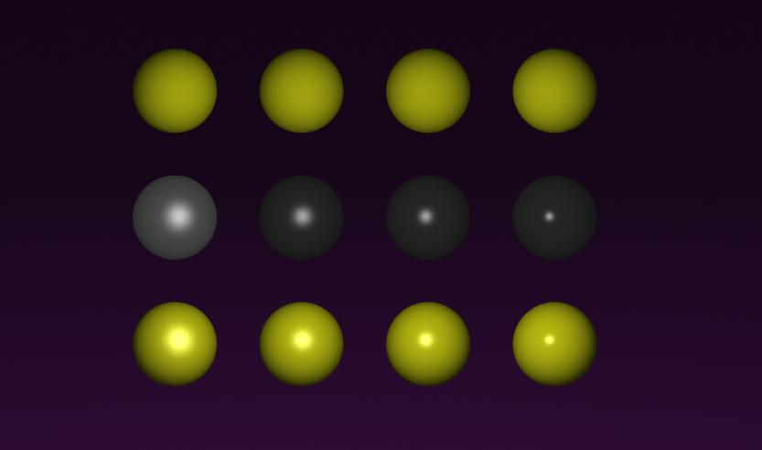
Diffúz + Phong-Blinn anyagok
diffuse
Phong-Blinn
diffuse +
Phong-Blinn
γ =
5 10 20 50
Notes:
Combining diffuse and glossy reflections gives us plastic-like or metal-like surfaces. For plastics, the highlight color is white (ks is the same for all wavelengths), for metals, it is proportional to the diffuse color kd.

Slide 49

Phong-Blinn probléma

Slide 50

Phong-Blinn probléma

Slide 51


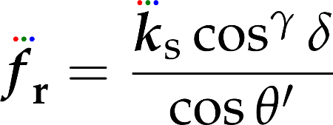
Mi a BRDF itt?
Phong-Blinn képlet
árnyalási egyenlet
tehát a BRDF
szimmetrikus
nem szimmetrikus

Slide 52
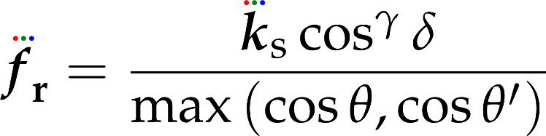

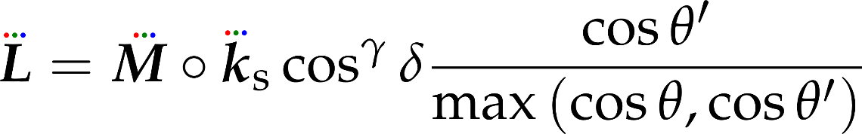

Szimmetrikus verzió
max-Blinn BRDF

