Slide 1
Vektor- és mátrixműveletek WebGL-hez
Szécsi László
3D Grafikus Rendszerek
4. előadás

Slide 2
Mit szeretnénk?
támogassa a szükséges műveleteket
legyen könnyen használható

Slide 3
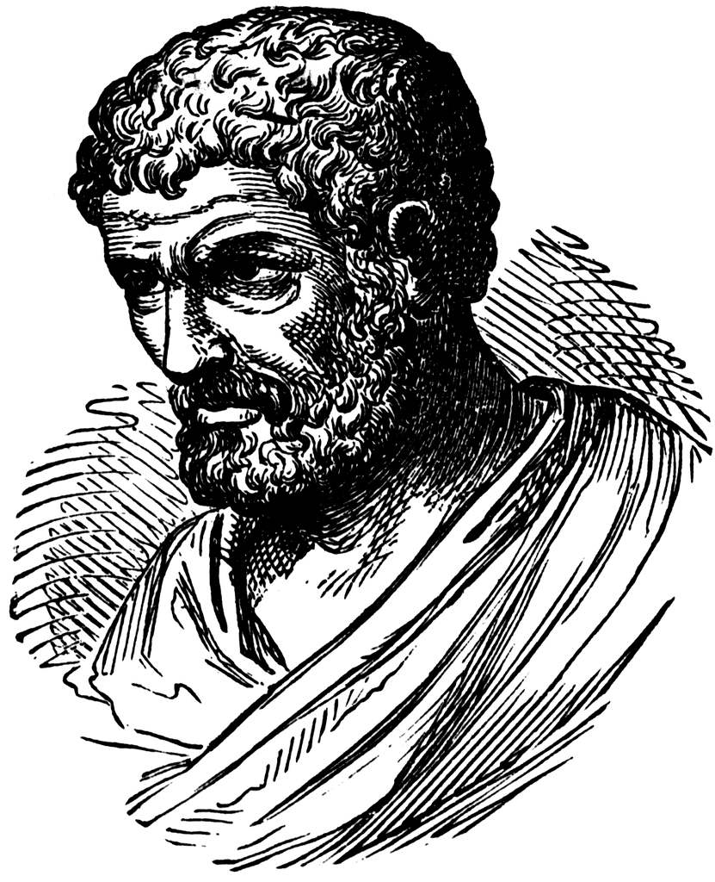
Eukleidész
Notes:
A geometria atyja.

Slide 4
Euklideszi geometria
Bármely két ponton keresztül pontosan egy egyenes húzható.
Bármely szakaszra pontosan egy egyenes illeszkedik.
Bármely középponttal és sugárral ponsan egy kört lehet rajzolni.
Bármely két derékszög egyenlő egymással.
Egy egyeneshez egy ponton át pontosan egy olyan egyenes húzható, aminek az egyenessel nincs közös pontja.
Ugyanazon dologgal egyenlő dolgok egymással is egyenlők.
Ugyanazon dolog kétszeresei egyenlők egymással.
Notes:
Computer graphics works with shapes. The field of mathematics that describes shapes is the geometry, so geometry is essential in computer graphics.
Geometry, like other fields of formal science, has axioms that are based on experience and cannot be argued but are accepted as true statements without arguments. From axioms other true statements, called theorems, can be deducted with logic reasoning.
For example, axioms of the Euclidean geometry include the following three postulates. Axioms have two purposes, on the one hand, they are accepted as true statements. On the other hand, axioms implicitly define basic concepts like points, lines etc. because they postulate their properties.
Based on the axioms and the applied tools, there are several different geometries that are different models of the world. Everybody knows the Euclidean geometry of the plane and of the space. We know that it is metric, i.e. we can talk of the distance between objects and size is an important concept in it. In Euclidean geometry parallel lines do not intersect, that is, a point at infinity is not part of the Euclidean plane.
However, if we define axioms differently, we can add points at infinity to the plane making all lines, even parallel lines, intersecting. Clearly, this is a different geometry with different axioms and theorems, which is called the projective geometry. Projective geometry is not metric since distance cannot be defined in it. The reason is that the distance from points at infinity is infinite, but infinite is not a number.
In Euclidean geometry size is an important issue, curves are measured by their length, surfaces by their area, and solids by their volume. However, when we try to apply these concepts to natural phenomena, like a snow crystal or a cloud, we fail. We have to realize that natural objects do not have a precise size, so Euclidean geometry is not appropriate for their description. For natural phenomena, we use fractal geometry.

Slide 5
Az euklideszi geometriában értelmezett fogalmak
pont, egyenes → sík, metszés, illeszkedés
szakasz, kör → távolság, eltolás, vektor
hossz → hossz kétszerese, fele, harmada
kerület, terület, felület, térfogat
súlypont

Slide 6
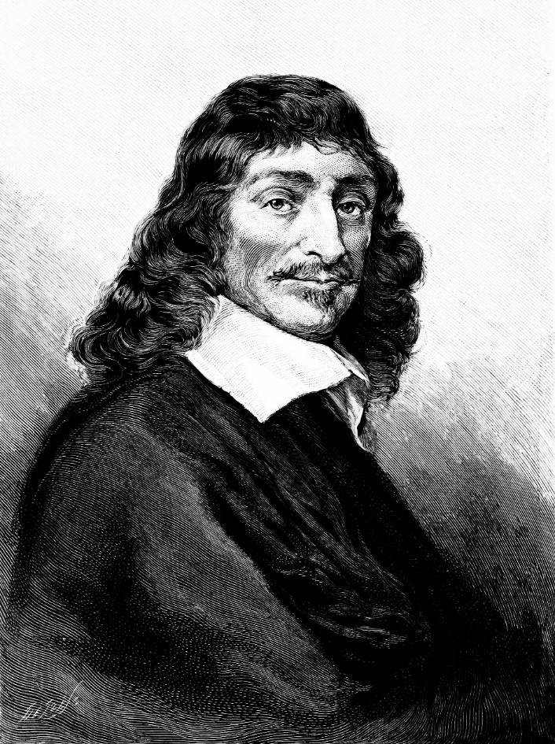
Descartes

Slide 7



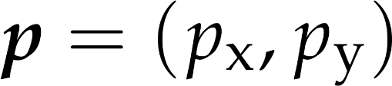
Descartes koordináta-rendszer
1

Slide 8
Analitikus geometria
pont → koordináták
Karteziánus koordináta-rendszer
ponthalmazok (egyenes, szakasz, sík, kör, gömb) → egyenletek
metszéspont → egyenletrendszer megoldása
eltolás, forgatás, tükrözés, nagyítás → koordináta-transzformációk
Notes:
In computer graphics, we should also take into account that a computer is programmed, which cannot do anything else but calculating with numbers. A computer is definitely not able to understand abstract concepts like point, line etc. So for the application of a computer, geometric concepts must be translated to numbers, calculation and algebra.
A geometry based on algebra, equations and numbers is called analytic geometry or coordinate geometry. To establish an analytic version of a geometry, we have to find correspondences between geometric concepts and concepts of algebra in a way that axioms of the geometry will not contradict to the concepts of algebra. If it is done, we can forget the original axioms and work only with numbers and equations.

Slide 9
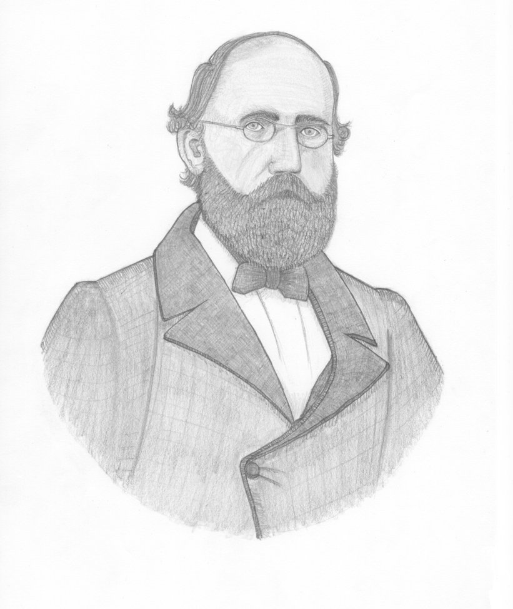
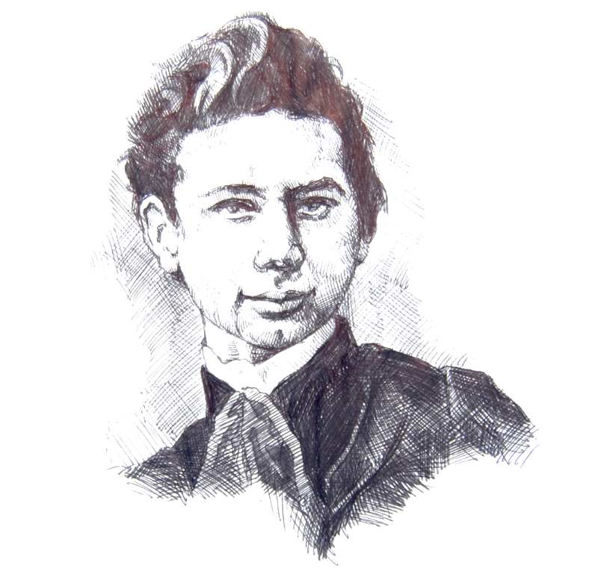
Bernhard Riemann, Bolyai János

Slide 10
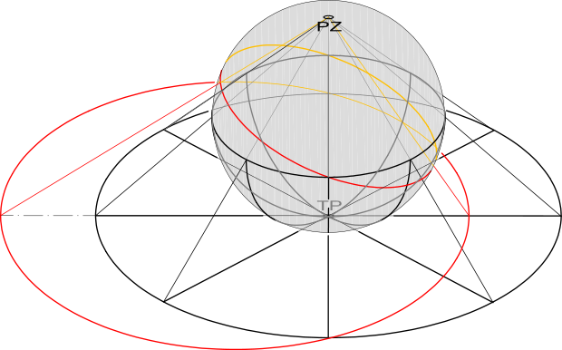
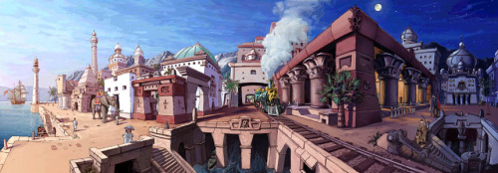
Projektív geometria
sztereografikus vetítés
perspektíva

Slide 11
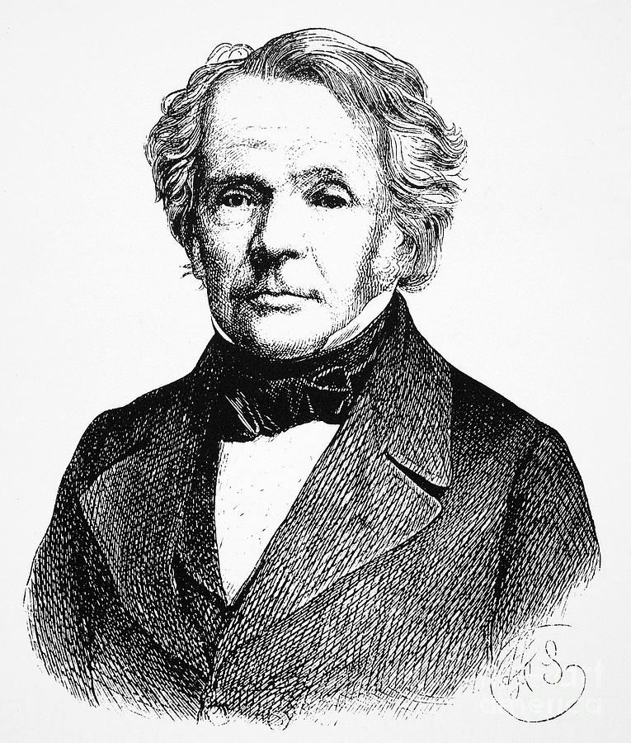
Ferdinand Möbius

Slide 12

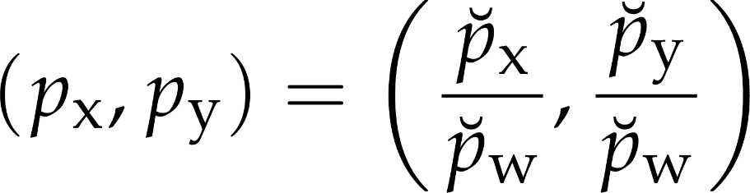
Homogén koordináták
Descartes + origó középpontú skálázás skálatényezője
ha a skálatényező nem nulla, visszaskálázva kaphajuk a Descartes koordinátákat
ha a skálatényező nulla, a pont a végtelenben van
Descartes
homogén

Slide 13
Baricentrikus koordináták
súlypont
a, b, c súlyok: pont a síkon
kitüntetett
3 csúcs
Miért hasznos?
mind pozitív: pont a háromszögön belül
a súlyok használhatók a csúcsokhoz rendelt értékek közötti interpolációra
homogén
2x súly: ugyanaz a pont
1
3
1
Notes:
Defining a point as the center of mass of a system where masses placed at finite number of reference points is also called the combination of these points with barycentric coordinates equal to the weights.
Note that we can due this in real life without mathematics and coordinate systems.
If all weights are non-negative, which has direct physical meaning, then we talk of convex combination since the points that can be defined in this way are in the convex hull of the reference points. By definition, the convex hull is the minimal set of points that is convex and includes the original reference points. For example, when presents are wrapped, the wrapping paper is on the convex hull of the presents.
Using the term combination or convex combination, we can define a line a combination of two points and a line segment as a convex combination of two points. Similarly, the convex combination of three not collinear points is the triangle, the convex combination of four points not being in the same plane is a tetrahedron.

Slide 14




Homogén koordináták
legyen a 3 pont:

Slide 15
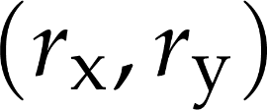

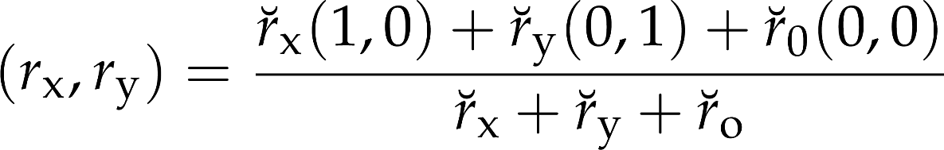
Descartes → spec. baricentrikus
ha a Descartes koordináták:
mik a szükséges súlyok?
írjuk fel a tömegközéppontot:
végtelen sok megoldás van

Slide 16


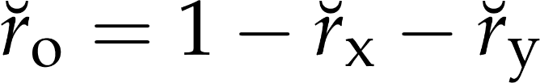
Ha súlyösszeg 1

Slide 17




Ha más legyen a súlyösszeg
legyen a súlyösszeg:
ezzel a megoldás:

Slide 18
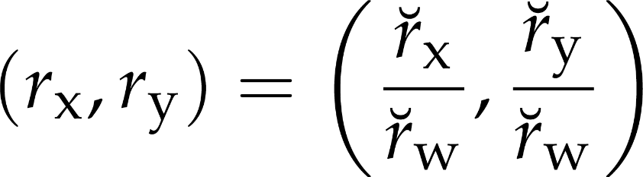
Súlyok → Descartes
ha adottak a súlyok
mi lesz a Descartes kooridináta?

Slide 19

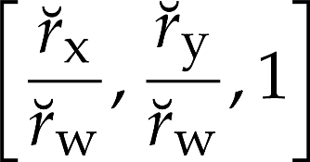
Homogén koordináták
sosem érdekes
mindig érdekes a súlyösszeg
homogén koordináták:
ugyanez a pont 1 összsúllyal:
Descartes koordináták:

Slide 20





Vektorok
geometriai vektor = eltolás
eltolás
van hossza
van iránya
ritkán dolgozunk közvetlenül irányokkal
adott irányú egységvektor
Notes:
In addition to combining points, we can also translate them. By definition a translation is a vector, which has direction and length. The length is denoted by the absolute value of the vector.

Slide 21
Vektorok és pontok
ha van kitüntetett origó
minden ponthoz rendelhető egy pozícióvektor
pont
pozícióvektor
origó
Notes:
If we select a special reference point, called the origin, then every point has a unique vector that translates the origin to here, or from the other point of view, every vector unambiguously defines a point that is reached if the origin is translated by this vector. Such vectors are called position vectors. The fact that there is a one-to-one correspondence between points and position vectors does not mean that points and vectors would be identical objects (wife and husband are also strongly related and unambiguously identify each other, but are still different objects with specific operations).

Slide 22

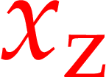

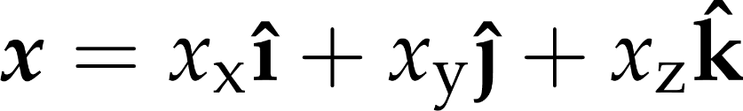
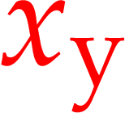
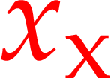
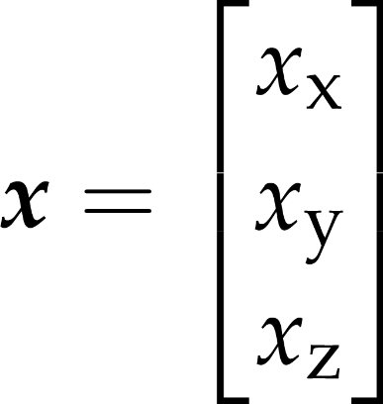
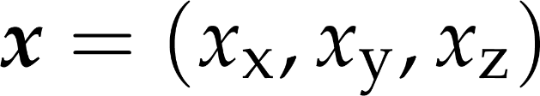
Vektorok 3D Descartes koordináták esetén
a Descartes koordinátarendszer
bázisvektorai
a pozíció kifejezhető a bázisvektorok
lineárkombinációjaként
sorvektor
oszlopvektor
Notes:
Depending on our choice of a coordinate system, vectors can be represented analytically (by numbers).
A 3D Cartesian coordinate system can be defined with an origin and the basis vectors i, j, and k. Given an origin, a point is associated to a position vector, and a position vector can be expressed as a linear combination of the basis vectors. The linear coefficients are what we call the coordinates. Thus, a geometric vector is associated with a tuple of coordinate values: in this case, 3-tuples, or triples.
In linear algebra, tuples can be represented by one-row or one-column matrices, also called row vectors and column vectors. Both are the representations of the same geometric vector, so for geometric vector operations, it is just a matter of convention which form we use.
For Cartesian 3D (or 2D) vectors, we use parentheses around the elements, and sometimes separate them with commas for readability.
In the following slides, we give the interpretation of the vector operations on Cartesian coordinates. This way, the operations are instantly linked to programmable arithmetic.
We also give code snippets using the types float and float3 realizing the operations. We assume appropriate operators and global functions are available.

Slide 23



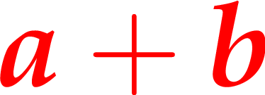
Vektorok összege
vec3 a;
vec3 b;
vec3 sum = a+b;
kommutatv
asszociatív
Notes:
Concerning vector operations, we can talk of addition that means the execution of the two translations one after the other. The resulting translation is independent of the order, so vector addition is commutative (parallelogram rule). If we have more than two vectors, parentheses can rearranged so it is also associative. Vector addition has an inverse, because we can ask which vector completes the translation of v2 to get a resulting translation v.

Slide 24
Vektorösszeadás

Slide 25



Vektorok különbsége
szempozíció
nézeti irány
(normaizálatlan)
vec3 pos;
vec3 eyePos;
vec3 viewDiff =
eyePos – pos;
árnyalt felületi pont
pozíciója
Notes:
Asking that question gives us vector difference.
Among its countless uses in graphics, taking the difference of two vectors has a prominent example in computing the view direction when a surface point and the eye position is known. The view direction is the direction of the difference vector. However, the length of this vector is of no interest, when only the view direction is required.

Slide 26

Vektorhossz
float eyeDist =
length(viewDiff);
Notes:
Cartesian vector length can be computed using the Pythagorean theorem.

Slide 27


Skálázás (vektor szorzása skalárral)
sv
vec3 v;
float s = 1.5;
vec3 vScaled =
v * s;
v
disztributív az összeadásra
Notes:
The length of a vector can be modified by scaling – which is multiplication of a vector by a scalar. All coordinates are multiplied. The direction is unchanged – even though if the scalar is negative, the vector is reversed.

Slide 28
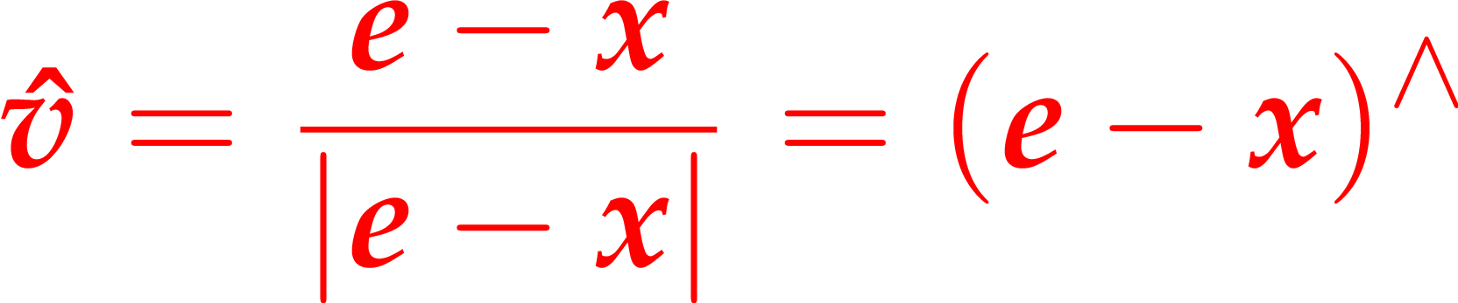
Normalizálás
float eyeDist =
length(viewDiff);
vec3 viewDir =
viewDiff / eyeDist;
OR
vec3 viewDir =
normalize(viewDiff);
szempozíció
nézeti irány
(normalizált)
árnyalt felületi pont
pozíciója
Notes:
In computer graphics, directions are most often represented by unit length vectors. If a direction is specified by a non-unit-length vector, but we want to use it in computations that assume unit length, we need to keep the direction, but change the length to one. This can be done by scaling the vector with the reciprocal of its length. This is called normalization, and the result is a normalized vector of unit length.

Slide 29


Skalárszorzat
skalár
vec3 a = vec3(1, 1, 0);
vec3 b = vec3(3, 0, 5);
float ab = dot(a, b);
Notes:
Vectors can be multiplied in different ways. The first possibility is the scalar product (aka dot or inner product) that assigns a scalar to two vectors. By definition, the resulting scalar is equal to the product of the lengths of the two vectors and the cosine of the angle between them.
The geometric meaning of scalar product is the length of projection of one vector onto the other, multiplied by the lengths of the other.
Scalar product is commutative (symmetric), which is obvious from the definition.
Scalar product is distributive on the vector addition, which can be proven by looking at the geometric interpretation. Projection is obviously distributive (the projection of the sum of two vectors is the same as the sum of the two projections.

Slide 30
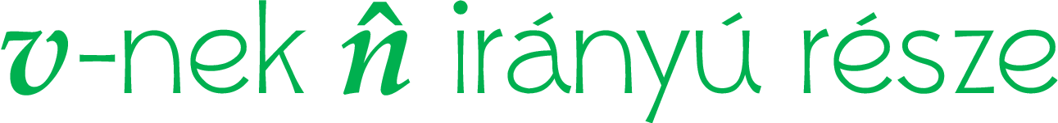

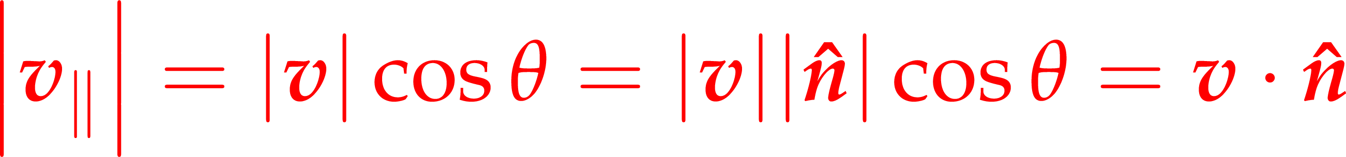
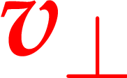

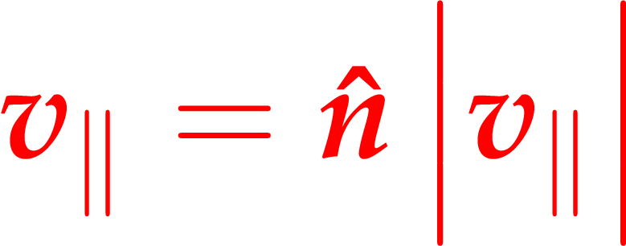

Skalárszorzat használata:
Pitagorasz
skalárszorzat
Notes:
Given the geometric definition of the dot product, it is a useful tool when we wish separate a vector v into the sum of two component, one perpendicular and one parallel to a given direction n.
v dot n is, by definition, |v||n|cos theta, ωηερε, ιφ ν ισ νορμαλιζεδ, |ν| ισ ονε. Γιϖεν τηε τριγονομετριχ δεφινιτιον οφ χοσινε (αδϕαχεντ/ηψποτενυσε), χοσ τηετα ισ |ϖ_ν|/|ϖ|. Τηατ, μυλτιπλιεδ βψ |ϖ|, γιϖεν |ϖ_ν|. Ωε κνοω τηε λενγτη οφ ϖ_ν ανδ ιτσ διρεχτιον, σο ιτ χαν βε ρεχονστρυχτεδ βψ σχαλινγ ν ωιτη |ϖν|.
Οβταινινγ ϖ_ρεστ ισ ϕυστ α ϖεχτορ διφφερενχε.

Slide 31







Példa: ideális visszaverődés iránya
vec3 reflect(vec3 inDir, vec3 normal)
{
return
inDir - normal *
normal.dot(inDir) * 2;
};
Notes:
Separating a vector to perpendicular components is used, for example, when we need to find the ideal reflection direction in ray optics. The component parallel to the surface does not change, but the one along the surface normal is inverted.
To render smooth surfaces, we should compute the ideal reflection direction. Assume that incident direction d and surface normal n are unit length vectors.
Incident direction d is decomposed to a component parallel to the normal and a component that is perpendicular to it. Then, the reflection direction is built up from these two components.

Slide 32

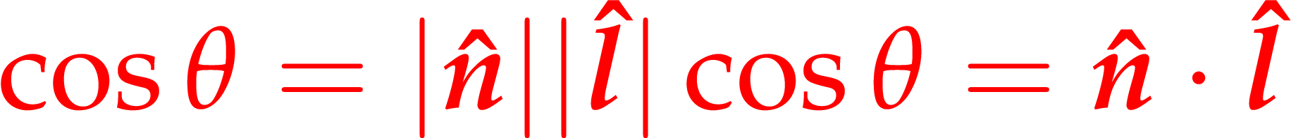
Skalárszorzat használata: két irány közötti szög cosinusa
Notes:
It is often required to find the cosine of an angle between two unit direction vectors. This tells us whether the directions are perpendicular (cosine is zero), at an acute angle (cosine is positive) or facing away at an obtuse angle (cosine is negative). The cosine is easily obtained as the dot product of the unit-length vectors.

Slide 33




Példa: fény beesési szögének cosinusa
float cosTheta =
dot(lightDir, normal);
felület
Notes:
On prime example is when we need to compute the amount of light incident on a surface. The cosine of the light incidence angle is a prominent factor in the lighting formula. It can be computed as the dot product between the light and surface normal directions.

Slide 34

Vektor hosszának négyzete
vec3 a = float3(34, 435, 353);
float a2 = dot(a, a);
Notes:
There is a direct relationship between dot product and the absolute value. The scalar product of a vector with itself is equal to the square of its length according to the definition since cos(0)=1.

Slide 35


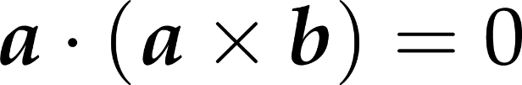
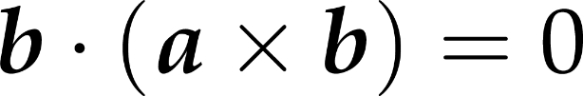

Keresztszorzat (vektoriális szorzat)
vec3 a = float3(1, 1, 0);
vec3 b = float3(3, 0, 5);
vec3 axb = cross(a, b);
Notes:
Vectors can be multiplied with the rules of the vector (aka cross) product as well. The result is a vector of length equal to the product of the lengths of the two vectors and the sine of their angle. The resulting vector is perpendicular to both operands and points into the direction of the middle finger of our right hand if our thumb points into the direction of the first operand and our index finger into the direction of the second operand (right hand rule).
The cross product is not commutative but anti-symmetric or alternating, which means that exchanging the two operands the result is multiplied by -1.

Slide 36
Keresztszorzat használata
merőleges keresése adott vektorra
keresztszorozzuk egy nem párhuzamos vektorral
merőleges két vektorra
keresztszorzatuk
ha az operandusok nem normalizáltak vagy nem derékszögben állnak, az eredmény normalizálizálására szükség lehet
Példa: parametrikus felület normálvektora
két érintővektor (tangens, binormál) keresztszorzata

Slide 37
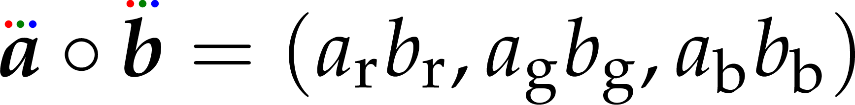
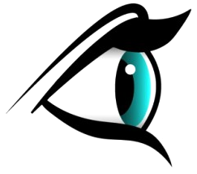

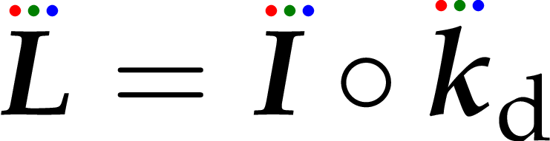
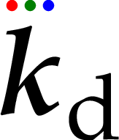
Elemenkénti (Hadamard) szorzat
analitikus geometriában nem értelmes, de a grafikában gyakori
szemirányú kimenő radiancia
(látható szín)
irradiancia:
diffúz felület
diffúz visszaverődési tényező (felület színe):
Notes:
The elementwise product is almost trivial, and rarely has a very meaningful interpretation in mathematics. Have you heard about the Hadamard product? That is its mathematical name.
In computer graphics, this product is used a lot, so that writing no operator between vector operands is understood to mean the elementwise product. This is in fact not because of geometric vectors at all: there, the elementwise product of the Cartesian coordinates is indeed useless. But in graphics, radiometric values like power emitted by a light source, of the diffuse color of a surface, are given on all RGB wavelengths. Performing the same computation on all wavelengths is easily written as working with 3-element vectors. As operations are performed for all channels independently, of course the elementwise product makes sense.
An example is computing the apparent color of a surface with a given own color and the color of the lighting. This is a simple multiplication of the appropriate radiometric measures, but performed on all three wavelengths.

Slide 38
Vektor osztályok C++-ban
Direct3D/HLSL programozáshoz
float, int, bool vektorok
float4x4 mátrix
teljes HLSL intrinsic függvénykészlet támogatása
swizzle

Slide 39
Alap struktúra
// float2.h – minden inline
namespace Nest { namespace Math {
class float2
{
public:
float x;
float y;
};
}}

Slide 40
Indexelhetőség
class float2
{
public:
union{
struct {
float x;
float y;
};
float v[2];
};
float operator[](unsigned int i) const
{
return v[i];
}
};

Slide 41
Indexelhetőség 2
float operator[](unsigned int i) const
{
return v[i];
}
float& operator[](unsigned int i)
{
return v[i];
}

Slide 42
Konstruktorok
float2():x(0.0f),y(0.0f){}
float2(float f):x(f),y(f){}
float2(float x, float y):x(x),y(y){}
float2(float x, float y, float z, float w)
:x(x),y(y){z; w;}
float2(int2 i):x((float)i.x),y((float)i.y){}

Slide 43
Összeadás
float2 operator+(const float2& o) const
{
return float2(x + o.x, y + o.y);
}

Slide 44
Hozzáadás
float2& operator+=(const float2& o)
{
x += o.x;
y += o.y;
return *this;
}

Slide 45
Keresztszorzat
float3 cross(const float3& o) const
{
return float3(
y * o.z - z * o.y,
z * o.x - x * o.z,
x * o.y - y * o.x
);
}

Slide 46
Konstansok
//float3.h
static const float3 xUnit;
//constants.cpp
const float3 float3::xUnit(1.0f, 0.0f, 0.0f);

Slide 47
Swizzle
union{
struct {
float x;
float y;
};
float v[2];
float2swizzle<2, float2, 1, 0> yx;
//...
float3swizzle<2, float3, 0, 1, 0> xyx;
float3swizzle<2, float3, 0, 1, -2> xy1;
//...
float4swizzle<2, float4, 1, 0, 1, 1> yxyy;

Slide 48
Swizzle jobbértékként
template<... int s0=0, int s1=0, int s2=0, int s3=0>
class float3swizzle {
float v[3];
operator float3() const
{
return float3(
(s0>=0)?v[s0]:((s0==-1)?0.0f:1.0f),
(s1>=0)?v[s1]:((s1==-1)?0.0f:1.0f),
(s2>=0)?v[s2]:((s2==-1)?0.0f:1.0f),
(s3>=0)?v[s3]:((s3==-1)?0.0f:1.0f));
}

Slide 49
Swizzle balértékként
inline floatswizzle& operator =(const T& o)
{
v[ s0 ] = o[0];
v[ s1 ] = o[1];
v[ s2 ] = o[2];
v[ s3 ] = o[3];
return *this;
}
nyilván nem negatív

Slide 50
Swizzle balértékként
inline floatswizzle& operator +=(const T& o)
{
v[ s0 ] += o[0];
v[ s1 ] += o[1];
v[ s2 ] += o[2];
v[ s3 ] += o[3];
return *this;
}

Slide 51
Metódushívás swizzleön
a vektorosztályok összes const metódusa legyen meg nekik is
nem const metódus: csak az értékadás operátorok
az implementáció létrehoz egy rendes vektorpéldányt, és meghívja rá

Slide 52
Mátrixok
static float4x4 translation(const float3& offset)
{
float4x4 t = identity;
t._30 = offset.x;
t._31 = offset.y;
t._32 = offset.z;
return t;
}
inline const float4& operator*=(float4& v, const float4x4& m)
{
v = m.transform(v);
return v;
}

Slide 53
Alternatívák: D3DXVECTOR3
D3DXVECTOR3* D3DXVec3Cross(
_Inout_ D3DXVECTOR3 *pOut,
_In_ const D3DXVECTOR3 *pV1,
_In_ const D3DXVECTOR3 *pV2
);

Slide 54
Alternatívák: DirectXMath
XMVECTOR XMVector3Cross(
[in] XMVECTOR V1,
[in] XMVECTOR V2
);
XMVECTOR XMLoadFloat2(
[in] const XMFLOAT2 *pSource
);

Slide 55
Vektor objektumok JavaScriptben
nincs inline: függvényhívás drága!
csak dinamikus példányosítás: drága!
ami olyan szép, mint a C++, az gyors nagyon nem lesz
nincs operátor overload
szép sem lesz soha

Slide 56
Vektor objektumok Kotlinban
an operátor overload
szép
de gyorsabb nem lesz, mint a JS
ha nagyon optimalizálni akarunk, kevésbé tudunk

Slide 57
Egyszerű vektor konstruktor
class Vec2(val x: Float = 0.0f, val y: Float = 0.0f){
operator inline fun plus(other : Vec2) : Vec2 {
return Vec2(
x + other.x,
y + other.y
)
}
fun toArray(dest : Float32Array){...}
}
szokásos objektuminicializálás
[OK]
szokásos pédányosítás
[OK]
number aritmetika
lassú
együttműködés a WebGL-lel
körülményes, csúnya, lassú

Slide 58
Típusos tömbbel
//a = b + c
val a = b + c
class Vec2(u: Float = 0.0f, v: Float = 0.0f){
val storage: Float32Array
operator inline fun plus(other : Vec2) : Vec2 {
return Vec2(
storage.x + other.storage.x,
storage.y + other.storage.y
)
}
}
típusos new
nagyon lassú
float aritmetika
gyors
együttműködés a WebGL-lel triviális

Slide 59
Koordinátatulajdonságok
inline var x : Float
get() = storage[0]
set(value) { storage[0] = value }
inline var y : Float
get() = storage[1]
set(value) { storage[1] = value }

Slide 60
New kikerülése: művelet értékadással
operator fun plusAssign(other : Vec2) {
storage[0] += other.storage[0]
storage[1] += other.storage[1]
}
// a = b + c
a.set(b)
a += c
//jsperf: 3x gyorsabb, mint val a = b + c

Slide 61
Vektortömbök
GLSL-ben is van
direkt beállításhoz nekünk is kell
nem lesznek nagyon nagy tömbök
indexelni szeretnénk
tömbökön végzett műveletek
egy függvényhívás
sok gyors aritmetika

Slide 62
Műveletek új tömbök létrehozása nélkül – lusta operátorok
interface Gif {
operator fun invoke(i : Int) : Float
}
class VecArray : Gif {
override operator fun invoke(i : Int) : Float{
return storage[i % storage.length]
}
infix fun gets(other : Gif){
for(i in 0 until storage.length) {
storage[i] = other(i)
}
}
operator fun plus(c : Gif) : Gif {
return object : Gif {
override operator fun invoke(i : Int) : Float {
return this@VecArray(i) + c(i)
}
}
}
a gets b + c

Slide 63
Kivonás
operator fun minusAssign(other : Gif) {
for(i in 0 until storage.length) {
storage[i] -= other(i)
}
}
ez is megy:
a -= b + c

Slide 64
Indexelhetőség
a[2]
class Vec2Array() : VecArray() {
operator fun get(i : Int) : Vec2{
return Vec2(storage, i*2)
}
}
class Vec2(backingStorage: Float32Array?, offset: Int = 0) {
constructor(u: Float = 0.0f, v: Float = 0.0f) : this(null, 0){
storage[0] = u
storage[1] = v
}
val storage: Float32Array =
backingStorage?.subarray(offset, offset+2)
?:Float32Array(2)

Slide 65
Swizzle
class Vec4(backingStorage: Float32Array?, offset: Int = 0) {
var xy : Vec2
get() = Vec2(storage)
set(value) { Vec2(storage).set(value) }
var xyz : Vec3
get() = Vec3(storage)
set(value) { Vec3(storage).set(value) }

Slide 66
Mátrixok
sor- vagy oszlopvektor?
jobbról vagy balról szorzunk a mátrixszal?
ez az előzőből következik
sor- vagy oszlopfolytonosan tároljuk az elemeket?
az előzőektől független
WebGL előírásnak meg kell felelni
jobb- vagy balkezes a koordinátarendszer?
az előzőektől teljesen független
csak a forgatásmátrix felírásában számít
merre van a pozitív forgatás?

Slide 67
Mátrixok
sor- vagy oszlopvektor?
jobbról vagy balról szorzunk a mátrixszal?
ez az előzőből következik
sor- vagy oszlopfolytonosan tároljuk az elemeket?
az előzőektől független
WebGL előírásnak meg kell felelni
jobb- vagy balkezes a koordinátarendszer?
az előzőektől teljesen független
csak a forgatásmátrix felírásában számít
merre van a pozitív forgatás?

Slide 68
Mátrixműveletek
teljesítmény kevésbé függ a paraméterek/kimenet módjától
több művelet/függvényhívás
vektor-mátrix szorzás az a vektoron végrehajtott művelet
ugyanúgy, mint a többi
mátrix-mátrix szorzás többnyire skálázás, elforgatás, eltolásmátrixokkal: erre spec függvények

Slide 69
vektor-mátrix szorzás
val v = Vec4(1.0f, 2.0f, 3.0f, 1.0f)
val m = Mat4(). // identity
rotate(PI/2) // rotation
v *= m // v <= (-2, 1, 3, 1);

Slide 70
Nincs 2x2, 3x3 mátrix? Sebaj!
val v = Vec2(1.0f, 2.0f)
val m = Mat4().
translate(3.0f, 4.0f)
v.set( v.xy01 * m )
// v <= (4, 6), the translated vector

Slide 71
Nincs 2x2, 3x3 mátrix? Sebaj!
val v = Vec3(0.0f, 1.0f, 0.0f)
val m = Mat4().
translate(3.0f, 4.0f).
rotate(PI/2.0f)
v.set( v.xyz0 * m )// v <= (-1, 0, 0), as the direction is invariant to translation

Slide 72
A konstruktor transzponálja a kapott tömböt
val m = Mat4( // row-major!!!!!!
1.0f, 0.0f, 0.0f, 0.0f,
0.0f, 1.0f, 0.0f, 0.0f,
0.0f, 0.0f, 1.0f, 0.0f,
2.0f, 3.0f, 5.0f, 1.0f
) // a translation matrix
val m2 = Mat4().translate(-2.0f, -3.0f, -5.0f)
// identity multiplied by
// translation in the opposite direction
m * = m2 // m <= identity

