Slide 1
2D kamera
Szécsi László
3D Grafikus Rendszerek
5.5 előadás

Slide 2




Transformation pipeline
model
transform
view
transform
viewport
transform
model space
world space
clip space
norm. device space
pixel
coordinates
window
space
modelling
Notes:
The task of computing the pixel coordinates of a vertex from the modeling coordinates is performed by a series of transformations. Originally, the vertices are given in model space, then transformed to world space using the model transform, to camera space (a.k.a. NDC, or clip space, for clipping will be performed using these coordinates) using the view transform, and finally to pixel coordinates using the viewport transform.
All the transformations take a 3-element homogenous 2D coordinate vector, and return a 4-element homogenous 2D coordinate vector. All transformations are linear in homogenous coordinates, they can all be written as 3x3 matrices. Transformation is multiplication by that matrix. A series of transformations can be performed as a single multiplication by a single compound transformation matrix obtained as a product of the element transformations.

Slide 3
Model and world coordinates (static interpretation)
model
world
Notes:
Recall that the virtual world contains model instances in different poses. The model transformation computes the world space coordinates of a model vertex for an object in a certain pose.
This interpretation tells us what we want to compute, but how the pose should be specified is not intuitive.

Slide 4
Model and world coordinates (dynamic interpretation)
Notes:
We can see this computation to move the model from its original reference position and orientation to its proper world pose. The transformation can be constructed a rotation for the orientation, and a translation for the position.
So, performing a rotation and a translation will compute world space coordinates from model space coordinates. The transformation can be said to take the model from model space to world space. This interpretation is useful for the construction of the model transform.

Slide 5
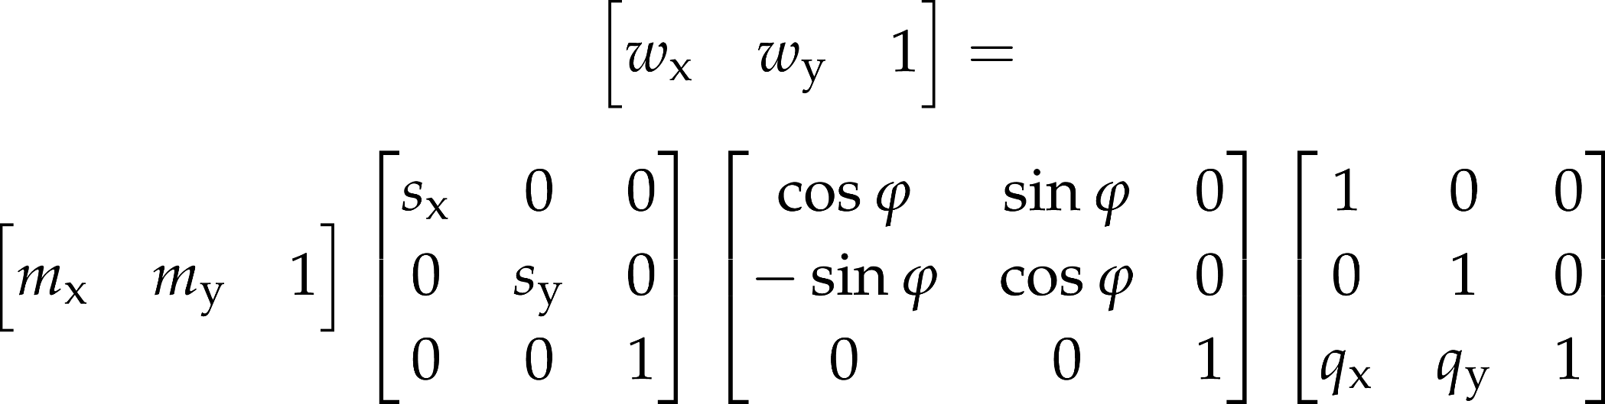
Constructing a model transformation
from
vertex
buffer
Notes:
When we are placing the object in the virtual world, we often want to think about this in human-interpretable terms. The notions of size, orientation and position are straightforward. A model matrix for such a pose can be constructed as a concatenation of a scaling, a rotation, and a translation.
As scaling and rotation are wrt. the origin and the coordinate axes, the order of transformations is important. If we first rotate then scale, then the object will be not be scaled along its model space axes. If we first translate, then rotate, then the object will not be rotated in place, but it will orbit the origin.

Slide 6
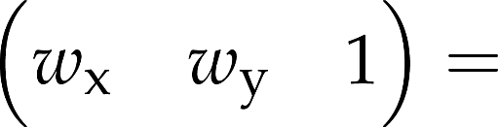
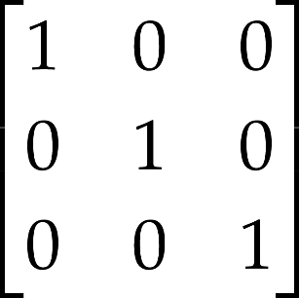
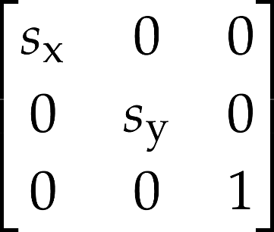
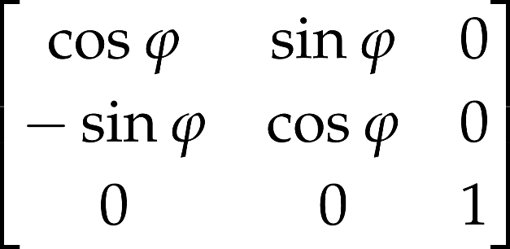
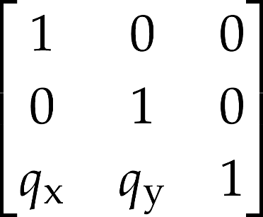
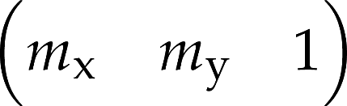
Constructing a model transformation
from vertex buffer
new Mat4()
.scale(sx, sy)
.rotate(phi)
.translate(qx, qy)
compose matrix on host
vector-matrix multiplication happens in the shader

Slide 7
View transformation – 2D camera, OrthoCamera
Where does this vertex go on the screen?
also:
What do I do with everything in the world, to get this part in particular on my screen?
1
1
Notes:
Screen projection maps the window rectangle, which is the camera in 2D, onto the viewport rectangle, which can be imagined as the photograph. This simple projection is usually executed in two steps, first transforming the window onto a normalized square, and then transforming the square to the viewport.
Transforming the window to a origin centered square of corners (-1,-1) and (1,1) is a sequence of three transformations: a translation that moves the bottom-left corner of the window to the origin; a scaling that modifies the window width and height to 2; a translation that moves the origin to (-1,-1). This is an affine transformation that can also be given as a matrix.
Transformation of the origin centered square to the viewport is similar.

Slide 8
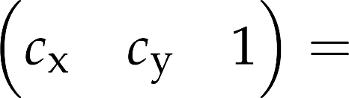
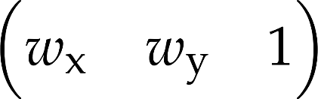


1
1

Slide 9

1
1

Slide 10
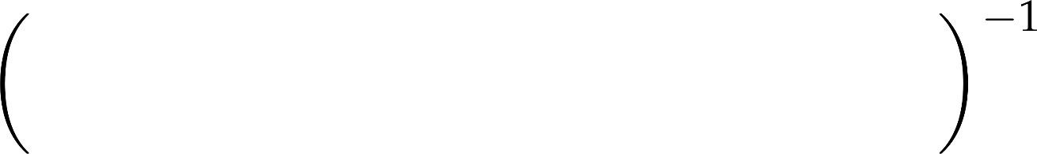
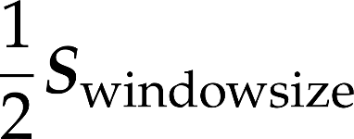


1
1

Slide 11
OrthoCamera
class OrthoCamera(vararg programs : Program) : UniformProvider("camera") {
val position = Vec2(0.0f, 0.0f)
val roll = 0.0f
val windowSize = Vec2(2.0f, 2.0f)
val viewProjMatrix by provided uniform Mat4()
init{
updateViewProjMatrix()
addComponentsAndGatherUniforms(*programs)
}
}

Slide 12
OrthoCamera:: updateViewProjMatrix
fun updateViewProjMatrix() {
viewProjMatrix.set().
scale(0.5f).
scale(windowSize).
rotate(roll).
translate(position).
invert()
}
fun setAspectRatio(ar : Float) {
windowSize.x = windowSize.y * ar
updateViewProjMatrix()
}

Slide 13
rajzolás kamerával
val camera = OrthoCamera(*Program.all)
gameObjects.forEach{ it.draw( camera ) }

Slide 14
Scene
class Scene (
val gl : WebGL2RenderingContext) :
UniformProvider("scene"){
addComponentsAndGatherUniforms(*Program.all)
gameObjects.forEach{ it.draw( this, camera ) }

