Slide 1
Limited effect of predators and generalist herbivores on plant-herbivore interaction networks in early successional vegetation in tropical rain-forest.

Slide 2
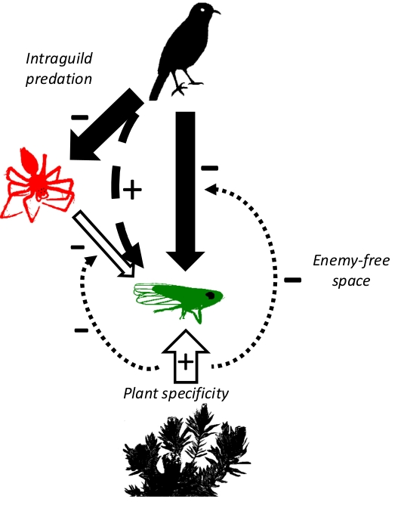
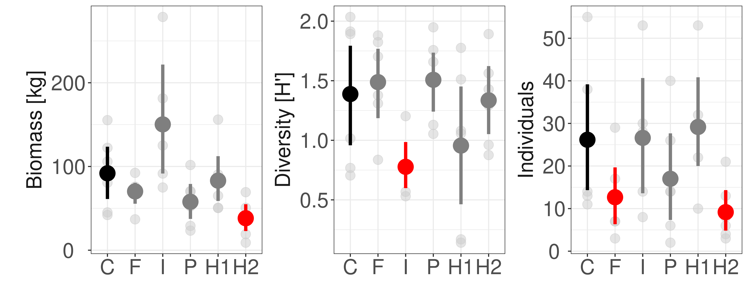
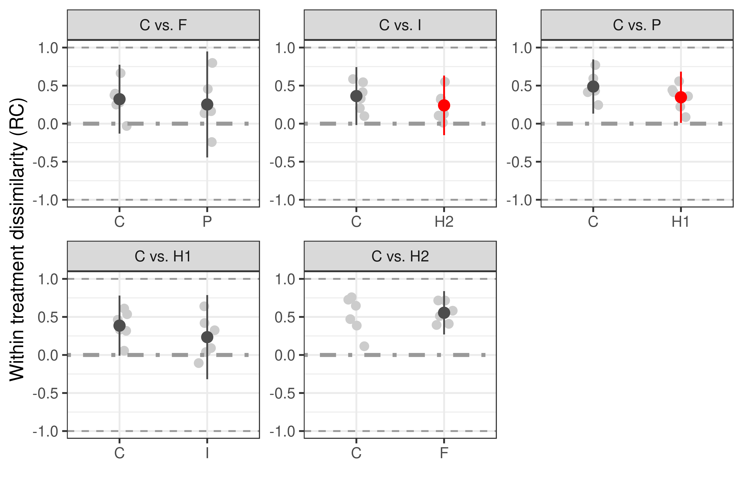

Slide 3
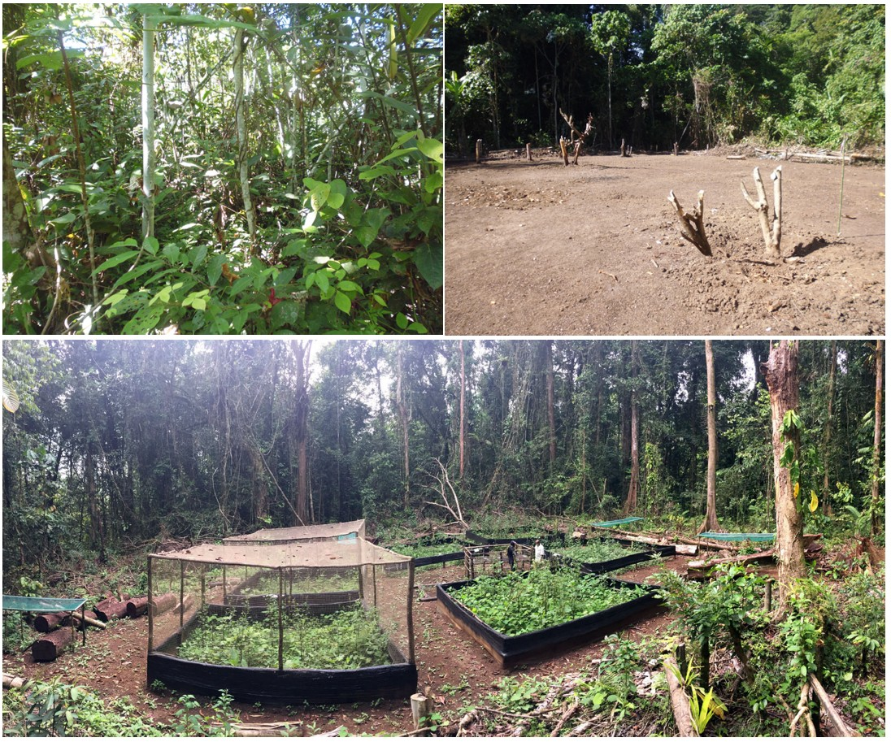
1. Control
2. Insecticide
3. Predator
4. Weevil25
5. Weevil125

Slide 4
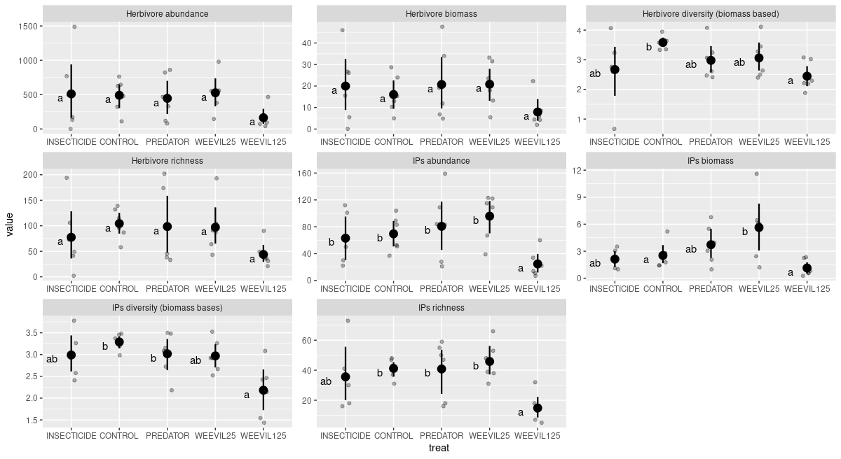

Slide 5
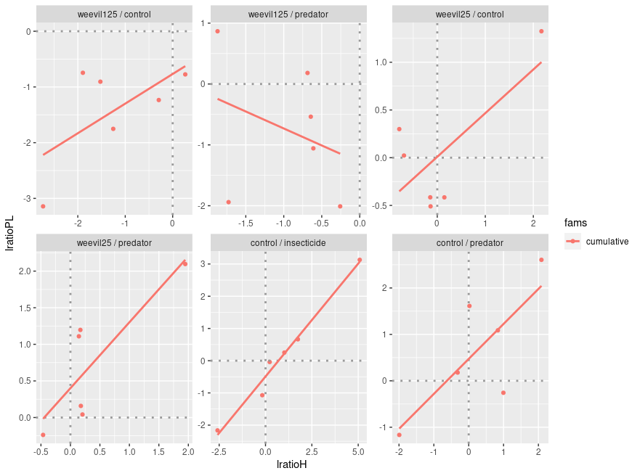

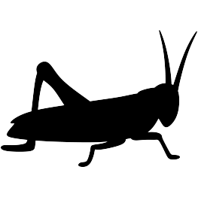

Slide 6
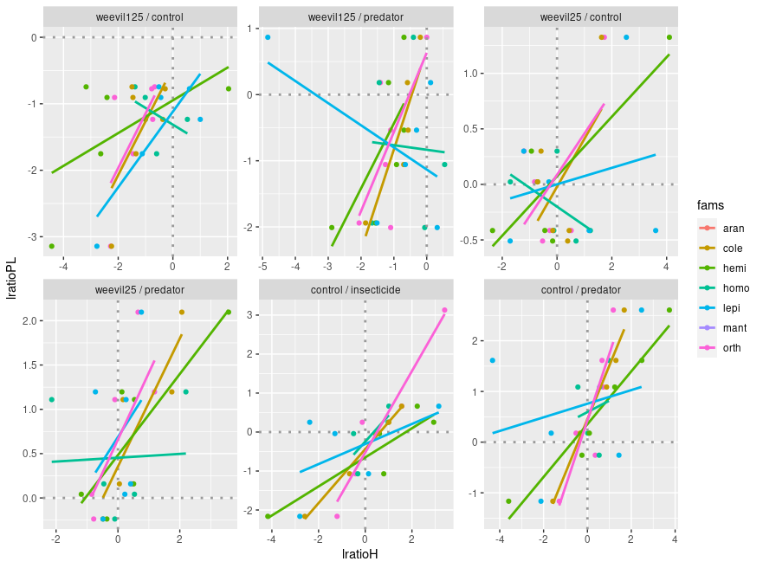
orders

Slide 7
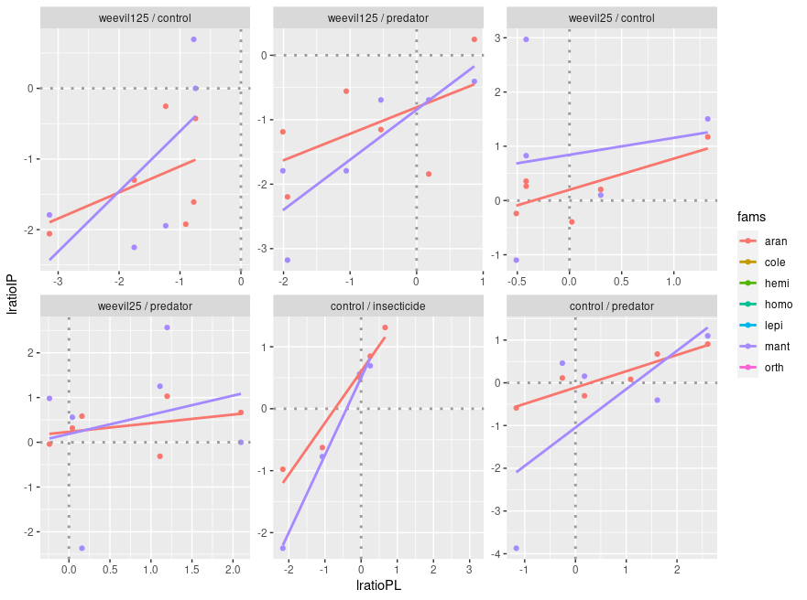
orders

Slide 8
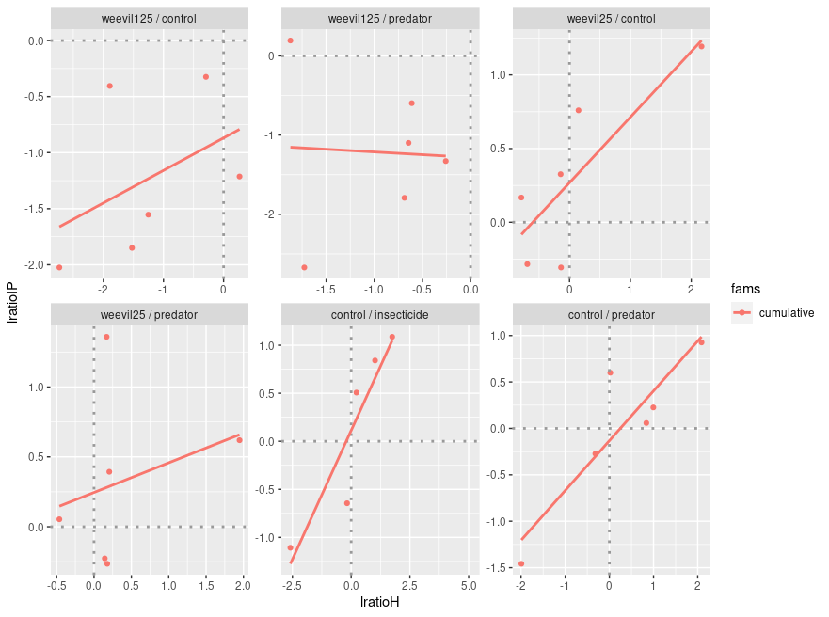
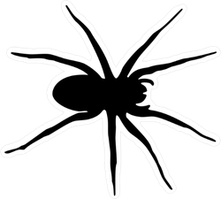

Slide 9
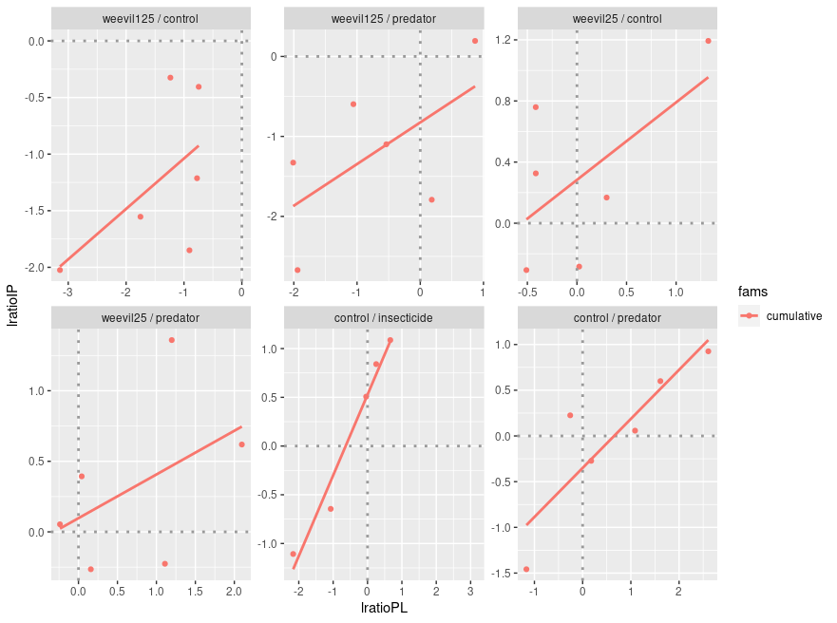

Slide 10
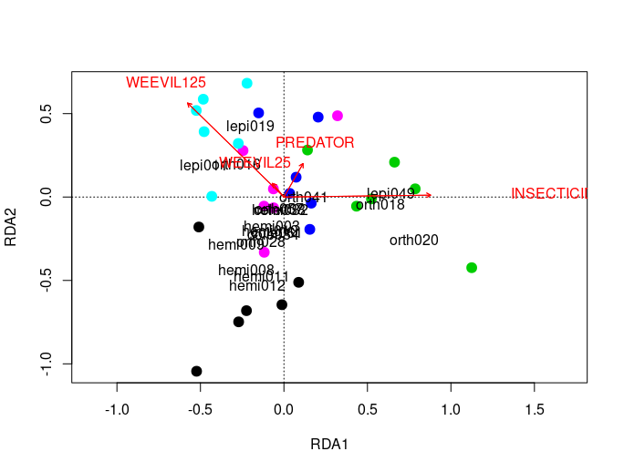
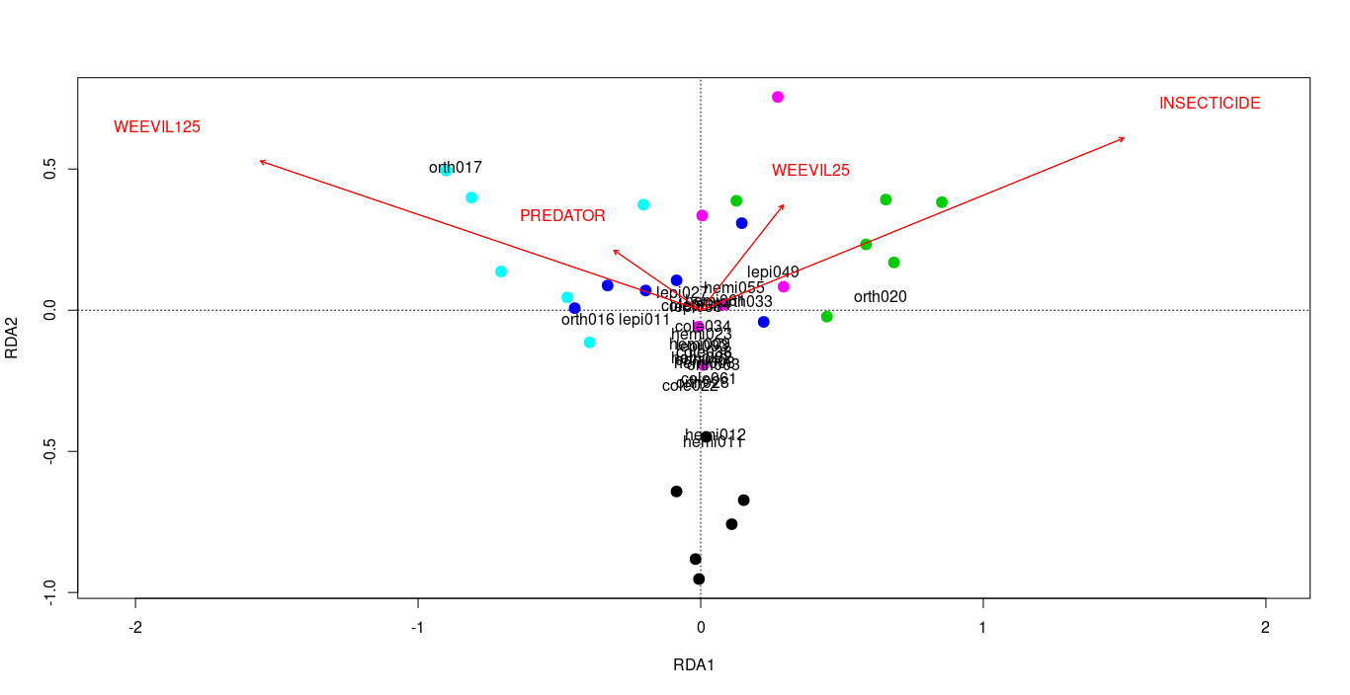
Abundance:
affected by insecticide
Biomass:
affected by weevil125

Slide 11
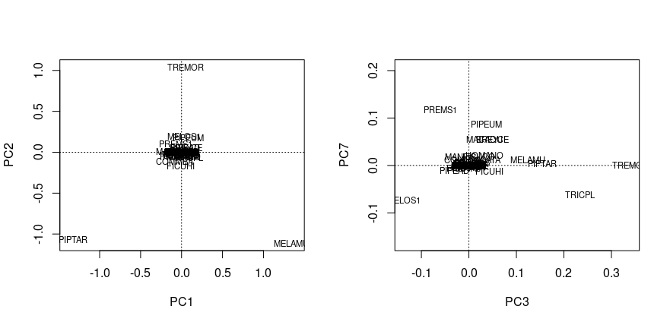
Plant community composition variability axes, significantly affecting herbivore community.

Slide 12
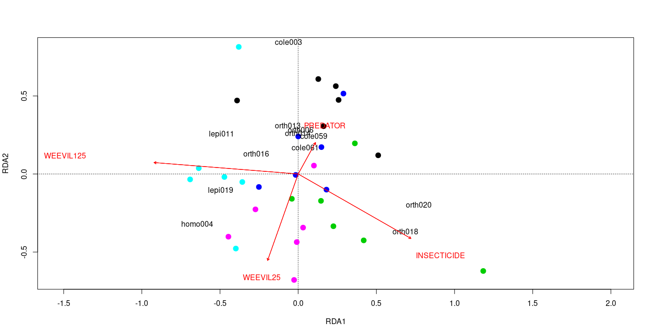
Herbivores: variability caused by plant community composition, IPs, and block was removed. For herbivores, this resulted in significance of both herbivore addition treatments.

Slide 13
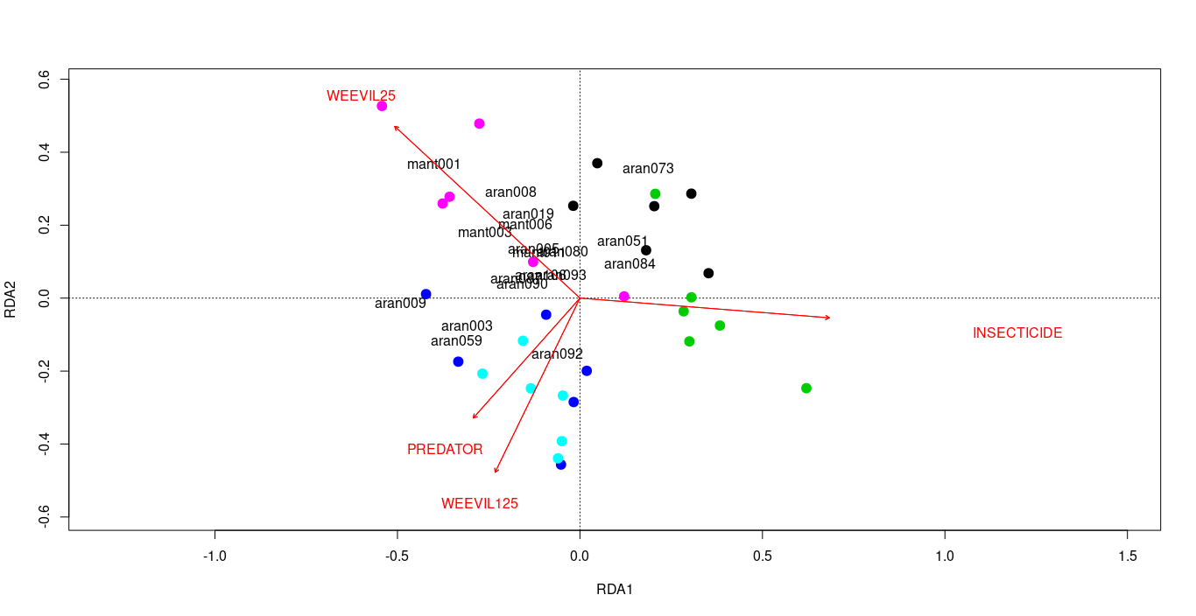
Intermediate predators: variability caused by plant community composition, and block was removed. This resulted in significance of lower herbivore addition treatment.

Slide 14
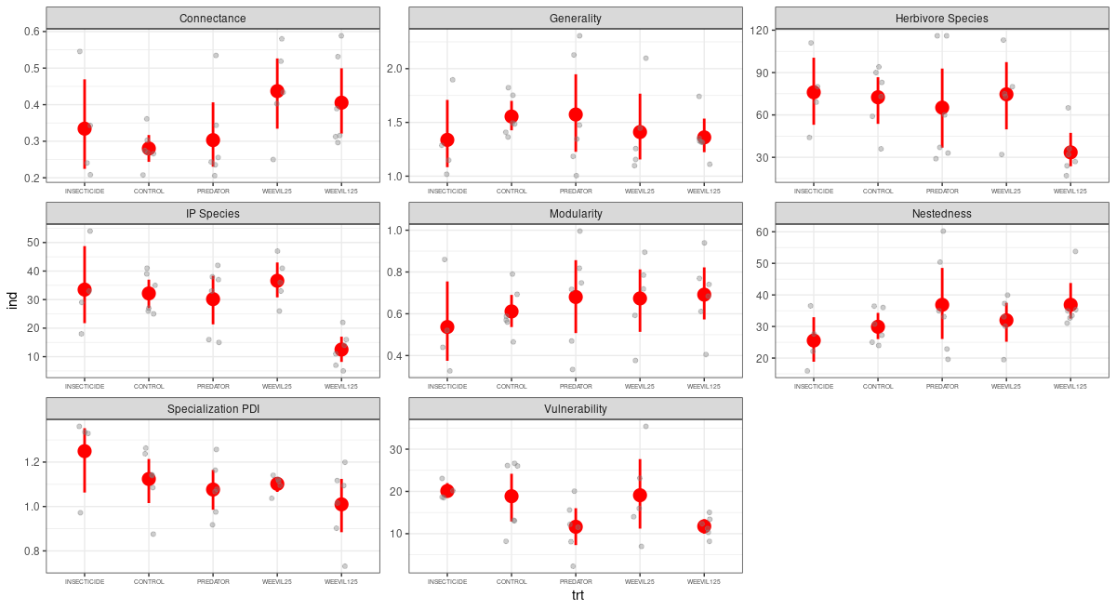
for the gradient
ns
ns
ns
cole001 was removed from all networks prior to the analyses
for the gradient

Slide 15
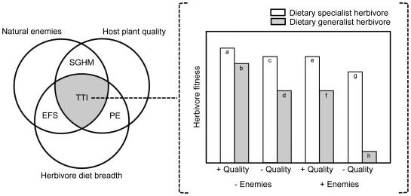
Specialization

Slide 16
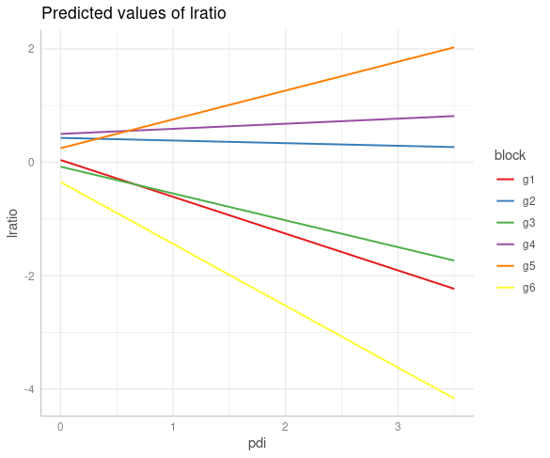
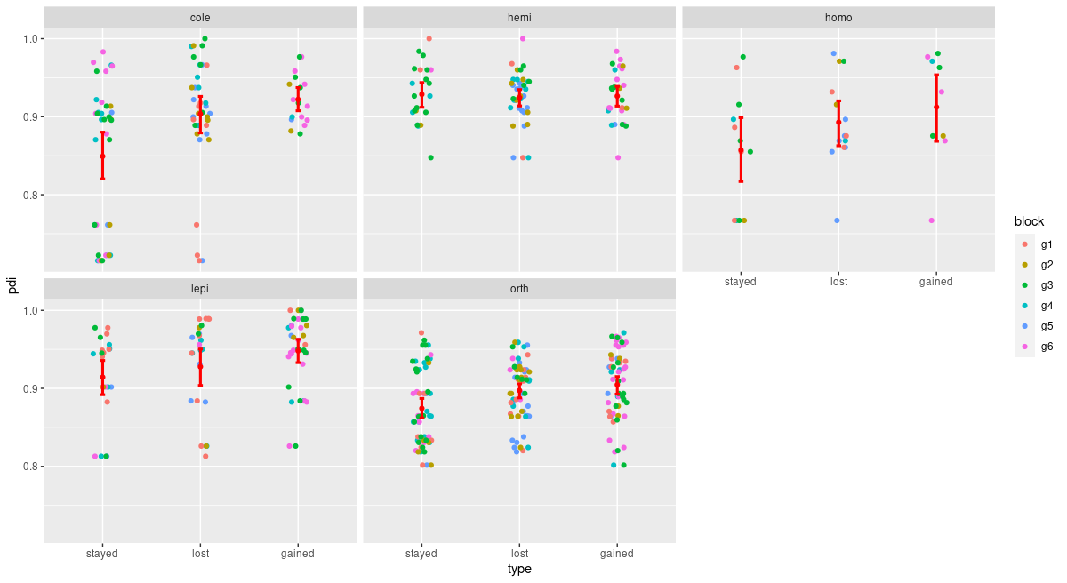
Exclosure

Slide 17
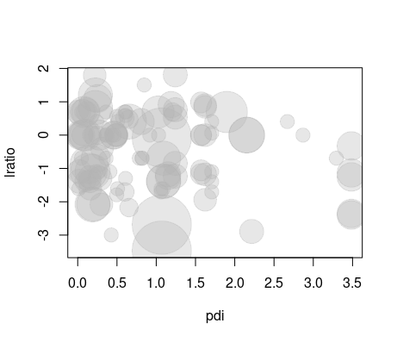
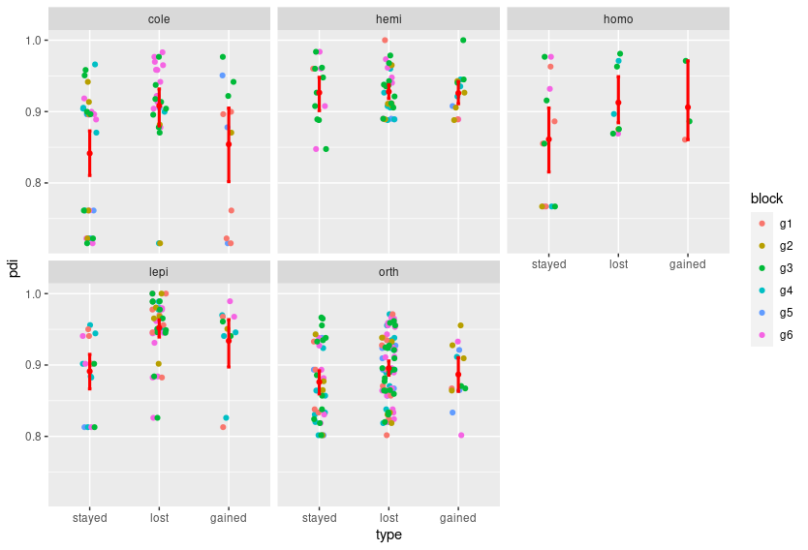
w125/control

