Slide 1
Predators have limited effects on plant-herbivore interaction network in early succession in tropical forest gaps

Slide 2
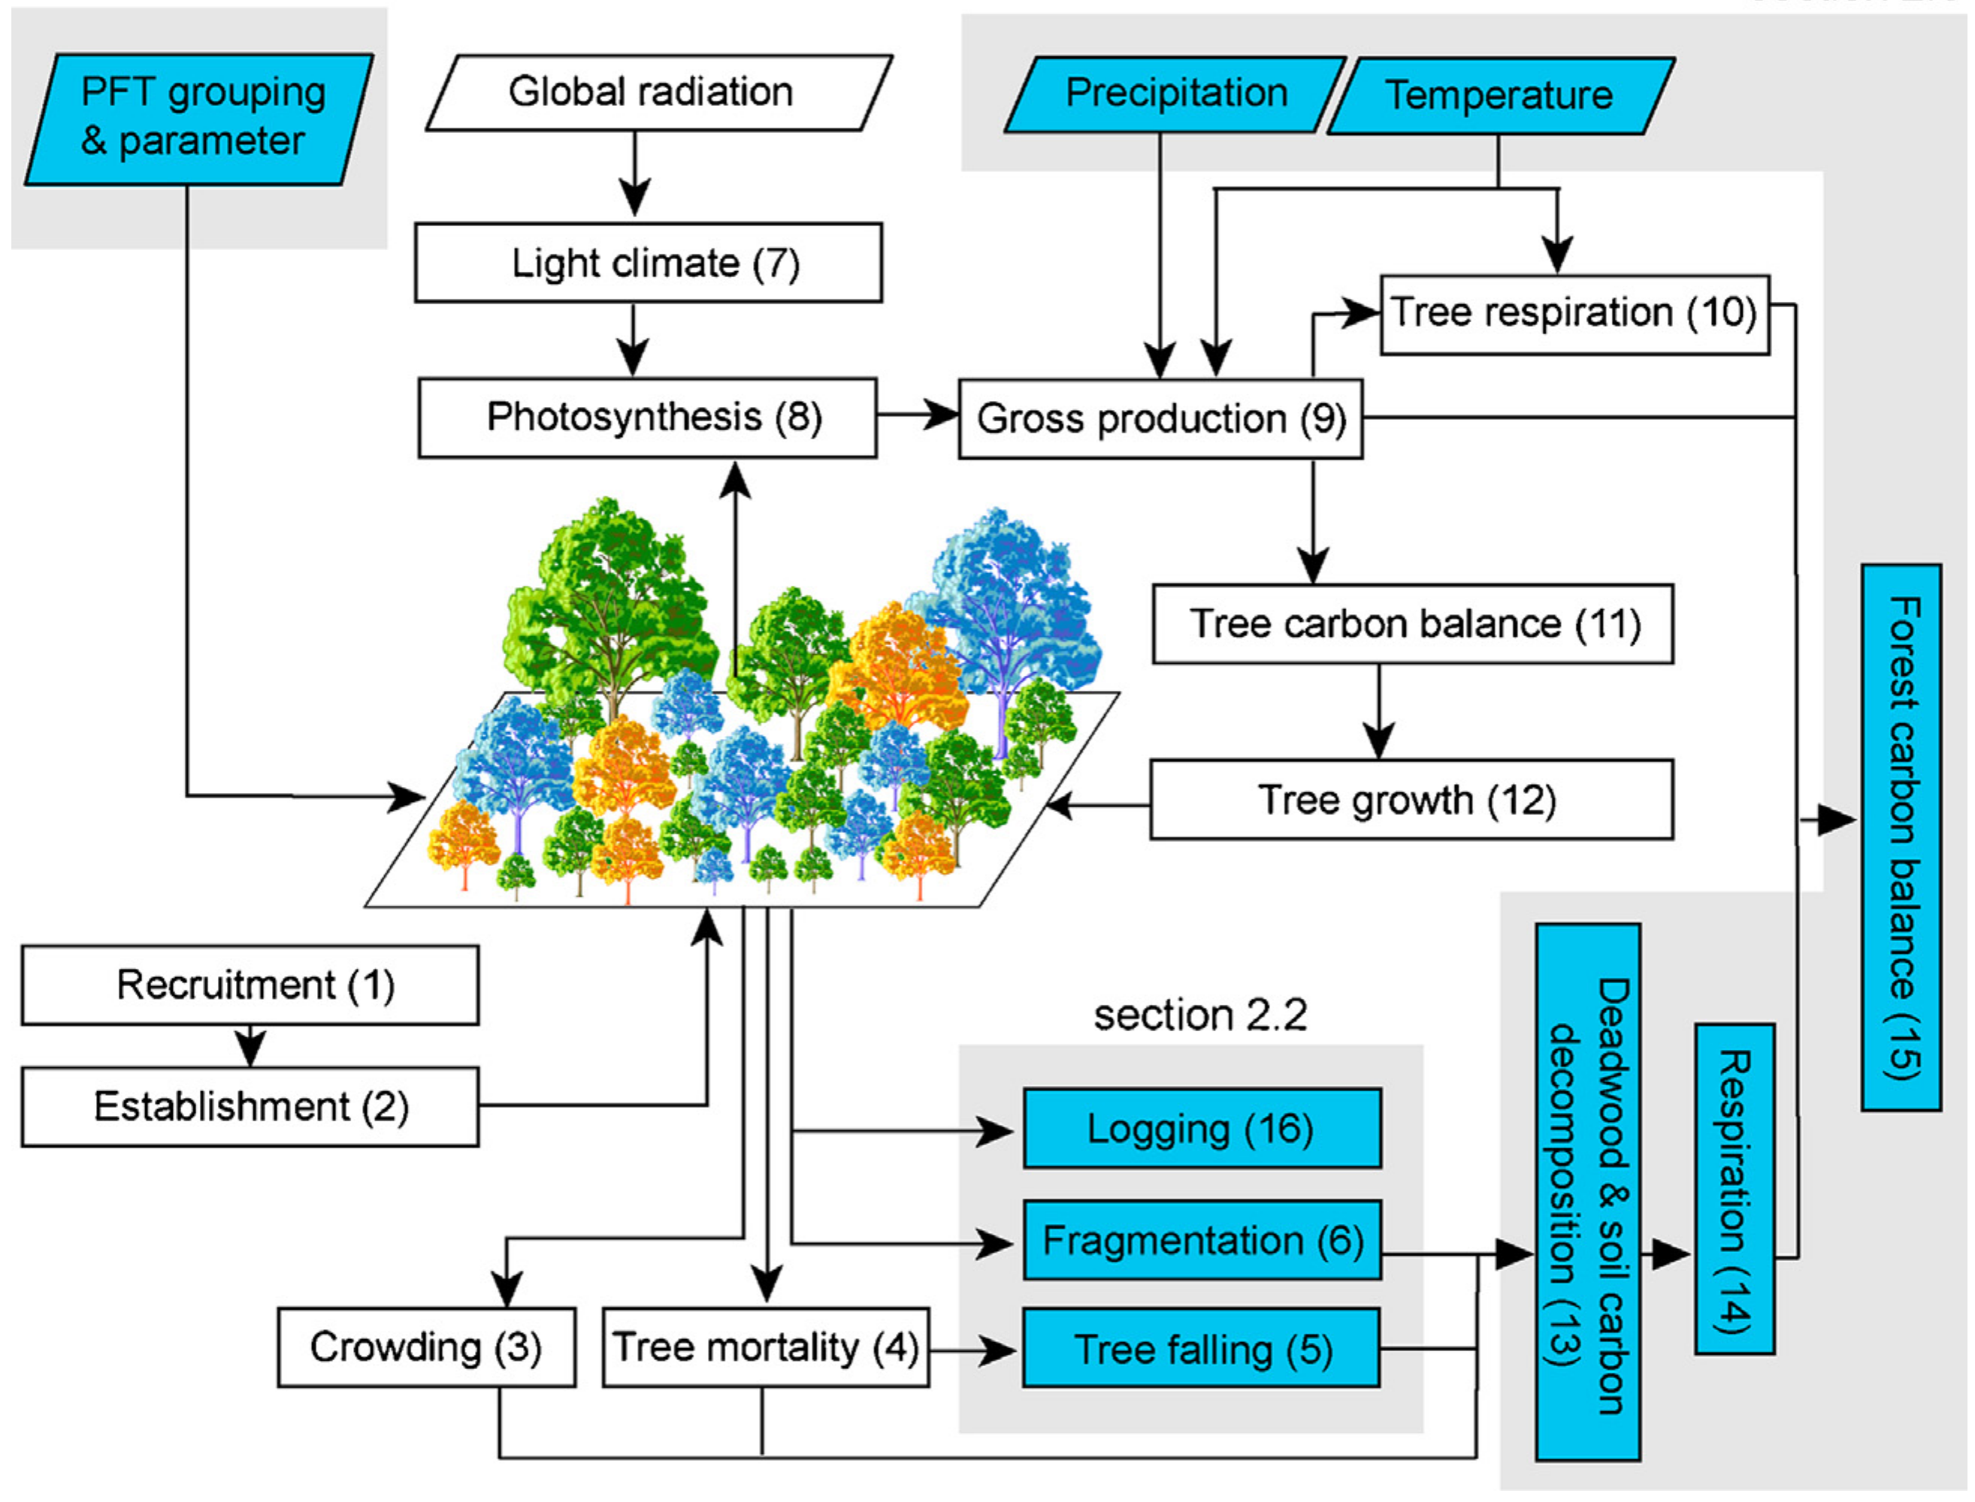
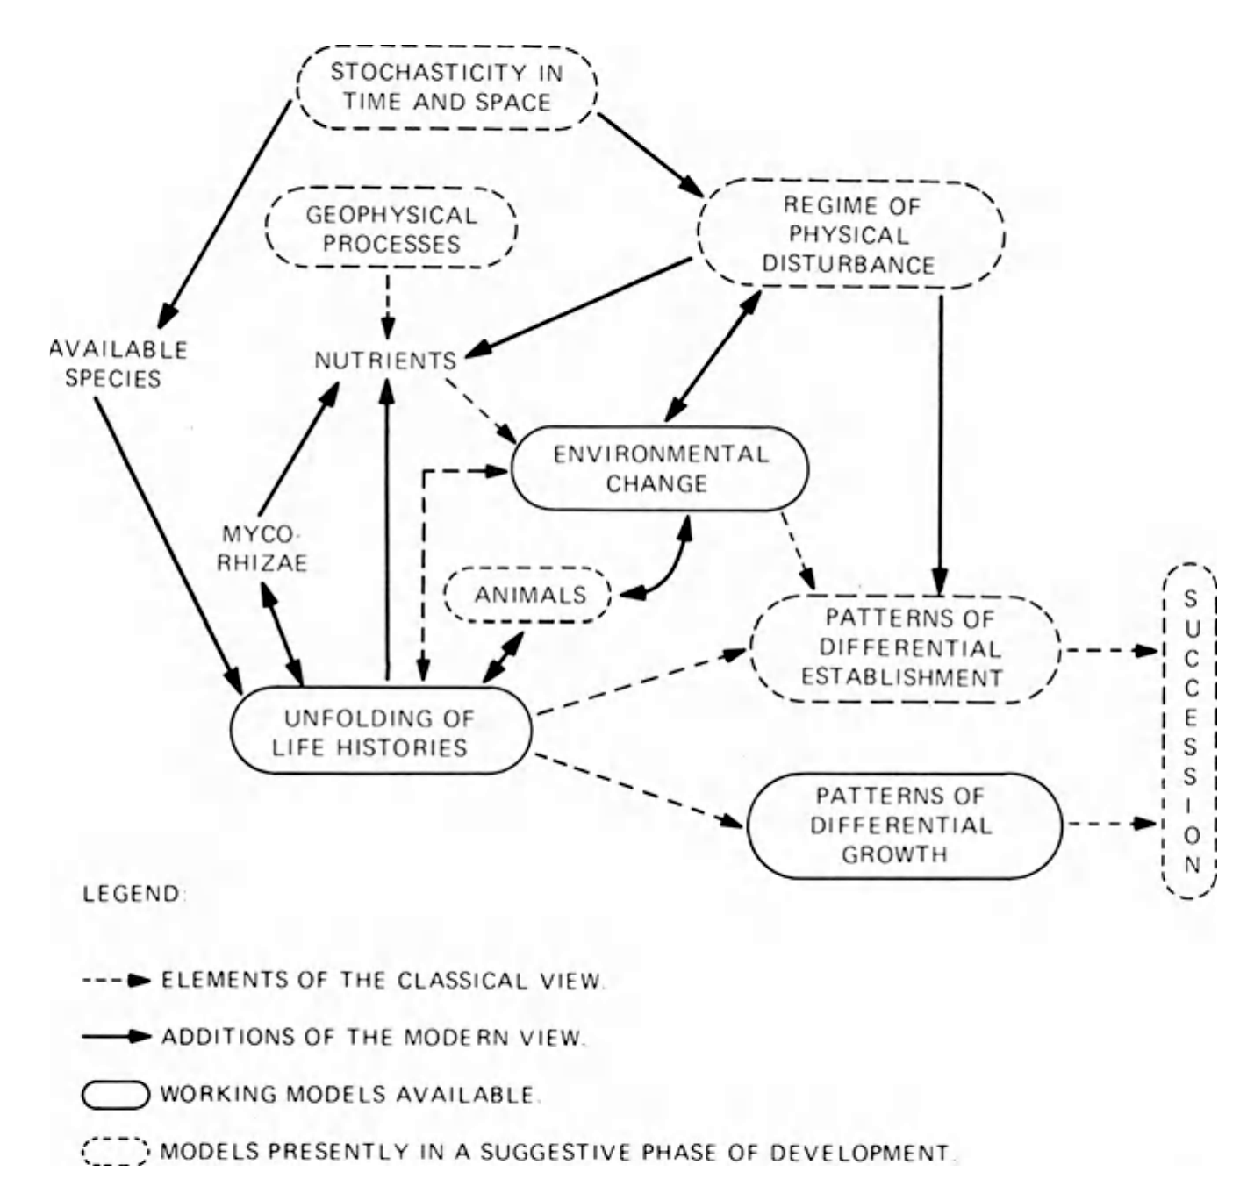

Slide 4
Modern approach
Traits and filters (from the introduction)

Slide 5
Competitive abilities p plants will ultimately be responsible for the successsional changes, but animals, natural enemies are important factors affecting successional process.
PSF examples
Herbivore examples

Slide 6
What about tropics?
But natural enemies were shown to be important in shaping diversity of primary tropical forest (Bagchi).
At the edges herbivores are more important (Krishnadas)
Predators are effective in tropical monocultures (...) and primary forests (Tvardikova)

Slide 7
Unpredictability
Our models reproduced the general successional trends observed, but high levels of noise were needed to increase model predictability
1.Norden, N. et al. Successional dynamics in Neotropical forests are as uncertain as they are predictable. PNAS 112, 8013–8018 (2015).

Slide 8
What do we expect in tropical forest gaps
Closely related plants sharing enemies
Traits related to fast growth, low defenses
Abundant, high quality food.
We previously showed weak casacading effects on plants, why? Compensation?

Slide 9
The tri-trophic interactions
Top down effects can be highly variable
In PNG early successional forests might be bottom-up controlled (), at least looking at the correlation patterns.
But birds have strong effects on herbivores (Tvardikova etc)
Bottom-up and top down are similar strength (Vidal and Murphy 2018)
Can we expect compensation?

Slide 10
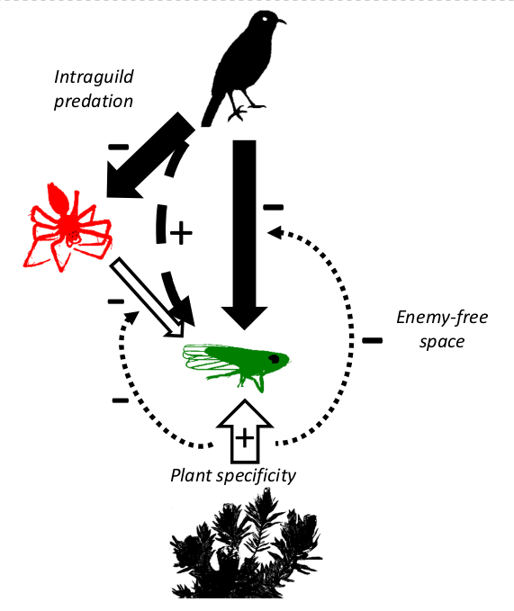
Compensation (explain how each would work and what patterns we would expect
IGP (what patterns)
Specialization (what patterns)
Food quality (pat)
Diet shift (patterns)
AP:H ratio explained

Slide 11
Experiment
Predator exclosure experiment

Slide 12
Methods
Make food web graphs (putative interactions)
Specialization
Plant traits

Slide 13
Results
Figure 1. Mean (points) and 95% bootstrapped CIs (whiskers) of the invertebrate herbivores (H) and arthropod predator (AP) community indices (A – no. of individuals, B – biomass in grams, D – inverse Simpson diversity, R – number of species, Dens – density [individuals/m2 of the leaf area]) in the control (C) and exclosure (Ex) plots. Grey points indicate empirical values for six experimental blocks, and dashed lines connect plots within blocks. Red color indicates significance at the α = 0.05, and yellow at the α = 0.1.

Slide 14
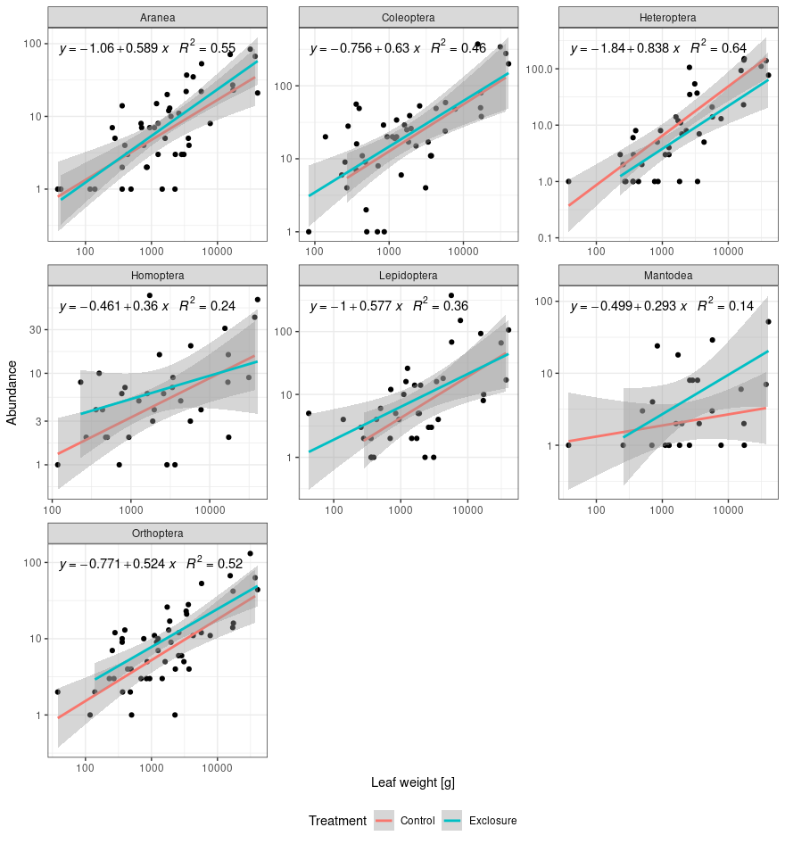

Slide 15
No change in community composition...Size changes

Slide 16
Figure 2. Relationships of predator (birds, bats and ants) effects on biomass between different trophic levels in individual plots: A – herbivores vs plants; B – herbivores vs arthropod predators (AP); C) herbivore orders vs plants, and D) AP divided into orders vs herbivores. Predator effects were evaluated using log response ratios (LRR): the logarithm of the ratio between the biomass at the control and predator exclosure treatment within the same experimental block. Positive/negative values of the LRR indicate increase/decrease in biomass of a given trophic level in the presence of predators. Solid line represents significance at the α = 0.05 level and dashed line at the α = 0.1 level. 95% CIs also plotted for significant relationships.

Slide 17
Figure 3. Pairwise Pearson correlations of the effects of birds, bats and ants on arthropod abundance between studied orders, Predator effects were evaluated using log response ratios (LRR): the logarithm of the ratio between the abundance at the control and predator exclosure treatment, within the same experimental block: LEPI – Lepidoptera; MANT – Mantodea; ORTH – Orthoptera; HETE – Heteroptera; COLE – Coleoptera; ARAN – Aarneae; HOMO – Homoptera. Significance is indicated with asterisks: P < 0.001 (***); P < 0.01 (**); p < 0.05 (*).

Slide 18
Figure 4. Mean (points) and 95% bootstrapped CIs (whiskers) for plant-herbivore network descriptors in control (C) and exclosure (Ex) plots. Grey dots represent empirical data. Dashed lines connect control and predator exclosure treatment plots within the same experimental block. Significance (α = 0.05) is indicated with the red colour.

