Slide 1
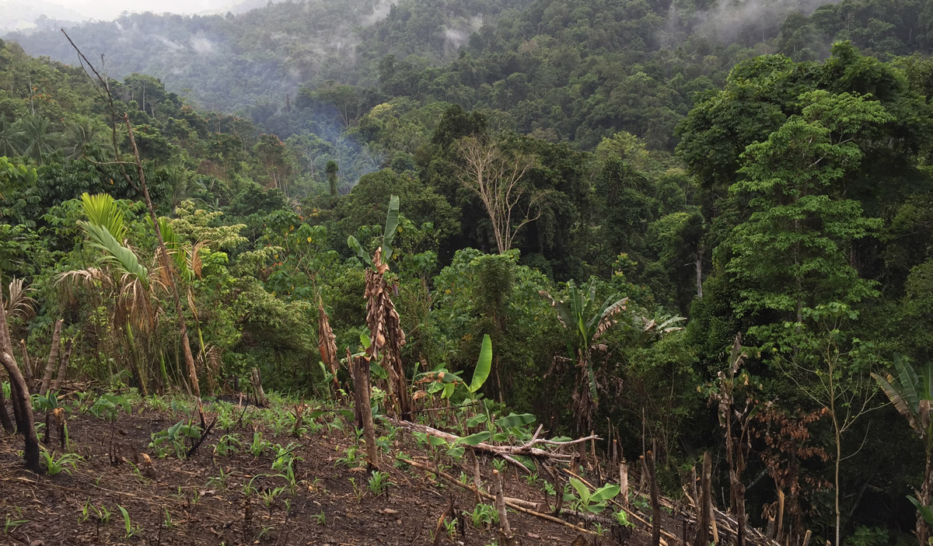
Predators have limited effects on plant-herbivore interaction network in early succession in tropical forest gaps

Slide 2
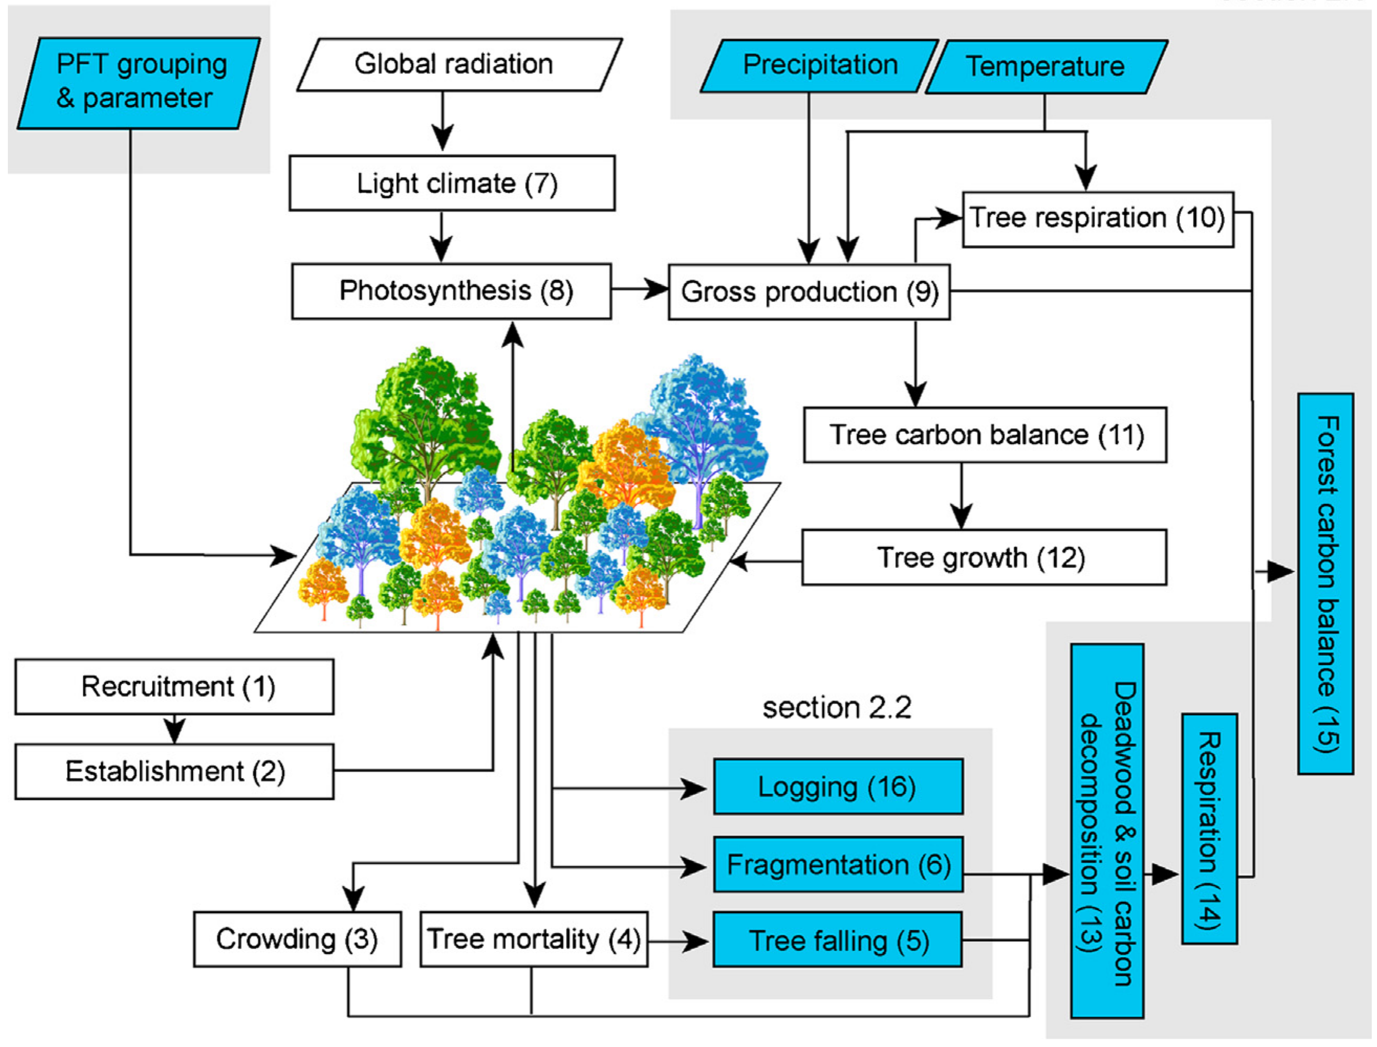
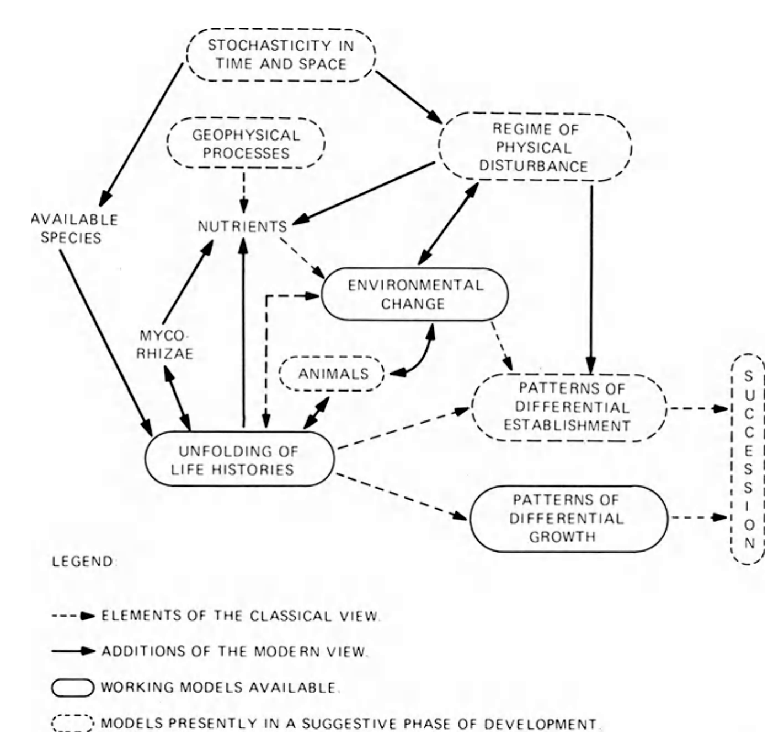
West et al. 1981. Forest Succession: Concepts and Application. (Springer-Verlag)
Fischer, R. et al. Ecological Modelling 326, 124–133 (2016).

Slide 3
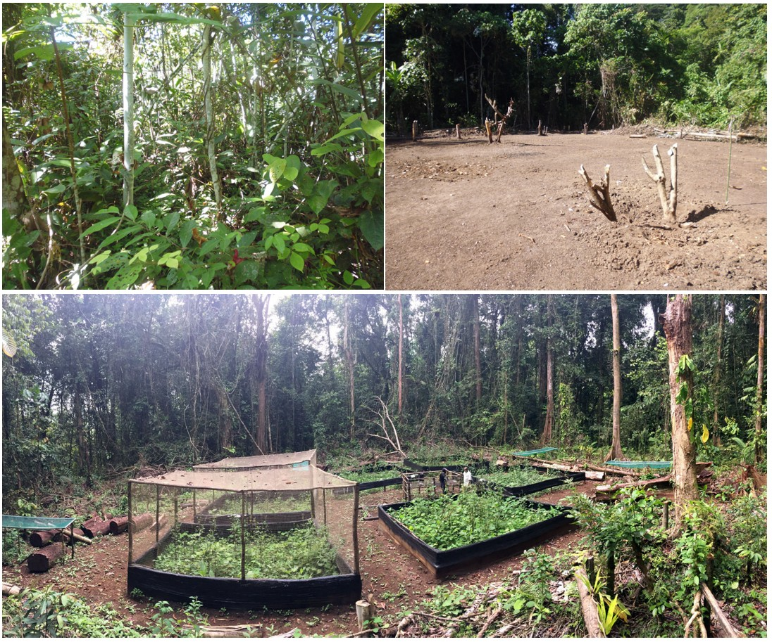
Increased
herbivory
Control
Fungicide
Birds, bats and ants
exclusion
Insecticide

Slide 4
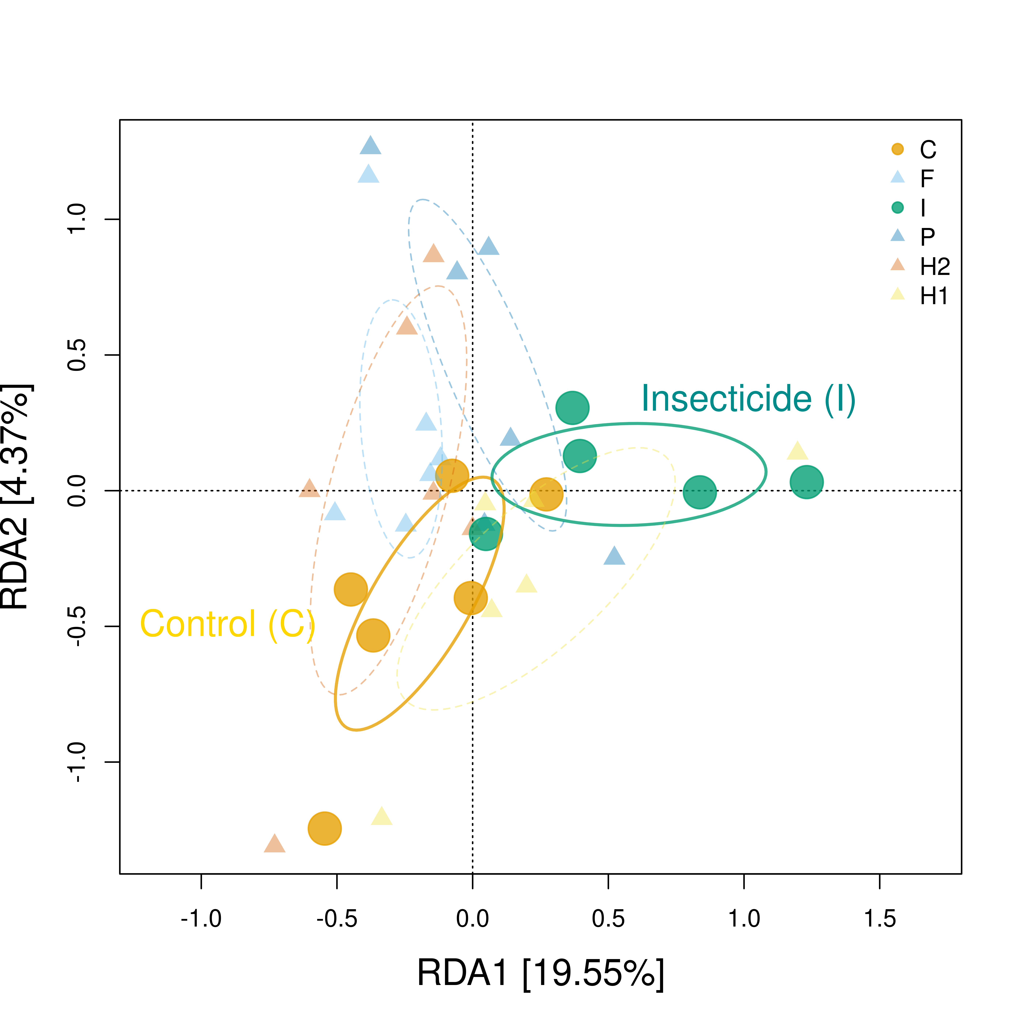
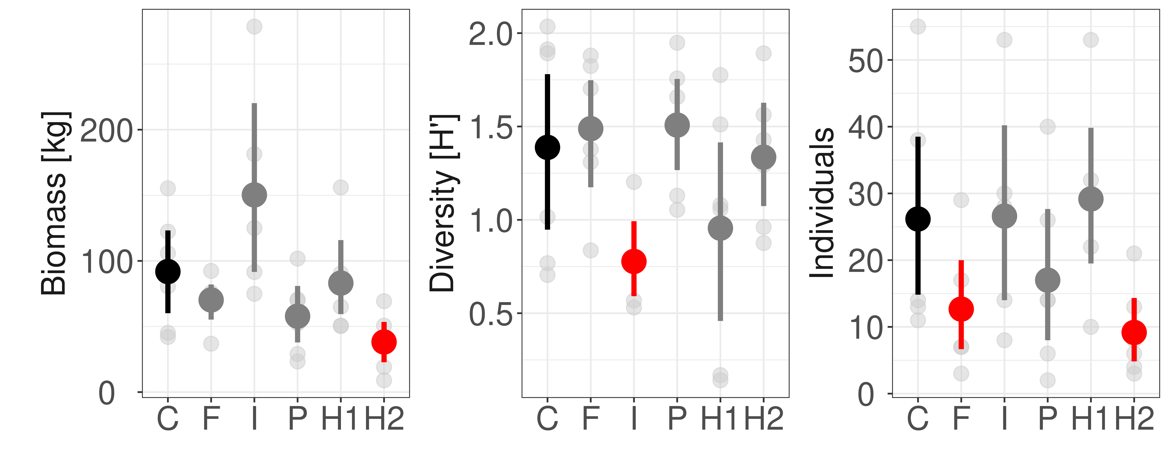
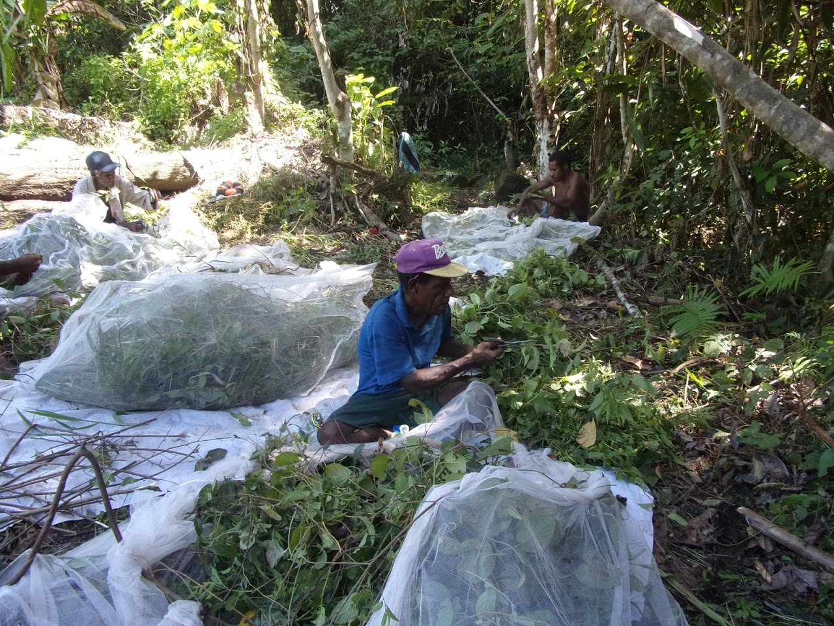
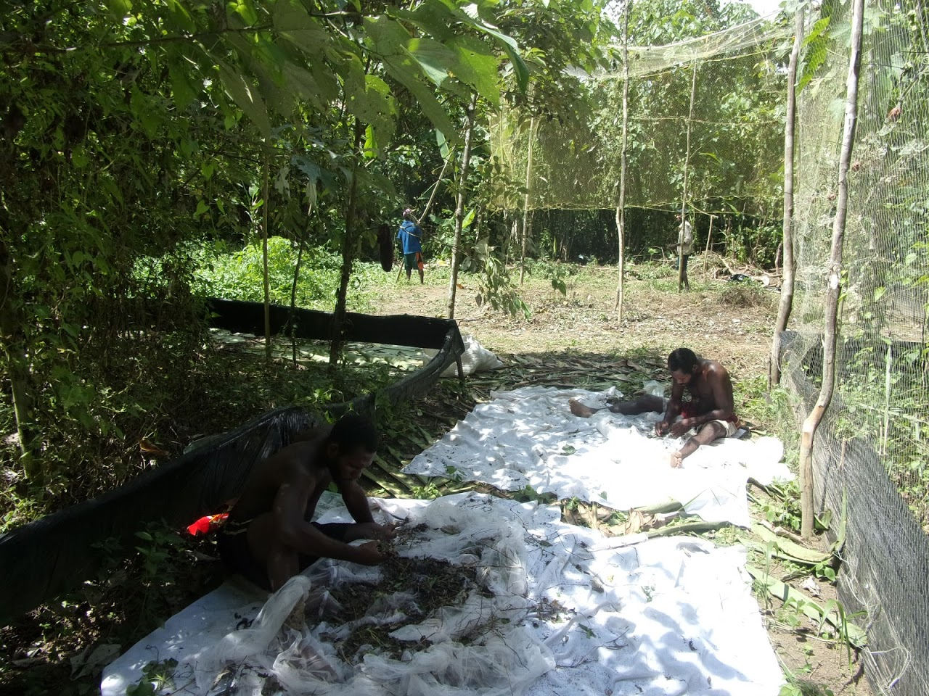

Slide 5
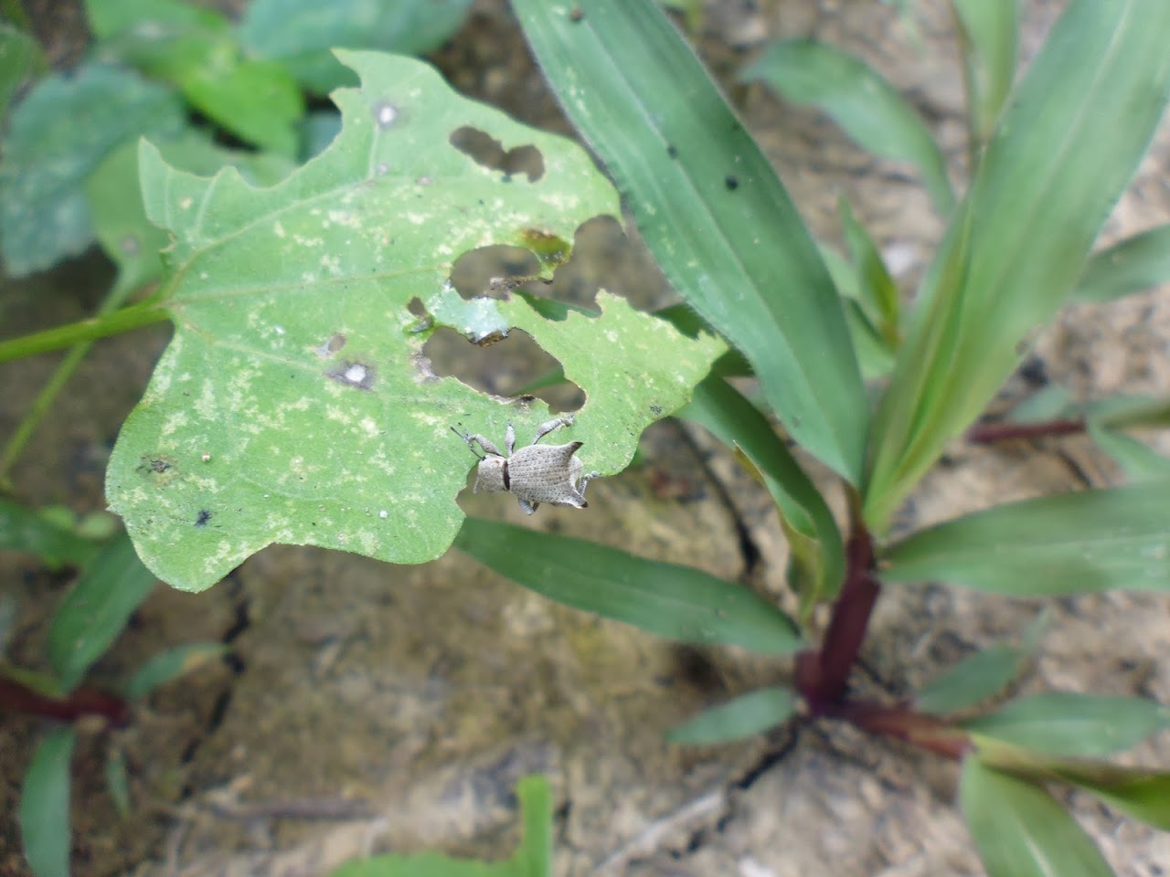
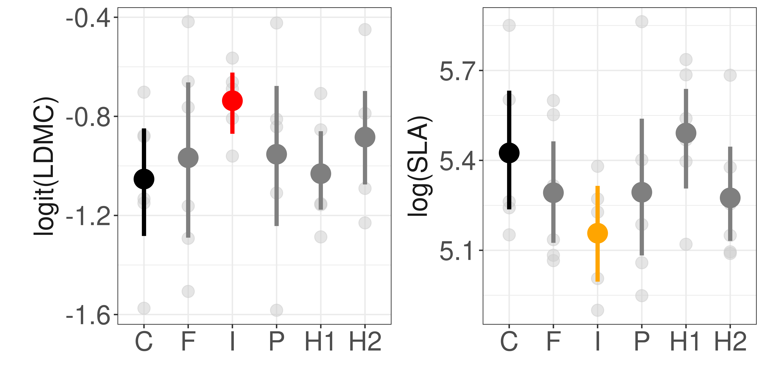
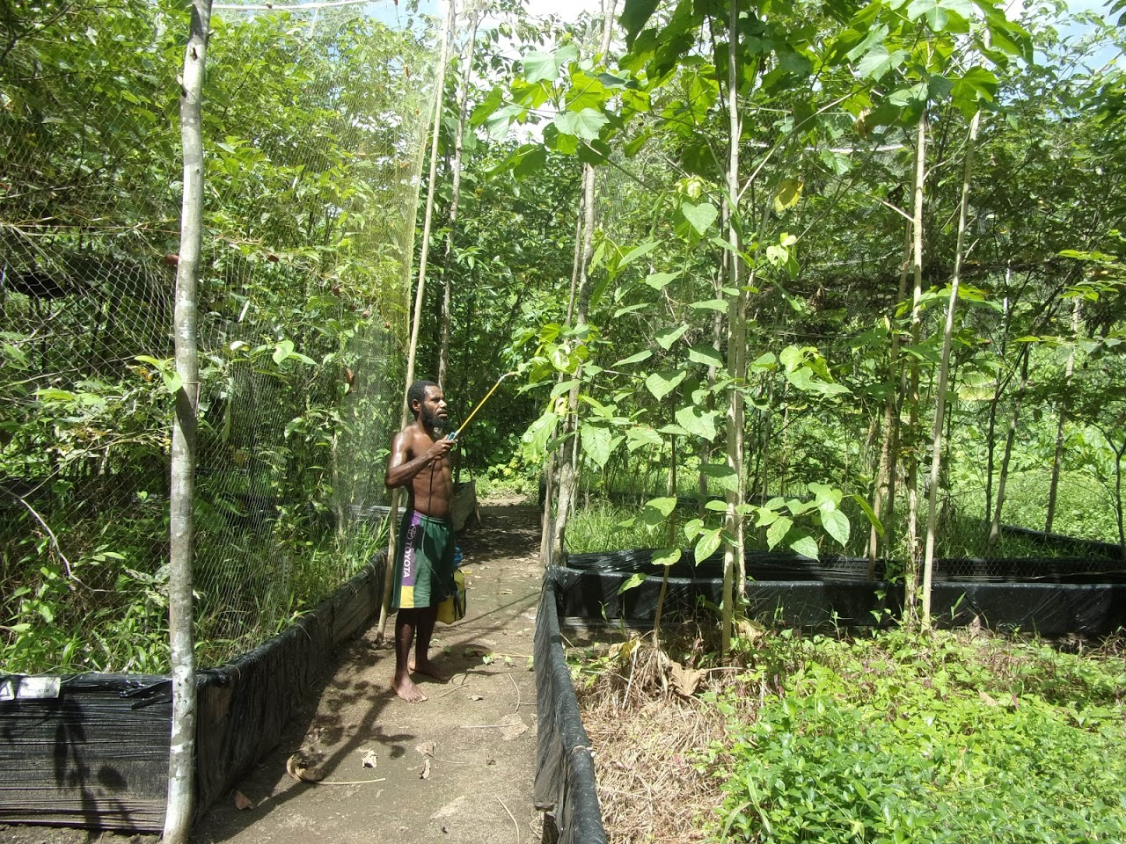
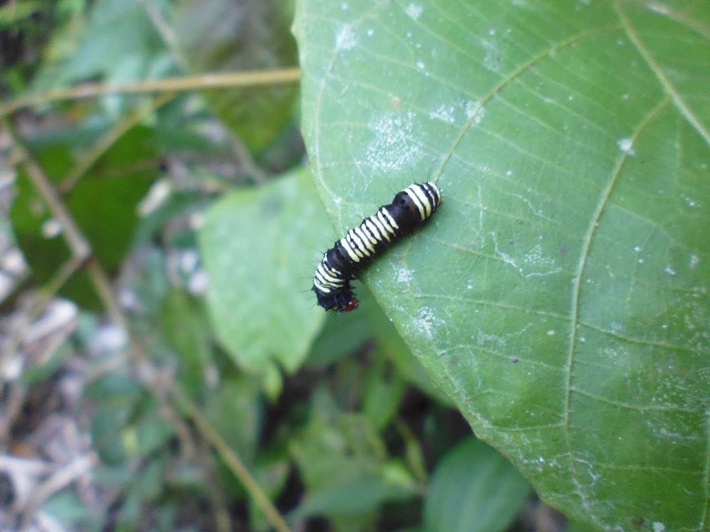
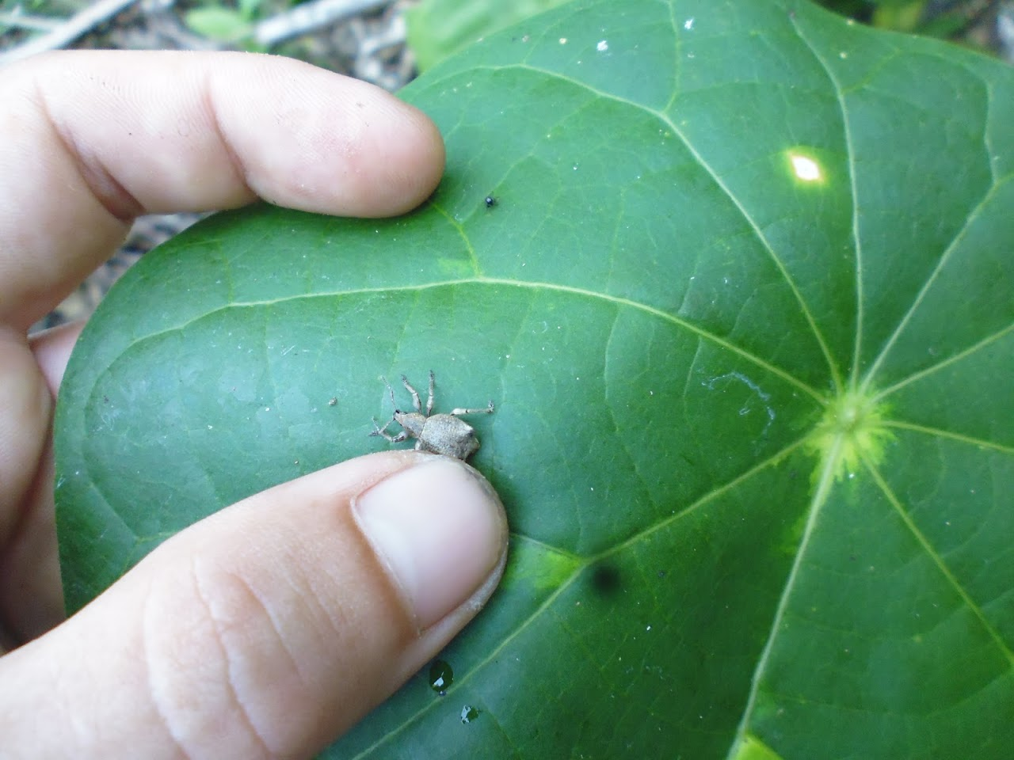

Slide 6
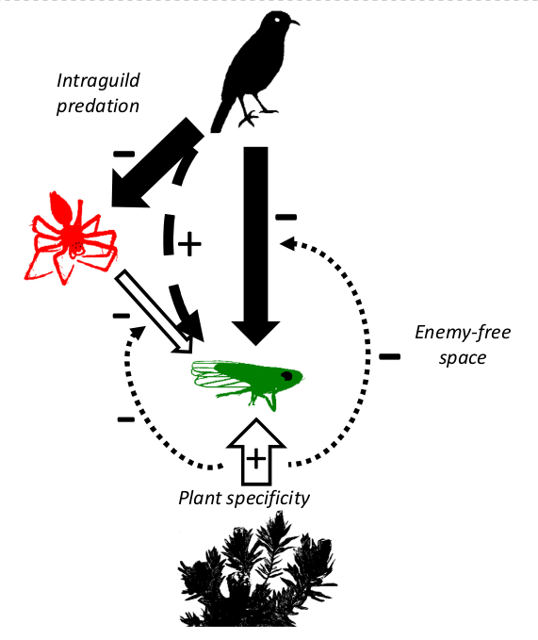
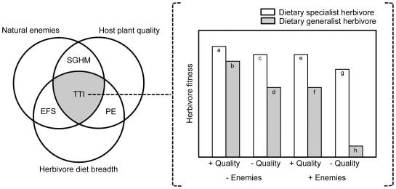
Mooney, K. A., Pratt, R. T. & Singer, M. S. 2012. PLOS ONE 7.
Bosc, C., Roets, F., Hui, C. & Pauw, A. 2018. Ecology 99, 1602–1609 (2018).

Slide 7
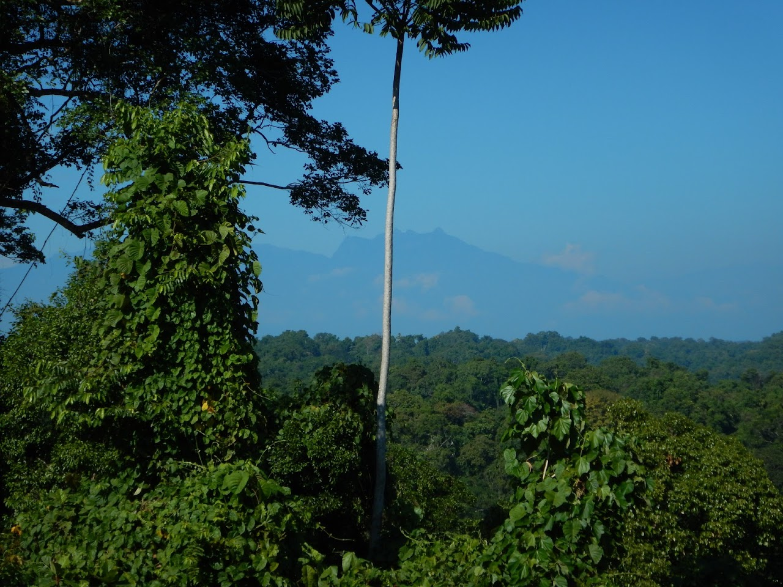
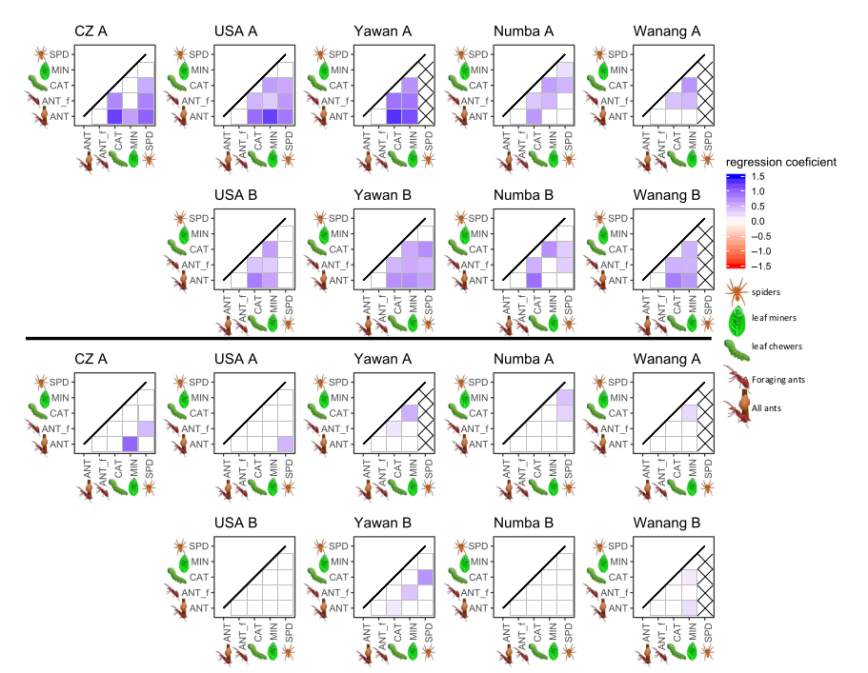
Mottl, O. et al. 2020. Ecology Letters 23, 1499–1510.

Slide 8
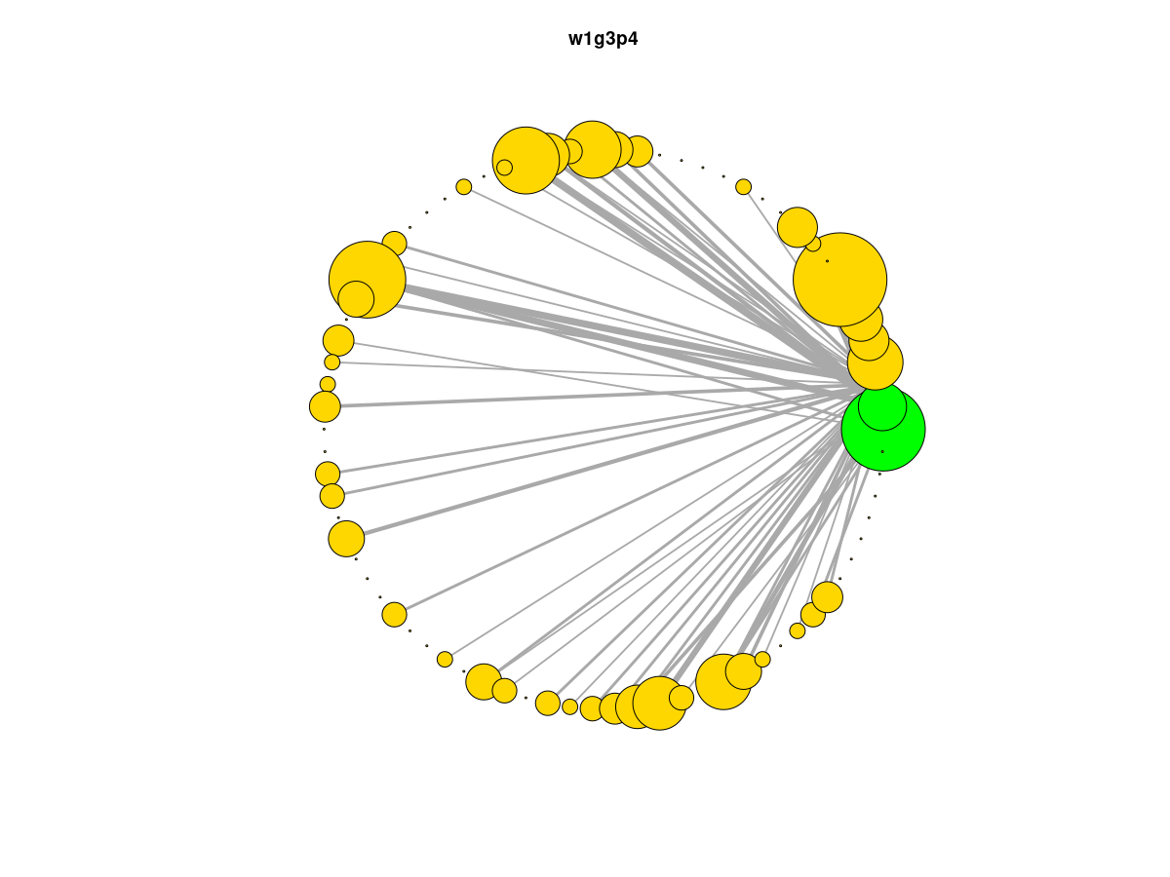
Specialization (Paired Differences Index):
sum(Pmax - Pi) /(Hpotential-1)
Plant traits: LDMC, water content, SLA
Effects, it is a log-response ratio (LRR):
log(Xcontrol (predators present)/Xexcosure (predators absent))

Slide 9
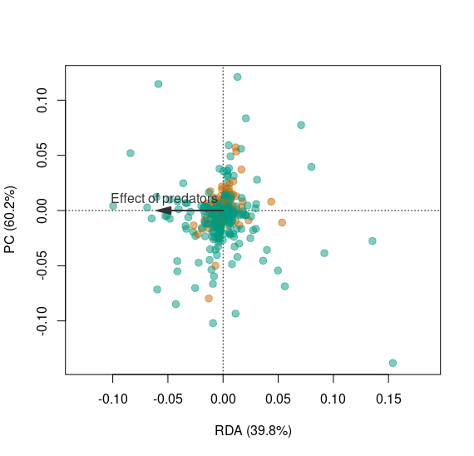
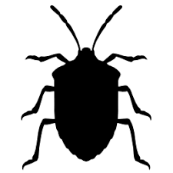
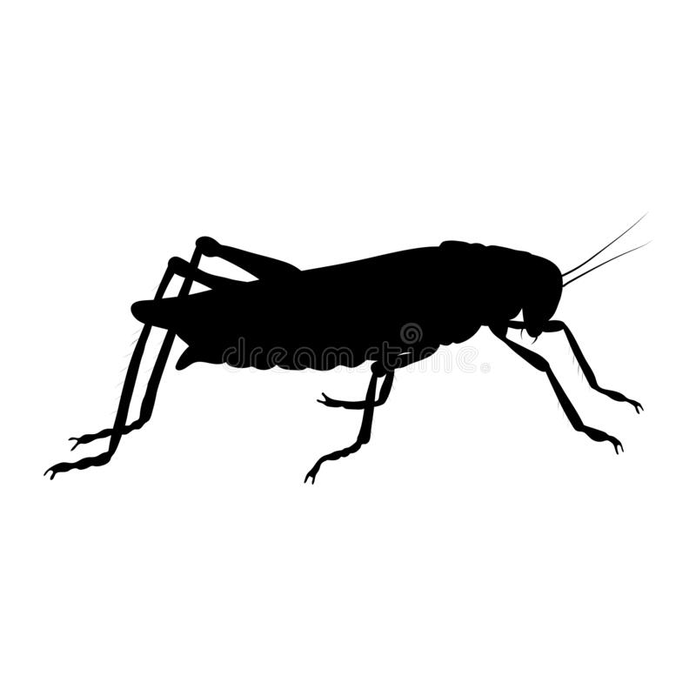
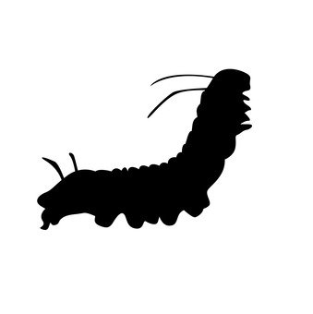
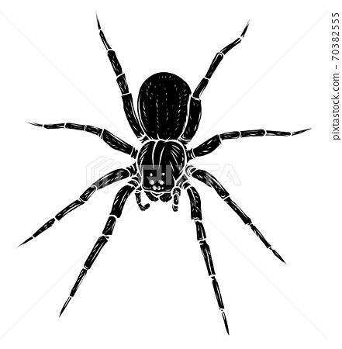


Slide 10
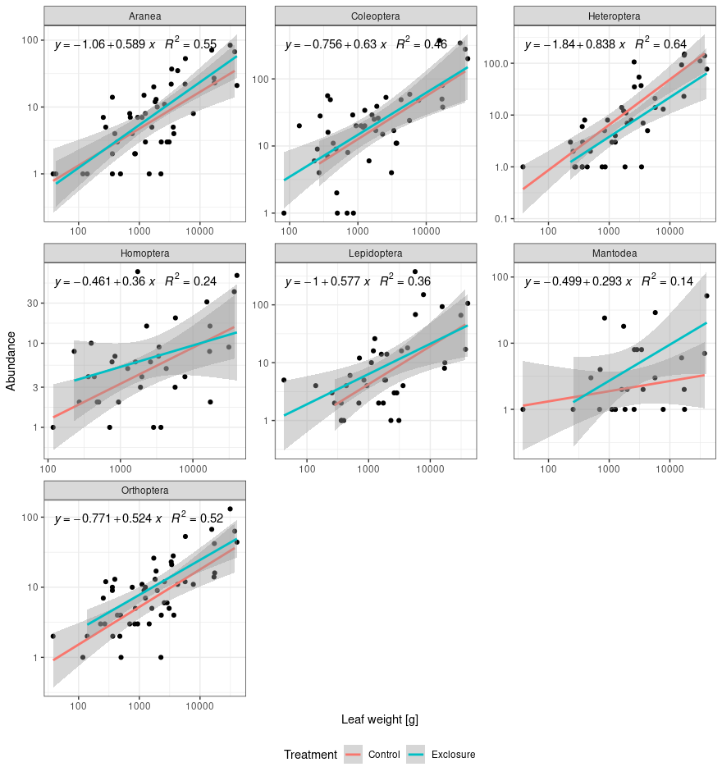
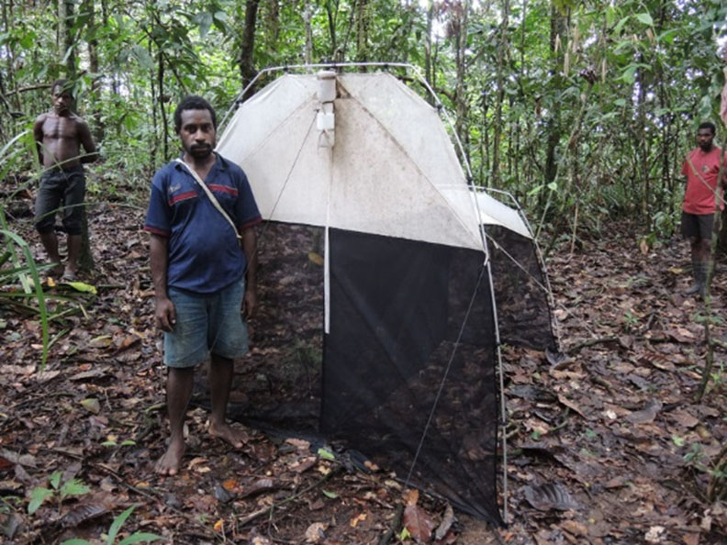
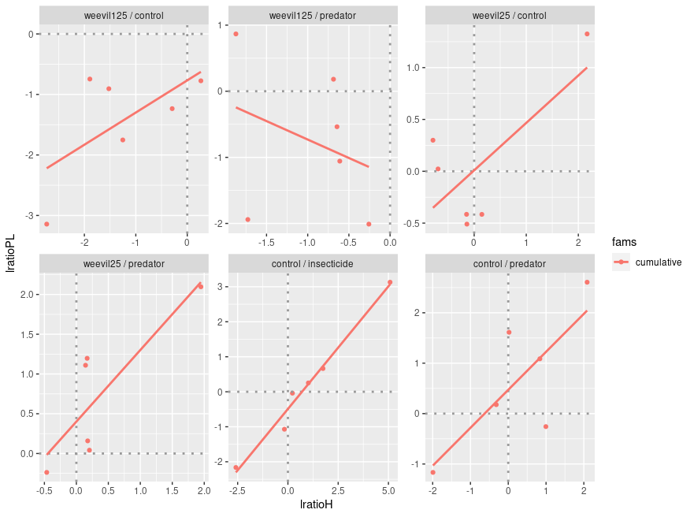

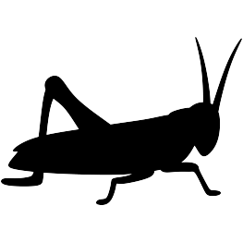

Slide 11
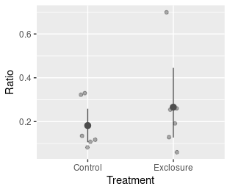

Slide 12
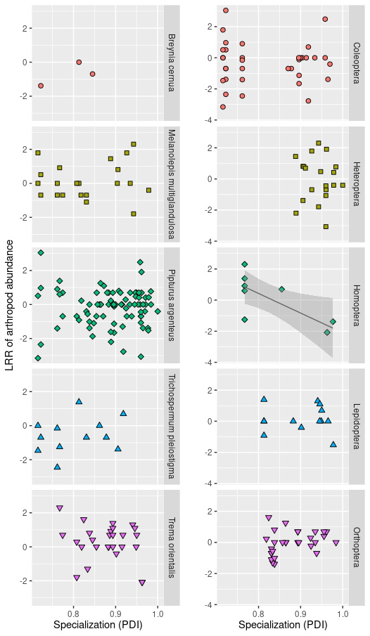
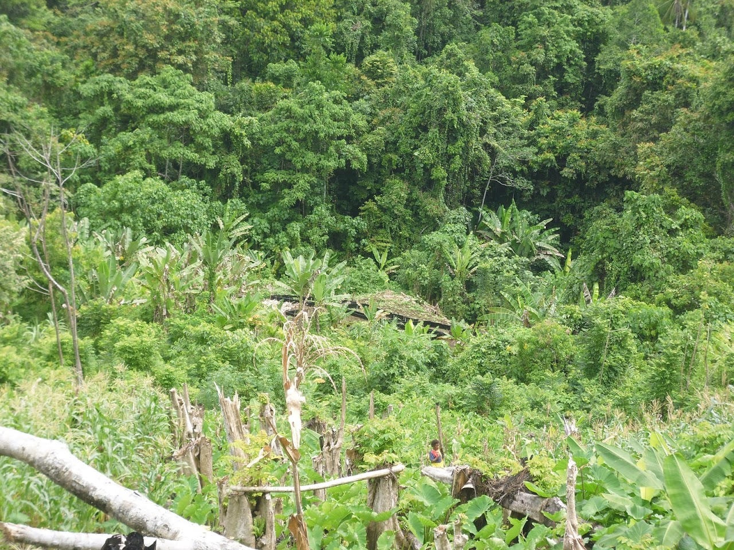

Slide 13
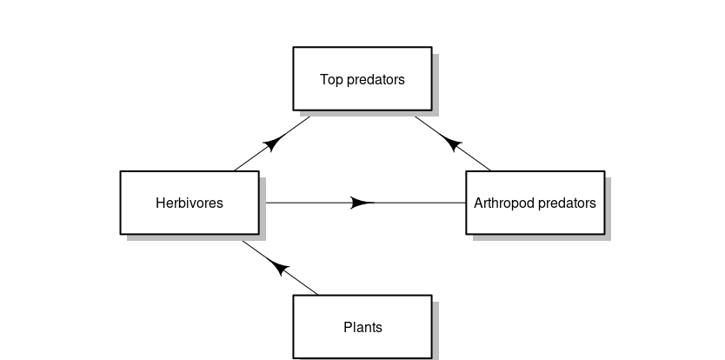
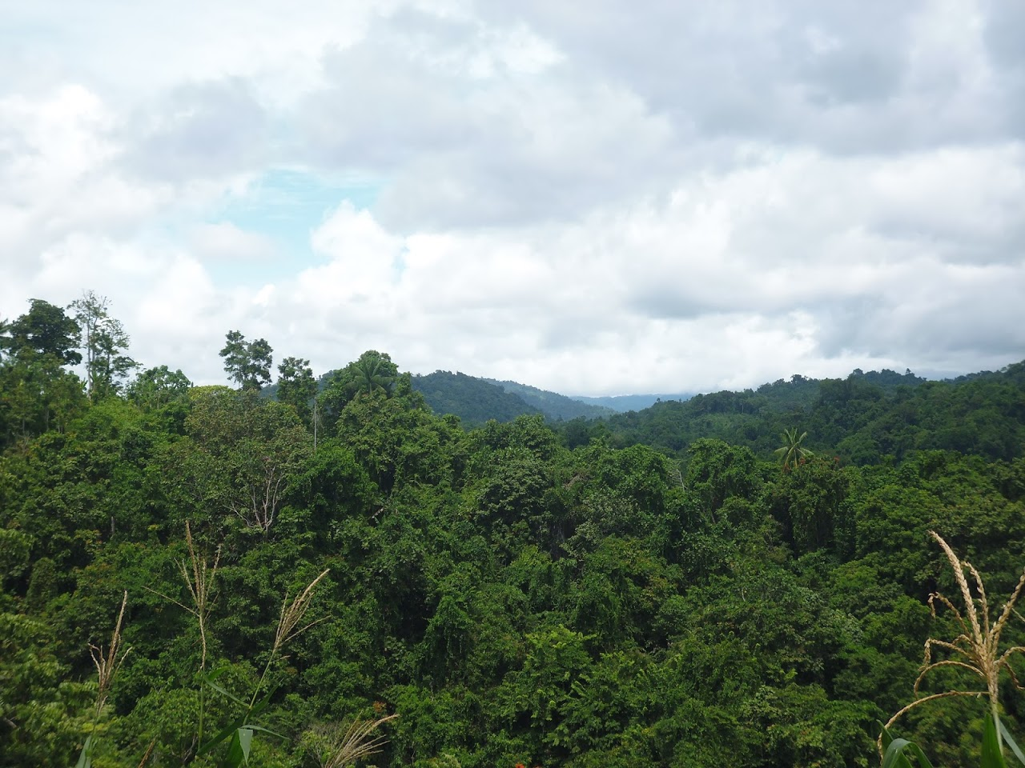

Slide 14


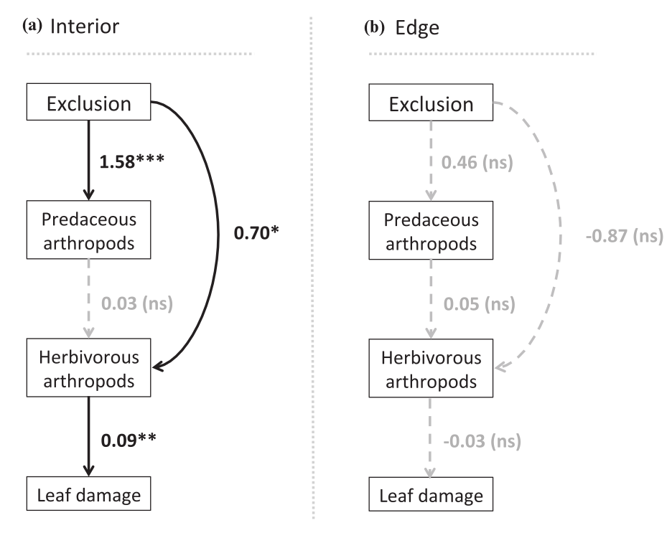
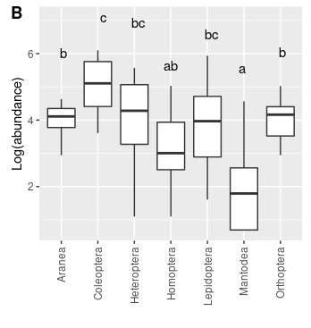
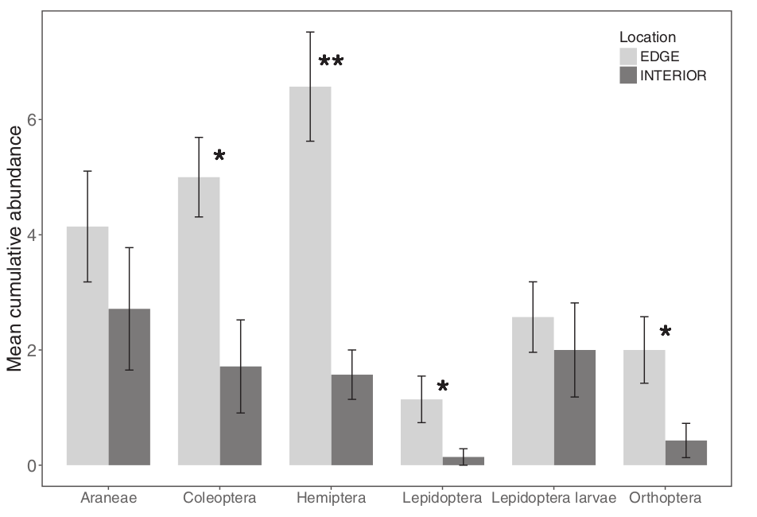
Harrison, M. L. K. & Banks‐Leite, C. 2020. Conservation Biology 34, 977–987.

Slide 15
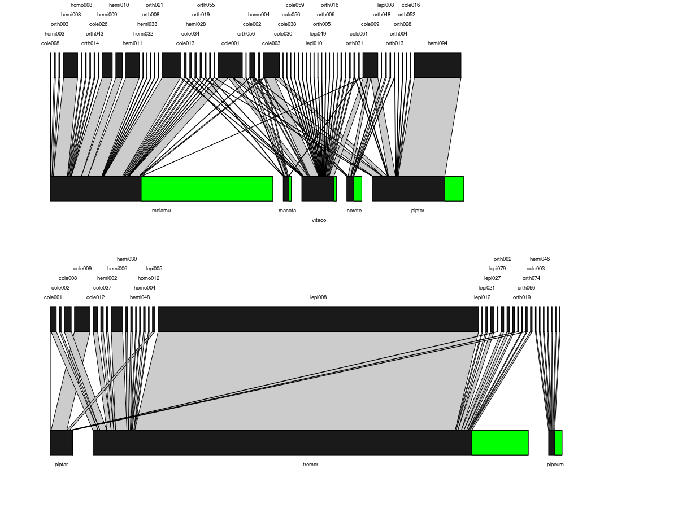
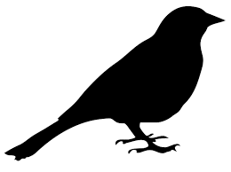
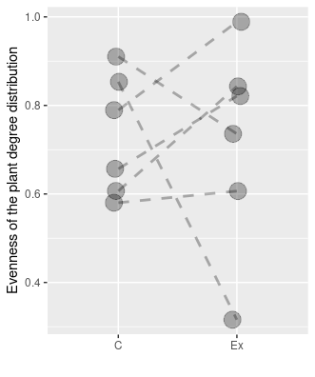
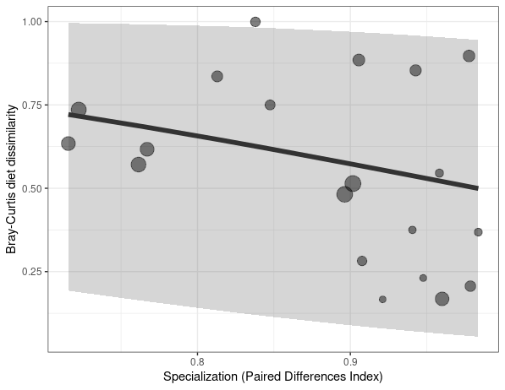

Slide 16
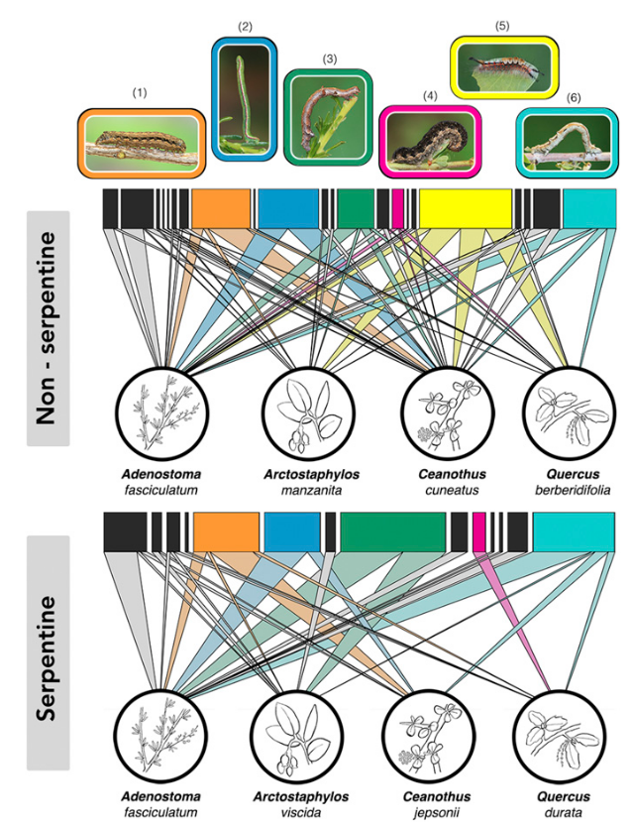
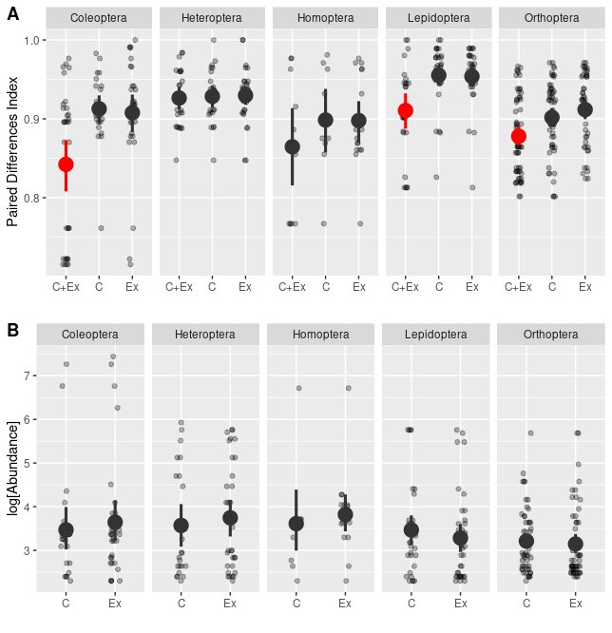
Robinson, M. L. & Strauss, S. Y. PNAS 117, 2043–2048 (2020).

Slide 17
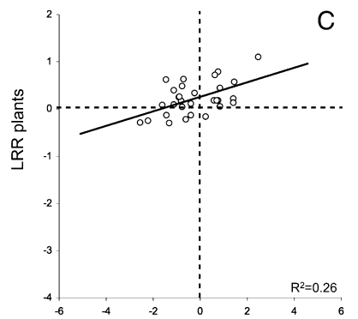
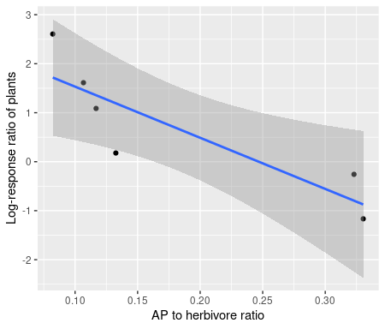
Mooney, K. A. et al. 2010. Proc. Natl. Acad. Sci. U.S.A. 107, 7335–7340.

Slide 18
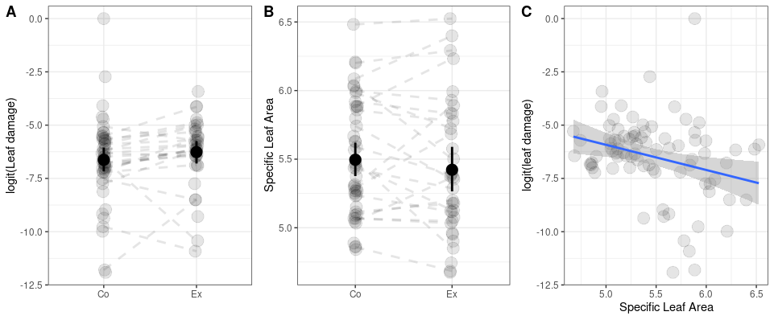
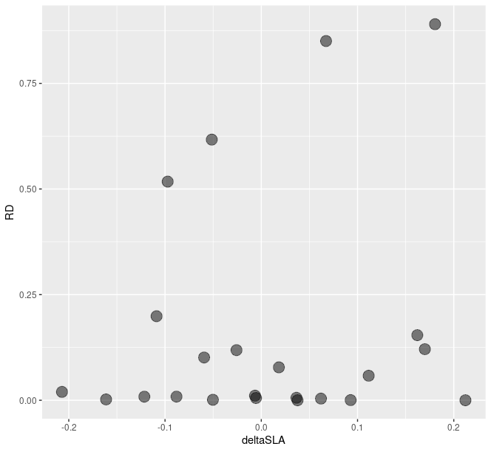
Defense Compensation

Slide 19
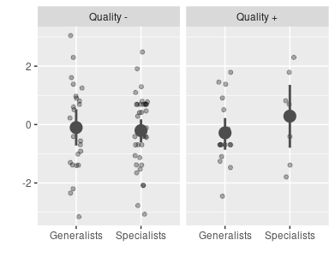
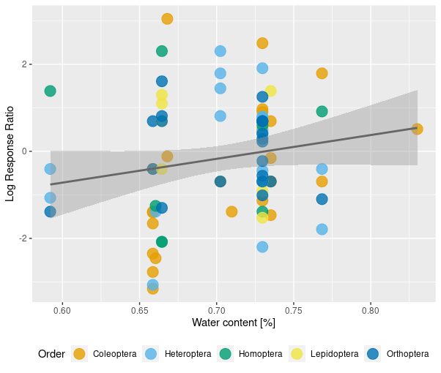

Slide 20
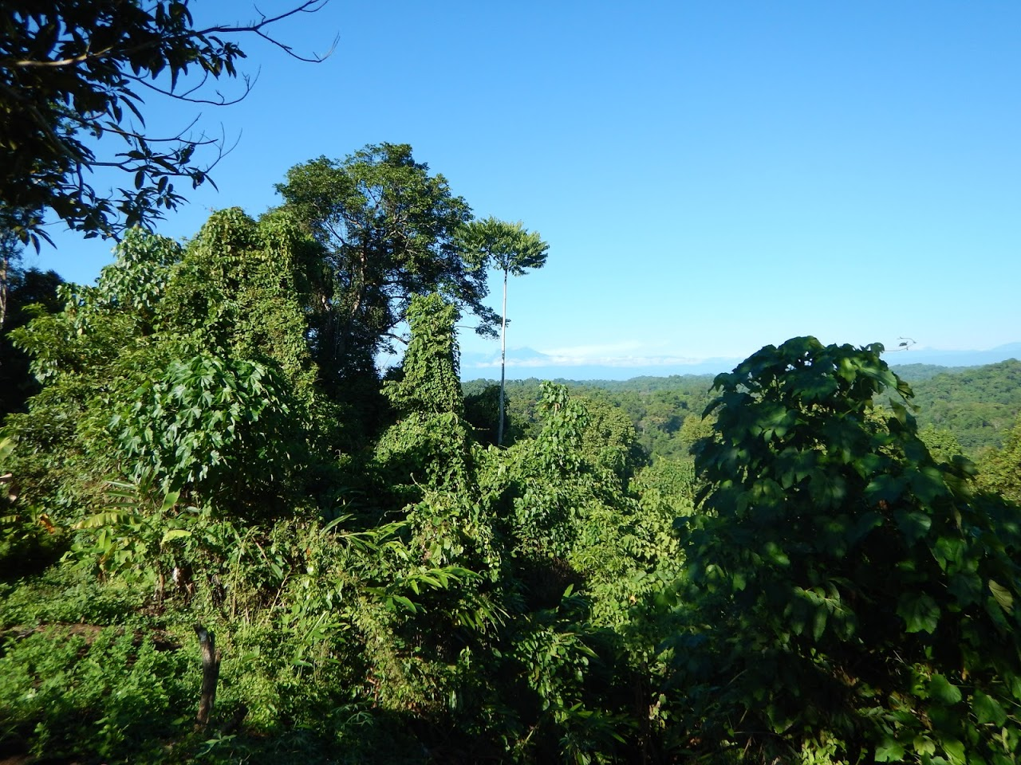
Conclusions
Effects of insectivorous birds, bats and ants are weak.
Herbivores are mainly bottom up controlled

