Slide 1
EV Battery Fault Detection using Neural Networks
ECE 5831 – Final Project
Sobhi Zeidan
University of Michigan – Dearborn
12/15/2025

Slide 2
Motivation
Battery failures are safety-critical in EVs
Traditional rule-based diagnostics do not generalize well
Neural networks can learn degradation patterns directly from data

Slide 3
Problem Statement
Detect battery fault conditions from time-series sensor data
Use discharge voltage, current, and temperature signals
Evaluate multiple neural network architectures

Slide 4
Dataset
NASA Li-ion Battery Aging Dataset
Batteries: B0005, B0006, B0007, B0018
End-of-life defined as 30% capacity fade

Slide 5
Preprocessing
Extract discharge cycles
Label faults using capacity threshold
Window signals into fixed-length segments

Slide 6
Models Evaluated
1D CNN (baseline)
LSTM (recurrent)
Temporal Convolutional Network (TCN)

Slide 7
Experimental Setup
Train: B0005
Validation: B0006
Test: B0018 (contains faults)
Window sizes: 256 and 512

Slide 8
Results – WIN=256
CNN achieved best balance of precision and recall
TCN competitive, LSTM less stable
Real test set evaluation performed

Slide 9
Results – WIN=512
Longer context improves CNN and TCN performance
CNN achieved highest F1 score
LSTM struggled with limited data

Slide 10
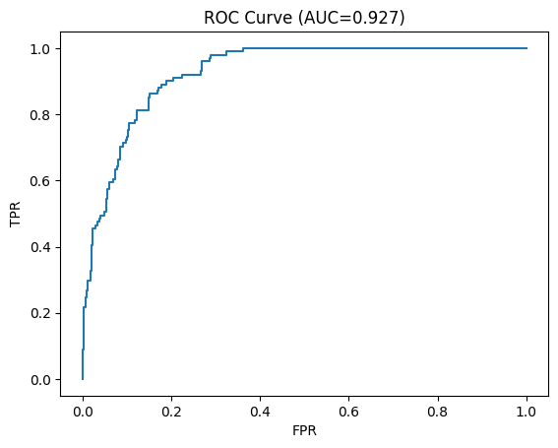
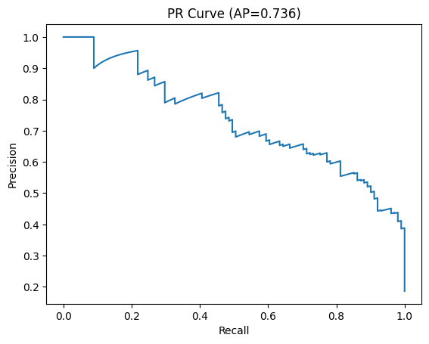
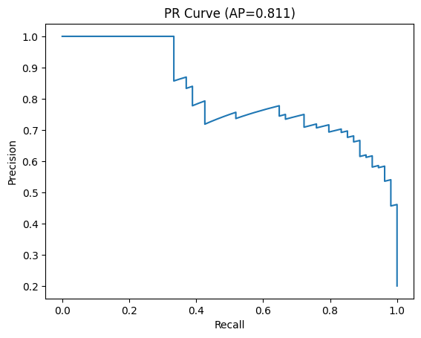
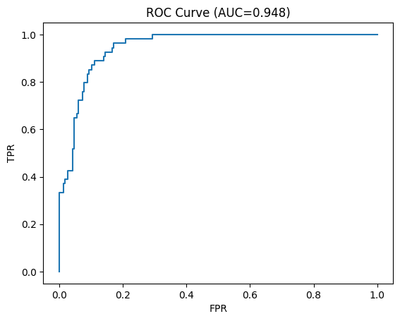
ROC & PR Curves
256
512

Slide 11
Threshold Tuning
Optimal decision threshold tuned on validation set
Improved F1 score without retraining model

Slide 12
Discussion
CNN and TCN suitable for embedded diagnostics
Performance depends on window size and data balance
Data-driven methods show strong promise

Slide 13
Limitations
Small number of batteries
Single dataset
No domain adaptation

Slide 14
Future Work
Multi-dataset training
Online learning
Deployment on embedded hardware

Slide 15
Conclusion
Neural networks can detect battery faults effectively
CNN provided best overall performance
Pipeline is reproducible and extensible

Slide 16
Thank You

